Slide 1
CUSTOMS & CULTURES
of Bible Times

Slide 2
The importance of customs & culture
It helps us to make sense of some circumstances
It helps us to understand some expressions or sayings in the Bible
It helps us to clarify actions of certain characters
It helps us to properly interpret certain passages

Slide 3
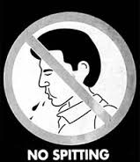
INTERPRET THIS VERSE!
Numbers 12:14: “And the LORD said unto Moses, If her father had but spit in her face, should she not be ashamed seven days? let her be shut out from the camp seven days, and after that let her be received in again.”

Slide 4
WHY SPITTING?
Spitting in the face was a sign of the deepest contempt. This appears to have been done only in cases of great provocation on the part of the child, and strong irritation on the side of the parent. In a case where a parent was obliged by the disobedient conduct of his child to treat him in this way, it appears he was banished from the father's presence for seven days.

Slide 5
WHY SPITTING?
The Jews, in common with all people in the East, seem to have had an intense hatred for spitting, and for a parent to express his displeasure by doing so on one of his children, or even on the ground in his presence, separated that child as unclean from society for seven days.

Slide 6
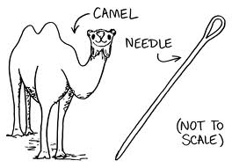
INTERPRET THIS VERSE!
Matthew 19:24 : “And again I say unto you, It is easier for a camel to go through a needle's eye, than for a rich man to enter into the kingdom of God.”

Slide 7
For the last two centuries it has been common teaching in some churches that there is a gate in Jerusalem called the eye of the needle through which a camel could not pass unless it stooped and first had all its baggage first removed. After dark, when the main gates were shut, travellers or merchants would have to use this smaller gate, through which the camel could only enter crawling on its knees!

Slide 8
From at least the 15th century, and possibly as early as the 9th but not earlier, this story has been put forth, however, there is no evidence for such a gate in JERUSALEM!

Slide 9
The camel was regarded as the largest land animal in Palestine, with the eye of a needle probably being the smallest opening found in the home. In this, Jesus paints a picture of something impossible in order to illustrate that even the seemingly impossible is possible with God. As stated earlier; there is no evidence for the popular interpretation that there was a gate in Jerusalem called “the eye of the needle,” which camels had to stoop to their knees to enter.

Slide 10
Such an interpretation completely misses the point: it is not merely difficult for the wealthy to be saved; without God’s grace it is impossible. Anyone who trusts in riches as an idolatrous replacement for God cannot enter the kingdom of God; his life disposition is opposed to submitting to God’s will. The hyperbole of a large camel having to fit through the small eye of a needle stresses that such a thing is humanly impossible, and that it’s only by God’s grace that such a thing may ever be achieved.

Slide 11
GROUPS (SECTS) IN THE N.T.
ZEALOTS: A group whose founder was believed to be Judas the Galilean (Acts 5:37). Their motive was to protest against the payment of taxes to Rome which they regarded as an act of treason against God. One of Jesus’ disciples was described as “Simon the Zealot” (Luke 6:15) though this may be a reference to his temperament rather than political.

Slide 12
GROUPS (SECTS) IN THE N.T.
ZEALOTS: Some Jews gave this name to themselves because they pretended to be more than ordinarily zealous for religion, and yet practiced the very worst of actions. It is very probable that this name was first given to certain persons who were more zealous for the cause of pure and undefiled religion than the rest of their neighbours; but like many other sects and parties who have begun well, they transferred their zeal for the essentials of religion to non-essential things. Zealots were a splinter group of the Pharisees.

Slide 13
GROUPS (SECTS) IN THE N.T.
PHARISEES: Pharisee means ‘separated one.’ It comes from the desire to maintain the purity of the Jewish faith against the onslaught of hostile foreign influences. Some were priests & professional scholars, while some had secular jobs. They tried to meticulously keep every one of the commandments & encouraged others to do the same.

Slide 14
GROUPS (SECTS) IN THE N.T.
PHARISEES: The Pharisees tried to adhere to 613 laws or commandments in addition to which they built a complex structure of regulations designed as a hedge around the laws in order to keep people from accidentally breaking the rules. Life was very complicated under such regime.

Slide 15
GROUPS (SECTS) IN THE N.T.
PHARISEES: They practiced things to the most minute details. Example: “they tithe even one tenth of their herbs grown in the garden.” They had the respect of the ordinary people for sticking to the law however they attracted the condemnation of Jesus for their hypocrisy. (Matthew 23:13-15, 23-24)

Slide 16
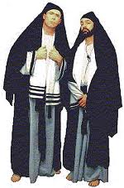
INTERPRET THIS VERSE!
Matt. 23:14: “Woe unto you, scribes and Pharisees, hypocrites! for ye devour widows' houses, and for a pretence make long prayer: therefore ye shall receive the greater damnation.”

Slide 17
They pretended to have a very exact knowledge of the law, and to the poor a perfect observance of it. They pretended to do justice to the poor, friendship for the distressed, and willingness to aid those who were in embarrassed circumstances. They thus induced widows and poor people to commit the management of their property to them, as guardians and executors, and then took advantage of them, and defrauded them.

Slide 18
By their long prayers they put on the appearance of great sanctity, and induced many weak women to give them much, under pretence of devoting it to religious purposes.
Their prayers are said to have been often three hours in length. One rule among them, was to meditate an hour, then pray an hour, and then meditate another hour--all of which was included in their long prayers or devotions.

Slide 19
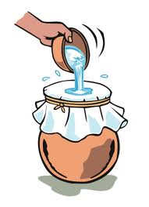
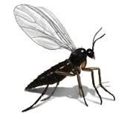
INTERPRET THIS VERSE!
Matt. 23:24: “Ye blind guides, which strain at a gnat, and swallow a camel.”

Slide 20
It was the custom of the stricter Jews to strain their water, wine, vinegar, and other liquids through linen or gauze, lest unaware they should drink down some little unclean insect therein and thus transgress.
They reckoned the gnat among the unclean creeping things. Note however that the camel was also an unclean animal.

Slide 21
The meaning therefore is, that they were very meticulous about little things, while, they disregarded the greater sins they committed.

Slide 22
GROUPS (SECTS) IN THE N.T.
SADDUCEES: The origin of this Jewish sect cannot definitely be traced. The name would seem to be derived from a Hebrew word meaning “THE JUST”; but others affirm that it comes from a certain leader called Sadoc (Zadok), or Sadducus, who was the founder of the sect, and lived about three centuries before the Christian era.

Slide 23
GROUPS (SECTS) IN THE N.T.
SADDUCEES: They were a sect of Jews, who were usually at variance with the Pharisees, but united with them in opposing Jesus and accomplishing his death. They disregarded all the traditions and unwritten laws which the Pharisees prized so highly, & professed to consider the Scriptures as the only source and rule of the Jewish religion.

Slide 24
GROUPS (SECTS) IN THE N.T.
SADDUCEES: They denied the existence of angels and spirits; considered the soul as dying with the body --- no resurrection (Matt. 22:23-32), and of course admitted no future state of rewards & punishments. Many members of the Sanhedrin were Sadducees and so was the high priest in the time of Christ.

Slide 25
GROUPS (SECTS) IN THE N.T.
SADDUCEES: The first time they are mentioned is with John the Baptist's ministry. They came out to him when on the banks of the Jordan, and he said to them, "O generation of vipers, who hath warned you to flee from the wrath to come?" (Mt 3:7) The next time they are spoken of they came to Jesus tempting him. He calls them "hypocrites" and "a wicked and adulterous generation" (Mt 16:1-4; 22:23).

Slide 26
GROUPS (SECTS) IN THE N.T.
SCRIBES: Means: (a) to write, (b) to set in order, (c) to count. The explanation of the word has been referred to each of these. They wrote out the law, or they classified and arranged its precepts, they counted with scrupulous minuteness every letter it contained.

Slide 27
GROUPS (SECTS) IN THE N.T.
SCRIBES: In the earlier Hebrew writings, a scribe was one skilled in writing and accounts, OR the person who communicated to the people the commands of the king, like the modern Secretary of State.

Slide 28
GROUPS (SECTS) IN THE N.T.
SCRIBES: In the later times of the Old Testament, especially after the captivity, and in the New Testament, a scribe is a person skilled in the Jewish law, a teacher or interpreter of the law

Slide 29
GROUPS (SECTS) IN THE N.T.
SCRIBES: The scribes of the New Testament were a class of men educated for the purpose of preserving and expounding the sacred books. They had the charge of transcribing them, of interpreting the more difficult passages, and of deciding in cases which grew out of the ceremonial law.

Slide 30
GROUPS (SECTS) IN THE N.T.
SCRIBES: The Jewish writers speak of them as the schoolmasters of the nation; and one mode in which they exercised their office was by meeting the people from time to time, in every town, for the purpose of holding familiar discussions, and raising questions of the law for debate. Their influence was of course great; many of them were members of the Sanhedrin, and we often find them mentioned in connection with the elders and chief priests

Slide 31
GROUPS (SECTS) IN THE N.T.
SCRIBES: The same persons who are termed scribes, are in parallel passages sometimes called lawyers and doctors of the law. Hence "scribe" is also used for a person distinguished for learning and wisdom

Slide 32
INTERPRET THIS VERSE!
Matt. 5:20 “For I say unto you, That except your righteousness shall exceed the righteousness of the scribes and Pharisees, ye shall in no case enter into the kingdom of heaven.”

Slide 33
The scribes’ righteousness consisted in outward observances of the ceremonial and traditional law. They offered sacrifices, fasted often, prayed much, were very precise about tithes and the ceremonies of religion, but neglected justice, truth, purity, holiness of heart, and did not strive to be pure in their motives before God. This righteousness was external, and was not real holiness.

Slide 34
The righteousness that Jesus required in his kingdom was purity, chastity, honesty, temperance, the fear of God, and the love of man. It is pure, eternal, teaching the motives, and making the life holy. The righteousness of true Christians is seated in the heart, and is therefore genuine. Jesus means, that unless they had more real holiness of character than the scribes, they could not be saved.

Slide 35
GROWING UP IN THE N.T.
SCHOOL: In the Jewish culture, the parents made more financial investments in the educational development of the boys rather than the girls. (Some parents did not think the girls were worth the expense & trouble of formal education). Schooling took place at the local synagogue from the age of 5 or 6.

Slide 36
GROWING UP IN THE N.T.
SCHOOL: During the reign of Herod the Great, the Pharisees instituted a nationwide program of education. The main focus was on learning the religious and moral laws contained in the O.T. Otherwise as soon as they were able, children were occupied in the work of their parents on the farm, workshop or home.

Slide 37
GROWING UP IN THE N.T.
SOCIAL LIFE: At the age of 13 boys were initiated into religious and legal maturity and ceremonies were performed to commemorate this achievement. During the ages 12-16 it was culturally & legally accepted, and quite normal for girls to get married. Most children would marry in their mid-teens. (How old was Anna: Luke 2:36-37?)

Slide 38
GROWING UP IN THE N.T.
SOCIAL LIFE: The parents chose the partners for their children & would negotiate an amount to be paid to the bride’s father as compensation for the loss of the useful work his daughter would have continued to do if she were still a member of his household.

Slide 39
GROWING UP IN THE N.T.
SOCIAL LIFE: A year long period of engagement would follow while arrangements were being made for the wedding. Often times there were lavish celebrations going on for days during the engagement period. An engagement was much more binding in Bible times than it is in modern western society today. (Mary & Joseph)

Slide 40
INTERPRET THIS VERSE!
1 Cor. 7:36 “But if any man think that he behaveth himself uncomely toward his virgin, if she pass the flower of her age, and need so require, let him do what he will, he sinneth not: let them marry.”

Slide 41
CUSTOMS & CULTURES
of Bible Times

Slide 42
ADULT LIFE IN THE N.T.
SOCIAL LIFE: Men had more rights & privileges than women and women tended to be treated as possessions rather than persons. Daughters could be sold into slavery without the prospect of release. A woman was only able to inherit from her husband or father if there were no male heirs to whom the property could go. A wife could not make certain legal vows without her husband.

Slide 43
ADULT LIFE IN THE N.T.
SOCIAL LIFE: If a person was wealthy one would live in luxury with servants to look after you. But if a person was poor ones life could be reduced to begging or even slavery. The more fortunate would have been taught a trade by their father, like Joseph & Jesus. Many without a steady job would become casual labourers who depended on someone to hire them for a day

Slide 44
ADULT LIFE IN THE N.T.
SOCIAL LIFE: Although life was hard for the ordinary people of Jesus’ day it had its lighter moments. People engaged in recreational activities like feasting, singing, story-telling and dancing. Indoor & outdoor games were also popular. Archaeologists discovered a number of board games & pieces in Israel.

Slide 45
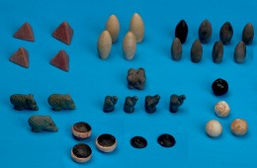
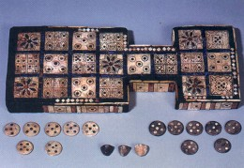

Slide 46
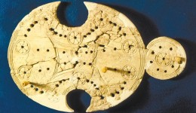
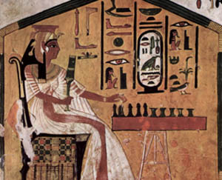

Slide 47
SLAVERY OR SERVANTHOOD?
SERVANT: a person who is bonded voluntarily or involuntarily. The word is used interchangeably at times with SLAVE
HIRED SERVANT: A person who is paid wages by the day or sometimes by the year.

Slide 48
SLAVERY OR SERVANTHOOD?
The Hebrew and Greek words for slave are usually rendered simply "servant," "bondman," or "bondservant." Slavery as it existed under the Mosaic law was very different from modern slavery as we know it. The Mosaic law did not originate slavery but certainly regulated the already existing custom of slavery.

Slide 49
SLAVERY OR SERVANTHOOD?
The culture accepted slavery while the Jewish law addressed it, but the law sought to minimize its hardships and to secure to every man his ordinary rights as well as how slaves/servants should conduct themselves: Exodus 21:1-6
(Eph. 6:5 / Col. 3:11; 22 / Titus 2:9)

Slide 50
SLAVERY OR SERVANTHOOD?
The circumstances under which a Hebrew might be reduced to slavery or servanthood were:
Poverty
The commission of theft
The father’s authority

Slide 51
SLAVERY OR SERVANTHOOD?
In the first case of POVERTY: a man who had mortgaged his property, and was unable to support his family, might sell himself to another Hebrew, with a view both to obtain maintenance and per chance a surplus sufficient to redeem his property. (His relatives could redeem him as well)
(Leviticus 25:39-49 / Matthew 18:24-25)

Slide 52
SLAVERY OR SERVANTHOOD?
In the second case of THEFT: a person was liable to slavery if restitution could not be made according to the law. The thief was bound to work out the value of his restitution money in the service of him on whom the theft had been committed
(Exodus 22:1-3)

Slide 53
SLAVERY OR SERVANTHOOD?
In the third case of the FATHER: due to extreme circumstances a father would sell his daughter at a tender age to be a maidservant, with the ulterior view of her becoming the concubine or wife of the purchaser.
(Exodus 21:7-11)

Slide 54
SLAVERY OR SERVANTHOOD?
All the religious privileges enjoyed by free Israelites were assured to their slaves,
including the rest of the Sabbath (Exod. 20:10), the right to attend the national
festivals (Deut. 16:10, 11), and the right to attend the gathering of the people to
hear the reading of the law (Deut. 31:10-13)

Slide 55
Slavery In The Roman Empire
In the first century human life was indeed cheap, for it has been estimated that a half of the total population of the empire, or about sixty million people, were slaves. Some wealthy Romans possessed as many as 20,000 slaves. Slave owners became very brutal, and the slaves themselves were without hope and many of them very corrupt.

Slide 56
Slavery In The Roman Empire
For the most part these slaves were those conquered in war. Some of those captured were more educated than their captors. Thus it came about that sometimes Greek slaves became schoolteachers for the family of their masters.

Slide 57
Slavery In The Roman Empire
Under the Roman law the slave did not have the rights or protection such as he enjoyed under the Hebrew legislation. A master might have his slave crucified for almost any reason. A slave who stole might be branded by his master on the face with the letters C. F., representing the words "Cave furem,” meaning, "Beware the thief."

Slide 58
Slavery In The Roman Empire
And in the case of a runaway slave, if he were caught, his master might brand him, give him more than customary labor, or could have him put to death if he so desired. The law did allow that he could be reinstated with mercy, through the intercession of a special friend of the master.

Slide 59
Slavery In The Roman Empire
The Apostle Paul was Philemon's friend who interceded on behalf of the runaway slave Onesimus. The Epistle to Philemon was Paul's plea to his friend on behalf of the converted slave. No doubt Philemon gave Onesimus his freedom after receiving Paul's letter. Paul's letter to Philemon has, no doubt, done more to overcome slavery than any other letter that he wrote.

Slide 60
INTERPRET THIS VERSE!
Philemon vs. 18 “If he hath wronged thee, or oweth thee ought, put that on mine account.”

Slide 61
Either by escaping from you,
OR by failing to perform the services he had agreed to,
OR by unfaithfulness when he was with you as a servant,
OR by taking your property when he went away
Any of these reasons would be plausible according to the custom

Slide 62
Slavery In The Roman Empire
The apostles did not attempt to do away with the terrible evil immediately. This would have been a hopeless task, and such an attempt would have been doubtless crushed by the iron hand of Rome. Rather, they were satisfied to give forth Christian principles, and so preach the gospel of liberation from sin, that the result would be to do away with human slavery through the conquering power of Christ

Slide 63
DWELLING PLACES
TENT LIFE: The Oriental tent is usually oblong in shape, and is divided into two and
sometimes three apartments by curtains usually made from goat's hair. The entrance leads into the apartment for the men, which also serves as the reception apartment. Beyond this
is the apartment for the women and children. And sometimes there is a third apartment for servants or for cattle.

Slide 64
DWELLING PLACES
TENT LIFE: The women in the inner apartment are screened from the view of those in the
reception room, but they can hear what goes on in that room. Thus Sarah in her apartment overheard what the angel said in the reception apartment of Abraham's tent (Gen. 18:9-15)

Slide 65
DWELLING PLACES
TENT LIFE: In some cases there is a separate tent for the women. It took several tents to care for the large family of Jacob. Reference is
made to Jacob's tent, to Leah's tent, to Rachel's tent, and to the tent of the two maidservants. (Gen. 31:33)

Slide 66
DWELLING PLACES
TENT LIFE: The furnishings of the tent must include only the necessities. Rugs cover the ground, but at night the bedding is brought out, which is composed of mats, or carpets on which to sleep; and their outer garments worn by day become their coverings by night. And hanging from the tent poles will be the skin bags or bottles, for water and other liquids.

Slide 67
DWELLING PLACES
TENT LIFE: Also there would be a leather
bucket with which to draw water from any well that may be available, and an earthen pitcher,
used by the women to carry the water. Cooking utensils will not be many, but will include pots, kettles, and pans. Serving dishes will include mats, platters, or larger dishes, and there will be cups for drinking. A primitive lamp burning olive oil will illuminate the tent by night.

Slide 68
DWELLING PLACES
TENT LIFE: A hole is dug in the earth where there is a fire kindled, and several stones are put around it, and the cooking utensils are placed on these and over the fire. One of these fireplaces is inside the tent, and another one is outdoors, quite likely near to the women's quarters. In the hot weather the cooking is done outside rather than inside the tent.

Slide 69
DWELLING PLACES
…. AFTER ISRAEL had been in the land of Canaan many years and had settled down from the nomadic life to the more stable agricultural pursuits, houses began to take the place of tents as places of abode. The average home of the common people was a one-room dwelling ….
“The widow at Zarephath” (1 Kings 17:8-19)

Slide 70
DWELLING PLACES
ONE ROOM HOUSE: In Bible times men did not build houses with the idea in mind that most of their daily living would be spent inside them. Their first interest was in spending as
much time as possible out-doors. The house served as a place of retirement. For this reason the outside walls of the humble house were not inviting. There was no effort to attract attention to this place of retirement.

Slide 71
DWELLING PLACES
ONE ROOM HOUSE: The houses generally had no floor except the earth, which was smoothed off and packed hard. Sometimes this was varied by mixing lime with the mud and letting it harden, and sometimes floors of cobblestones or stone chippings mixed with
lime were found. In the Roman period mosaic floors, made by embedding small smoothly cut squares of stone in the earth, were introduced.

Slide 72
DWELLING PLACES
ONE ROOM HOUSE: The walls of the houses were often made of bricks, but these were not ordinarily burned, but were composed of mud dried in the sun. Job speaks of these kinds of
dwelling as "houses of clay" (Job 4:19)

Slide 73
DWELLING PLACES
ONE ROOM HOUSE: Sometimes the walls were made of rough sandstones, common in the land. These were of varying sizes and were set in mud. The joints between them were apt to be wide and irregular. It was only the palaces or houses of the wealthy that were constructed of cut stones, like the palaces of Solomon (1Kings 7:9), and the rich of Isaiah's day, who boasted they would replace fallen down brick walls with walls of cut stones (Isa. 9:8-10).

Slide 74
DWELLING PLACES
ONE ROOM HOUSE: The roof of these humble Palestinian houses is made by laying beams across from wall to wall, then putting on a mat of sticks, or perhaps thorn bushes & over it a coating of clay or earth. Sand & pebbles are scattered over this & a stone roller is used to make it smooth & able to shed rain. This roller is usually left on the housetop & the roof is rolled again several times, especially after rain in order to keep it from leaking.

Slide 75
DWELLING PLACES
ONE ROOM HOUSE: A low guard rail or wall, with spaces to allow the rain water to flow off, was expected to be built on the housetops in order to prevent people from falling off. The law of Moses was very definite in commanding the erection of such. (Duet 22:8)
With the rooves of the houses made largely of dirt or clay, one can easily imagine how grass could grow on the tops of the houses as Bible references indicate. (Psalm 129:6; 2Kings 19:26)

Slide 76
DWELLING PLACES
ONE ROOM HOUSE: With a dirt roof it can be understood how natural it would be for a heavy rainfall to produce a leak, which would make it quite inconvenient for those inhabiting
the house at the time. Travelers who stop for the night at one of these dwellings, have sometimes had to change their sleeping quarters, because of the dripping of the rain water. Proverbs compares this dropping to a contentious woman (Prov. 19:13; Prov. 27:15).

Slide 77
DWELLING PLACES
ONE ROOM HOUSE: Since the walls of the houses are so often built of clay or dirt, or of stones with mud between them, it makes it an easy task for a robber to dig through and get
into the house; Job referred to this: "In the dark they dig through houses" (Job 24:16). Jesus also spoke of the same thing. (Matthew 24:43)

Slide 78
DWELLING PLACES
ONE ROOM HOUSE: Because the walls of the, stone houses were built so that the joints between the stones were wide and irregular, a snake might readily crawl into the crevices and unexpectedly come in contact with an inhabitant. Concerning this kind of house the prophet Amos said that a man "leaned his hand on the wall and a serpent bit him" (Amos 5:19).

Slide 79
DWELLING PLACES
ONE ROOM HOUSE: The furnishings of a one-room Palestinian house were very simple. Mats and cushions were used to sit on by day, and carpets or mats are slept on at night. There would be vessels of clay for household needs, with perhaps some cooking utensils of metal.

Slide 80
DWELLING PLACES
ONE ROOM HOUSE: There would be a chest for storing bedding, a lamp placed on a lamp stand and a broom for house cleaning and the goatskin bottles in which liquids are kept. The
fireplace would be on the floor often in the middle of the room.

Slide 81
DWELLING PLACES
ONE ROOM HOUSE: The arrangements for sleeping - The cushion-mattresses are spread side by side in the living room, in a line as
long as the members of the family. The father
sleeps at one end of the line, and the mother at the other end, to keep the children from rolling from under the cover. (Luke 11:5-7)

Slide 82
DWELLING PLACES
ONE ROOM HOUSE: Like the Nomads who lived in tents, the commoners who lived in one-room houses, carry on as much of their meal-cooking outside as the weather will permit. These operations are transferred inside only when the cold winter comes. A small, open, “clay-baked” box, or else a thick jar with holes at the sides, is what usually serves as a stove.

Slide 83
DWELLING PLACES
ONE ROOM HOUSE: The common folks often used dried dung as fuel for their fire. Some of the poorer classes use this themselves, and sell the sticks they find to those who can afford to buy them. In Bible times fuel is usually so scarce that dried grass and withered flowers were used for making fire. Another popular fuel for fires was thorns.

Slide 84
DWELLING PLACES
ONE ROOM HOUSE: “USES OF THE ROOF”
The roof was a popular place for persons to SLEEP. For a great part of the year the roof, or "housetop," is the most agreeable place
about the house, especially in the morning and evening. There many slept during the summer, both in the city and the country. Samuel called Saul who had slept on the house-top. (1 Samuel 9:25-26)

Slide 85
DWELLING PLACES
ONE ROOM HOUSE: “USES OF THE ROOF”
The flat roof so exposed to the air and sunshine was well suited for STORING GRAIN OR FRUIT to be ripened or dried. Rahab hid the spies with the stalks of flax which she had on her roof. (Joshua 2:6)

Slide 86
DWELLING PLACES
ONE ROOM HOUSE: “USES OF THE ROOF”
Used as a GATHERING PLACE in times of excitement or some major event. The inhabitants would go to the housetops, where they can see down the streets, and discover what is happening.

Slide 87
DWELLING PLACES
ONE ROOM HOUSE: “USES OF THE ROOF”
A place for PUBLIC PROCLAMATIONS. The orders of local governors were proclaimed from the top of the highest house available. Such a proclamation was usually made in the evening, after the people had returned from their work in the field. (Matthew 10:27; Luke 12:3)

Slide 88
DWELLING PLACES
ONE ROOM HOUSE: “USES OF THE ROOF”
Used as a place of WORSHIP AND PRAYER.
The Scriptures indicate that housetops were used to worship. The prophet Zephaniah speaks of "them that worship the host of heaven upon the housetops” (Zeph. 1:5) And Luke tells us that Peter at Joppa "went up upon the housetop to pray about the sixth hour" (Acts 10:9)

Slide 89
DWELLING PLACES
ONE ROOM HOUSE: “USES OF THE ROOF”
Used as a place to HIDE! ☺
Proverbs 21:9
Proverbs 25:24
☺

Slide 90
CUSTOMS & CULTURES
of Bible Times

Slide 91
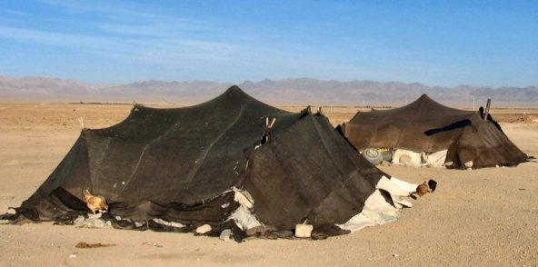

Slide 92
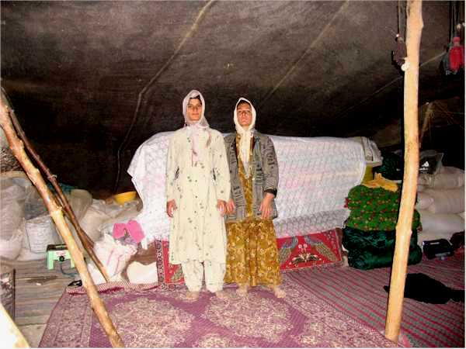

Slide 93
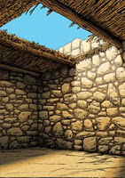
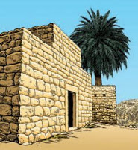

Slide 94
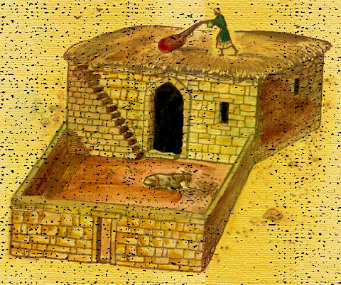

Slide 95
DWELLING PLACES
“TWO ROOMS OR MORE” HOUSES: Houses of more than one room were owned by those who were more or less prosperous. Usually the houses of one room were in the villages, and those of more than one room were in the cities.

Slide 96
DWELLING PLACES
“TWO ROOMS OR MORE” HOUSES: If a house of two rooms is to be built, they did not place the rooms side by side, as with the case of the tent accommodations. Instead the length of a room is left between the two rooms, and a wall is constructed between the ends, and as a result of this arrangement, the house has an open court.

Slide 97
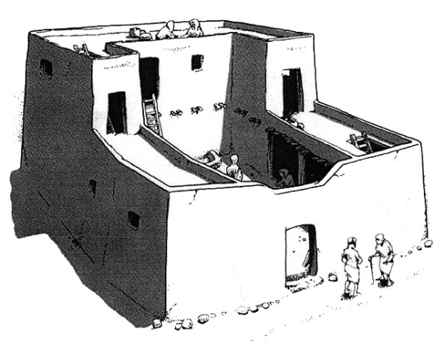

Slide 98
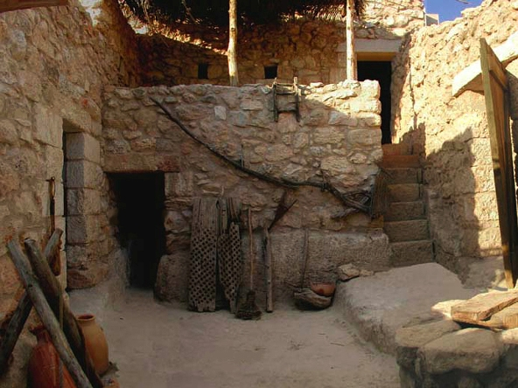

Slide 99
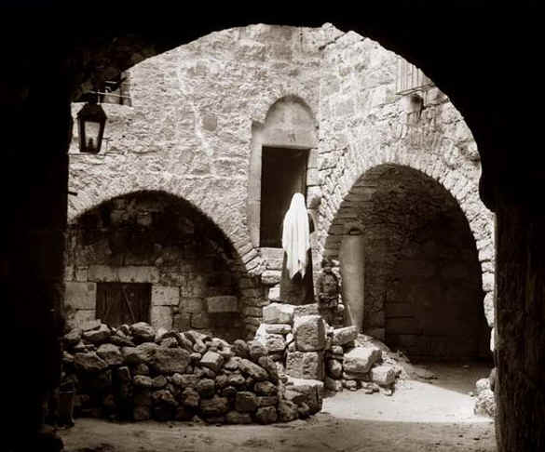

Slide 100
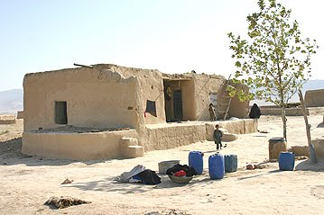

Slide 101
DWELLING PLACES
“THE COURTYARD”: At the center of the Oriental house of several rooms is a courtyard that is open to the sky. The courtyard is an important part of the house. Although the court was open to the air above, at times an awning was drawn over a portion of it. These Oriental courtyards are often made beautiful by the presence of trees, shrubs, or various flowers.

Slide 102
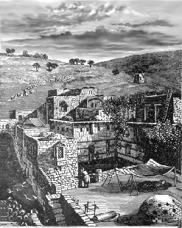

Slide 103
DWELLING PLACES
An incident was mentioned in 2 Samuel 17: 17-21 about Jonathan & Ahimaaz hiding from Absalom.

Slide 104
DWELLING PLACES
The "well" mentioned was otherwise called a "cistern" which is often dug in courtyards in order to catch the rain water. When these cisterns are dry, they make good places for fugitives to hide. Because the mouth of these cisterns is at the level of the ground, it makes it easy to cover it over with some article, and then spread grain over it, and thus the place of hiding can be kept secret.

Slide 105
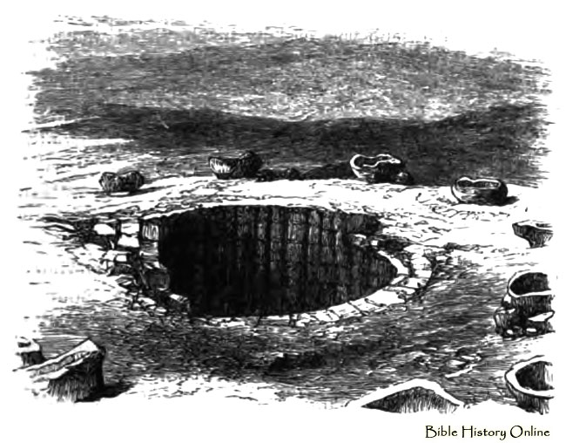

Slide 106
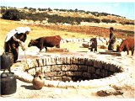

Slide 107
DWELLING PLACES
“THE COURTYARD”: When the Scripture says that David from his palace roof saw the beautiful Bathsheba bathing (2 Sam. 11:2), it needs to be understood, that she was in the
courtyard on the inside of her house, not visible to ordinary observation, yet the king from his palace roof saw her and was tempted to sin.

Slide 108
DWELLING PLACES
“Location And Appearance Of The Door”:
The door or gate was located in the middle of the front of the house. The entrance was usually arranged that nobody could see into it from the street and sometimes a wall was built in front of it to serve this purpose.

Slide 109
DWELLING PLACES
The keys were usually made of wood. The lock is placed on the inside of the gate or door to make it possible for the owner of the house to unlock it, a hole is cut in the door, and he
thrusts his arm through this hole, and then inserts the key. In Song of Solomon 5:4-6, the bride says: "My beloved put in his hand by the hole of the door." She saw him thrust his hand through the hole, probably trying to unlock the door and get in.

Slide 110
DWELLING PLACES
It was the duty of the porter (or servant or member of the family serving in that
capacity) to communicate with any visitor who knocks on the door desiring admission. The purpose of this was to give opportunity to recognize the voice of the visitor & identify him as a friend. So it is not expected that the door will be opened as soon as the knock was heard.

Slide 111
DWELLING PLACES
The one inside will call out, "Who?" And the outsider, instead of giving his name, will rather answer, "I." Acts 12:13-16: "And as Peter knocked at the door of the gate, a damsel came to hearken, named Rhoda. And when she knew Peter's voice, she opened not the gate for gladness." When Rhoda had listened to Peter's voice then she recognized who it was outside the gate.

Slide 112
DWELLING PLACES
The familiar words of Revelation 3:20 present the same idea: "Behold, I stand at the door and knock: if any man hear my voice , and open the door, I will come into him and sup with him and he with me"

Slide 113
DWELLING PLACES
The Upper Room: The upper room or chamber was a well-known part of many Oriental houses, and was frequently referred to in the Bible (2 Kings 1:2; 2 Kings 23:12; Acts
9:37; Acts 20:7-12, etc.)
Those who could not afford such a room were content with booths on the roof of their houses. But when it was possible to do so, they constructed a room.

Slide 114
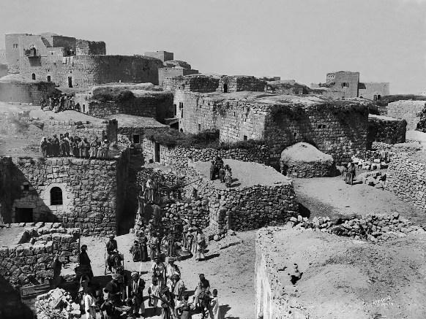

Slide 115
DWELLING PLACES
The Upper Room: It provided a place of coolness in the hot weather, a place of
retreat, and a distinguished guest was given accommodations there. If more than
one room is built on the roof, it is called a summer house, in contrast with the
winter house which is downstairs.

Slide 116
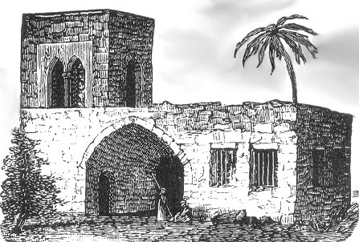

Slide 117
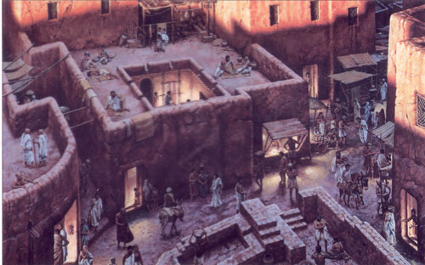

Slide 118
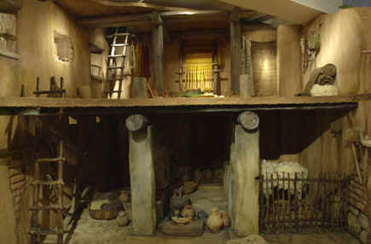

Slide 119
DWELLING PLACES
The Upper Room: The most famous upper room of Old Testament times was the prophet's chamber built for Elisha, that he might have a place of retirement suited to a man of prayer.
There was doubtless an outside stairway leading to it, so that the prophet might come and go without disturbing the people in the house. The furnishings of the room included a bed, a table, a stool and a lampstand.

Slide 120
DWELLING PLACES
The Upper Room: In the New Testament there are several notable uses of the upper room. Jesus sent two disciples to secure the use of a guest chamber for the Passover meal. A large
upper room was put at their disposal. It was expected that anybody having such a room would gladly let it be used for that purpose. And then the prayer meeting that preceded Pentecost was held in an upper room (Acts 1:13).

Slide 121
DWELLING PLACES
FURNISHINGS: The wealthy usually had upper rooms as well as lower rooms, and of course, the furnishings were more elaborate. The divan or raised seat was located around the borders of the room. They were used for seats during the daytime, and beds were put on them at night. The bed customarily in use was a mattress and pillow that could be placed where
desired. In wealthy homes, carpets, curtains, and awnings were present in abundance.

Slide 122
THE SIGNIFICANCE OF FOOD
The ordinary food of the average Hebrew of Bible times was bread, olives, oil, buttermilk cheese from their flocks; fruits and vegetables from the orchards and gardens; and meat on
rare occasions. Only few more varieties would have to be added to make this a complete list of foods eaten in those days.

Slide 123
THE SIGNIFICANCE OF FOODS
BREAD: In the East it has been estimated that three-fourths of the people lived entirely
upon either bread or upon that which is made from wheat or barley flour. Bread was unquestionably the principal food of the East. The Palestinians were brought up to think of bread as having a sacred meaning. It may be said that this attitude of the people toward bread is essentially religious.

Slide 124
THE SIGNIFICANCE OF FOODS
BREAD: Everything about bread from the sowing of the seed to the baking of the loaves is
done in the name of God. The Hebrews sensed the importance of the petition in the Lord’s prayer: "Give us this day our daily bread" (Matt. 6:11). It was to people who really appreciated the value of bread, that Jesus first said, "I am the bread of life"

Slide 125
THE SIGNIFICANCE OF FOODS
BREAD: Since there was this attitude of sacredness towards bread; there was an Eastern custom of breaking bread and not cutting it. One who lived in Palestine says about the natives of the country: "They never put a knife to bread, as it was considered to be absolutely wicked to cut it, but always break it into pieces with their fingers." To cut bread would be thought of as cutting life itself.

Slide 126
THE SIGNIFICANCE OF FOODS
BREAD: This custom of breaking bread rather than cutting it, is found throughout
the Scriptures:
Lamentations 4:4
Matthew 26:26 (Communion)
Mark 6:41
Acts 2:42,46 / 20:7
1 Corinthians 10:16

Slide 127
THE SIGNIFICANCE OF FOODS
BREAD: Two (2) kinds of bread were in use in Bible times: wheat bread and barley bread. Both of these are in use in Palestine today. There is this distinction between them: barley bread is used by the poorer classes, whereas if a family is able to have wheat bread, they were considered to have arrived at a place well up in the comfort scale.

Slide 128
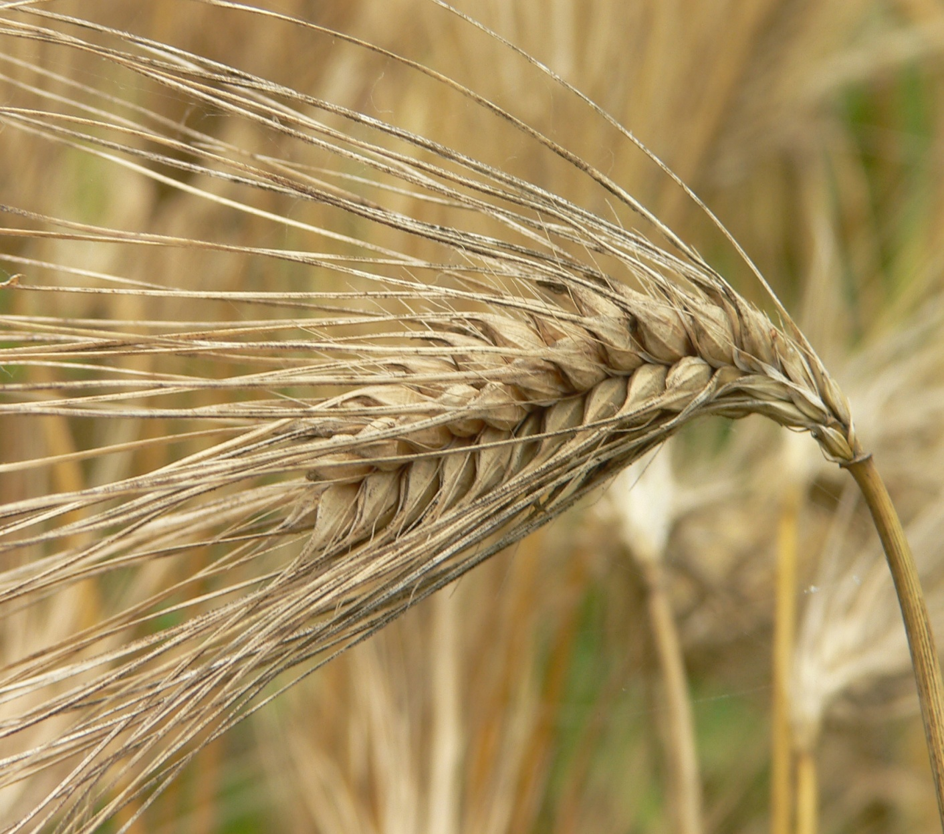
BARLEY

Slide 129
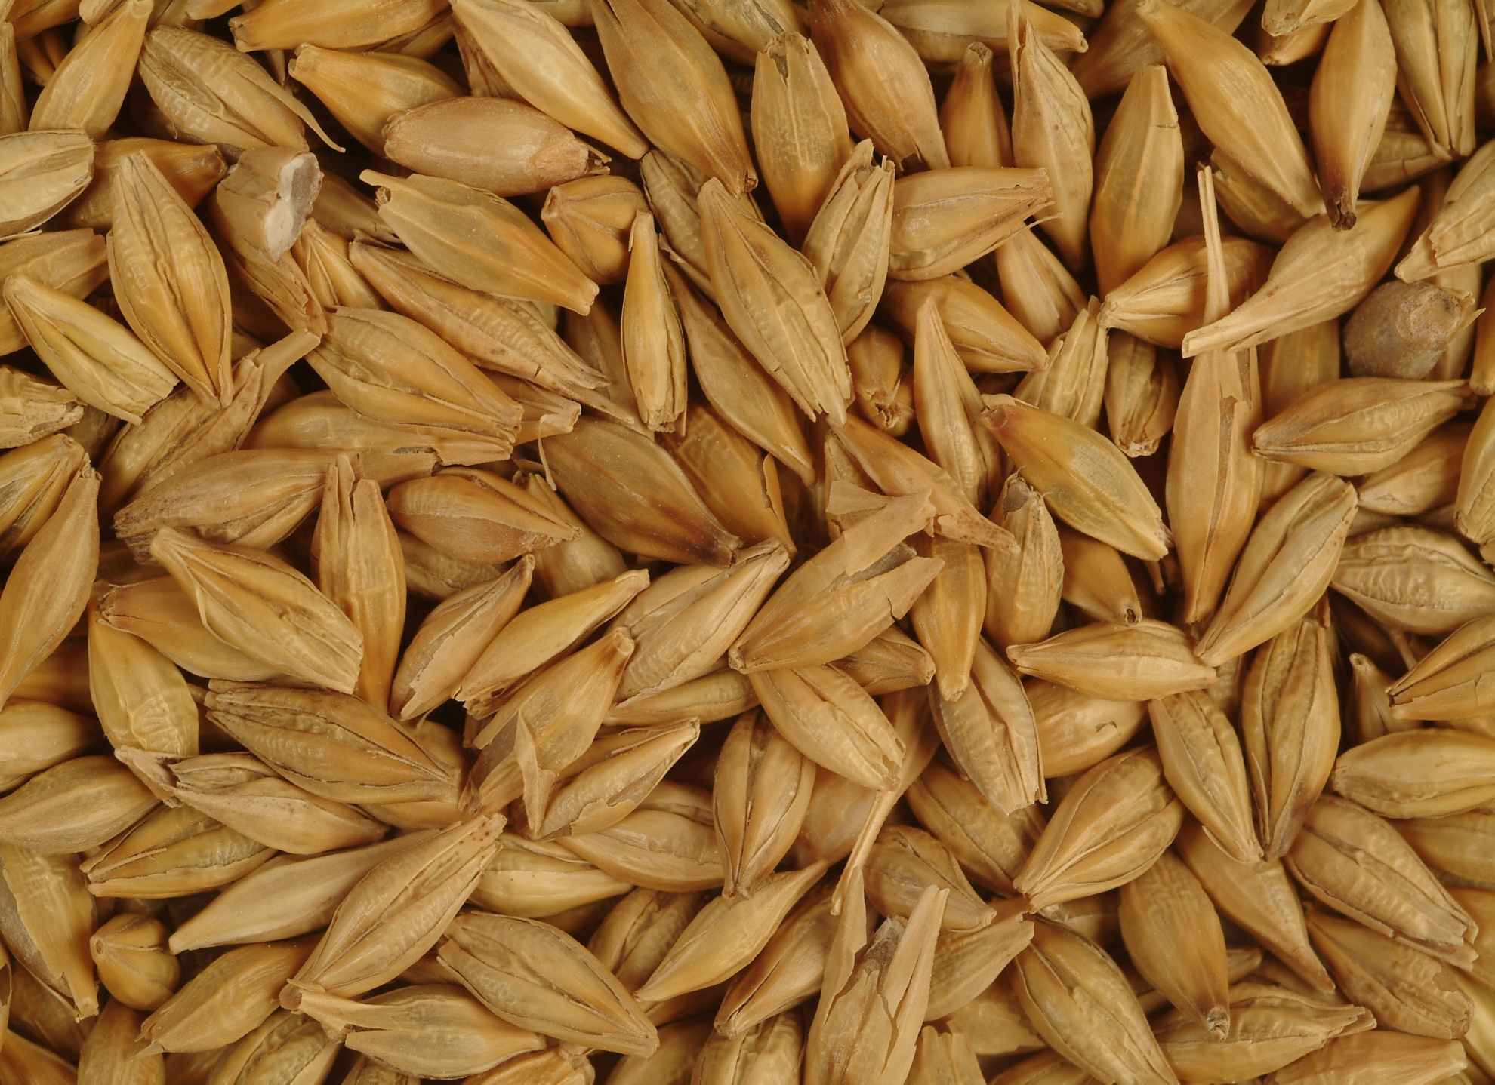
BARLEY

Slide 130
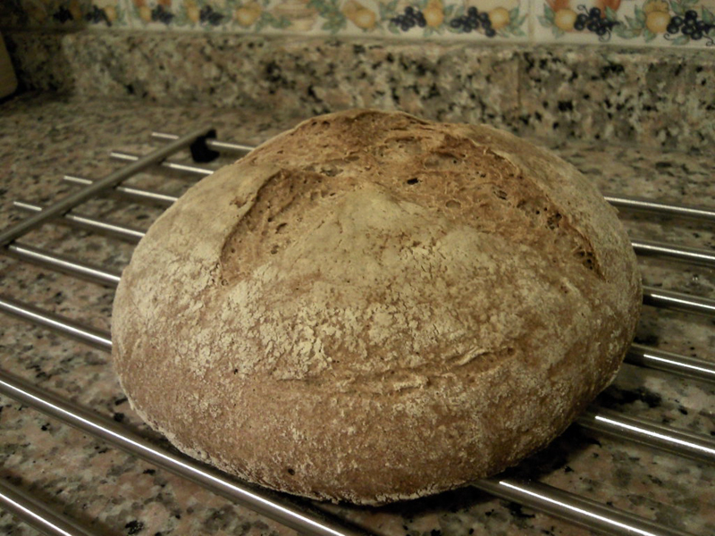
BARLEY BREAD

Slide 131
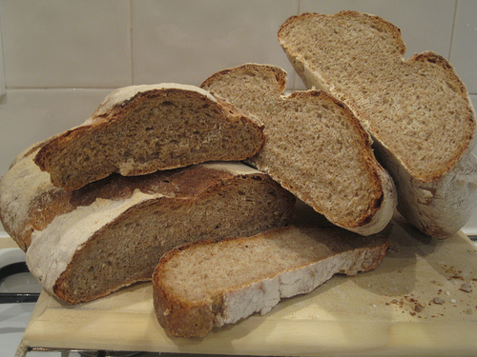
BARLEY BREAD

Slide 132
THE SIGNIFICANCE OF FOODS
BREAD: In the Holy Land where the old customs prevail, bread took three forms. First,
there were the small loaves which somewhat resemble the light bread biscuits. It was this kind the lad had and gave to Jesus. Second, there were the larger loaves, nearly as heavy as the modern loaves of the West, but round instead of rectangular. The ten loaves which Jesse sent by David to the camp of Israel, were probably of this form

Slide 133
THE SIGNIFICANCE OF FOODS
BREAD: Third, were the flat loaves which are thin like paper. This kind of bread was used to take the place of the knife, fork, or spoon. They would "cup it up" and use it to dip into the food sauces. Some even folded it and put it in their scrip (bag), and took it with them, so they could eat it as needed.

Slide 134
THE SIGNIFICANCE OF FOODS
MEAT: As a rule, Bible characters, did not eat meat except on special occasions. When a stranger or guest was entertained, or when a
feast was made, then meat would be served. Kings and other wealthy men had meat often.

Slide 135
THE SIGNIFICANCE OF FOODS
MEAT: The daily provision of meat for King Solomon's court is given in Scripture – 4 kinds of meat for the king's daily menu are mentioned: beef, mutton, venison, and chicken (1Kings 4:23). Abraham served veal to his guests (Gen.18:7). Gideon's guest was provided with a kid (Judges 6:19). On the shores of the Sea of Galilee, fish was a common article of food in the days of Jesus.

Slide 136
THE SIGNIFICANCE OF FOODS
MEAT: Roasting was perhaps the oldest way of cooking meat, but less common among the Israelites than boiling, roast meat being used as a rule only by the rich & upperclasses, as is still the case in the East. The servants of Eli's sons said to those bringing offerings, "Give meat to roast for the priest; for he will not have boiled meat from you" (1 Samuel 2:12-17)

Slide 137
THE SIGNIFICANCE OF FOODS
MEAT: After the meat was cooked it was divided up into small pieces, and a broth was
prepared to serve with it, and this would often have vegetables in it.

Slide 138
CUSTOMS AT MEALTIME
HANDWASHING: Hebrews were careful to wash their hands before a meal. The servant or whomever; pours water on the hands to be washed as they are held over a basin. Often the basin has a cover with holes, so as to allow the dirty water to run through and thus be out of sight. The method of eating without knives, forks, or spoons, makes this washing a necessity.

Slide 139
CUSTOMS AT MEALTIME
HANDWASHING: When the Pharisees complained against the disciples of Jesus, because they ate without washing their hands (Mark 7:1-9; 14-23), it was concerning a lengthy ceremonial washing of hands that they spoke. The Jewish hierarchy of that day had given an injunction as to exactly how this should be done. It was not a law of Moses but a tradition of the elders.

Slide 140
CUSTOMS AT MEALTIME
HANDWASHING: Jesus refused to sanction it as a rule that was binding. It was not the custom of washing hands before eating that
Jesus objected to, but the authority the rabbis claimed to have in telling the people the exact and detailed manner in which it must be done.

Slide 141
HOSPITALITY
These men of the East believed that a person who becomes their guest is sent to them by God. Thus their hospitality becomes a sacred duty. When a host entertained Westerners, he was so happy that, he wept tears of joy that "Heaven had sent him guests". When Abraham entertained three strangers who proved to
be angels, he showed much the same attitude.

Slide 142
HOSPITALITY
Abraham’s enthusiasm in receiving the guests would indicate his belief, that those he was to entertain were sent to him by the Lord. It is said that he "ran to meet" the three men, that he "hastened into the tent unto Sarah" to get her to make ready food, that he "ran unto the herd," and that he "fetched a calf," and that he "hasted to dress it" (Gen. 18:2-8).

Slide 143
HOSPITALITY
Friends As Guests: In the East a friend is always welcome to receive hospitality. The Romans of New Testament times had a token of hospitality between two friends, which consisted of a tile of wood or stone, which was divided in half. Each person wrote his name
on one of the two pieces, and then exchanged that piece with the other person. These were often kept and handed down from father to son.

Slide 144
HOSPITALITY
Strangers As Guests: There is an Oriental proverb that says, "Every stranger is an invited guest." The inspired apostle gave command concerning hospitality to this type of guest: "Be not forgetful to entertain strangers: for thereby some have entertained angels unawares" (Heb. 13:2). When Paul exhorted the Roman believers to be "given to hospitality" (Rom. 12:13), he was referring to the same thing, for the Greek word
for hospitality, means, "love to strangers.

Slide 145
HOSPITALITY
Guests in Holy Land homes expect to be kissed as they enter. When entertained by a Pharisee, Jesus commented on his reception by saying to him, "Thou gavest me no kiss" (Luke 7:45). In Palestine, they place their right hand on their friend's left shoulder and kiss his right cheek, and then reversing the action, place their left hand on his right shoulder, and kiss his left cheek.

Slide 146
HOSPITALITY
Jacob kissed his father (Gen. 27:27). Esau kissed Jacob (Gen. 33:4). Joseph kissed his brothers
(Gen. 45:15). Jacob kissed the sons of Joseph
(Gen. 48:10). Aaron kissed Moses (Exod. 4:27). Moses kissed Jethro (Exod.18:7). David and Jonathan kissed each other (1Sam. 20:41).
The Father kissed the Prodigal (Luke 15:20). The elders of Miletus kissed Paul (Acts 20:37).

Slide 147
HOSPITALITY
Removing The Shoes: Upon entering a house to be entertained, a guest would take off their boots, shoes, or slippers before entering a room. This becomes necessary since they sit on a mat, rug, or divan, with their feet beneath them, and
shoes would soil the couch and the clothes, and would also make a very uncomfortable seat.

Slide 148
HOSPITALITY
The idea of defilement from the shoes led to the custom of removing the shoes upon entering sacred places. Thus at the burning bush the Lord told Moses, "Put off thy shoes from off thy feet, for the place whereon thou
standest is holy ground" (Exod. 3:5).

Slide 149
HOSPITALITY
Washing The Feet: After bowing, greeting, and kissing, the guest is offered water for washing their feet. Wearing of sandals would naturally necessitate foot washing, but it was still often done when shoes were worn as well. A servant will assist the guest by pouring the water upon their feet over a copper basin, rubbing the feet with his hands, and wiping them with a napkin.

Slide 150
HOSPITALITY
Washing The Feet:
This custom was common in Old Testament days: Gen. 18:4
Gen. 19:2
Gen. 24:32
Gen. 43:24
1 Sam. 25:41
& OTHER PASSAGES!

Slide 151
HOSPITALITY
Washing The Feet:
This custom was common in New Testament days:
When Jesus and his disciples were gathered together, the Saviour took the place of the servant, and washed the feet of His disciples, who themselves had disdained to do such a humble task.

Slide 152
HOSPITALITY
Washing The Feet:
John tells us that Jesus "laid aside his garments;
and took a towel, and girded himself. After that he poureth water into a basin, and began to wash the disciples' feet, and to wipe them with the towel" (John 13:4, 5).
A woman washed Jesus’ feet (Luke 7:36-38,44)
Widows washed the saints feet (1 Tim. 5:10)

Slide 153
HOSPITALITY
Anointing The Head With Oil: The custom of anointing guests with oil was an ancient one among nations of the East. Olive oil alone was often used, but sometimes it was mixed with spices. Simon the Pharisee was accused of lack of hospitality by Jesus because he failed to anoint Jesus (Luke 7:46). This would indicate the custom was quite common in the days
of the Gospel accounts.

Slide 154
HOSPITALITY
A guest would think they were ill-treated if they were left alone at any time. They do not usually need privacy at night, because they sleep with their clothes on. The guest is happy to have others sleep with him or her. If a sleeping place is assigned to the guest in an upper room, then one or more of the family members sleep alongside of the guest that the guest might
have their companionship.

Slide 155
EARLY RISING
The habit of early rising is almost universal in Palestine. The climate makes rising early a necessity for the greater part of the year, the heat being so great that hard labor is oppressive a few hours after sunrise. At early dawn laborers go to their work and travelers start on their journeys.

Slide 156
EARLY RISING
Many Bible passages indicate that the custom of early rising was practiced in those days. The Genesis account mentions an occasion when "Abraham rose early in the morning" (Gen. 22:3). The Book of Exodus tells that "Moses rose up early in the morning" (Exod. 34:4). Scripture says that on a certain day "Job rose up early in the morning" (Job 1:5).

Slide 157
EARLY RISING
Concerning the people who wished to hear
Christ's teachings, Luke says, "And all the people came early in the morning to him in the temple, for to hear him" (Luke 21:38). And Mark says of Jesus, "And in the morning, rising up a great while before day, he went out, and departed into a solitary place, and there prayed (Mark 1:35). The women went very early to embalm Jesus (Luke 24:1)

Slide 158
The first sound to greet the ear in the early morning in many a Palestinian village would be the sound of the grinding of the grain. They began grinding early in the morning, and it often required half a day to complete. The task
is for servants if the family has them, and if not the women do the job, but the men would consider it beneath them to engage in such a menial task.

Slide 159
Part of the judgment upon Israel at the destruction of Jerusalem was that the enemy "took the young men to grind" (Lam. 5:13). And the Philistines punished Samson in this way, for it says of him, "and he did grind in the prison house" (Judges 16:21).
Although there were simple hand mills made for the use of one person, more often two women operate one together. The two women sit at these stones facing each other.

Slide 160
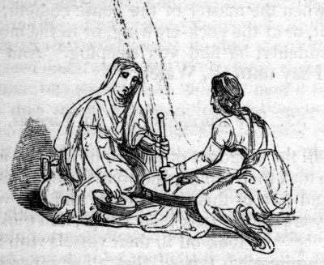

Slide 161
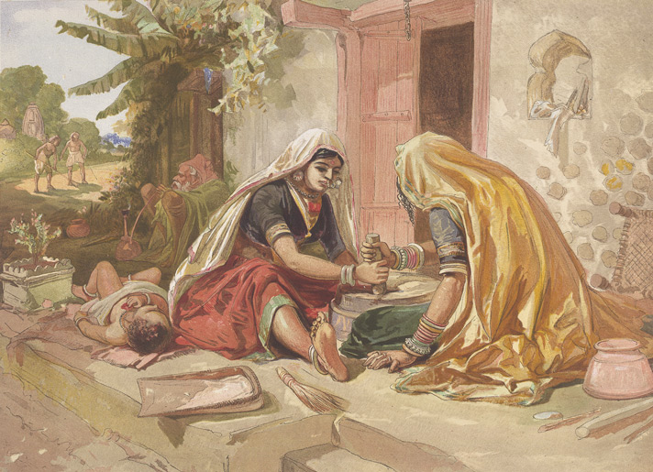

Slide 162
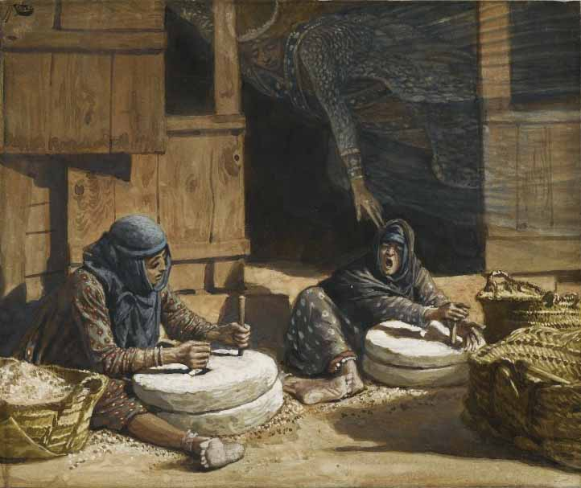

Slide 163
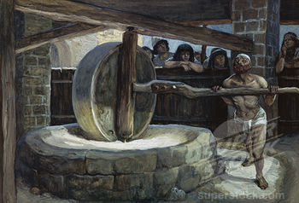

Slide 164
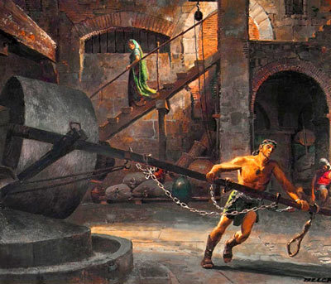

Slide 165
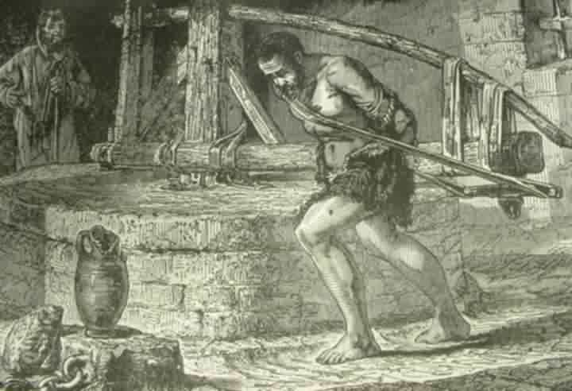

Slide 166
SICKNESS IN BIBLE LANDS
The families of Israel who were acquainted with the Hebrew Bible would be brought up on the idea that health was the reward for obedience, and sickness the punishment for disobedience.

Slide 167
SICKNESS IN BIBLE LANDS
The Hebrew families looked to the promise God originally gave to them about health for
their bodies: If thou wilt diligently hearken to the voice of the Lord thy God, and wilt do that
which is right in his sight, and wilt give ear to his commandments, and keep all his statutes, I will put none of these diseases upon thee which I have brought upon the Egyptians, for I am the Lord that healeth thee (Exod. 15:26). Health was promised upon condition of obedience to God.

Slide 168
SICKNESS IN BIBLE LANDS
The law also taught Israel that sickness could be expected when God's law was disobeyed:
He will bring upon thee all the diseases of Egypt, which thou wast afraid of; and they shall cleave unto thee. Also every sickness, and every plague, which is not written in the book of this law, them will the Lord bring upon thee, until thou be destroyed (Deut. 28:60-61).

Slide 169
Old Testament Jews In Times Of Sickness
Ordinarily, the ancient Hebrews did not go to physicians when they were sick. There are surprisingly few references to physicians in Old Testament days. Job mentions the existence of such when he says, "Ye are all physicians of no value” (Job 13:4). King Asa was criticized by the sacred writer who said: “… Asa had a very bad disease of the feet; but he did not go to the Lord for help in his disease, instead he went to physicians.” (2 Chron. 16:12)

Slide 170
The prophet Jeremiah asked the question:
"Is there no balm in Gilead; is there no physician there? why then is not the health of the daughter of my people recovered?" (Jer. 8:22)
There are many examples of prayers to God for healing of sickness under the dispensation of law.

Slide 171
Moses prayed for the healing of the Israelites bitten by the snakes (Num. 21:7). Psalm 6 was David's prayer in time of sickness & God heard. One of the great thanksgiving Psalms has a section in it dealing with gratitude to God for healing of the sick (Psa. 107:17-21).
King Solomon in his prayer, encouraged the people to expect God to answer their prayer for healing of sickness (2 Chron. 6:28-30). King Hezekiah was healed in answer to prayer (2 Kings 20).

Slide 172
New Testament Jews In Times Of Sickness
The Jews of that day were largely lacking in a scientific knowledge of medicine. This fact may be accounted for in their belief that sickness was caused by either the sin of the sick person, or of his relations, and that it was sent as punishment for that sin. Concerning the blind man, the disciples asked Jesus, "Master, who
did sin, this man, or his parents, that he was born blind?"(John 9:2)

Slide 173
New Testament Jews In Times Of Sickness
Also, sickness was sometimes attributed to demons. Therefore, they considered that the
cure was casting out these evil spirits. St. Mark adds an interesting fact in his report of Christ healing the woman with the issue of blood. He says that she "had suffered many things of many physicians” (Mark 5:26). Thus implying that physicians may have been more prevalent in New Testament times.

Slide 174
New Testament Jews In Times Of Sickness
Some of the rabbis themselves posed as physicians, and very queer remedies indeed were prescribed by them at times. EXAMPLE:
“Dig seven pits & burn some young vine branches in the pits. Then let the woman, carrying a cup of wine in her hand, come up to each pit in succession, and sit down by the side of it, and each time let the words be repeated: "Be free from thy sickness."

Slide 175
New Testament Jews In Times Of Sickness
The Gospel records tell of the presence of a multitude of sick people in the land,and how these were brought in great numbers to Jesus to be healed. "And . . . they brought unto him all that were diseased . . . and all the city was gathered at the door. And he healed many that were sick of divers diseases" (Mark 1:32-34).

Slide 176
Another fact that sheds light upon the work of Jesus and His disciples in their ministry of healing, is the universal expectation of the cure of disease through the supernatural power of some representative of God.
A multitude of people lay about the pool of Bethesda expecting an angel to trouble the waters and cure their sicknesses (John 5:1-4).

Slide 177
DEATH IN BIBLE LANDS
The Death Wail: As soon as a death had taken place in the Orient, a wail is raised that announces to all the neighborhood what has happened. This is a sign for the relatives to begin demonstrating their sorrow. Such a death-wail heard in an Eastern desert has been thus described as, "a sharp, shrill, ear-piercing shriek." This shriek is followed by prolonged wails. When this is heard, everybody knows a death has occurred.

Slide 178
DEATH IN BIBLE LANDS
Lamentation: From the time the death wail is heard, until the burial takes place, relatives and
friends continue their lamentation. The prophet Micah compares it to the cry of wild beasts or birds: "I will make a wailing like the jackals, and a lamentation like the ostriches" (Micah 1:8).

Slide 179
DEATH IN BIBLE LANDS
Lamentation: Such lamentation was in the house of Jairus when Jesus entered it: "And he cometh to the house of the ruler of the synagogue, and seeth the tumult, and them that wept and wailed greatly" (Mark 5:38).

Slide 180
DEATH IN BIBLE LANDS
The Hebrew prophets mention professional mourners, who were called in at the time of sorrow to express mourning for the dead. "Call for the mourning women, that they may come; . . . and let them make haste, and take up a wailing for us“ (Jer. 9:17-18).
Another reference is to "such as are skillful of lamentation” (Amos 5:16).

Slide 181
DEATH IN BIBLE LANDS
In times of grief and sorrow, sackcloth is worn, and they often tear their garments in order to let people know how deep is their grief (2 Sam. 3:31). The beating of the breast is another method of expressing sorrow (Luke 23:48). Tears flow freely at such times and are considered to be a definite means of bringing comfort to sorrowing hearts (John 11:33).

Slide 182
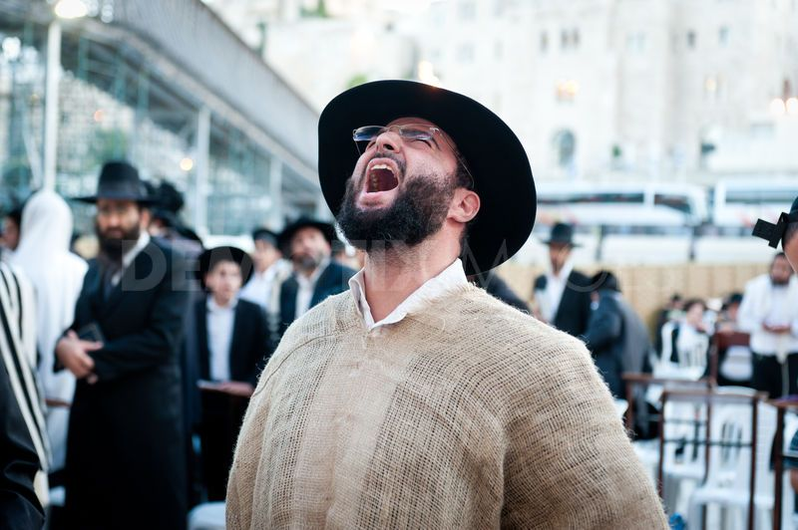

Slide 183
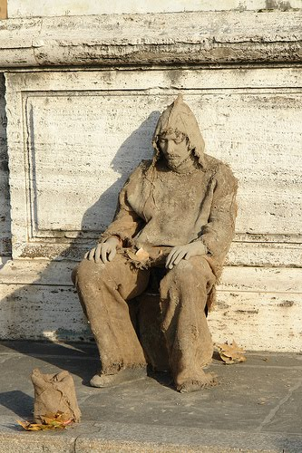

Slide 184
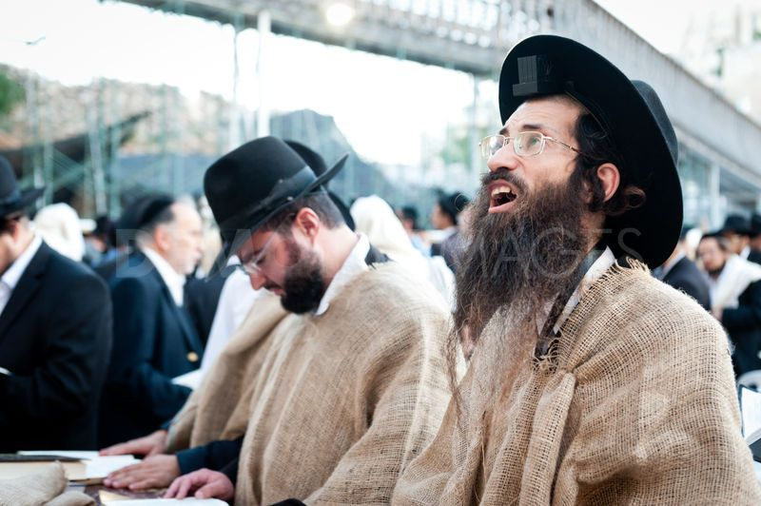

Slide 185
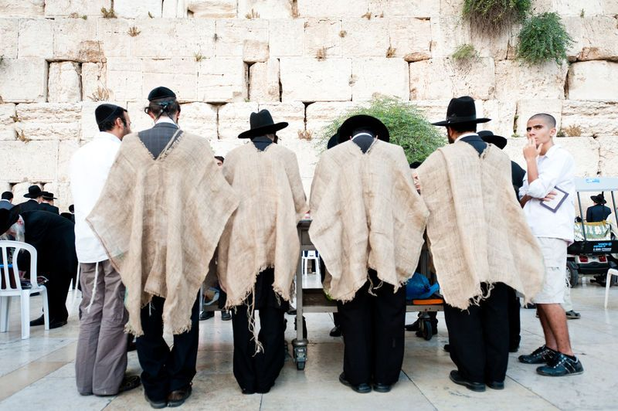

Slide 186
DEATH IN BIBLE LANDS
Preparation Of The Body For Burial:
Usually the face is covered with a napkin, and then the hands and feet are bound all the way around with linen cloth. The body is then put upon a bier, with a pole at each corner, and then carried on the shoulders of men to the tomb for burial.

Slide 187
DEATH IN BIBLE LANDS
Preparation Of The Body For Burial:
The description of Lazarus, when Jesus called him forth from the tomb, indicates that the custom was practiced in those days:
“And he that was dead came forth, bound hand and foot with grave clothes: and his face was bound about with a napkin. Jesus saith unto them, Loose him, and let him go.” (John 11:44)

Slide 188
Also we know that the body of Jesus was thus wrapped by Joseph of Arimathea and Nicodemus:
"Then took they the body of Jesus, and wound it in linen clothes with the spices, as the manner of the Jews is to bury" (John 19:40).
Embalming spices were used when they could be afforded.

Slide 190
DEATH IN BIBLE LANDS
The burial of the dead in the East takes place soon after death, usually the same day. Some of the people of these regions had a primitive idea that the spirit of the one who dies, hovers near the body for three days after death. Mourners think of this spirit as being able to bear the wailing calls of grief.

Slide 191
DEATH IN BIBLE LANDS
Tombs were made by the wealthy. Some of these tombs had many chambers in them. They
were closed by a rolling-stone which ran down an inclined plane in front of the mouth of the sepulcher. The poorer folks were not able to afford tombs, so they buried their dead in graves.

Slide 192
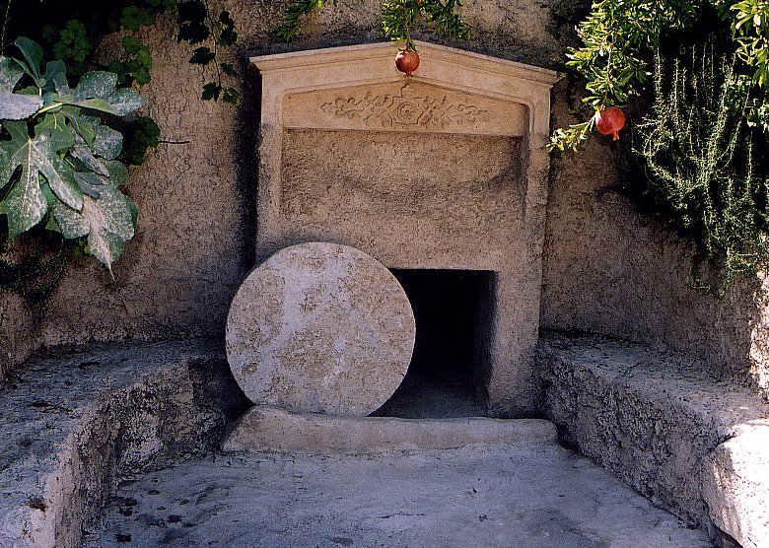

Slide 193
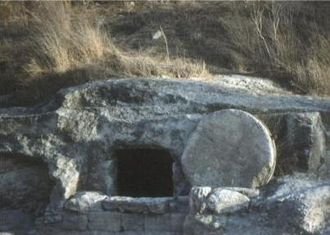

Slide 194
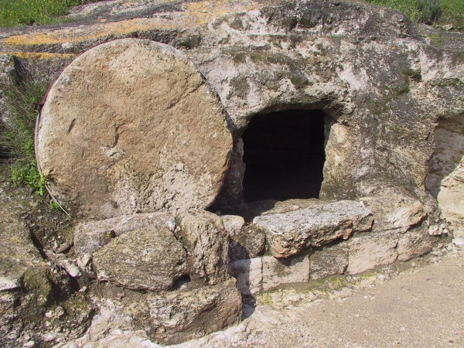

Slide 195
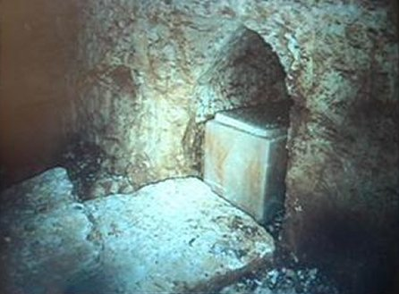

Slide 196
DEATH IN BIBLE LANDS
Often the dead was buried in graves dug in the earth, as in the case of Deborah, Rebekah's nurse, who was buried under an oak at Bethel (Gen. 35:8). Natural caves were sometimes utilized, as in the case of the cave where Abraham, Sarah, Isaac, Rebekah, Leah, and Jacob were placed (Gen. 49:31; Gen. 50:13). When they could afford to do so, families had a sepulcher. Gideon was buried in the sepulcher of his father (Judges 8:32).

Slide 197
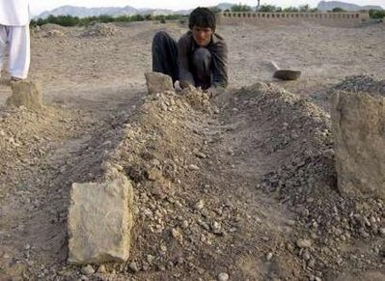

Slide 198
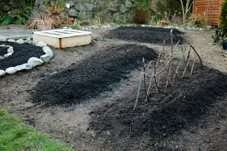

Slide 199
DEATH IN BIBLE LANDS
In Bible times it was quite customary for the sorrowing ones to fast, up to the time of burial. Then, following the funeral, they would be offered bread and wine as a comforting refreshment. Such was called a mourning feast!
This mourning feast brought to an end the period of deepest sorrow and strict fasting.

Slide 200
ENGAGEMENT & MARRIAGE
Difference Between a Promise & Betrothal:
A promise of marriage among the Jews of Bible times might mean an engagement without anything definite. There could be a number of engagements broken off. It was the betrothal
that was binding, rather than a mere promise of marriage. The promise might be set aside, but a betrothal entered into was considered as final.

Slide 201
BETROTHAL
Among the ancient Hebrews the betrothal was a spoken covenant usually inclusive of signing a written document of marriage. The Jewish betrothal in Christ's time was conducted as followed….

Slide 202
BETROTHAL
The families of the bride and groom met, with some others present to serve as witnesses. The young man would give the young woman either a gold ring, or some article of value, or simply a document in which he promised to marry her. Then he would say to her: "See by this ring [or this token] thou art set apart for me, according to the law of Moses and of Israel."

Slide 203
Difference Between Betrothal & Marriage
The betrothal was not the same as the wedding. At least a whole year elapsed between the betrothal and the actual wedding. These two events must not be confused. The Law said, "What man is there that hath betrothed a wife, and hath not taken her?" (Deut. 20:7).

Slide 204
Difference Between Betrothal & Marriage
Two events were differentiated:
betrothing a wife: “making a covenant to marry her” and taking a wife: “taking a wife in actual wedding & marriage.”
It was during this period of about a year, between the betrothal and the wedding, that Mary was found to be with child of the Holy Spirit.

Slide 205
The Groom & Bride Apparel
When the night arrived for the wedding festivities to begin, and it was time to go
for the bride, the groom was dressed as much like a king as possible. If he were rich enough to afford it, he wore a gold crown. Otherwise it would be a garland of fresh flowers.

Slide 206
The Groom & Bride Apparel
His garments would be scented with frankincense and myrrh, his girdle would be a silken one brilliantly colored, his sandals would be figured and carefully laced, and all of this would give effect to the "flowing drapery of the loose robes and to the graceful design peculiar to the lands of the East.

Slide 207
The Groom & Bride Apparel
The adorning of the bride, was a very costly and elaborate affair. Much time was given to the preparation of her. Every effort was put forth to make her complexion glossy and shining with a luster like marble.

Slide 208
The Groom & Bride Apparel
Her locks of hair were often braided with gold and pearls. She was decked with all the precious stones & jewels that the family had inherited from previous generations. Those who were too poor to afford much themselves would borrow what they could from their friends.

Slide 209
The Groom & Bride Apparel
The wedding festivities, and especially the bride's adornment, would always be remembered by her. The prophet Jeremiah made reference to this thought, "Can a maid forget her ornaments, or a bride her attire?"
(Jer. 2:32).
The Apostle John saw New Jerusalem "prepared as a bride adorned for her husband" (Rev. 21:2).

Slide 210
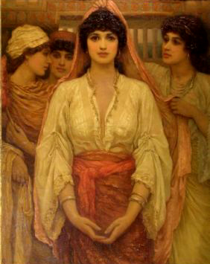

Slide 211
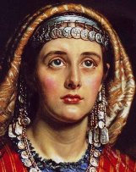

Slide 212
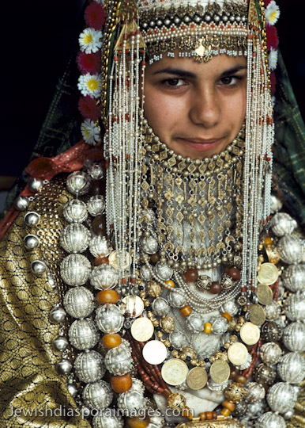
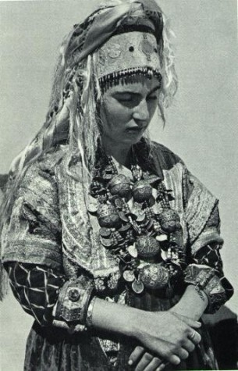

Slide 213
The bridegroom set out with the bride from the house of her parents, and there followed a grand procession all the way to his house. The streets of the cities were dark, and it was necessary that anybody venturing forth at night should carry a lamp or torch…. They could NOT join the procession or enter the bridegroom's house without a torch or lamp.

Slide 214
Those invited guests, who did not go to the
bride's home were allowed to join the procession along the way, and go with the whole group to the marriage feast. The Ten Virgins waited for the procession to arrive at the point where they were waiting; and five wise ones were able to proceed because they had a reserve supply of oil for their lamps; but the foolish virgins lacked that oil and so, not being ready, they were barred from the wedding feast (Matt. 25:1-11).

Slide 215
In going from the bride's house to the groom's house, the bride allowed her hair to be loose and flowing, and she had her face veiled. Some of her own relatives preceded her in the procession, and scattered ears of parched grain along the way. There were demonstrations of joy all along the road to the destination. Part of the procession included men who played on drums or other musical instruments. And there was dancing along the way.

Slide 216
After arriving at the groom's house, some of the older women had the task of arranging the bride's hair. Her flowing locks were hidden beneath a thick veil. From this time on, the
custom would dictate that her face was not to be unveiled in public. She was led to her place under a canopy, which was located either inside the house, or if the weather permitted, in the open air.

Slide 217
After the wedding feast was over the husband was escorted by his friends into the apartment where his wife had previously been.
These wedding festivities with relatives and friends lasted for a whole week, and sometimes up to 30 days of what was called "the days of the
Marriage.”

Slide 219
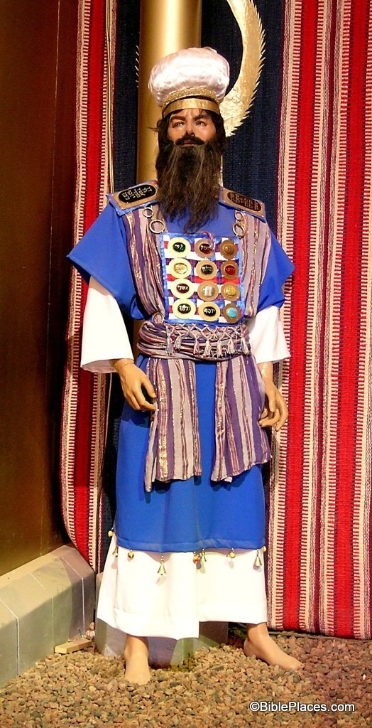
GARMENTS OF THE PRIESTS

Slide 221
THE EPHOD (Exo. 28:6-14; 39:2-7):
An ephod was a shawl or a kind of apron for the High Priest it was a particular outer garment. It was made of linen; in blue, purple, and scarlet and there were golden threads woven into it. It was made in two pieces joined together at the shoulders with golden clasps. Each clasp was set with an engraved stone. The front and back of the ephod were made to be as one garment by a sash or girdle or belt, which was tied about the priest's waist. This was also of blue, purple, and scarlet linen intertwined with golden threads.

Slide 224
1 Sam. 2:18 But Samuel ministered before the LORD, being a child, girded with a linen ephod.
1 Sam. 23:9 And David knew that Saul secretly practised mischief against him; and he said to Abiathar the priest, Bring hither the ephod.
1 Sam. 30:7 And David said to Abiathar the priest, Ahimelech's son, I pray thee, bring me hither the ephod. And Abiathar brought thither the ephod to David.
2 Sam. 6:14 And David danced before the LORD with all his might; and David was girded with a linen ephod.
1 Chron. 15:27 And David was clothed with a robe of fine linen, and all the Levites that bare the ark, and the singers, and Chenaniah the master of the song with the singers: David also had upon him an ephod of linen

Slide 225
The Breastplate (Exo. 28:15-29, 39:8-21)
Over the ephod the High Priest wore a breastplate which was a pouch made of beautifully woven material. On the front of the breastplate were fastened twelve precious stones in four rows of three. On each of these stones were engraved the name of one of the tribes of Israel. The breastplate was actually a piece of elaborately finished cloth of the same material as the ephod. It was a strip twice as long as it was wide, but folded back on itself so as to form a square bag into which the Urim & Thummim were placed.

Slide 227
Urim and Thummim (Exo. 28:30, Num. 27:21,
1 Sam.28:6)
It is not known for certain exactly what the Urim and Thummim really were, but it is thought that they may have been two precious stones, possibly gems, which were identical in shape. One or the other could be drawn from the pouch in order to provide a yes or no answer in seeking the Lord for guidance. Since Scripture explicitly states that the Urim and Thummim were placed in the breastplate it would seem that they were separate from the twelve stones mounted on the outside.

Slide 228
The wearing of the URIM & THUMMIM qualified the high priest to consult the divine oracle on all public or national emergencies, by going into the holy place--standing close before the veil and putting his hand upon the Urim and Thummim, he conveyed a petition from the people and asked counsel of God.

Slide 229
The Urim and Thummim are to be regarded as a certain medium, given by the Lord to His people, through which the congregation required divine illumination to guide its actions. When God was displeased with His people in later history, He refused to permit the Urim and Thummim to function as a means of guidance.
There is no record of this method being used to discover God's will after the time of David and the ministry of the prophets.

Slide 230
The name Urim means "lights," while Thummim means "perfections;" by urim also is meant knowledge, and thummim holiness. These meanings have led some to speculate that perhaps the stones flashed in a particular way to indicate "yes" or "no."

Slide 231
The Robe (Exo. 28:31-35, 39:22-26)
The robe of the ephod was a plain blue sleeveless garment worn directly beneath the ephod and probably extending some inches below it. Apparently there was a row of pomegranates embroidered upon the hem interspaced with tinkling golden bells which sounded as the priest moved. The bells speak of listening to God while in His service and the music of them brings a certain joy.

Slide 233
The sound of the bells could be heard when Aaron went into the Holy Place before the Lord, and the listening people would know that he had not been struck dead in God's presence, but that his offering on their behalf had been accepted by God.
Exod 28:35 "And it shall be upon Aaron when he ministers, and its sound will be heard when he goes into the holy place before the LORD and when he comes out, that he may not die."

Slide 234
The Turban and Crown (Exo. 28:36-38, 39:30, 31)
On his head the High Priest wore a turban or mitre of fine linen which was bound around the head in coils like a turban or tiara. On the front of the mitre on Aaron's forehead, attached by a blue lace ribbon, there was the golden plate engraved HOLINESS TO THE LORD. This was a constant reminder to the people in Israel and to the High Priest in his calling.

Slide 235
The tunic (Exo. 28:39-40)
The tunic was as an undergarment worn by the High Priest and priests. It was made of pure linen, covering the entire body from the neck to the feet, with sleeves reaching to the wrists. That of the High Priest was embroidered; those of the priests were plain. However; on the Day of Atonement, the High priest would change into a special tunic made of fine linen that was not embroidered when he would enter the Holy of Holies. This tunic could only be used once, with a new set made for each year.

Slide 239
Garments of the common people
The Inner Garment-tunic Or Shirt
The tunic (inappropriately translated "coat") was a shirt which was worn next to the skin. It was made of leather, haircloth, wool, linen, or in modern times, usually of cotton. The simplest form of it was without sleeves and reached to the knees or sometimes to the ankles. The well-to-do wore it with sleeves and extending to the ankles. Women as well as men wore it although there was no doubt a difference in style and pattern in what was worn by the two.

Slide 240
Garments of the common people
Among the lower classes, the tunic was often the only dress worn in warm weather. Persons of higher rank might wear the tunic alone inside the house, but would not wear it without the outer garment outside, or when they were to receive a caller. In the Bible the term "naked" was sometimes used of men clad only with their tunic (John 21:7). To be dressed in such a scanty manner was thought of as nakedness or immodest at times.

Slide 242
The Outer-tunic Or Robe
In Bible times there was a looser and longer kind of tunic that was sometimes used but not by the ordinary people. Scripture indicates its use by kings (1 Sam.24:4), prophets (1 Sam. 28:14), nobles (Job 1:20), and sometimes youths (1 Sam.2:19).

Slide 245
Garments of the common people
THE GIRDLE:
If the tunic was ungirded it would interfere with a person's ability to walk freely, and so a girdle was always worn when leaving home for any kind of a journey. (2 Kings 4:29; Acts 12:8).
There were two kinds of girdles.

Slide 246
(1) The common girdle: usually made of leather, usually six inches broad and furnished with clasps. This was the kind of girdle worn by Elijah (2 Kings 1:8), and by John the Baptist (Matt. 3:4).

Slide 247
(2) The more valuable girdle: usually made of linen (Jer. 13:1), or sometimes of silk or embroidered material. It is generally a handbreadth wide.

Slide 248
The girdle sometimes served as a pouch in which to keep money and other things that might be needed. The girdle was used to fasten a man's sword to his body (1 Sam. 25:13). Thus the girdle was a very useful part of a man's clothing.

Slide 249
THE MANTLE OR CLOAK:
An outer garment (large cloak) which would serve the purpose of a “Westerner's overcoat.” It was usually made of wool or goat's hair and sometimes of cotton. It was usually dark brown or different shades of brown. It served as a shelter from the wind and rain, and as a blanket at night.

Slide 252
It is a more or less common sight to behold a man walking on a hot day wearing his heavy cloak, and if he should be asked why he does so, his answer would be, "What keeps out the cold, keeps out the heat also."

Slide 253
It was this outer garment or mantle with which Elijah smote the waters of Jordan and crossed over with Elisha, and when he was taken up to Heaven this mantle became the property of Elisha
(2Kings 2:8-13).
The three young men who were cast into the fiery furnace were clad in their mantles as well as their tunics and other clothing (Dan. 3:21).

Slide 254
Going to bed at night was a very simple matter for the common folks. Mats, rugs, or mattresses are used to lie upon, but the host does not usaully provide any covering. Each person provides his own which consists of his mantle. Being closely woven, it is warm, and if he sleeps out-of-doors, this covering is usually waterproof.

Slide 255
The mantle served as a means of carrying various
things. The lap was often filled with grain or fruit. Jesus said, "Give, and it shall be given unto you; good measure, pressed down, and shaken together, and running over, shall men give into your bosom" (Luke 6:38).
Ruth could put six measures of barley into her mantle (Ruth 3:15). Thus the outer garment served many useful purposes.

Slide 256
It was strictly forbidden for men and women to wear each others clothes (Deut 22:5) the differences between the genders were represented more in detail and ornamentation rather than substance. Thus a woman's mantle may be rather more flowing and she may have adorned it with more needlework but essentially the articles of her clothing would have been similar to her husband's; with the exception of the veil.

Slide 257
The difference in ornamentation can most easily be characterized by the observation that the men did not ornament themselves. They might carry a walking staff and they might wear a signet ring to act as a legal seal but other than that they did not ornament. In contrast a woman might take time to elaborately braid her hair, she may have earrings usually of a long and dangling variety (somewhat similar to a Christmas tree ornament).

Slide 258
In public the Jews always wore a turban, for at certain seasons of the year it is dangerous in Palestine to expose the head to the rays of the sun. This turban was of thick material and was wrapped several times around the head. It was somewhat like our handkerchief and was made of linen.
Due to the heat of the sun it would have been common for both men and women to wear a head covering.

Slide 259
It was customary for a woman of any stature to wear a veil. This was essentially a piece of cloth which would cover the majority of the face and would be worn during most public occasions.
Hebrew women did appear to be granted some degree of latitude as Egyptian's saw Sarah's face and Eli was able to see the mouth of Hannah.

Slide 261
HEADDRESS:
The headgear of women from Bethlehem had an additional piece; a cap of coins. The cap was a string of seven to ten coins for a married woman; and then up to twenty coins for a single woman. The central coin is designed to be the largest and most valuable. This head cap would be part of the dowry for a woman and the cap was considered a reflection of her character.

Slide 263
HEADDRESS:
The Jews of Bible times gave much attention to the care of their hair. The young people loved to wear it long and curly and they were proud to have thick and abundant hair. (2 Sam. 14:25, 26).

Slide 264
HEADDRESS:
Middle-aged men and priests would occasionally cut their hair but very little. Baldness was scarce and suspicion of leprosy was often attached to it. Thus when the youth said of Elisha, "Go up, thou bald head" (2 Kings 2:23-24), they could have been implying that Elijah was cursed.
Men would not cut their beards, but allowed them to grow long (Ps. 133:2; 2 Sam. 20:9; 10:4-5). Beards would be anointed with oil often.

Slide 266
TRADES & PROFESSIONS
THE POTTER: There was a demand for this profession because copper vessels were so expensive, because leather bottles were not suitable for some domestic purposes and because earthenware vessels were so easily broken and must therefore be replaced often. Earthenware jars were in much demand to keep drinking-water cool. In a warm climate, courtesy usually demands that
"a cup of cold water" be given (Matt. 10:42).

Slide 267
Broken pieces of earthen vessels are to be seen about a potter's place, and also in many other places in the East. Some of these pieces which happen to be of suitable size and shape are of practicable use for the peasants. In the evening time it is a common sight to see children coming
to the public ovens with pieces of pottery in their hands, and go away with a small amount of hot coals.
Job used a piece of pottery to scrape away his sores (Job 2:8)

Slide 269
Then at the spring, well, or cistern pieces of pottery that are of the right size and shape to hold water are often left there that they might be used as ladles for filling the container, or as drinking cups. In ancient times when parchment was so
expensive to possess, peasants would use fragments of pottery on which to scratch information of business transactions.
Many of these have been uncovered by archaeologists, and have proven to be of great value in revealing past history

Slide 272
TRADES & PROFESSIONS
THE CARPENTER: The carpenters sometimes sat on the floor beside their work board where they crafted their product. They did not always have workbenches so they worked on the floor or stood worked over the project. They did much of their work at the doorsill where the light was much better. The tools used by the carpenter in Bible times are still used by some primitive Palestinian carpenters of today.

Slide 273
The "rule" was a measuring line; the "line" was a marking tool, taking the place of our pencil ; the “plane” was a scraping tool; and the "compass" was an instrument for making a circle, as it is today.
The "axe" was used in olden times to shape timber as well as to cut down trees. It had an iron head usually fastened to a wooden handle, and so it was easy for the head to slip off
(Deut. 19:5 and 2 Kings 6:5).

Slide 274
AXES

Slide 275
 | 1. Axe 2. Chisel 3. Hone for sharpening tools 4. Adz 5. Bradawl 6. Bowdrill 7. Adz 8. Small handsaw 9. Mallet 10. Saw

Slide 277
As there were many farmers among the ancient Hebrews, there would be a great demand for yokes and plows. The yoke, and most of the plow, with the exception of the iron ploughshare, were constructed of wood, and so it would be the task of the carpenters to make them. Other products of the carpenter would include wooden locks and wooden keys for houses, doors, roofs, windows, low tables, chairs or stools, and chests for storage use. The carpenter's most ornamental work would include paneling of the roof, latticework for windows, and decorative art on house doors.

Slide 278
TRADES & PROFESSIONS
THE FISHERMAN: In Palestine the main fishing places have been along the Mediterranean coast, and in the Sea of Galilee. The Galilee fishing expeditions were widely mentioned because of the Gospel incidents connected with the Lord Jesus and his early fishermen disciples. The Jews
engaged in a large fishing business in the days of Jesus in the waters of Galilee.

Slide 279
Galilee fishermen often have fished at night. They light their way with a blazing torch, and sighting fish they let fly their fishing spear, or throw their net into the sea. But sometimes they fish all night with no results, as was the case with Simon Peter and his comrades. "Master, we have toiled all the night, and have taken nothing" (Luke 5:5).

Slide 280
TRADES & PROFESSIONS
THE MASON: Expert masons have always been in demand in Bible lands through the years. The
building of house walls and terrace walls usually called for stone or brick. In building foundations it is important to get down to rock or otherwise the
shrinkage and expansion due to the summer heat and the winter rains will do damage to the construction.

Slide 284
TRADES & PROFESSIONS
THE METAL WORKER: Most metal workers specialized in categories such as:
COPPERSMITH (2 Timothy 4:14)
SILVER SMITH (Acts 19:24)
GOLDSMITH (Isaiah 40:19)
BLACKSMITH (Isaiah 44:12)

Slide 285
TRADES & PROFESSIONS
THE TANNER: This has always been an important business in Bible lands for the people depended on them for the making of sandals, shoes, bags, bottles, etc. Sheepskins were sometimes used for making leather shoes, although goatskin leather is generally considered to be superior to that made from sheepskins. Goatskins were used largely for the making of bottles for carrying water or other liquids.

Slide 286
The goatskins are stripped off whole; excluding the neck, legs, and tail. The holes where the legs and tail were located are sewn up, and the end where the neck was, becomes the mouth of the bottle. Sheepskins are treated in a similar way and made soft, and then they are dyed a yellow or red color when used in the making of shoes.

Slide 290
TRADES & PROFESSIONS
THE TENTMAKER: Because of the large use of tents by the Hebrew people, there was a great
demand for tentmakers. Besides the ordinary tent used as a dwelling, many portable tents were made for the use of travellers. In New Testament times it was the custom to teach every Jewish boy some trade. As Jesus was a carpenter, so Paul was a tentmaker. Paul practiced this trade in company with Aquila at Corinth (Acts 18:1-3). Rough goat's hair was used in making these tents.

Slide 291
TRADES & PROFESSIONS
THE MERCHANT: In the city or village, the market place is an important place for doing business. It is not always located in the same place. It may be near the city gates, or it may be in the open streets of the town. The market is not always in operation in some districts, but is open for business whenever there is something to be sold.

Slide 292
The arrival in town of a caravan would be one great occasion for setting up the market place and the selling of produce. Also, many goods were sold in the oriental bazaar….This is usually a covered
arcade containing a row of narrow shops on each side, and those of like trade often having their shops together, such as those selling dry goods, grocery items, tin utensils, leather goods & meats.

Slide 293
Buying And Selling: No fixed price is put upon
whatever is to be sold. Ordinarily the buyer must expect to spend from a few minutes to an hour or so to complete a purchase. The merchant begins by asking a high price and the buyer by offering a low price. Then the bargaining continues in earnest. When the sale is made, the buyer will go away to boast of his splendid bargain, and will be greatly
admired by the seller.

Slide 294
END
OF
SERIES

