Slide 1
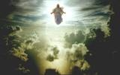
COMING SOON
THE END

Slide 2
THE RAPTURE
The word “rapture” is not the term used in the English Bible.
RAPTURE means: Transported into a spiritual realm. The term RAPTURE expresses “snatching or catching away”
The biblical term used in 1 Thess. 4: 17 connotes the same idea as rapture. The phrase that is used is “caught up”

Slide 3
THE RAPTURE
CAUGHT UP ➔ “HARPAZO” means: to seize, catch, pluck, pull or take
The rapture therefore is the catching away of saints both dead & living, as they will be caught up together by the Lord Jesus to meet him in the air.

Slide 4
COMING SOON
THE END

Slide 5
THE RAPTURE
There are two (2) important events which will transpire at the rapture:
Resurrection of the dead saints
Transformation of the living saints

Slide 6
THE RAPTURE
Resurrection of the dead saints
1 Thessalonians 4: 13-14
Vs. 13: “asleep” – deceased, dead
Vs. 14: “sleep in Jesus” – dead in Christ… “God will bring with him”
Who is being called God here?
What will God bring with him?

Slide 7
THE RAPTURE
Resurrection of the dead saints
Jesus is God
Jesus will be returning with the spirits of the saints. Their bodies had separated from them at death but their spirits went to heaven to be with the Lord.

Slide 8
THE RAPTURE
Resurrection of the dead saints
Vs. 16: “with a shout” – an order, a declaration or a proclamation
“with the voice of the archangel” – The angel Michael was ascribed this title (Jude vs. 9); it could possibly mean that he could be vocal accompaniment like a chorus.

Slide 9
THE RAPTURE
Resurrection of the dead saints
Vs. 16: “with the trump of God” – The trumpet which God appoints to be sounded on that solemn occasion. It does not have to be sounded by God himself. (Matt. 24: 31; Rev. 8: 2)

Slide 10
THE RAPTURE
Resurrection of the dead saints
Vs. 16: “dead in Christ shall rise first” –
What will rise? Their physical bodies
From where will they rise? The Graves: The grave represents land or water; wherever their bodies are buried around the world.
This resurrection is only for the saints!

Slide 11
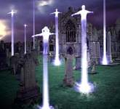

Slide 12
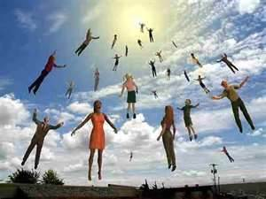
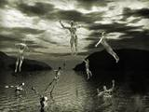

Slide 13
THE RAPTURE
 Transformation of living saints
1 Thess. 4: 17; 1 Cor. 15: 51-53
Vs. 17: “alive & remain” – The saints which are alive will then unite with the resurrected saints & the Lord in the air.
* However they will have to receive a new body just like the dead in Christ did.

Slide 14
THE RAPTURE
 Transformation of living saints
* 1 Cor. 15: 51-53
Vs. 51: “mystery” – A secret – which is:
“We shall not all die, but we shall all be transformed”
All saints will receive a glorified body whether you are dead or alive!

Slide 15
THE RAPTURE
Transformation of living saints
Vs. 52: “dead raised incorruptible” – Never to decay anymore
Vs. 53: mortal to immortality: from a state of being liable or destined to die to never die again; deathlessness.

Slide 16
Distinctions between the Rapture & the 2nd Coming
RAPTURE | 2nd Coming
Christ does not appear on the earth (The action is up ↑) | Christ appears to all the earth (The action is down ↓)
Christ comes to claim his bride | Christ returns with his bride
The Tribulation is about to begin | The Millennial Kingdom is about to begin
It is related to the church | It is related to Israel & the world

Slide 17
COMING SOON
THE END

Slide 18
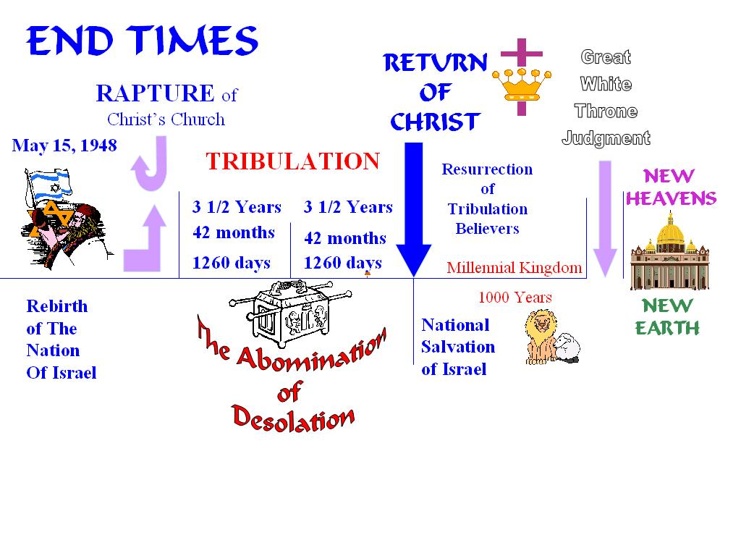

END TIMES
Bema Seat
Marriage of the lamb
CHURCH AGE
END TIMES

Slide 19
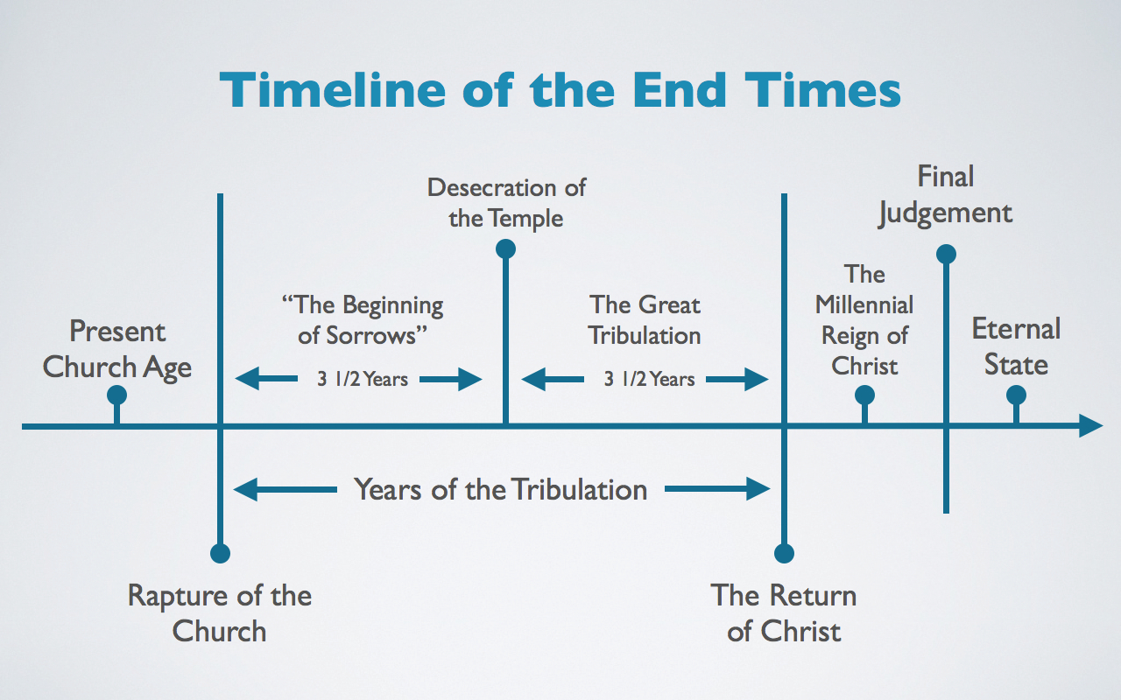
Bema Seat
Marriage of the Lamb

Slide 20
MARRIAGE of the LAMB
WHAT IS IT? Christ appearing as a bridegroom to take His bride unto Himself to consummate the relationship that He pledged
WHO PARTICIPATES? Christ & the Church
WHERE DOES IT HAPPEN? In heaven
WHEN DOES IT HAPPEN? Possibly near the end of the tribulation, sometime after the Bema seat & most likely before the second coming of Christ

Slide 21
Bema Seat
Marriage
RAPTURE
Living Saints
Dead Saints
TRIBULATION
Church Age

Slide 22
MARRIAGE of the LAMB
Bride & Groom “ENGAGEMENT”: Rom. 7:4 So, my brethren, to you also the Law died through the body of Christ, that you might be married to Another, namely to Him who rose from the dead in order that we might yield fruit to God.
II Cor. 11:2 I am jealous over you with God's own jealousy. For I have betrothed you to Christ to present you to Him like a pure virgin (faithful bride) to her one husband.

Slide 23
MARRIAGE of the LAMB
Eph. 5:23-32
The Church is represented as the spouse of Christ, as the woman is the spouse of the man; and, to prepare this Church for himself, he washes, cleanses, and sanctifies it. There is certainly an allusion here to the ancient method of purifying women, who were appointed to be consorts to kings; twelve months, it appears, were in some instances spent in this purification: 6 months with oil of myrrh, & 6 months with sweet odors & with other things, for the purifying of women.

Slide 24
MARRIAGE of the LAMB
Eph. 5:23-32
Vs. 27 …that Christ might both receive the Church to Himself & present her to others as His glorious bride, without spot or wrinkle or any other defect, but to be holy and unblemished….HENCE THE CHURCH IS ENGAGED TO CHRIST & ONE DAY THERE WILL BE A WEDDING …
“MARRIAGE OF THE LAMB”

Slide 25
MARRIAGE of the LAMB
Bride & Groom “WEDDING DAY”: Rev. 19: 7 The church has been from the first engaged to Christ as a chaste virgin, but now he takes her into full union with himself, and thus gives her rest from all her conflicts and sufferings.
All the preparations had been made for a permanent and uninterrupted union with its Redeemer, and the church was henceforward to be recognized as his beautiful bride

Slide 26
MARRIAGE of the LAMB
Bride & Groom “WEDDING DAY”: Rev. 19: 8
“Here comes the bride, all dressed in white.” White has been in most if not all cultures, the traditional color of the bridal dress--as an emblem of innocence & purity.
“To be arrayed in fine linen, white and clean”-This is an emblem of the righteousness of the saints-Both of their justification and sanctification.

Slide 27
MARRIAGE of the LAMB
Bride & Groom “WEDDING DAY”: Rev. 19: 8
It should be remarked, however, that this is not their own righteousness, for it is said that this was "given" to the bride--to the saints. It is the gracious bestowment of their Lord; and the reference here must be to that righteousness which they obtain by faith--the righteousness which results from justification through the merits of the Redeemer.

Slide 28
MARRIAGE of the LAMB
Bride & Groom “RECEPTION”: Rev. 19: 9
“What is a wedding without a reception?”
“What is a reception without food?”
Since there will be a “marriage of the lamb” & a “marriage supper of the lamb” it is logical to deduce that the church will be involved in the supper, since we would be married to the same groom.

Slide 29
MARRIAGE of the LAMB
The Groom takes his bride with him Rev. 19: 14
The heavenly hosts; particularly representing the multitude of Christ's redeemed followers. These hosts of the redeemed on white horses accompany him to be witnesses of his victory, and to participate in the joy of the triumph.
This is why we infer that the marriage occurs before the 2nd coming of Christ because His BRIDE will be with Him!

Slide 30
Marriage SUPPER of the LAMB
Who will partake in this supper?
JEWS only?
CHURCH only?
ALL BELIEVERS?
OTHER PASSAGES which speak of the supper:
Matthew 22:1-14; Luke 14:16-24
Matthew 25:1-13 (Bridegroom’s return)
ALL BELIEVERS WILL BE AT THE SUPPER!

Slide 31
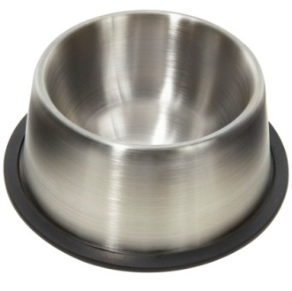
Bema Seat
Marriage
RAPTURE
Living Saints
TRIBULATION
Dead Saints
7 Trumpets
7 Bowls
Church Age
7 Seals

Slide 32
THE TRIBULATION
The Nature of the Tribulation
  1. It is a time of wrath
  2. It is a time of judgment
  3. It is a time of Punishment
  The Purpose of the Tribulation
  1. To pour out judgment on unbelievers
  2. To prepare Israel for the Messiah

Slide 33
THE TRIBULATION
The Source of the Tribulation
  1. God will be the primary source to execute the 7 seals, trumpets & bowls
  2. Satan will be a secondary source to persecute tribulation saints & Israel
  3. The anti-Christ will be a source of (false) peace & then pain & discomfort

Slide 34
THE TRIBULATION
7 Seals (Revelation 6-8)
  1. White Horse (1-2)
  2. Red Horse of war (3-4)
  3. Black Horse of famine (5-6)
  4. Pale Horse of death (7-8)
  5. Martyred Souls (9-11)
  6. Cosmic Disturbances (12-17)
  7. Introduction of 7 trumpets (8:1-5)

Slide 35
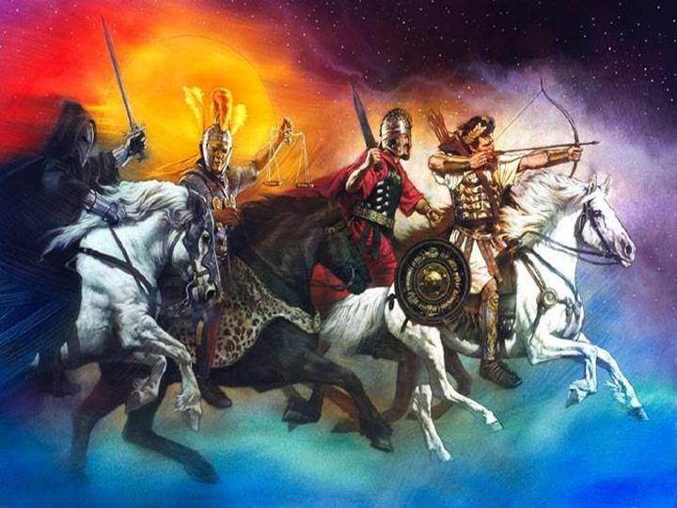
4 RIDERS

Slide 36
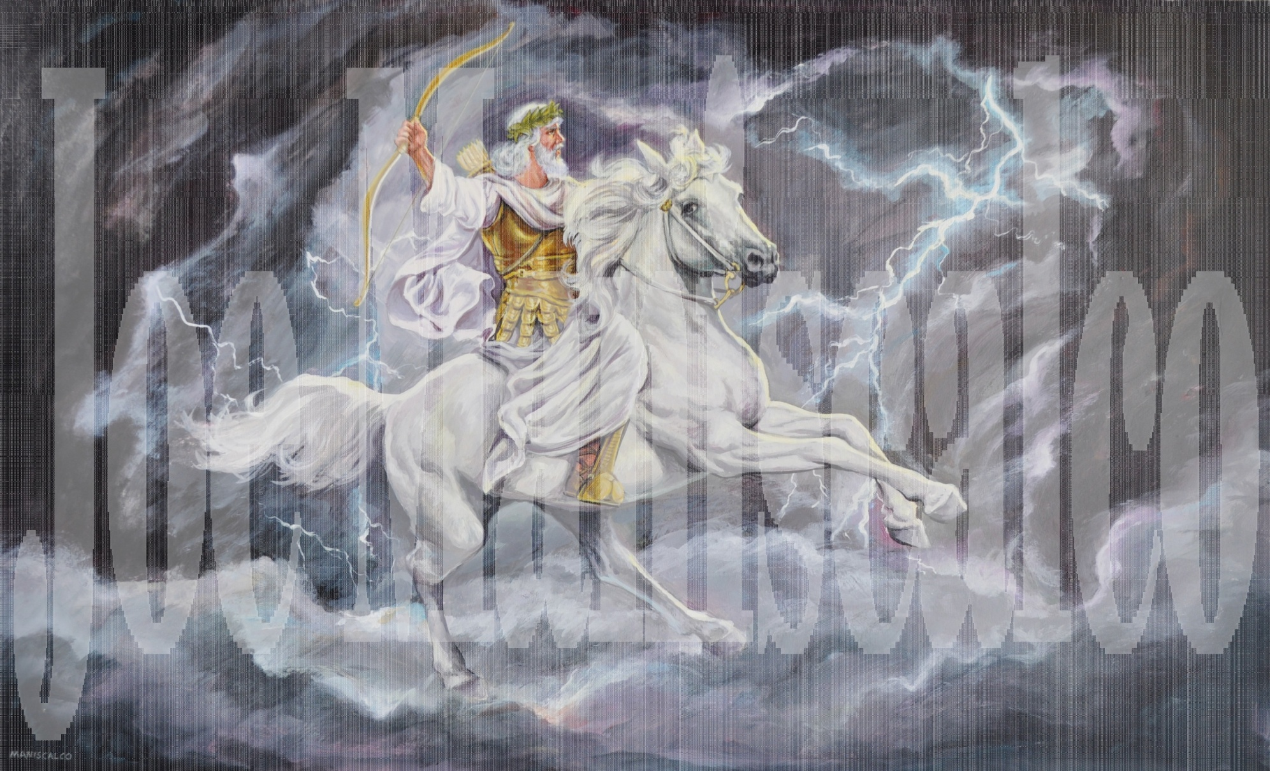
1st SEAL: White Horse Rider

Slide 37
1st SEAL: White Horse Rider
Who is the rider?
Some say: Christ or Anti-Christ or possibly an angel
Verdict: Uncertain
Why Christ? White horse in Rev. 19:11
Uncertainty of Christ: 1) The Lamb’s role-6:1 2) Two different crowns (6:2) “Stephanos” but (19:11) “diadema”

Slide 38
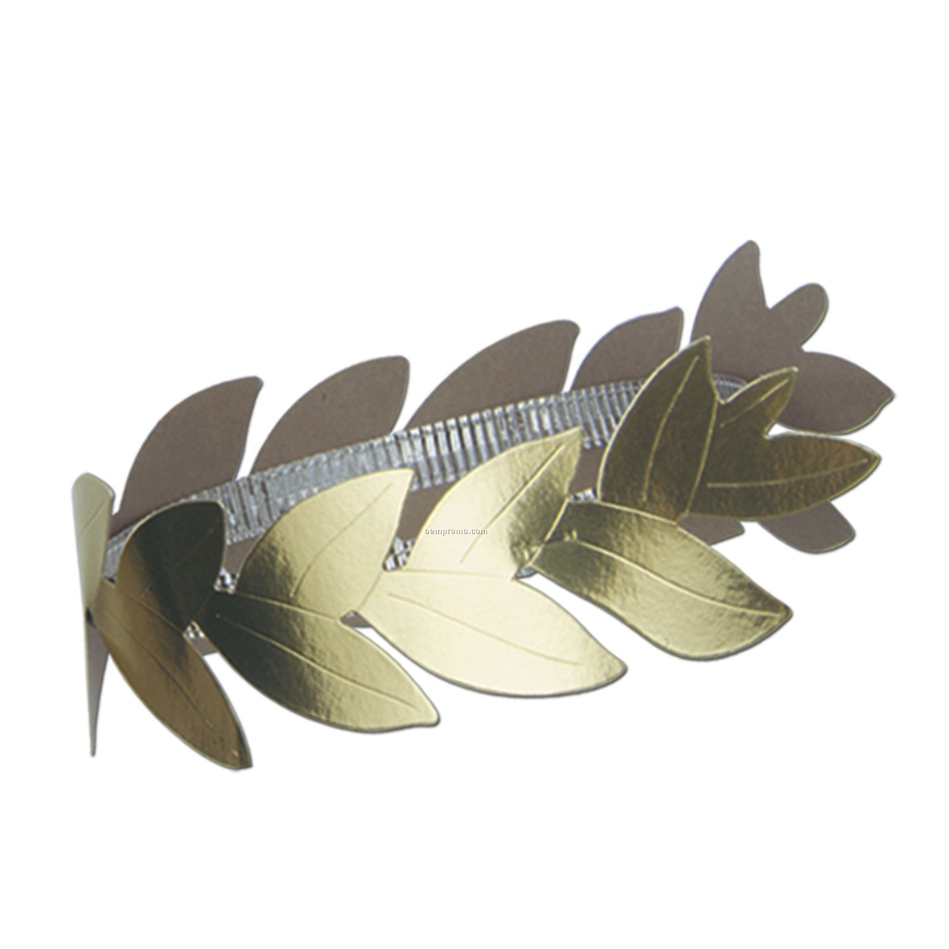
STEPHNOS

Slide 39
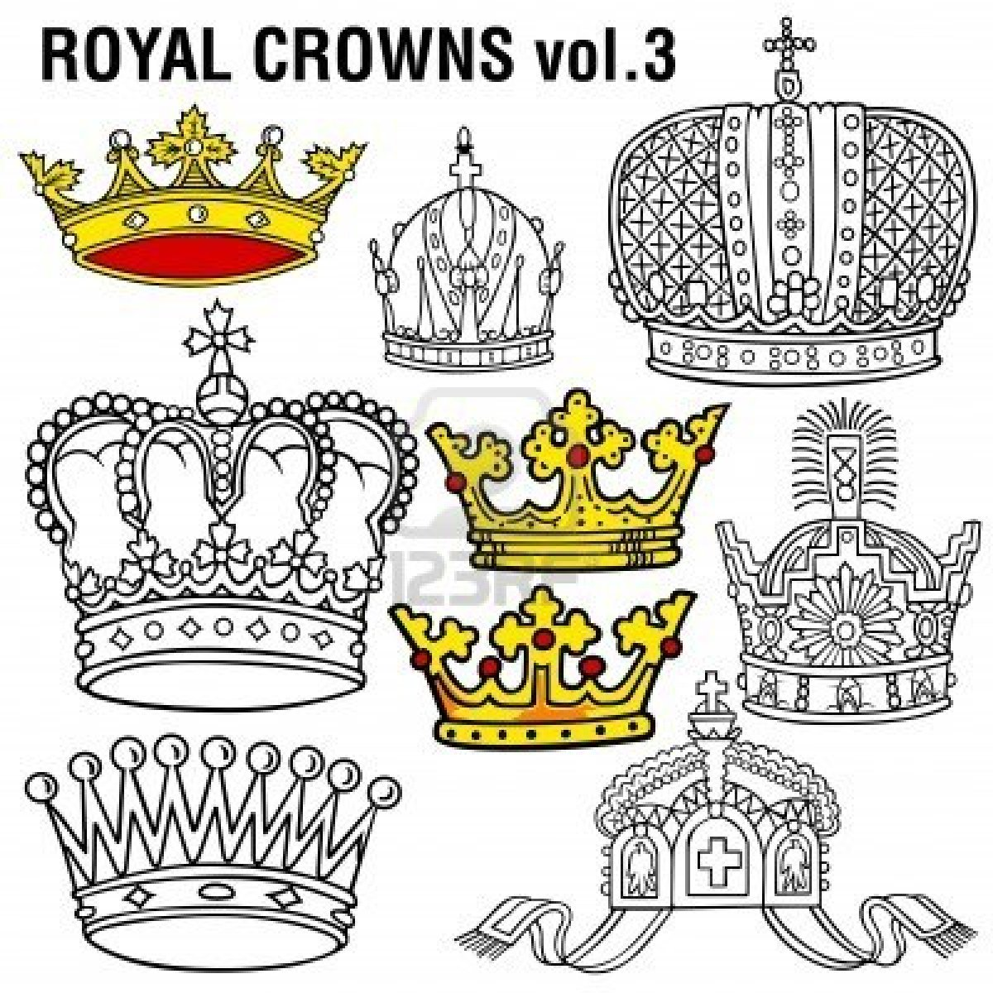
DIADEMA

Slide 40
1st SEAL: White Horse Rider
Who is the rider?
Why Anti-Christ? He will rise to power & prominence during that period & have the same motive to conquer
Uncertainty of Anti-Christ: Why white? Who crowns him? Is he worthy of such honor?
When all other identities are uncertain; it could very well be an ANGEL!

Slide 41
1st SEAL: White Horse Rider
What did the rider come on?
A WHITE HORSE!
WHITE: Prosperity, happiness, triumph
HORSE: An animal reserved for war

Slide 42
1st SEAL: White Horse Rider
What did the rider carry?
A BOW!
BOW: A weapon of war; a symbol of military might & power

Slide 43
1st SEAL: White Horse Rider
What did the rider do?
CONQUER!
CONQUER: To defeat & subdue
“Cold War” – No warfare is described so it would seem like a silent, one-sided kind of war.

Slide 44
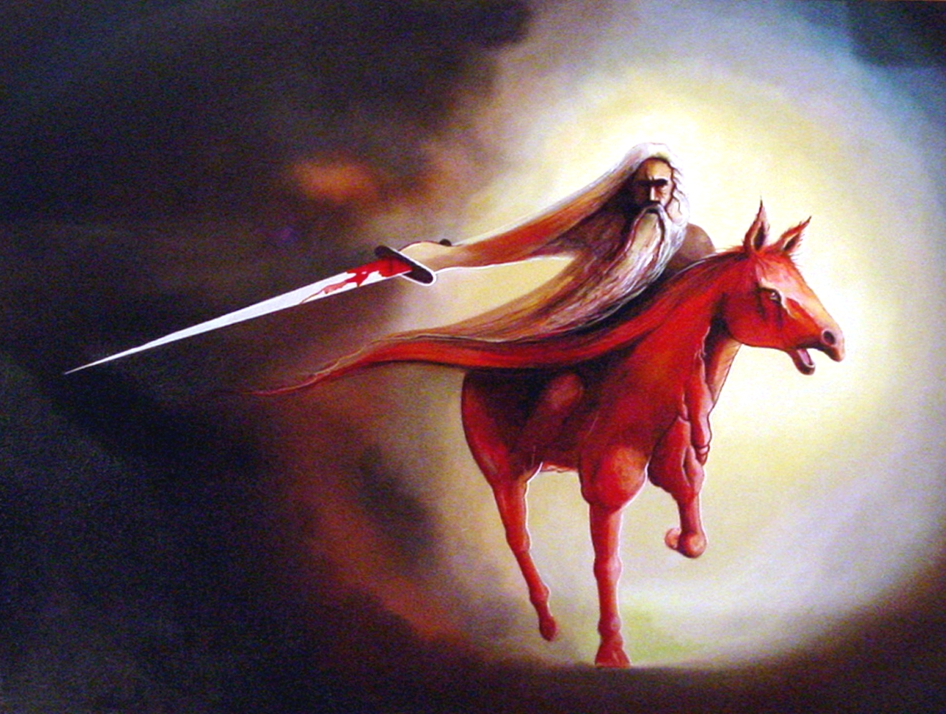
2nd SEAL: Red Horse Rider

Slide 45
2nd SEAL: Red Horse Rider
What did the rider come on?
A RED HORSE!
RED: Bloodshed
What did the rider carry?
A GREAT SWORD!
SWORD: Death, murder, carnage

Slide 46
2nd SEAL: Red Horse Rider
What did the rider do?
He removes peace from the earth & people will begin to war against each other. People will slaughter each other.

Slide 47
4 RIDERS

Slide 48
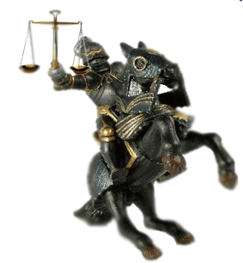
3rd SEAL: Black Horse Rider

Slide 49
3rd SEAL: Black Horse Rider
What did the rider come on?
A BLACK HORSE!
BLACK: Doom, Gloom, Hardships
What did the rider carry?
A SCALE!
SCALE: Famine, Starvation

Slide 50
3rd SEAL: Black Horse Rider
What did the rider do?
He brings famine to the land which normally follows war. An announcement is made of how food will be rationed. (Normally a denarius was a day’s wages for a rural worker & it could buy 10 quarts of wheat or 30 quarts of barley)

Slide 51
3rd SEAL: Black Horse Rider
Under these famine conditions the same wage will buy only 1 quart of wheat & 3 quarts of barley.) There will be one tenth the normal supply of food.

Slide 52
3rd SEAL: Black Horse Rider
“Hurt not the oil & wine”: Commandment to spare these items from scarcity. Do not include them on the list of famine. (Example of similar phrase 9:4) Even though these items were not to be items affected by the famine they may very well become scarce commodities due to poor distribution & hoarding.

Slide 53
4 RIDERS

Slide 54
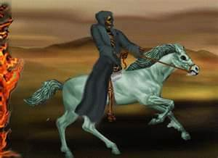
4th SEAL: Pale Horse Rider

Slide 55
4th SEAL: Pale Horse Rider
What did the rider come on?
A PALE HORSE!
PALE (Pale green): corpse, death
What did the rider come with?
He had the name of death
Hell came with him

Slide 56
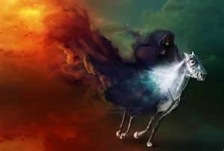

Slide 57
4th SEAL: Pale Horse Rider
What did the rider do?
Destroy one-fourth of the earth with:
Sword (probably war)
Hunger (famine & starvation)
Death (probably plagues, diseases)
Beasts (wild animals on earth)

Slide 58
4th SEAL: Pale Horse Rider
“DEATH & HELL”
Death claims the physical or material part of the persons.
Hell claims the spiritual or immaterial part of the persons

Slide 59
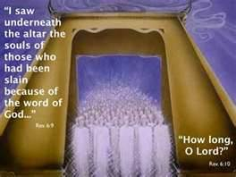
5th SEAL: Martyred Souls

Slide 60
5th SEAL: Martyred Souls
The 5th seal depicts actions in heaven that result from certain happenings on earth. They are a group of martyrs in heaven who were martyred on the earth. They are most likely saints who were saved in the early part of tribulation when the judgment of the 4 seals were being poured out.

Slide 61
5th SEAL: Martyred Souls
The reason they were killed was because of their belief in God, His Word & taking a stand for their faith (6:9). They were faithful witnesses during the tribulation in the face of opposition. As soon as they died they were received into heaven & they were pictured as under an altar maybe because they had sacrificed their lives for the cause of Christ.

Slide 62
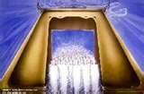

Slide 63
5th SEAL: Martyred Souls
They were crying out to God for justice, for him to vindicate them in the eyes of those who took their lives (6:10).
God responds by saying they will have to wait for a little while until others die and His program be fulfilled (6:11)
However, they are given white robes to signify their redeemed & glorified state.

Slide 64
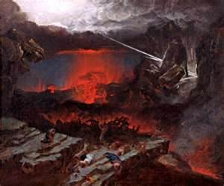
6th SEAL: Cosmic Disturbances

Slide 65
6th SEAL: Cosmic Disturbances
Disturbance of the earth & galaxies:
Great earthquake
Sun became black
Moon became red
Stars fell to the earth
Sky rolled back
Mountains & islands dislocated
Everyone hides in fear

Slide 66
SEALING OF 144,000 JEWS
Revelation 7: 1-8
They were sealed with the Father’s name on their foreheads (14:1)
12,000 Jews were sealed & selected from each of the 12 tribes of Israel
Their purpose was to be witnesses to the world for God

Slide 67
SAINTS OF THE TRIBULATION
Revelation 7: 9-14
They were an innumerable group
They were saved during the period of tribulation

Slide 68
THE REACHED & THE UNREACHED IN THE TRIBULATION
THE CONDEMNED GROUP IN THE TRIBULATION
SAINTS OF THE TRIBULATION

Slide 69
Revelation 7:14 states that SOME will be saved during the tribulation period. Therefore in order for it to be true, it has to come to pass.
2 Thessalonians 2:11-12 states that SOME will be damned during the tribulation period. This too must come to pass.

Slide 70
The two situations do not contradict each other because both will have to happen. One group will be saved and another group will be condemned. In other words not all persons living in the tribulation will go to hell & not all will go to heaven.
If all went to hell it would contradict Rev. 7: 14 which states some will be saved!
If all went to heaven it would contradict 2 Thess. 2:11-12 which states some will be dammed!

Slide 71
The reached in the tribulation would be those who already heard the truth but rejected it so that is why they have no more chances.
The unreached in the tribulation would be those who never heard the gospel which gives them that opportunity to hear, acknowledge & be saved.
NOTE: This does not mean that all the unreached will be saved as they have a choice to still accept or reject God.

Slide 72
TRIBULATION POPULATION: 7 Billion
UNREACHED
(UNSAVED)
“2 Billion”
S A V E D
“1 B illion”
REACHED
(DAMNED)
“4 Billion”

Slide 73
7th SEAL: Introduces 7 trumpets
Revelation 8: 1-5
A moment of silence (vs. 1)
7 Angels given 7 trumpets (vs. 2)
An angel with golden vessel: burning incense, offering prayers of saints on a golden altar & casting fire to the earth (vs. 3-5)

Slide 74
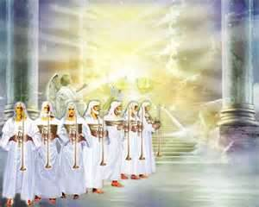
Rev. 8:6: “And the 7 angels which had the 7 trumpets prepared themselves to sound”

Slide 75
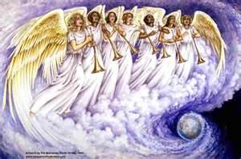
THE SEVEN TRUMPETS

Slide 76
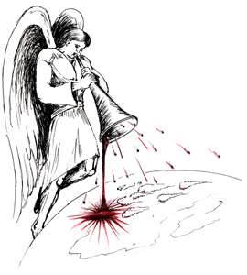
1st TRUMPET
Revelation 8: 7
Hail storm mixed with fire & blood
A third of the trees are burnt up
ALL the grass (vegetation) is burnt

Slide 77
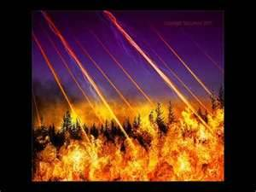

Slide 78
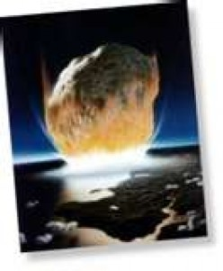
2nd TRUMPET
Revelation 8: 8-9
A huge fiery mountain cast into sea
A third of the sea becomes blood
A third of sea creatures died
A third of sea vessels destroyed

Slide 79
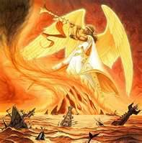

Slide 80
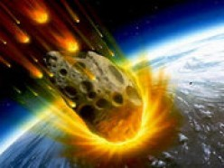
3rd TRUMPET
Revelation 8: 10-11
A huge fiery star cast into the fresh waters (rivers, streams, etc.)
A third of the waters become bitter

Slide 81
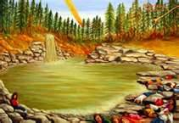

Slide 82
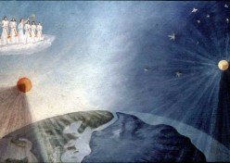
4th TRUMPET
Revelation 8: 12-13
A third of the sun, moon & stars darkened
Angel warning worst is yet to come

Slide 83
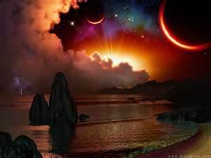

Slide 84
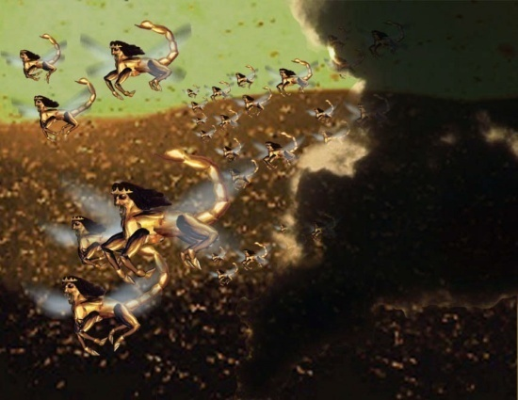
5th TRUMPET: “1st WOE”
Revelation 9: 1-12
(Vs. 1) A “star” or ‘angel’ (Rev. 1:20; Job 38:7) was given a key to the bottomless pit (abyss)
(Vs. 2) He opened the pit & smoke came out

Slide 85
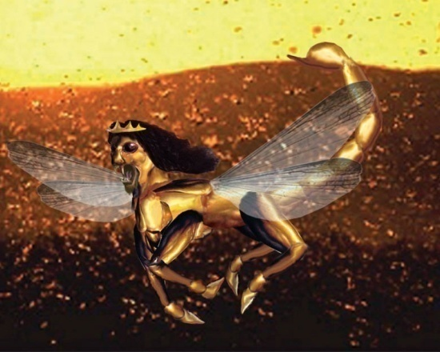
5th TRUMPET: “1st WOE”
3. (Vs. 3, 7-12) An army of locusts

Slide 86
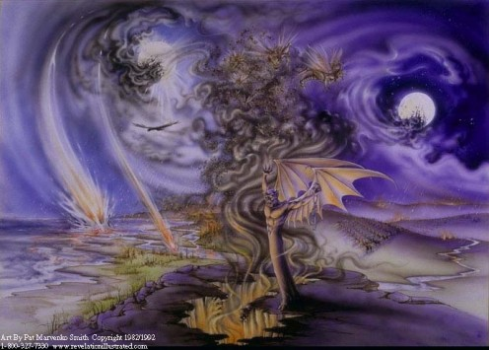

Slide 87
5th TRUMPET: “1st WOE”
(Vs. 4) Commanded to hurt those who were not sealed BUT NOT to hurt the sealed nor the vegetation.
(Vs. 5) They were to torment BUT not kill.
(Vs. 6) The tormented will not be able to die even if they wanted to!

Slide 88
6th TRUMPET: “2nd Woe”
Revelation 9: 13-21
(Vs. 13-14) Four powerful angels released
(Vs. 15) Angels were designated for that specific *time & purpose to kill a third of the earth. * “… an hour, day, month, year”: Literally (396 days) OR Prophetically (396 years)

Slide 89
6th TRUMPET: “2nd Woe”
Revelation 9: 13-21
3. (Vs. 16) Angels lead army of 200 hundred million horsemen
4. (Vs. 17) Horsemen are supernatural beings:
Fiery breastplates
Lion head horses
Fire, smoke & brimstone mouths
Tails like snakes with heads (vs. 19)

Slide 90
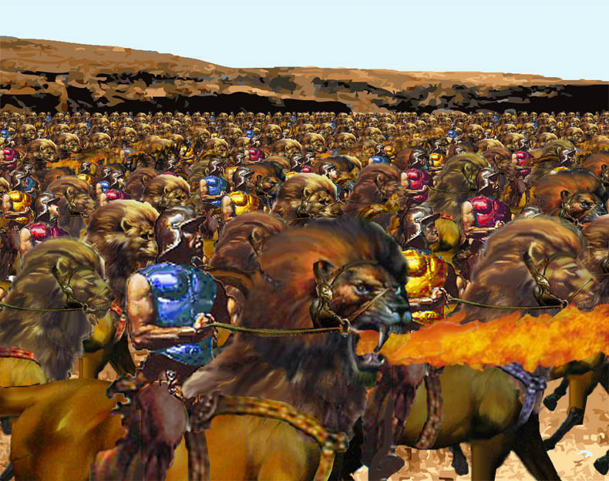

Slide 91
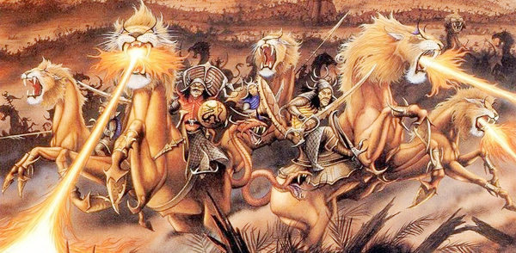

Slide 92
6th TRUMPET: “2nd Woe”
Revelation 9: 13-21
5. (Vs. 18-19) A third part of the population killed by the army
6. (Vs. 20-21) The remainder did not repent nor learn their lesson (Maybe because they were damned)

Slide 94
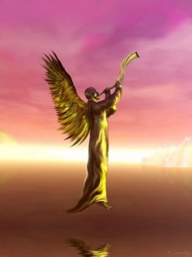
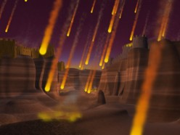
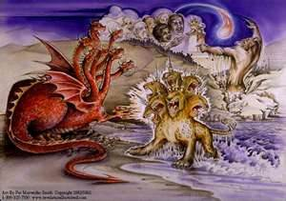
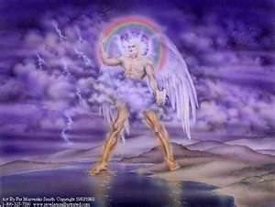
EXTRA PICTURES

