Slide 1
Ways of worship
The Diversity of worship

Slide 2
❶A JOYFUL NOISE IS GOOD AT TIMES
The phrase “joyful noise” is mentioned 7 times in the Bible
The Hebrew word “RUWA” (Roo-ah) describes what a ‘joyful noise’ really sounds like; it means: To mar (especially by breaking); to split the ears with sound or to shout for alarm or joy.
The phrase “loud noise” is also used to convey the same idea
The Hebrew word “TARUWA” (Ter-oo-aw) describes what a ‘load noise’ sounds like: An acclamation of joy or a battle cry; jubilee; shout; rejoice or an alarm.

Slide 3
❶A JOYFUL NOISE IS GOOD AT TIMES
Psalm 33:1-3
Psalm 66:1-8
Psalm 81:1-3
Psalm 95:1-6
Psalm 98:4-6
Psalm 100:1-2
(Israel’s worship style) 1Chronicles 13:8 & 15:28

Slide 4
❷A SHOUT IS NOT BAD EITHER
The Hebrew word “RANAN” (raw-nan‘) describes what a ‘shout’ really sounds like; it means: To creak or emit a stridulous sound; cry aloud for joy; cry out; be joyful or triumph.

Slide 5
❷A SHOUT IS NOT BAD EITHER
Psalm 5:11-12
Psalm 32:10-11
Psalm 35:27-28
Psalm 47:1 (‘RUWA’)
Psalm 132:7-9; 16
1 Thessalonians 4:16 (Jesus’ shout)

Slide 6
“LOUD VOICES OF THE HEAVENLY HOSTS”
Revelation 5:2;11-12
Revelation 6:10
Revelation 7:2; 9-10
Revelation 10:1-3
Revelation12:10

Slide 7
❸A TIME TO KEEP SILENCE & BE STILL
The Hebrew word “CHASHAH” (Khaw-shaw) describes ‘silence’ as: To hush or keep quiet; to hold ones peace, be still.

Slide 8
❸A TIME TO KEEP SILENCE & BE STILL
The Hebrew word “RAPHAH” (Raw-faw) describes ‘being still’ as: To abate, cease, consume, leave, let alone, stay.

Slide 9
❸A TIME TO KEEP SILENCE & BE STILL
Psalm 4:3-5
Psalm 46:10
1 Kings 19:12-13
Ecclesiastes 3:7 (Revelation 8:1)
Habakkuk 2:20 (Zechariah 2:13)
Isaiah 32:17-18; 41:1

Slide 10
A TIME & PLACE FOR EVERYTHING!
Ecclesiastes 3:7 “…a time to keep silence, and a time to speak”
OBSERVE St. LUKE 19:35-40 (Zechariah 9:9)

Slide 11
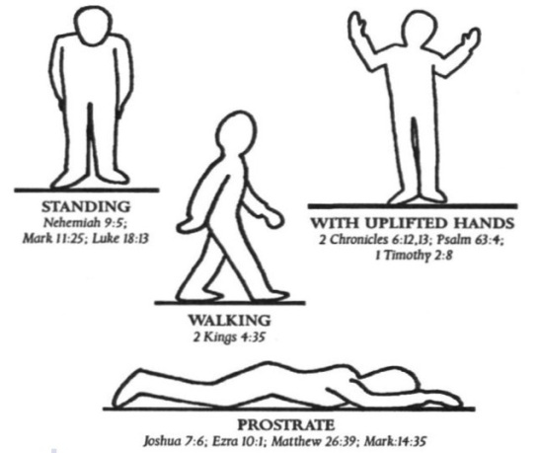
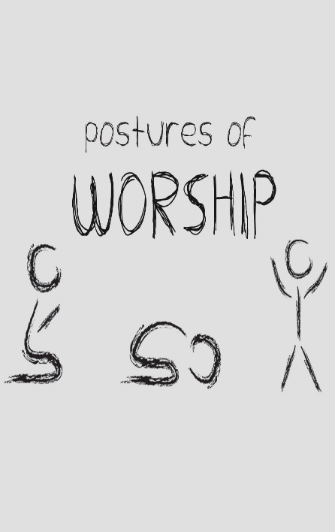
❹Various postures of worship

Slide 12
❹Various postures of worship
Standing:1 Kings 8:22-23
Nehemiah 8:1-7; 9:1-6
Psalm 134:1; 135:1-2
Mark 11:25
Luke18:11-13

Slide 13
❹Various postures of worship

Slide 14
❹Various postures of worship
Hands in worship: (Lifting, waving, clapping…is all good & acceptable)
2 Chronicles 6:12-13
Psalm 28:2; 47:1; 63:4; 134:2; 141:2; 143:6
Lamentations 3:41
1 Timothy 2:8

Slide 15
❹Various postures of worship

Slide 16
❹Various postures of worship
Prostrate: Genesis 17:3 / Joshua 7:6
1 Kings 18:38-39/ 2 Chron. 7:3; 20:18/ Neh. 8:6
Job 1:20 / Ezra 10:1
Ezekiel 3:23
Matthew 2:11
Mark 3:11
Revelation 5:14; 19:4

Slide 17
❹Various postures of worship
Prostrate :
Naphil (Hebrew): fall down / dead
Paniym (Hebrew): face down
Pros-pip'-to (Greek): to fall towards, i.e. (gently) prostrate oneself (in supplication or homage)

Slide 18
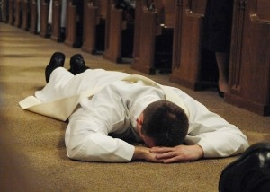
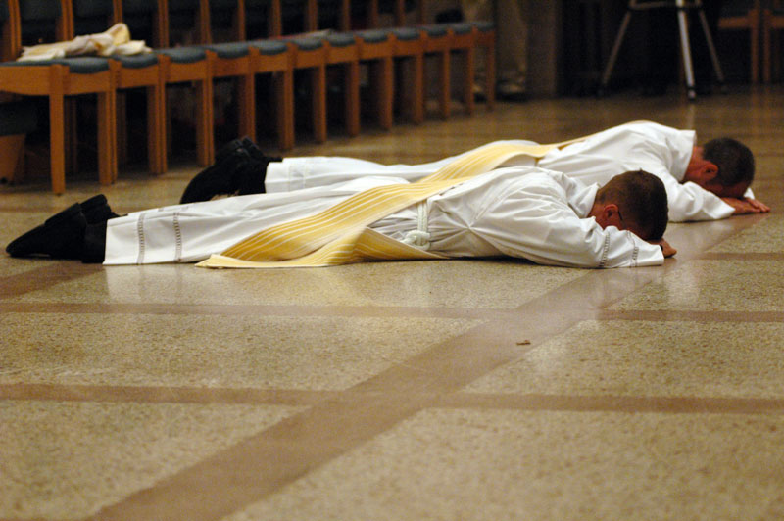

Slide 19
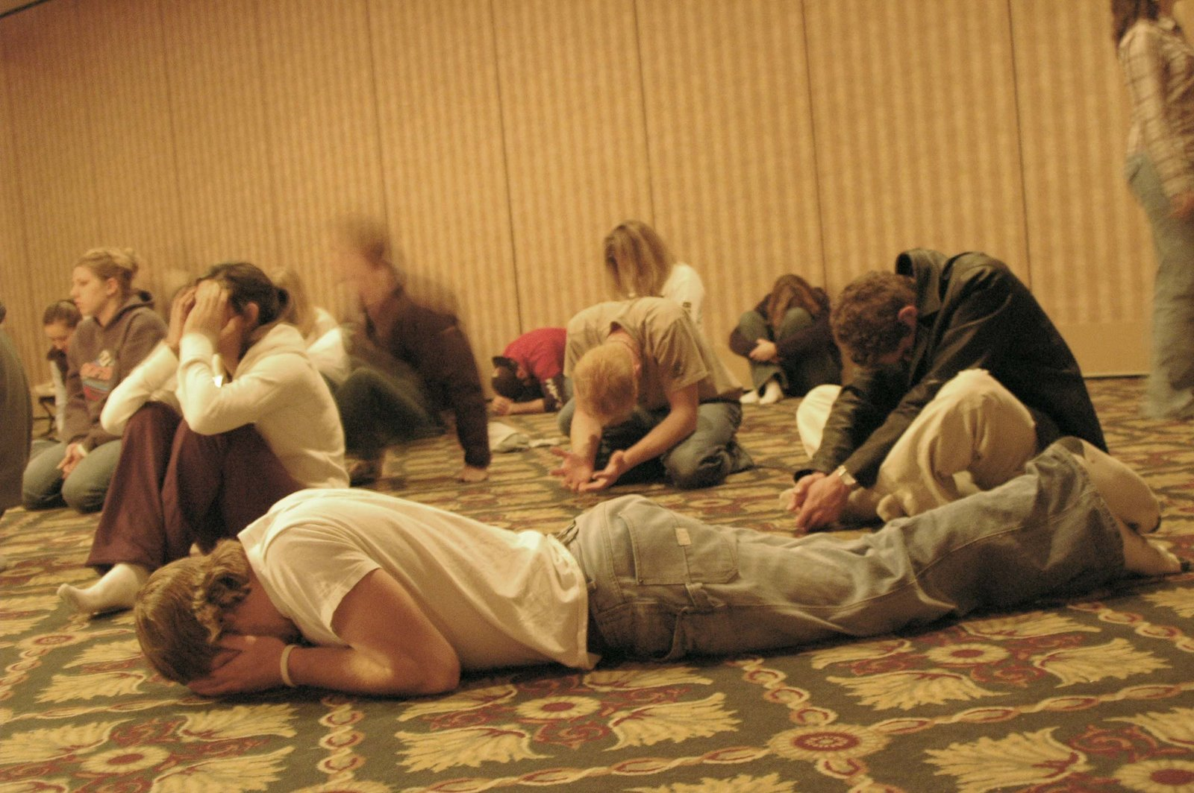

Slide 21
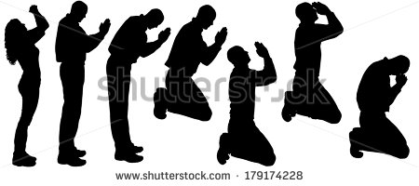
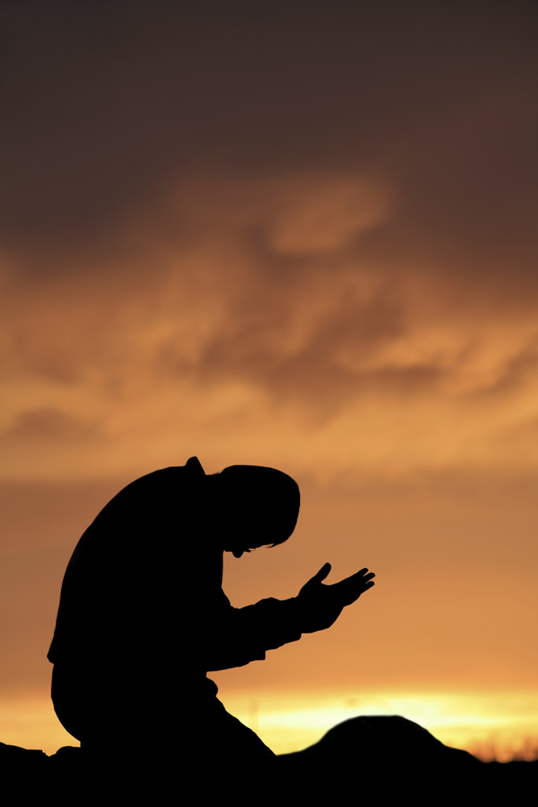
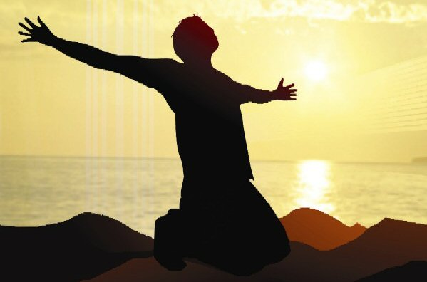

Slide 22
❹Various postures of worship
Bowing (Qadad): to shrivel up, i.e. contract or bend the body (or neck) in respect or submission:--bow (down) (the) head, stoop..(kaw-rah): to bend the knee; to sink, bow (down, self), bring down (low), cast down, crouch
Kampto (Greek): to bend

Slide 23
❹Various postures of worship
Kneeling (Barak): to kneel; by implication to bless God (as an act of adoration)

Slide 24
BOWING
& KNEELING

Slide 25
❹Various postures of worship
Bowing Genesis 24:26-27
& Exodus 4:31; 12:27; 34:8
Kneeling: 1 Chronicles 29:20
2 Chronicles 29:29-30
Psalm 95:6
Romans 14:11; Ephesians 3:14

Slide 26
Ways of worship
The Diversity of worship

Slide 27
❺WORSHIP IN GIVING
1 Chron. 16:29 Give unto the LORD the glory due unto his name: bring an offering, and come before him: worship the LORD in the beauty of holiness.
Bring an offering:
(SACRIFICE) ----- OURSELVES
MONEY
TITHE
GIFT

Slide 28
❻WORSHIP IN GOD’S HOUSE
Psalm 5:7 ¶ But as for me, I will come into thy house in the multitude of thy mercy: and in thy fear will I worship toward thy holy temple.
Psalm 132:7 We will go into his tabernacles: we will worship at his footstool.
Psalm 138:2 I will worship toward thy holy temple, and praise thy name for thy lovingkindness and for thy truth: for thou hast magnified thy word above all thy name.

Slide 29
❻WORSHIP IN GoD’S HOUSE
Jeremiah 7:2 Stand in the gate of the LORD'S house, and proclaim there this word, and say, Hear the word of the LORD, all ye of Judah, that enter in at these gates to worship the LORD.
Jeremiah 26:2 Thus saith the LORD; Stand in the court of the LORD'S house, and speak unto all the cities of Judah, which come to worship in the LORD'S house, all the words that I command thee to speak unto them; diminish not a word:
Ezekiel 46:3 Likewise the people of the land shall worship at the door of this gate before the LORD in the sabbaths and in the new moons.

Slide 30
❼WORSHIP IN SINGING
Psalm 66:4 All the earth shall worship thee, and shall sing unto thee; they shall sing to thy name. Selah.
Psalm 100:2 Serve the LORD with gladness: come before his presence with singing.
Psalm 27:6 And now shall mine head be lifted up above mine enemies round about me: therefore will I offer in his tabernacle sacrifices of joy; I will sing, yea, I will sing praises unto the LORD
Psalm 47:7 For God is the King of all the earth: sing ye praises with understanding.

Slide 31
❼WORSHIP IN SINGING
Psalm 57:7 ¶ My heart is fixed, O God, my heart is fixed: I will sing and give praise.
Psalm 61:8 So will I sing praise unto thy name for ever, that I may daily perform my vows.
Psalm 71:23 My lips shall greatly rejoice when I sing unto thee; and my soul, which thou hast redeemed.
Isa 49:13 ¶ Sing, O heavens; and be joyful, O earth; and break forth into singing, O mountains: for the LORD hath comforted his people, and will have mercy upon his afflicted.

Slide 32
❼WORSHIP IN SINGING
Romans15:9 And that the Gentiles might glorify God for his mercy; as it is written, For this cause I will confess to thee among the Gentiles, and sing unto thy name.
Hebrews 2:12 Saying, I will declare thy name unto my brethren, in the midst of the church will I sing praise unto thee.
James 5:13 Is any among you afflicted? let him pray. Is any merry? let him sing psalms.

Slide 33
❼WORSHIP IN SINGING
Ephesians 5:18-20 And be not drunk with wine, wherein is excess; but be filled with the Spirit;19 Speaking to yourselves in psalms and hymns and spiritual songs, singing and making melody in your heart to the Lord; 20 Giving thanks always for all things unto God and the Father in the name of our Lord Jesus Christ;

Slide 34
Worship in the “Beauty of holiness”
1 Chron. 16:29 Give unto the LORD the glory due unto his name: bring an offering, and come before him: worship the LORD in the beauty of holiness.
2 Chron. 20:21 And when he had consulted with the people, he appointed singers unto the LORD, and that should praise the beauty of holiness, as they went out before the army, and to say, Praise the LORD; for his mercy endureth for ever.

Slide 35
Worship in the “Beauty of holiness”
Psalm 29:2 Give unto the LORD the glory due unto his name; worship the LORD in the beauty of holiness.
Psalm 96:9 O worship the LORD in the beauty of holiness: fear before him, all the earth
Psalm 110:3 Thy people shall be willing in the day of thy power, in the beauties of holiness from the womb of the morning: thou hast the dew of thy youth

Slide 36
Worship in the “Beauty of holiness”
Psalm 110:3 (BBE) Your people give themselves gladly in the day of your power; in holy splendor, like the dew of the morning is the army of your young men.

Slide 37
Worship in the “Beauty of holiness”
“BEAUTY” – Hadarah: decoration, honour --- “BEAUTIES” – Hadar: magnificence, ornament or splendor, comeliness, excellency, glorious, glory, goodly, majesty.
“HOLINESS” – Qodesh: A sacred place or thing; consecrated, dedicated, hallowed.

Slide 38
Worship in the “Beauty of holiness”
To give praise to God and to praise his holiness, which is one of God’s most beautiful characters
Let the whole service be conducted in such a way as to be no dishonour to the Divine Majesty.
The loveliness of a spiritual worship…the joy we should have and the joy that worship should ignite in us as we praise God.

Slide 39
Worship in the “Beauty of holiness…”
…This is the real beauty which God cares for in our public services, and it is one for which no other can compensate. Beauty of architecture and clothes does not compare; moral and spiritual beauty is that in which his soul delights. Worship must not be rendered to God in a sinful or superficial manner; we must be reverent, sincere, earnest and pure in heart both in our prayers and praises.

Slide 40
Worship in the “Beauty of holiness”
Give God the honour which he deserves in his holy and beautiful house. Be clothed with all the gifts and graces, which are necessary in the worship of God.
The spiritual beauty of inward purity and outward holiness is far more precious in the eyes of our holy God. Let us worship with holy motives and in a holy manner, as becometh saints! Holy reverence is an essential ingredient in true worship.

Slide 41
LET’S JUST WORSHIP god!
Deut. 26:10 And now, behold, I have brought the firstfruits of the land, which thou, O LORD, hast given me. And thou shalt set it before the LORD thy God, and worship before the LORD thy God:
2 Kings 17:36 But the LORD, who brought you up out of the land of Egypt with great power and a stretched out arm, him shall ye fear, and him shall ye worship, and to him shall ye do sacrifice.

Slide 42
LET’S JUST WORSHIP god!
Psalm 99:9 Exalt the LORD our God, and worship at his holy hill; for the LORD our God is holy.
Zech. 14:16 ¶ And it shall come to pass, that every one that is left of all the nations which came against Jerusalem shall even go up from year to year to worship the King, the LORD of hosts, and to keep the feast of tabernacles.17 And it shall be, that whoso will not come up of all the families of the earth unto Jerusalem to worship the King, the LORD of hosts, even upon them shall be no rain.

Slide 43
LET’S JUST WORSHIP god!
Rev. 14:6 ¶ And I saw another angel fly in the midst of heaven, having the everlasting gospel to preach unto them that dwell on the earth, and to every nation, and kindred, and tongue, and people, 7 Saying with a loud voice, Fear God, and give glory to him; for the hour of his judgment is come: and worship him that made heaven, and earth, and the sea, and the fountains of waters.

Slide 44
LET’S JUST WORSHIP god!
Rev. 15:2 And I saw as it were a sea of glass mingled with fire: and them that had gotten the victory over the beast, and over his image, and over his mark, and over the number of his name, stand on the sea of glass, having the harps of God. 3 And they sing the song of Moses the servant of God, and the song of the Lamb, saying, Great and marvellous are thy works, Lord God Almighty; just and true are thy ways, thou King of saints. 4 Who shall not fear thee, O Lord, and glorify thy name? for thou only art holy: for all nations shall come and worship before thee; for thy judgments are made manifest.

Slide 45
LET’S JUST WORSHIP god!
Rev. 22:7 Behold, I come quickly: blessed is he that keepeth the sayings of the prophecy of this book. 8 And I John saw these things, and heard them. And when I had heard and seen, I fell down to worship before the feet of the angel which shewed me these things. 9 Then saith he unto me, See thou do it not: for I am thy fellowservant, and of thy brethren the prophets, and of them which keep the sayings of this book: worship God!

