Slide 1


EPHESIANS
[Part 4]
Christ & His Church

Slide 2
BRIEF OUTLINE OF EPHESIANS
CHAPTERS 1-3 ➔
“The Powerful Blessings in Christ”
CHAPTERS 4:1-5:20 ➔
“The Power to Live”
CHAPTERS 5:21-6:9 ➔
“The Power to Love & Work”
CHAPTERS 6:10-24 ➔
“The Power to fight”

Slide 3
EPHESIANS ANALYSIS
CHAPTER 6:10-13
(Vs. 10): In conclusion, strengthen yourselves in the Lord and in the power which His supreme might imparts.
(Vs. 11): Take up God's instruments of war, so that you may be able to keep your position against all the wiles: (deceits, strategies, methodical plans, schemes) of the Evil One.

Slide 4
EPHESIANS ANALYSIS
CHAPTER 6:10-13
(Vs. 12): Our warfare is not against physical elements but against spiritual forces:
“Principalities” – Chief rulers, magistrates
“Powers” – Authorities, mastery, superhuman
“Rulers of the darkness of this world” – Empire underworld leaders, demonic kingpins
“Spiritual wickedness in high places” - The evil spirits occupy the lofty regions of the air as a dwelling-place and medium of their evil influences… angels which kept not their first estate; who fell from the heavenly places but are ever longing after and striving to regain them; and which have their station in the regions of the air.

Slide 5
EPHESIANS ANALYSIS
CHAPTER 6:10-13
(Vs. 13): Therefore put on the complete armour of God, so that you may be able to stand your ground on the day of battle, and, having fought to the end, to remain victors on the field… For this reason take up all the arms of God, so that you may be able to be strong in the evil day, and, having done all, to keep your place.

Slide 6
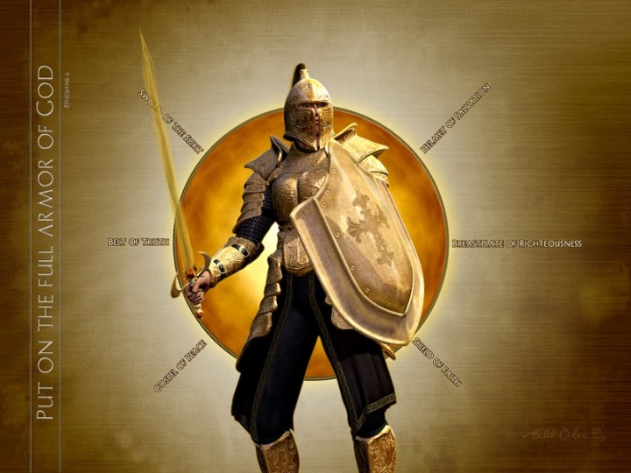
EPHESIANS ANALYSIS
CHAPTER 6:14-17
THE ARMOUR OF GOD

Slide 7
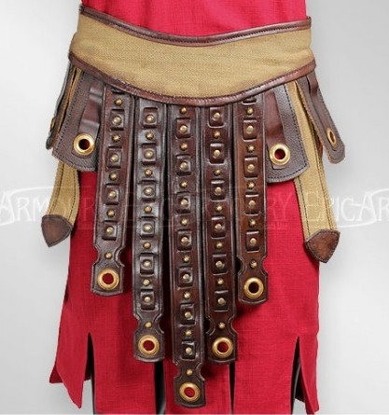
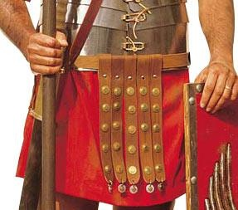
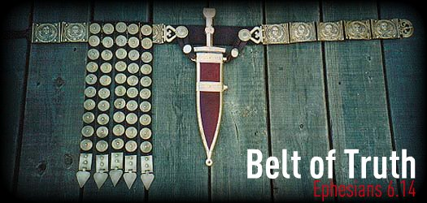
THE GIRDLE OF TRUTH (Vs. 14)

Slide 8
THE GIRDLE OF TRUTH (Vs. 14)
“…AS THE GIRDLE HOLDS EVERYTHING TOGETHER SO DOES TRUTH…”
Have on the belt of truth to combat Satan's lies.
—Get accurate facts about complaints and accusations.
—Take responsibility for your failures.
—Face each situation with honesty, sincerity, and integrity.

Slide 9
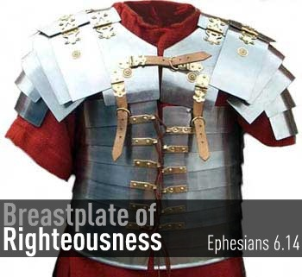
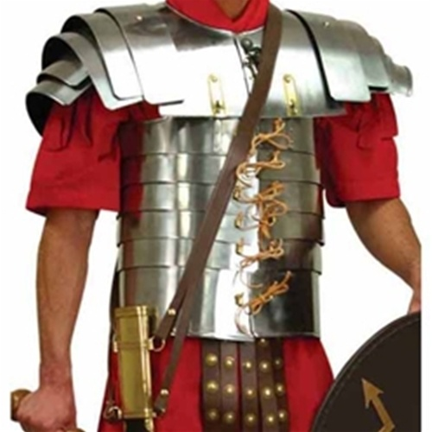
THE BREASTPLATE OF RIGHTEOUSNESS (Vs. 14)

Slide 10
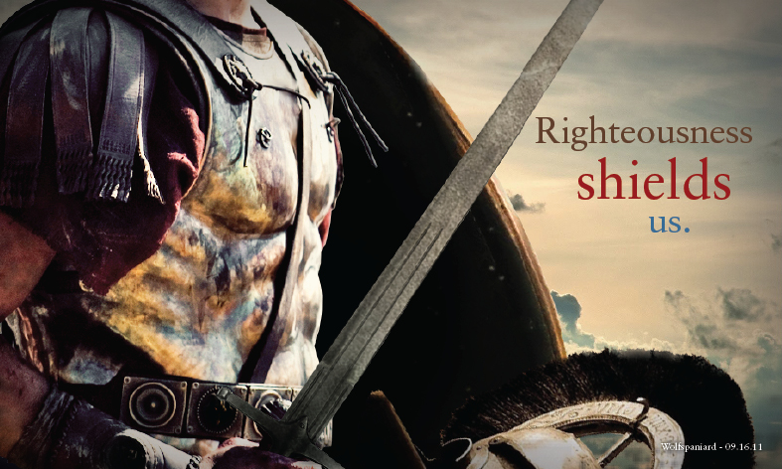
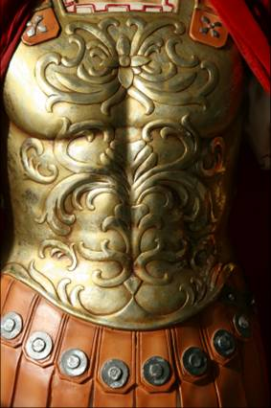
THE BREASTPLATE OF RIGHTEOUSNESS (Vs. 14)

Slide 11
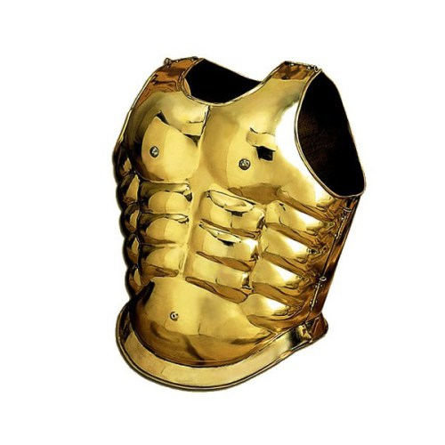
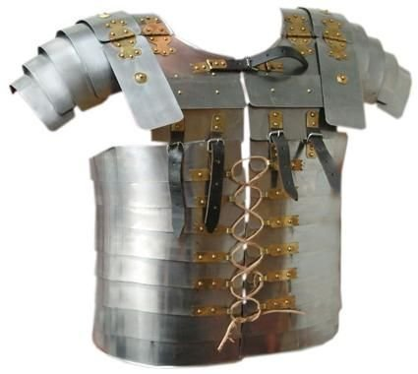
THE BREASTPLATE OF RIGHTEOUSNESS (Vs. 14)

Slide 12
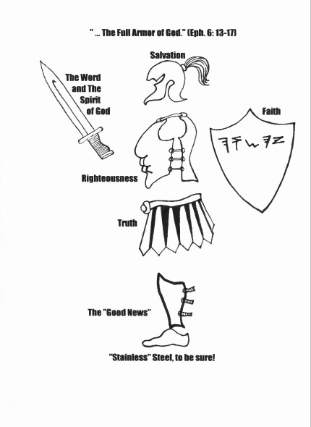

Slide 13
THE BREASTPLATE OF RIGHTEOUSNESS (Vs. 14)
“…AS THE BREASTPLATE PROTECTS VITAL PARTS SO DOES RIGHTEOUSNESS PROTECT VITALITY OF CHARACTER & INTEGRITY…”
Put on the breastplate of righteousness to overcome temptation.
—Have a right relationship with God. Confess and repent known sin.
—Act on God's principles, not your passions.
—Eliminate anything from your life that is not "holy."
—Lean on your righteousness in Christ.

Slide 14

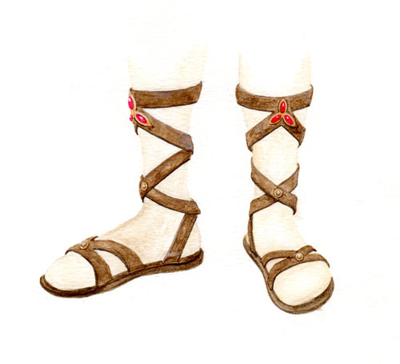
GOSPEL SHOES (Vs. 15)

Slide 15
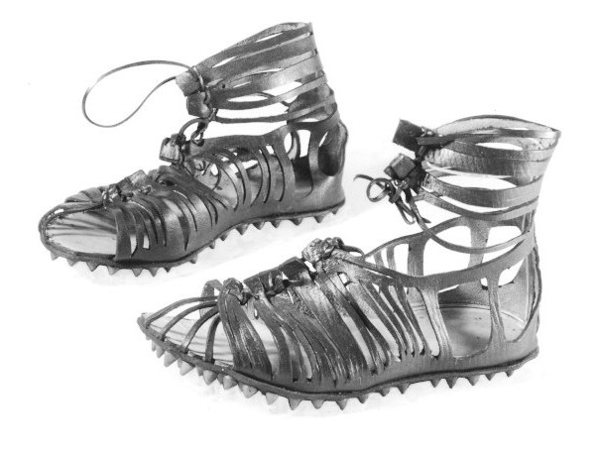
GOSPEL SHOES (Vs. 15)

Slide 16
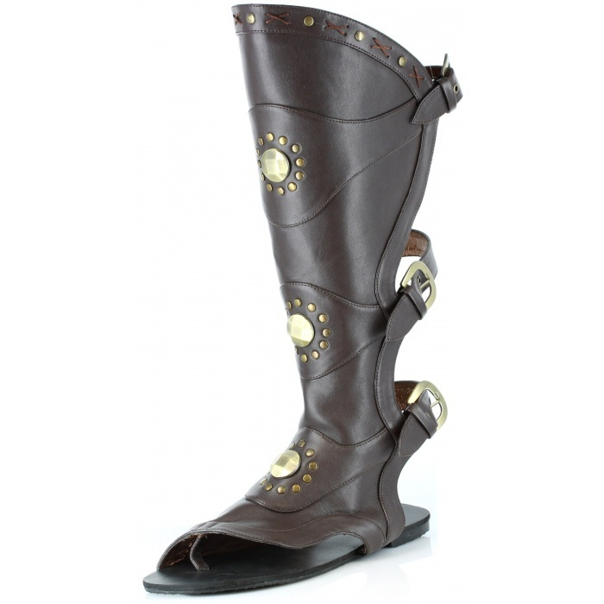
GOSPEL SHOES (Vs. 15)

Slide 17
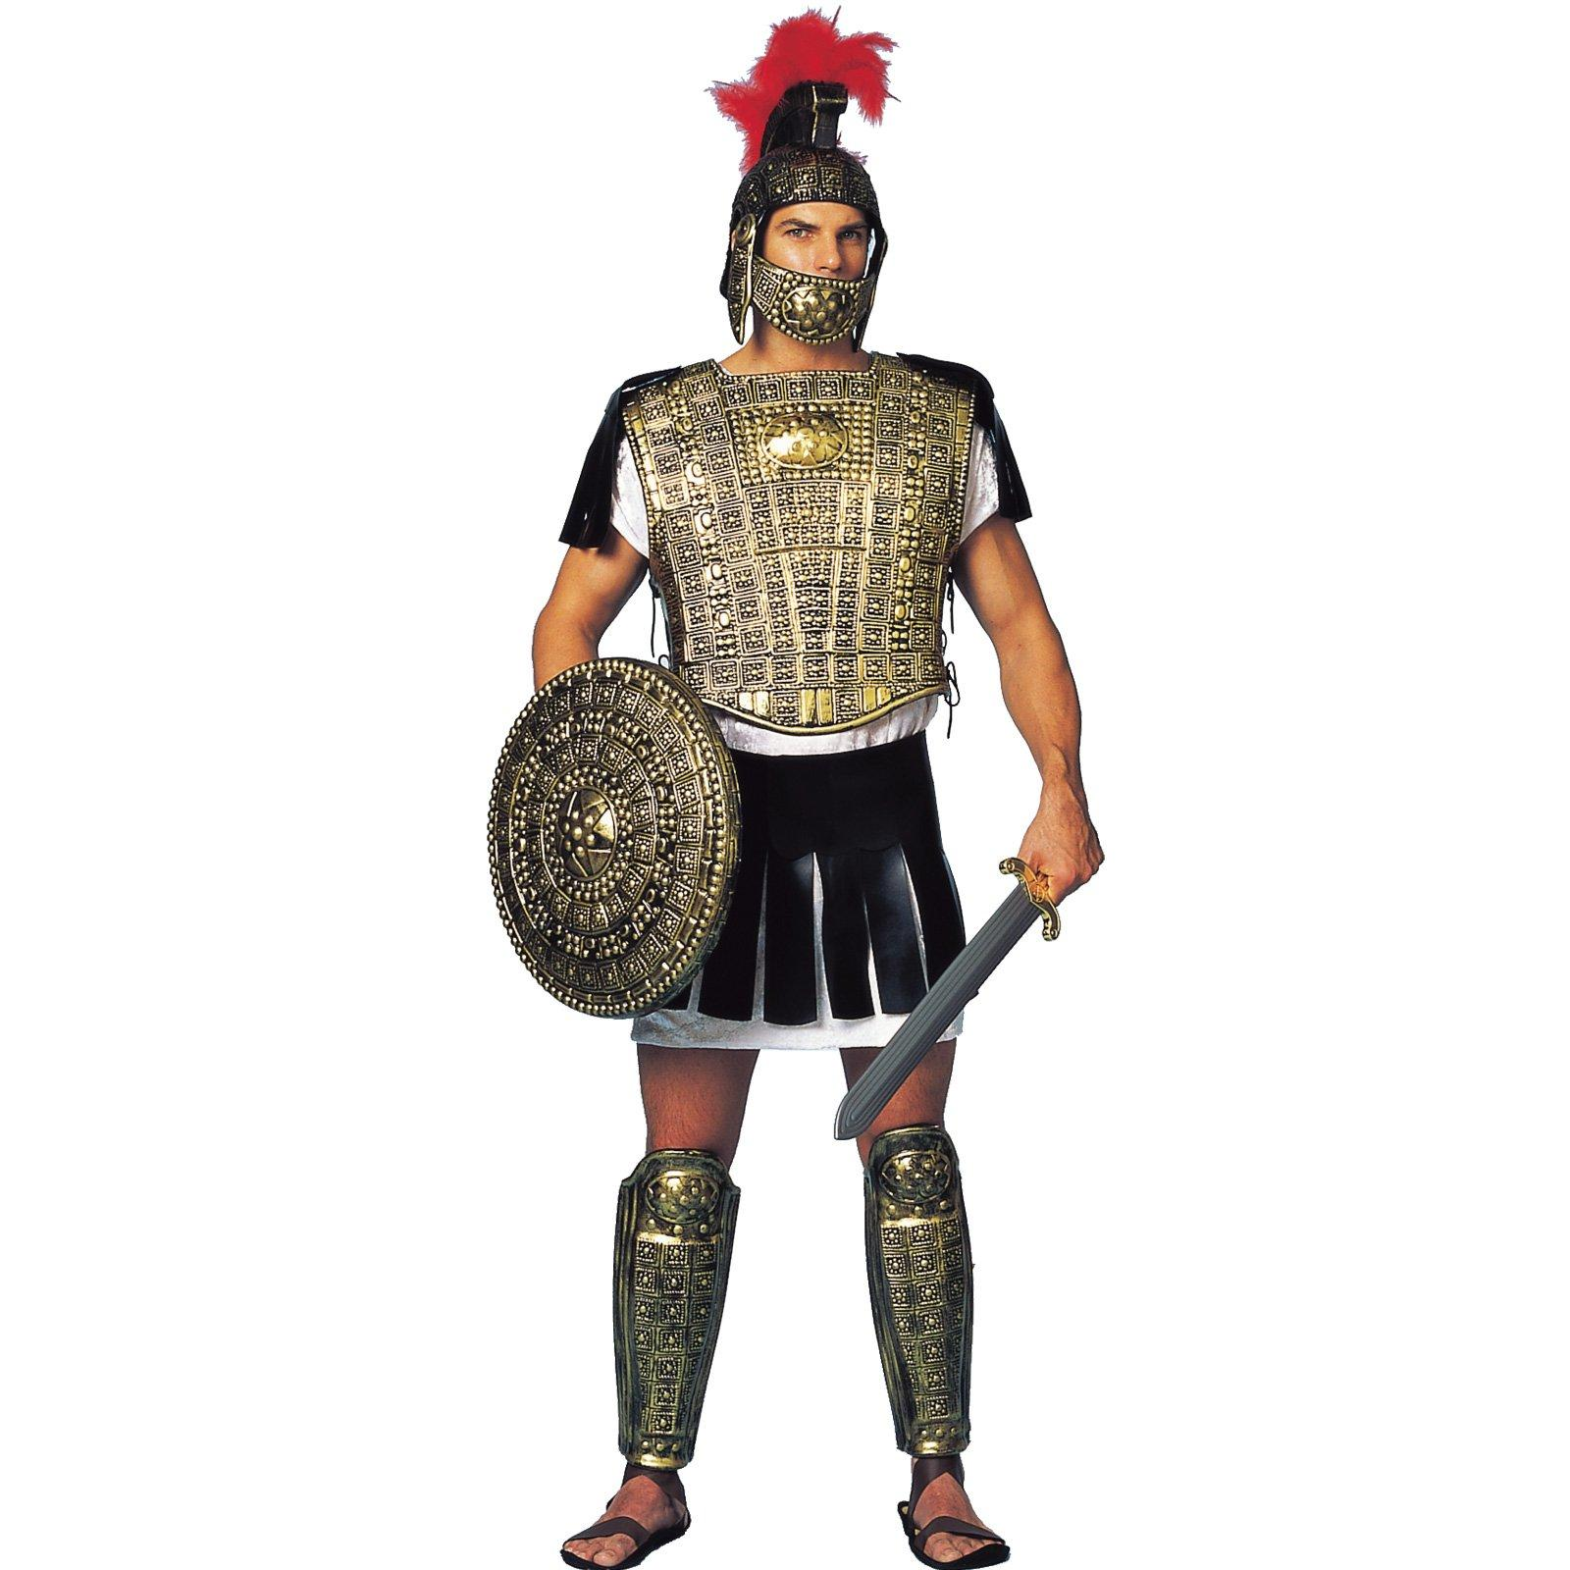
GOSPEL SHOES (Vs. 15)

Slide 19
GOSPEL SHOES (Vs. 15)
“…THE SHOES PROVIDE A STEADY & SECURE WALK IN THE SPIRIT & A READINESS TO GO SHARE THE GOSPEL…”
Wear the shoes of peace, knowing God is on your side.
—Seek reconciliation with broken relationships.
—Confront issues with compassion.
—Spread the word of peace & truth.

Slide 20
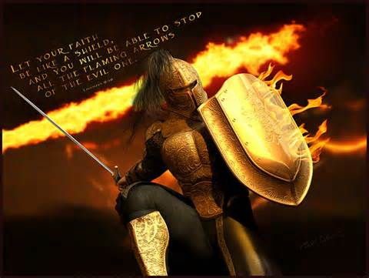
THE SHIELD OF FAITH (Vs. 16)

Slide 21
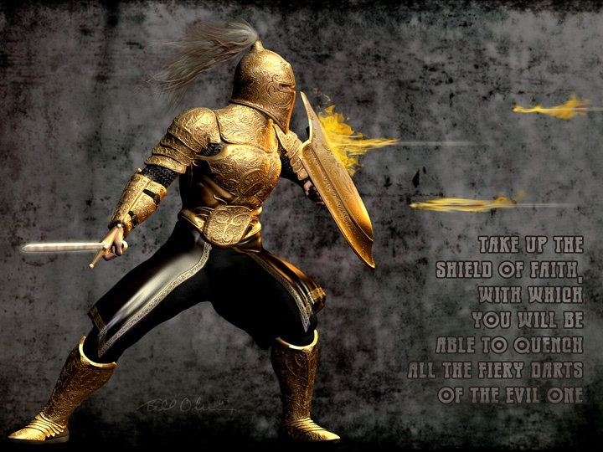
THE SHIELD OF FAITH (Vs. 16)

Slide 22
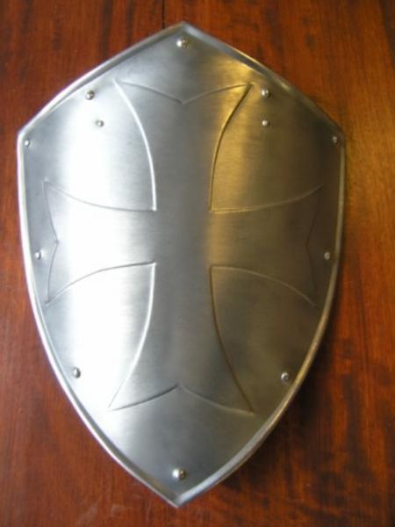
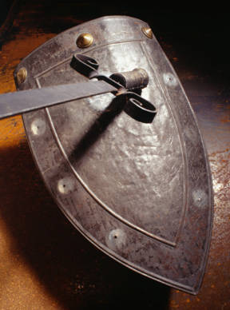
THE SHIELD OF FAITH (Vs. 16)

Slide 23
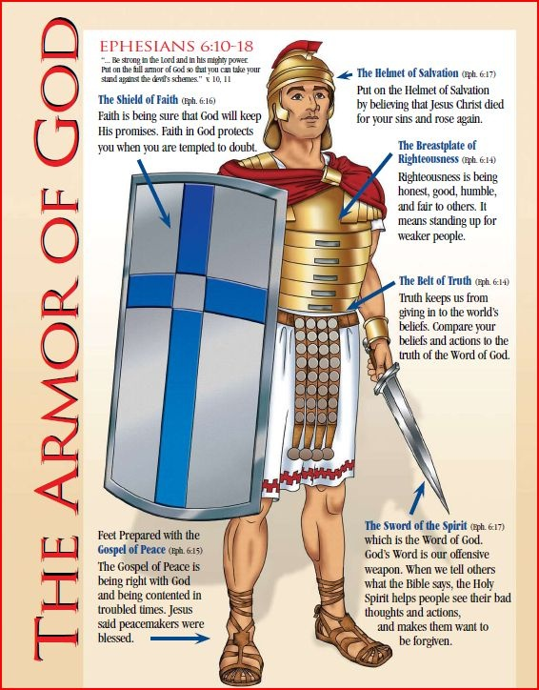

Slide 24
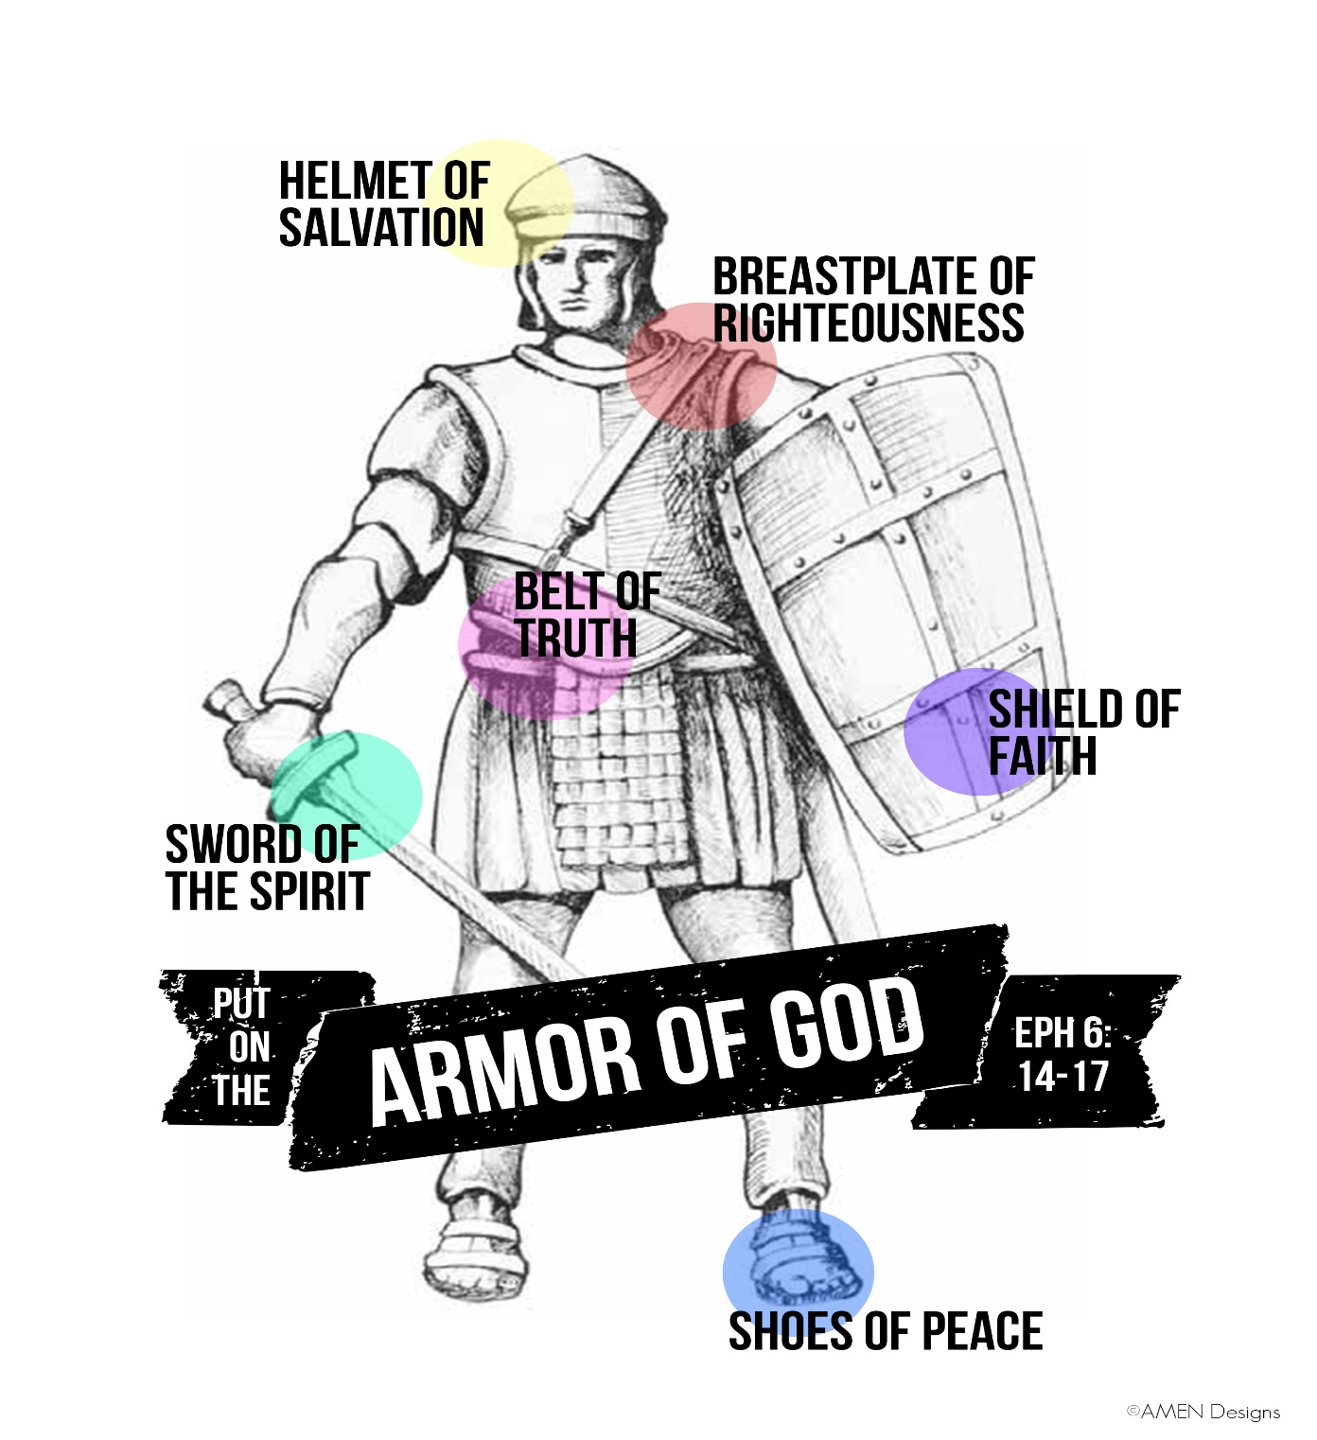

Slide 25
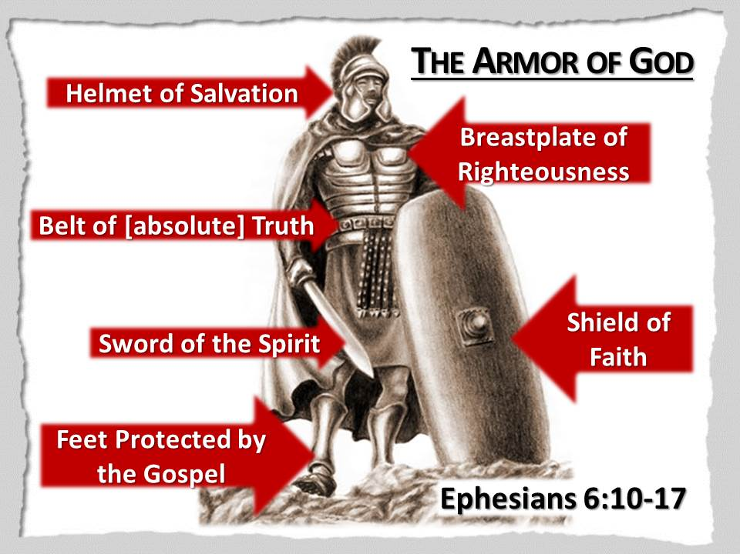

Slide 26
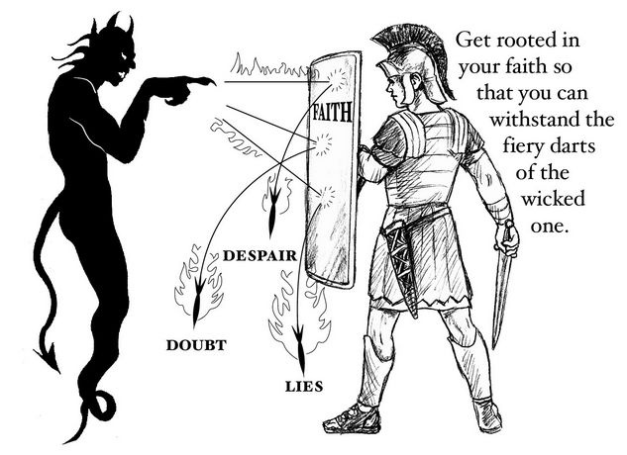
THE SHIELD OF FAITH (Vs. 16)

Slide 27
THE SHIELD OF FAITH (Vs. 16)
“…FAITH IS THE DEFENSE & GUARDIAN OF EVERY CHRISTIAN. IT WILL QUENCH, STOP & PUT OUT ALL DOUBTS & EVIL SUGGESTIONS OF THE WICKED…”
Carry the shield of faith to withstand doubt and unbelief.
—Believe what God says and obey Him.
—Resist the temptation to do things your way.
—Don't act before God gives the orders.
—Trust God to work on your behalf.

Slide 28
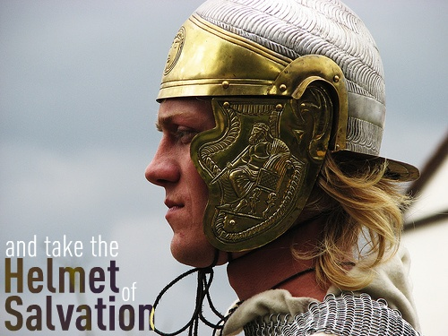
THE HELMET OF SALVATION (Vs. 17)

Slide 29
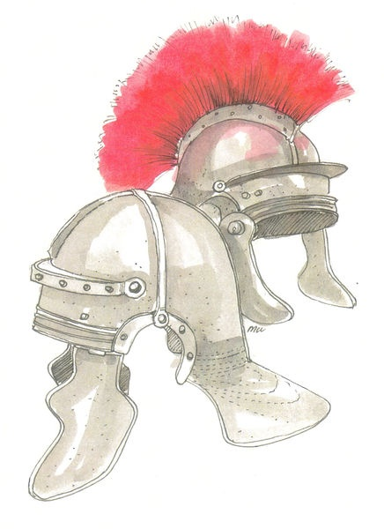
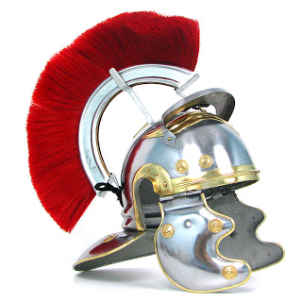
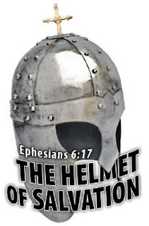
THE HELMET OF SALVATION (Vs. 17)

Slide 30
THE HELMET OF SALVATION (Vs. 17)
“…THE HELMET PROTECTS THE MIND & GIVES THE BELIEVER ASSURED CONFIDENCE IN THEIR SALVATION WHEN THE DEVIL LAUNCHES AN ONSLOUGHT OF DOUBTS TO MAKE US WONDER IF WE ARE SAVED…”
Put on the helmet of salvation to protect your mind. —Be assured of your own salvation.
—Be confident of your eternal security.
—Know that you are free from the penalty of your sins—past, present, and future sins.
—Know that you are free from the power of sin—you don't have to sin.

Slide 31
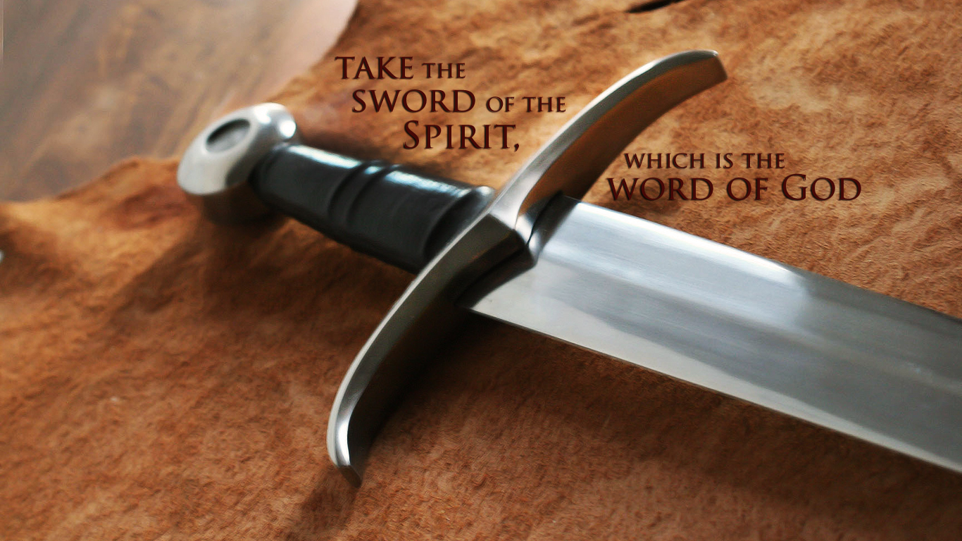
THE SWORD OF THE SPIRIT (Vs. 17)

Slide 32
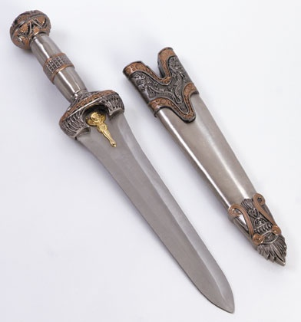
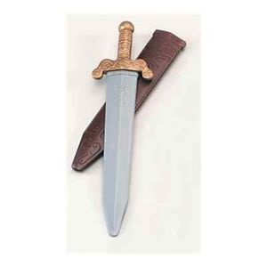
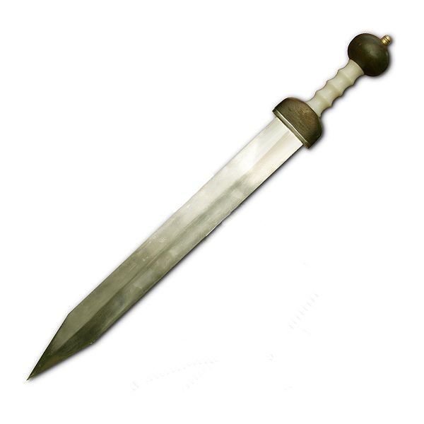
THE SWORD OF THE SPIRIT (Vs. 17)

Slide 33
THE SWORD OF THE SPIRIT (Vs. 17)
“…THE SWORD IS A POWERFUL WEAPON TO FIGHT SATAN AS IT PROVIDES FATAL BLOWS TO THE ENEMY…”
Use the sword of the Spirit accurately.
—Become diligently involved in studying God's Word.
—Know specific Scriptures that deal with common temptations.
—Memorize Scriptures that clearly defend the faith.

Slide 34
EPHESIANS ANALYSIS
CHAPTER 6:18 – “THE PRAYER WARRIOR”
Prayer is not mentioned as part of the armour but it certainly powers the army…The Christian soldier must be prayed up & covered in prayer before engaging in battle.
“Prayer is the fuel that keeps the engine running, it is the motivation that keeps you going, it is the driving force, the protective force-field, the attacking force and the power source that keeps the force together and drives the opposing forces away.”

Slide 35
EPHESIANS ANALYSIS
(Vs. 18) Be in consistent, frequent, daily prayer…praying varied (all kinds of prayer) in supplication (requesting & pleading) with the guidance & communion of the Holy Spirit.
Pray with unceasing prayer on every fitting occasion in the Spirit… and be always on the alert to seize opportunities to pray for the saints, with unwearied persistence and pleading on behalf of all God's people

Slide 36
EPHESIANS ANALYSIS
CHAPTER 6:19-24
(Vs. 19): Also pray on my behalf…pray for me that words may be given to me so that I may be outspoken and fearless to make known the truths (hitherto kept secret) of the Good News…
(Vs. 20): …. (the Good News) For which I am a representative in chains, and that I may say without fear the things which it is right for me to say.

Slide 37
EPHESIANS ANALYSIS
CHAPTER 6:19-24
(Vs. 21): So that you may have knowledge of my business, and how I am, Tychicus, the well-loved brother and proven servant in the Lord, will give you news of all things:
We learn, from Acts 20:4, that Tychicus was from Asia, and that he was a useful companion of Paul. This same person, and with the same character and commendation, is mentioned in Col. 4:7. He is mentioned also in Tit. 3:12, and in 2Tim. 4:12; from all these places it is evident that he was a person in whom the apostle had the highest confidence, and that he was a very eminent minister of Christ.

Slide 38
EPHESIANS ANALYSIS
CHAPTER 6:19-24
(Vs. 22): “I have sent Tychicus you for the very purpose--that you may know about us and that he may encourage you.”
The churches where Paul had preached, would feel a great interest in his welfare. He was a prisoner at Rome, and it was doubtful what the result would be. In this situation, he felt it proper to dispatch a special messenger to give information about his condition; to state what he was doing in Rome; to ask the prayers of the churches; and to administer consolation to them in their various trials.

Slide 39
EPHESIANS ANALYSIS
CHAPTER 6:19-24
(Vs. 23): Peace be to the brethren. The epistle is closed with the usual salutations. The expression, "peace to you," was the common form of salutation in the East.
And love with faith. Love united with faith; not only desiring that they might have faith, but the faith which worked by love.
From God the Father and the Lord Jesus Christ. The Father and the Son are regarded as equally the author of peace and love.

Slide 40
EPHESIANS ANALYSIS
CHAPTER 6:19-24
(Vs. 24): May God's blessing be with all who love our Lord Jesus Christ with a true, undying love…a love without hypocrisy.
There could not be a more appropriate close of the epistle than such a wish; there will be nothing more needful for us, when we come to the close of life, than the consciousness that we love the Lord Jesus Christ IN SINCERITY!

