Slide 1
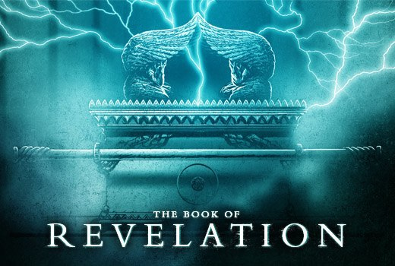

Slide 2
BACKGROUND
DATE WRITTEN: A.D. 94-96
AUTHOR: John (1:4, 9; 22:8)
SETTING: Isle of Patmos (a small island off the coast of Ephesus) By this time John is the soul survivor of the original 12 disciples. He was now an elderly man, he has been banished to Patmos for the preaching of the gospel. While on Patmos, John receives a series of visions which describe the history & future of the world. The visions reveal Jesus as the Shepherd, the sacrificial Lamb, the righteous Judge and the triumphant King.

Slide 3
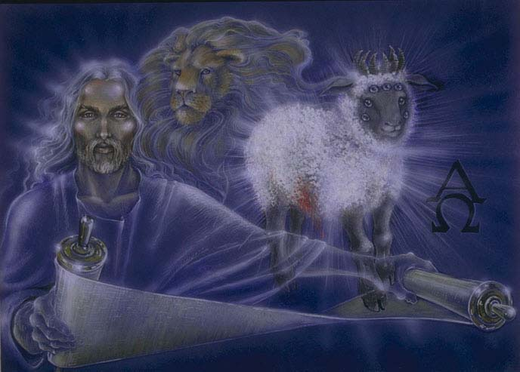
THEME
The
Unveiling
(Revelation)
of
Jesus
Christ

Slide 4
THEME VERSES
Rev. 1:1 ¶ “The Revelation of Jesus Christ, which God gave unto him, to shew unto his servants things which must shortly come to pass…”
Rev. 1:8 “I am Alpha and Omega, the beginning and the ending, saith the Lord, which is, and which was, and which is to come, the Almighty.”
Rev. 1:18 “I am he that liveth, and was dead; and, behold, I am alive for evermore, Amen”
Rev. 1:19 “Write the things which thou hast seen, and the things which are, and the things which shall be hereafter”

Slide 5
OUTLINE OF REVELATION
❶ THE THINGS WHICH YOU HAVE SEEN (Chap. 1)
- The risen Christ
THE THINGS WHICH ARE (Chap. 2-3)
- The letters to the seven Churches
THE THINGS WHICH SHALL BE (Chap. 4-22)
- Tribulation - Throne in heaven - Scroll in heaven - SEALS
- The saints - TRUMPETS - The little scroll - Two Witnesses
- Antichrist & False prophet - BOWLS - Babylon
- CHRIST’S COMING - Millennium - Eternal state

Slide 6
Revelation commentary
Rev. 1:1
“Revelation” (APOKALUPSIS) – disclosure, appearing, coming, lighten, manifestation; unveiling.
The chain of communication ➔ It came from God the Father to Christ, from Christ to the angel, from the angel to John, and from John to the Churches

Slide 7
Revelation commentary
Rev. 1:1
“…He sent and signified it…”- Showed it by signs or symbols --- Here, and throughout the Apocalypse; the duty of unveiling the different scenes appears to be assigned to a particular angel.

Slide 8
Rev. 1:2
“This is the John who taught the truth concerning the Word of God and the truth told to us by Jesus Christ-- a faithful account of what he had seen.”
John regarded himself merely as a witness of what he had seen, and claimed to make an accurate and faithful record of it.

Slide 9
Rev. 1:3
A blessing is pronounced on the (public) reader; on those that hear, and lastly upon those that keep the words contained in this prophecy.
Blessed is he who reads & hears ➔ attentive & tries to understand… and blessed is he who keeps the things that are written ➔ takes heed to the prophecies & obey those things which are required.

Slide 10
Rev. 1:4
“The Seven Spirits” - Seven was a sacred number in the Jewish church: but it did not always imply a precise number. It sometimes is to be taken figuratively, to denote completeness or perfection. The 7 Spirits most likely represent the Holy Spirit & not 7 angels (Rev. 3:1). The angels are never termed spirits in this book. Notice in heaven when all the angels stand up, & the 4 living creatures & the 24 elders worship him that sat on the throne, the 7 spirits neither stand up nor worship (Rev. 4:5, 8,10; Rev. 5:6). [Verse 4-5 is perhaps a benediction/salutation from the Triune God - Trinity]
Notes:
Benedictions (1 Cor. 1:3; 2 Cor. 1:2; Gal. 1:3; Eph. 1:2; Phil. 1:2; Col. 1:2; 2 Thess. 1:2; Phile. 1:3

Slide 11
Rev. 1:5
A description of Jesus Christ:
“Faithful witness” - Jesus is faithful in the sense that he is one whose testimony is completely reliable and who is entirely worthy to be believed. He is the true teacher, whose testimony is infallible, and whose sayings must all come to pass. Jesus is the faithful witness, because all things that He heard of the Father He faithfully made known to His disciples. He was the faithful witness of the will of God before his death, in His death, after resurrection, and remains such in glory.

Slide 12
Rev. 1:5
A description of Jesus Christ:
“First begotten of the dead” – Jesus was the first person who rose to die no more, and the leader and head of all who shall be raised from the dead to eternal life.
“Prince of the kings of the earth” – Jesus is the chief ruler or head, of all earthly powers & authorities; and has them all under his dominion and control. He is the Ruler of rulers; the King of kings.

Slide 13
Rev. 1:5
A description of Jesus Christ:
“Him that loved us” – Love is Jesus’ ever-continuing character He loves us, and shall forever love us. His love rests evermore on His people.
“Him that washed us from our sins…” – Jesus removed the pollution of sin from our souls by his blood; his blood has been applied to cleanse us from sin. Christ has redeemed the soul, with forgiveness of sins and purification from unrighteousness.

Slide 14
Rev. 1:6
The word kings refers to the exalted rank and dignity which believers will have in common with their Saviour. They will reign triumphant over all enemies. The word priests refers to the fact that believers are engaged in the holy service of God or that they offer to him acceptable worship… a kingdom of priests or a royal priesthood. In other words; Christians are exalted to royalty of a king, and are invested with the office of a priest. Because of that; all glory & praise, power & authority belongs to Jesus for what he has done for the saints.

Slide 15
Rev. 1:7
The Lord Jesus when he returns will come accompanied with clouds. This is in accordance with the uniform representation pertaining to the return of the Lord & Saviour. Clouds are appropriate symbols of majesty, and God is often represented as appearing in that manner. Even among the heathen, it was common to represent their divinities as appearing clothed with a cloud… And every eye shall see him… Christ will be made visible in his glory to all that dwell upon the earth at that time of His return.

Slide 16
Rev. 1:7
“And they also which pierced him…” …
Particularly this phrase primarily refers to the Jews, who were responsible for Christ’s death. They crucified Him.
Secondarily, the phrase speaks to the general judgment of all the ungodly, not only those who actually pierced Him, but those who did so by their sins, shall look with trembling upon Him.

Slide 17
Rev. 1:7
“And they also which pierced him…”
The design seems to be, to show that the coming of the Saviour will be an event of great interest to all mankind. None can be indifferent to it, for all will see him. All who were engaged in putting him to death, and all who in any manner have pierced his heart by sin and ingratitude, unless they have repented, will have occasion of bitter lamentation when Christ returns.

Slide 18
Rev. 1:7
“…all kindreds of the earth shall wail because of him …”
All that dwell on the face of the earth shall wail because of him. On account of their treatment of Jesus. The word rendered wail means properly to beat, to cut; then to beat or cut one's self in the breast as an expression of sorrow; and then to lament, to cry aloud in intense grief… (a) because it will be an event which will call the sins of men to remembrance (b) because they will be overwhelmed with the awareness of the wrath to come.

Slide 19
Rev. 1:8 The obvious interpretation here would be to apply this to the Lord Jesus; for (a) it is he who is spoken of in the verses before, and (b) there can be no doubt that the same language is applied to him in Rev. 1:11. Christ shows that he is the cause and end of all things. It is a description of Christ as Jehovah, self-existent, unchangeable, and eternal. Christ calling himself the first and the last, that is, the first cause and the last end, (as nothing began before him, so nothing can outlast him,) does hereby unveil his divinity/deity… Making himself equal with God the Father (Compare with vs. 4)

Slide 21
Rev. 1:9
This narration, opens the way by declaring the authority and calling of John for this particular revelation, and to give credibility to this prophecy. The proposition shows who was called to this revelation, in what place and why he was there…. Hence the verse declares that John is the author and he received this revelation on the Island of Patmos. He was exiled to Patmos for preaching the Word and for asserting himself as a follower of Jesus Christ.

Slide 22
Rev. 1:10 This is a holy trance which the prophets were entranced and being carried out of the world to converse with God. In other words; John received the Spirit of prophecy, and was under its influence when the first vision was exhibited.
“The Lord's day”- It properly means “pertaining to the Lord;” and so it might mean a day pertaining to the Lord in any sense or for any reason-either because he claimed it as his own and had set it apart for his own service; or because it was designed to commemorate some important event pertaining to him; or because it was observed in honor of him.

Slide 23
Rev. 1:10
“The Lord's day”- Some have simply declared it as the first day of the week… Sunday; which is observed as the Christian Sabbath for many, because on Sunday Jesus Christ rose from the dead; therefore it was called the Lord's day. In addition, the early church began to assemble on a Sunday.
John heard a loud voice. This was of course sudden, and took him by surprise… As loud as a trumpet. It does not mean that the tone of the voice resembled a trumpet, but only that it was clear, loud, and distinct like a trumpet.

Slide 24
Rev. 1:11
The voice, in addition to the declaration "I am Alpha and Omega" gave this direction that John should record what he saw. Make a fair record of it all--evidently meaning that he should describe things as they occurred, and implying that the vision would be held so long before the eye of his mind that he would be able to transfer it to the "book.“… Then John was to send it to the seven churches in Asia….

Slide 25
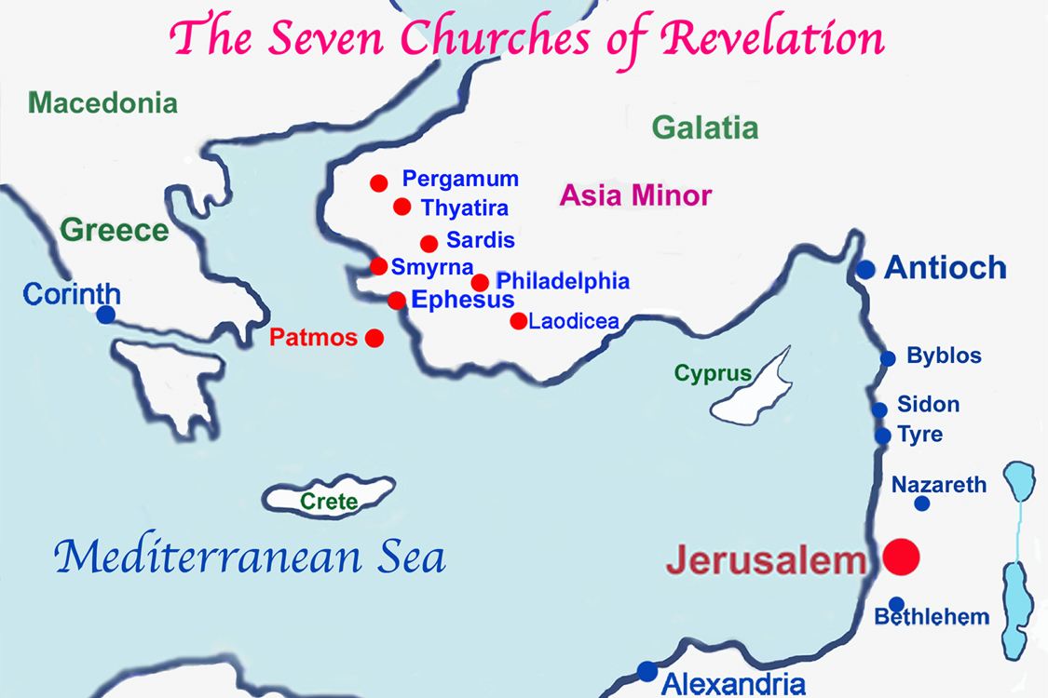

Slide 26
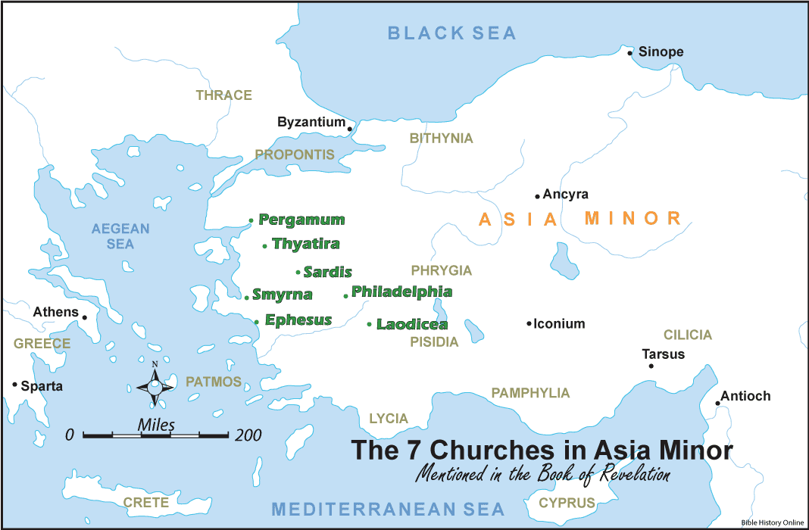

Slide 27
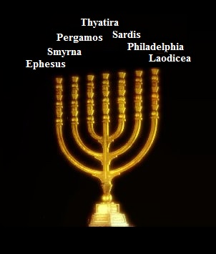
Rev. 1:12

Slide 28
Rev. 1:13-16

Slide 29
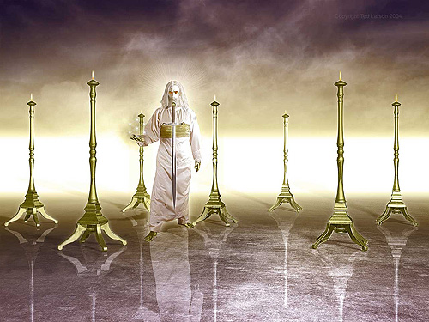
Rev. 1:13-16

Slide 30
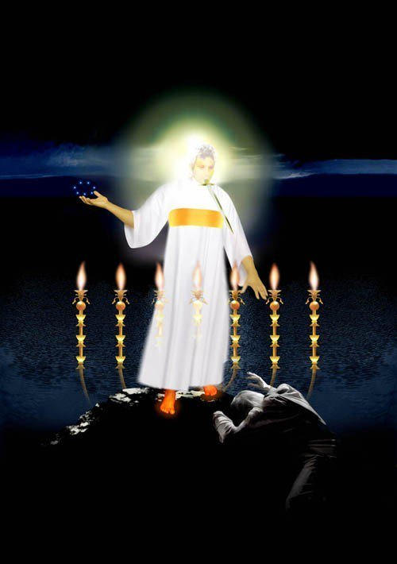
Rev. 1:13-16

Slide 31
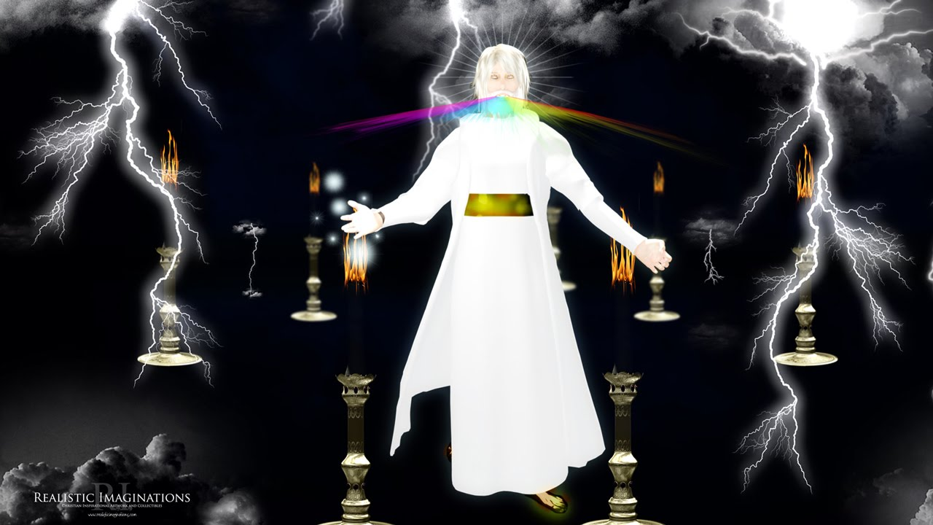
Rev. 1:13-16

Slide 32
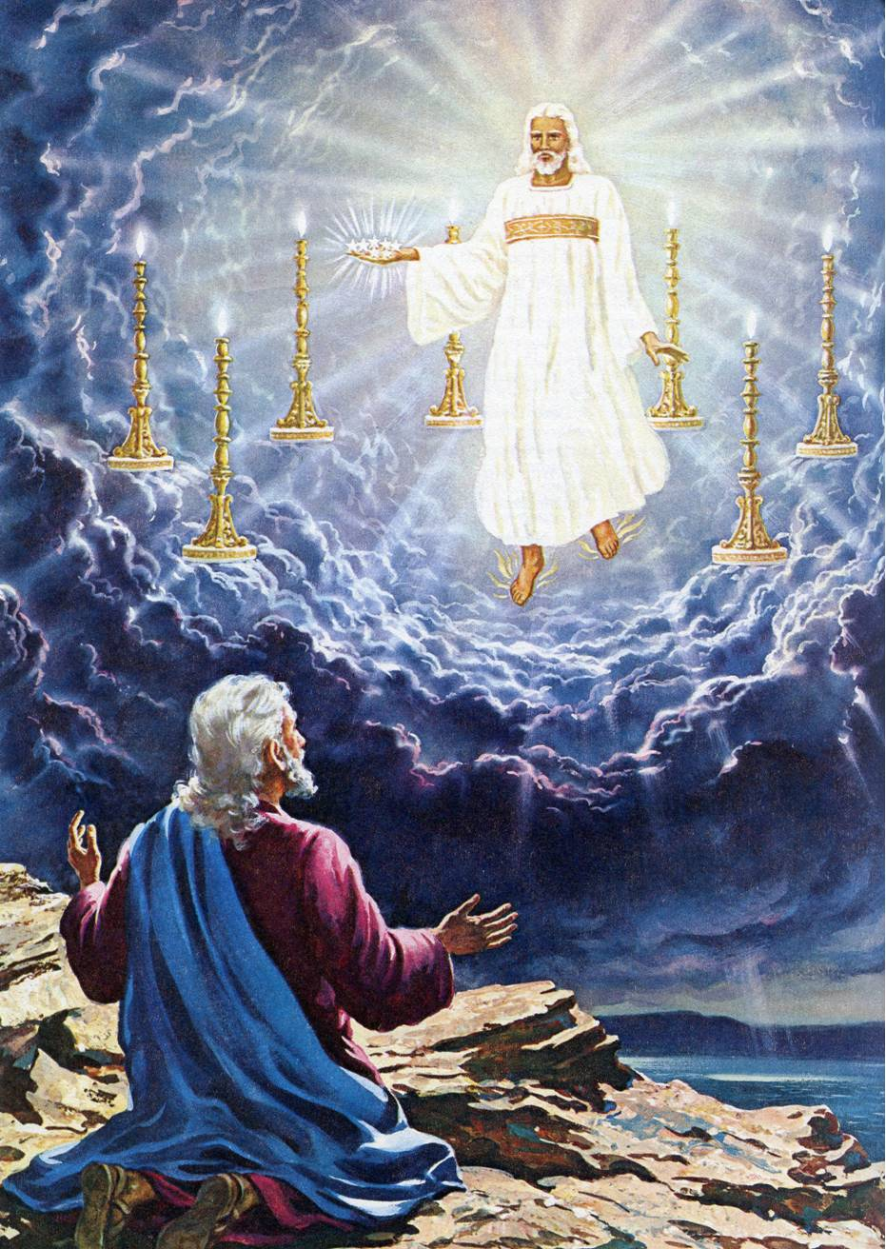
Rev. 1:13-16

Slide 33
Rev. 1:18 I am Jesus the Saviour, who died for mankind; and being raised from the dead I shall die no more, the great sacrifice being consummated…I was indeed once dead, but now I live, and shall continue to live for ever.
And have the keys of death and hell: The key here signifies the power and authority over life, death, the grave and hell. To hold the key was to hold the power over the invisible world. It was fitting that Jesus had this authority, as he had himself been raised from the dead by his own power, thus showing that the dominion over this dark world was entrusted to him.

Slide 34
Rev. 1:18
And of death. This was a personification. Death reigns in the underworld. But the Saviour holds the key, and can have access to this empire when he pleases, releasing all whom he chooses, and confining those as he pleases.

Slide 35
Rev. 1:19
THE THINGS WHICH YOU HAVE SEEN (Chap. 1)
- The risen Christ
THE THINGS WHICH ARE (Chap. 2-3)
- The letters to the seven Churches
THE THINGS WHICH SHALL BE (Chap. 4-22)
- The future events

Slide 36
Rev. 1:20
“Angels”- AGGELOS (Ang'-el-os): A messenger; usually an "angelic being"; by implication, a minister, overseer or a pastor.
Practically speaking, it could be a minister of a church
OR
Spiritually speaking, it could be an angel assigned to a church

Slide 37
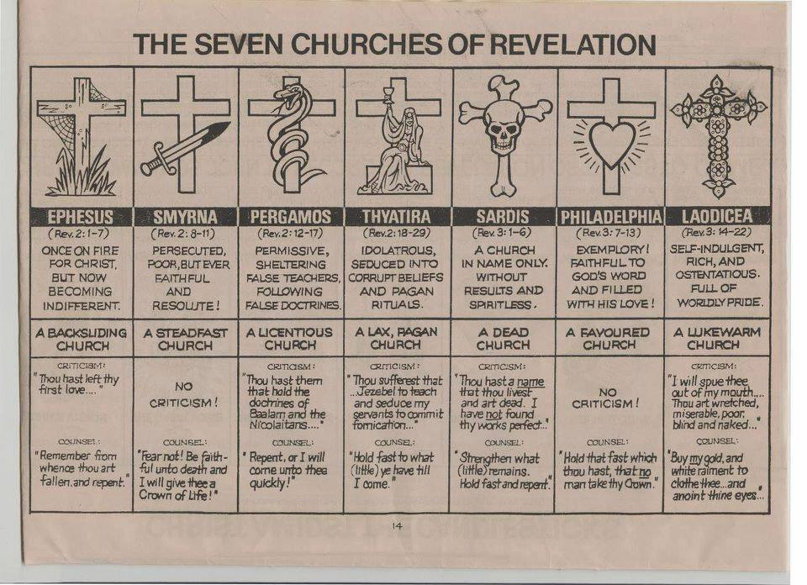
Revelation chapter 2-3

Slide 38
WHY SEVEN CHURCHES?
There were many churches in the Roman province of Asia Minor in John's day. Why did the author only write to seven of them?
1. Seven is the biblical number to denote perfection or completion. There are numerous literary structures of sevens in the Revelation book.
2. These churches formed a travel route, starting at Ephesus and ending at Laodicea. It was possibly the Imperial postage route.
3. They are to some extent representative of the types of churches found in every age and culture.

Slide 40
Rev. 2:1-7: ❶ The Church at EPHESUS: “Desirable”
Ephesus was the largest city of the Roman province of Asia Minor & the Roman governor lived there. It was the capital of Ionia; which was one of the twelve Ionian cities of Asia Minor. Under the Romans it was the capital not only of Ionia, but of the entire province of Asia, and bore the honourable title of the first and greatest metropolis of Asia.
It was a free city, which was allowed to have its own local government, including no garrison of Roman soldiers.

Slide 41
Rev. 2:1-7: ❶ The Church at EPHESUS
It was the site of the Temple of Diana which was one of the seven wonders of the world of its day.
It was a commercial center because of its excellent natural harbor
It was the only city which was allowed to hold the biannual Asian games.
Paul stayed in this city more than three years

Slide 42
Rev. 2:1
“To the messenger of the church in Ephesus write: (Jesus)…who is the One who holds the seven messengers in His right hand, and the One who walks among the seven churches, says this to you His church at Ephesus…” [Refer to Rev.1:13; 16; 20]

Slide 43
Rev. 2:2-3 – Ephesus’ Commendations:
Labour: Excessive toil; Hard work; Troublesome task
Patient: Cheerful endurance; perseverance; waiting
Intolerant to evil: Opposed wickedness & immorality
Uncompromising: Against false teachers & teaching *(Vs. 6)
Steadfast: Enduring to the end; not weary; not giving up
* Nicolaitanes taught that Christian liberty meant license to commit sensual sins. Their doctrines and lives were equally corrupt. They allowed the most abominable lewdness and adulteries, sacrificed to idols & mixed pagan rituals with Christian ceremonies.

Slide 44
Rev. 2:4 – Ephesus’ Criticism:
They LEFT their first love…
… Love for Christ.
… Love for one another.
… Love for the lost.
… ALL OF THE ABOVE.

Slide 45
Rev. 2:5 – Ephesus’ Counsel:
Remember where you were at first (Fallen; Backslidden) AND
change your heart (Repent) AND
do the first works (Fasting, Praying, Devotions with Christ ---- Reconciling, Helping, Caring for one another ---- Evangelizing, Discipling, Mission to the lost.) OR
I will come to you, and will take away your church from its place, if your hearts are not changed.

Slide 46
Rev. 2:7 – Ephesus’ Compensation:
“To him that overcometh” --- To him that gains the victory, or is a conqueror. This may refer to any victory of a moral character, and the expression used would be applicable to one who should triumph in any of these respects:--
(a) Over his own easily-besetting sins
(b) Over the world and its temptations
(c) Over prevalent error
(d) Over the trials & hardships of life

Slide 47
Rev. 2:7 – Ephesus’ Compensation:
The meaning is, that God would admit the overcomer into heaven (represented as paradise) and permit him to enjoy its pleasures by partaking of its fruits (Rev. 22:2).
The phrase "the tree of life" refers undoubtedly to the language used pertaining to the Garden of Eden (Gen. 2:9; 3:22) where the "tree of life" is spoken of as that which was adapted to make the life of man perpetual.

Slide 48
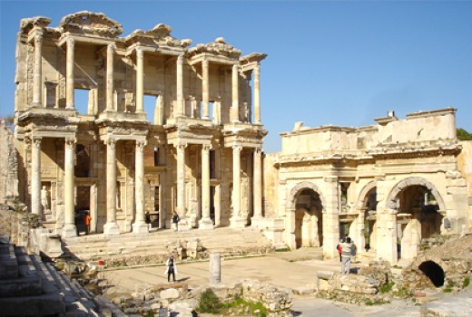
Where is Ephesus Now?

Slide 49
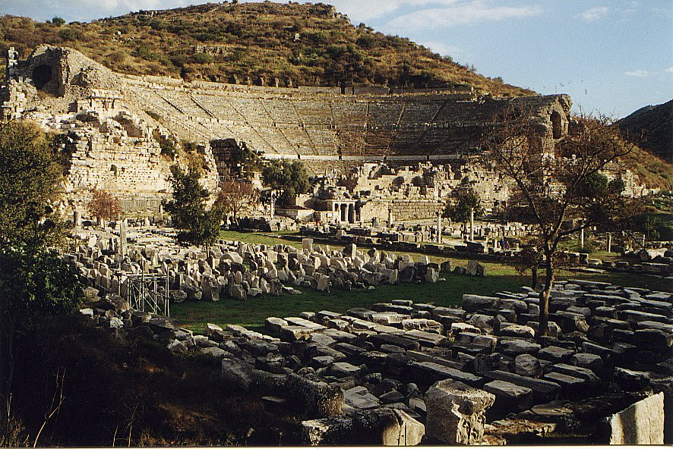
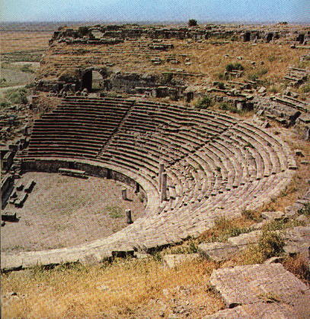
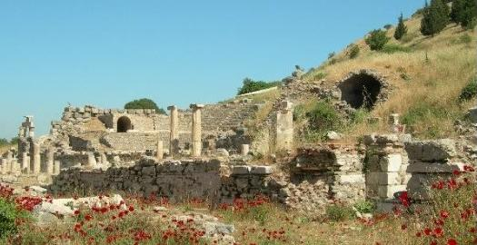

Slide 50
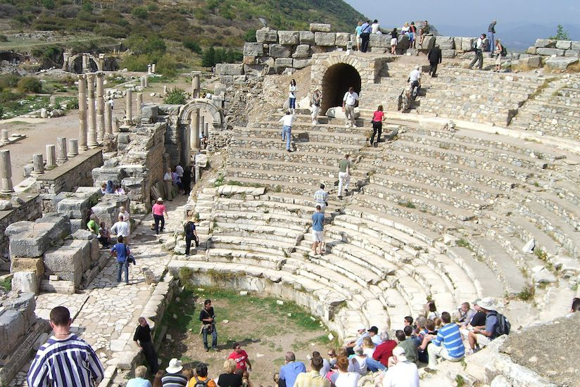

Slide 51
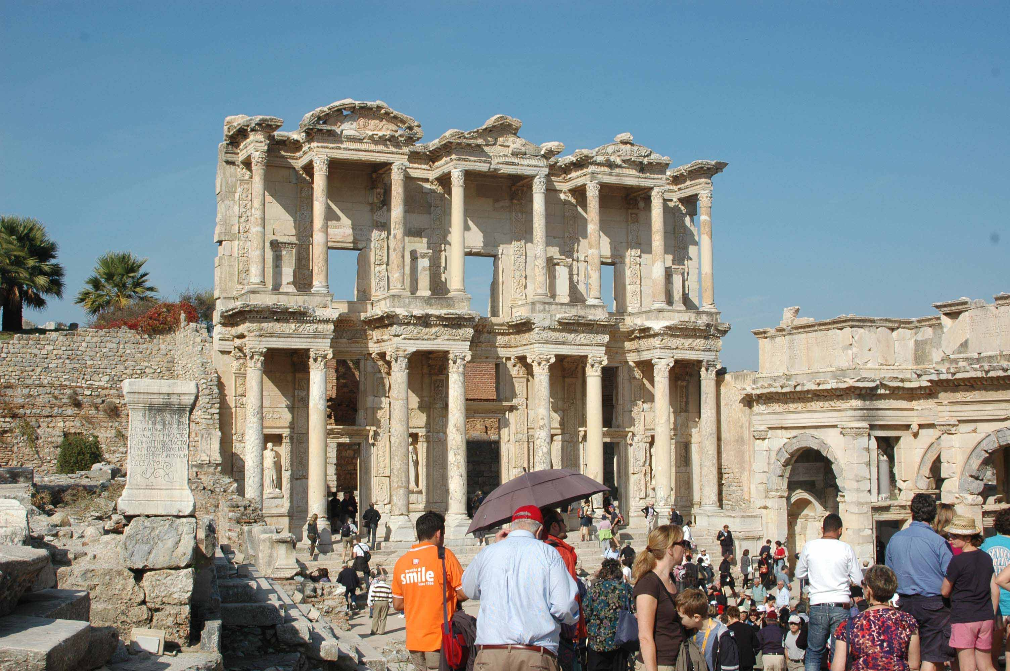

Slide 52
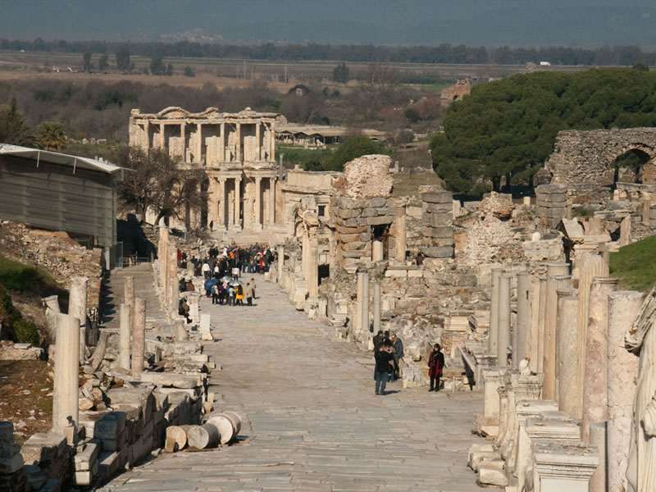

Slide 54
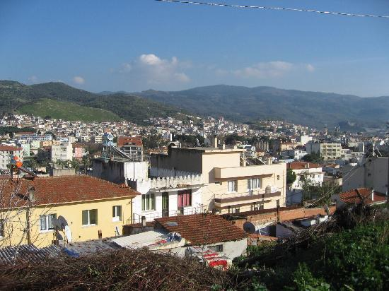
SELCUK, TURKEY

Slide 55
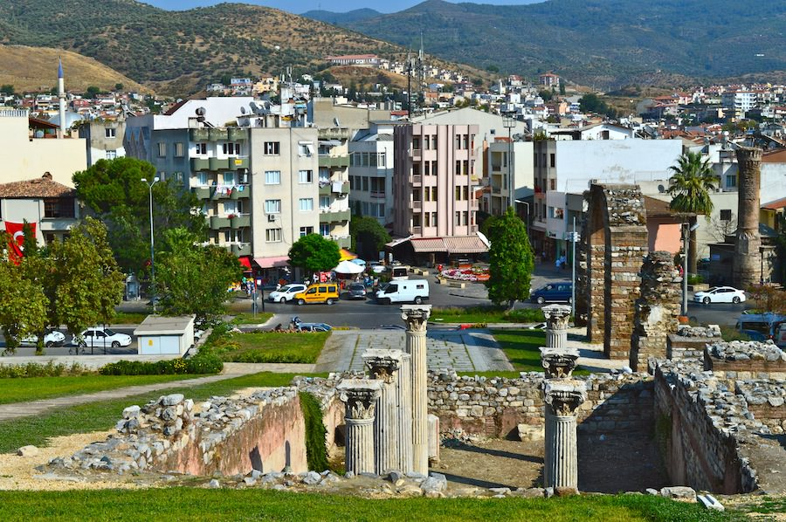
SELCUK, TURKEY

Slide 56
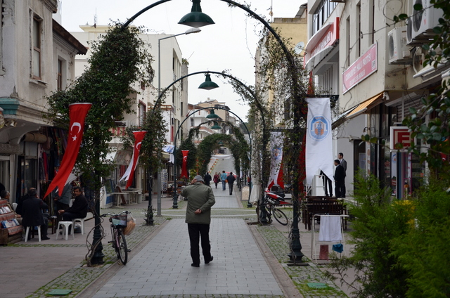
SELCUK, TURKEY

Slide 58
Rev. 2:8-11: ❷ The Church at SMYRNA
The word Smyrna means “bitter” & is also translated as “myrrh” elsewhere in the NT (Matt. 2:11; Mark 15:23; John 19:39).
In John's day it was a city of about 200,000 people.
It was located on the Aegean Sea. It had an ideal natural harbor and was a commercial center surpassed only by Ephesus in Asia Minor. It was a very wealthy city.
It was also a free city because it had helped the retreating Roman soldiers after their defeat by Mithradates.

Slide 59
Rev. 2:8-11: ❷ The Church at SMYRNA
It was a center of worship of the goddess Roma and Emperor worship. It had the first temple to Emperor Tiberius
It was a religious center with the worship of Cybele and the pantheon of Homer. Its many temples were located on the Acropolis called Pagos with a golden road between the Temple of Zeus and Cybele.
It had a large active anti-Christian Jewish population. It was the city in which Polycarp (John the Apostle's disciple) was martyred.

Slide 60
Rev. 2:8-11: ❷ The Church at SMYRNA
Smyrna is located about 35 miles north of Ephesus.
It was an important seaport and continues to be one to this day.
It was known for its trade in wines & boasted a library and a stadium.

Slide 61
Rev. 2:8 ❷ The Church at SMYRNA
The church at Smyrna was under persecution, many of whose members experienced martyrdom; so the Lord appropriately presents himself as the first and the last, the one who died and lived; thus assuring them of the hope of resurrection.
(Description of Christ from chapter 1:8; 17-18)

Slide 62
Rev. 2:9 ❷ The Church at SMYRNA
"I know your tribulation and your poverty" - These are two very strong Greek words. TRIBULATION: This word is of a general signification and probably includes all that they suffered in any form, whether from persecution, poverty, or the blasphemy of opposers. POVERTY: Is significant because the city of Smyrna was very prosperous. The fact that the church was poor seems to imply economic persecution. They were stripped probably of all their temporal possessions, because of their attachment to the Gospel.

Slide 63
Rev. 2:9 ❷ The Church at SMYRNA
“…but thou art rich...” Not in this world's goods, but in a more important respect--in the grace and favour of God. They were spiritually rich even though they lacked physical riches. They were rich in faith, and heirs of the kingdom of Christ.

Slide 64
Rev. 2:9 ❷ The Church at SMYRNA
“The blasphemy of them which say they are Jews…”
There were persons there who professed Judaism, and had a synagogue in the place, and professed to worship the true God; but they had no genuine religion, and they served the devil rather than God. They applied a sacred name to an unholy thing: and this is one meaning of the word blasphemy in this book. They were Jews by national descent, but not spiritually of "the true circumcision.” They were not Jews inwardly, they were not circumcised in heart.

Slide 65
Rev. 2:10 ❷ The Church at SMYRNA
“Fear none of those things which thou shalt suffer.” He did not promise them exemption from suffering. He saw that they were about to suffer, and he specifies the manner in which their affliction would occur. But he entreats and commands them not to be afraid.
“Behold, the devil shall cast some of you into prison”. He will cause some of you to be cast into prison. This would be done undoubtedly by the hands of men, but still Satan was the prime instigator in doing it. It was common to cast those who were persecuted into prison.

Slide 66
Rev. 2:10 ❷ The Church at SMYRNA
“That ye may be *tried” That the reality of your faith may be subjected to a test to show whether it is genuine or not.
* to test, scrutinize, entice, discipline, examine, prove, tempt
The same event is often both a temptation from the devil, and a test from God
“God sifting and winnowing the man to separate his chaff from his wheat, the devil sifting him in the hope that nothing but chaff will be found in him” [TRENCH].

Slide 67
Rev. 2:10 ❷ The Church at SMYRNA
“and ye shall have tribulation ten days”
There has been much speculation about the phrase "ten days":
Some say that it referred to a literal ten day period of persecution in the city of Smyrna in John's day
Some say that it referred to an unspecified period of persecution
However, in an apocalyptic book one is never sure if the numbers are used figuratively or literally!

Slide 68
Rev. 2:10 ❷ The Church at SMYRNA
“and ye shall have tribulation ten days”
In the book of Revelation and in Daniel, years are signified by days; therefore 10 days could represent 10 years…. and 10 years was precisely the duration of the persecution under Emperor Diocletian during which the Asia Churches were grievously afflicted.
* There was also an intense period between emperors Nero to Diocletian… called the “10 principal persecutions;” which some refer to that period as the 10 days.

Slide 69
Rev. 2:10 ❷ The Church at SMYRNA
“and ye shall have tribulation ten days”
Ten days was also a symbolical designation for a short time period. The shortness of the duration of the persecution is used as grounds for comfort. Meaning: The time of trial shall be short, “Just 10 days, just a few days” but the duration of your joy shall be for ever.
Whether the "ten days" of persecution means a short time, or a definite period symbolized by "ten days" is uncertain. The good news is that it has a limit. The persecution will end!

Slide 70
Rev. 2:10 ❷ The Church at SMYRNA
“be thou faithful unto death, and I will give thee a crown of life.”
This was the victor's crown called the “stephanos” - A wreath or a chaplet… as a badge of royalty, a prize in the public games or a symbol of honor generally. It is the reward of Christian martyrs, or believers who endure trials & temptations (James 1:12; Rev. 3:11)
In the former case of Ephesus it is the peaceful image of those admitted into the scenes of paradise; here with Smyrna it is the triumph of the crowned martyr.

Slide 71
Rev. 2:11 ❷ The Church at SMYRNA
“He that overcometh shall not be hurt of the second death.”
The believer who is an overcomer will not be cast into the lake of fire which burns forever…this is the 2nd death (Rev. 20:6,14; 21:8). They will not go to hell nor the lake of fire; instead they will be ushered into heaven. The believer may die once, but not twice; they shall inherit life eternal!

Slide 72
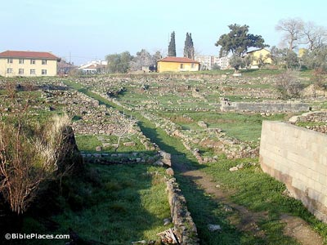
Where is SMYRNA Now?

Slide 73
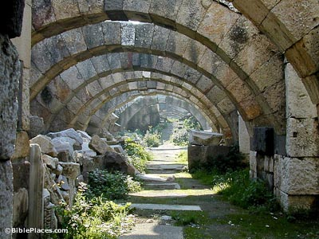
Where is SMYRNA Now?

Slide 74
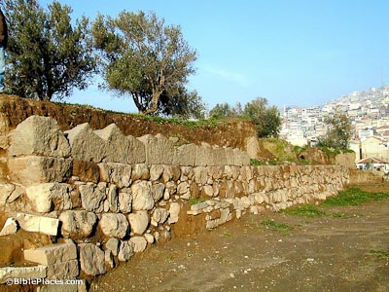
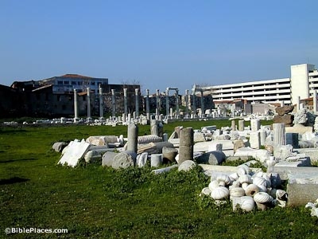
Where is SMYRNA Now?

Slide 75
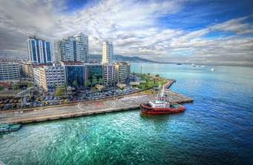
SMYRNA is now Izmir, Turkey

Slide 76
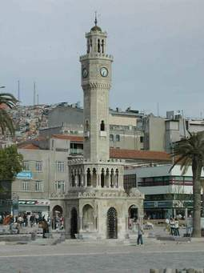
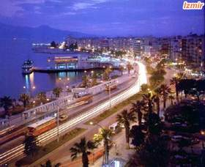
SMYRNA is now Izmir, Turkey

Slide 77
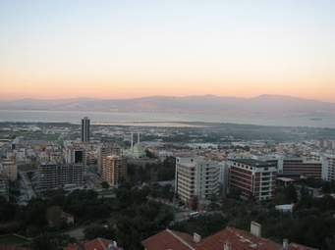
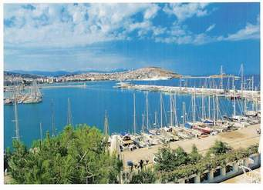
SMYRNA is now Izmir, Turkey

Slide 78
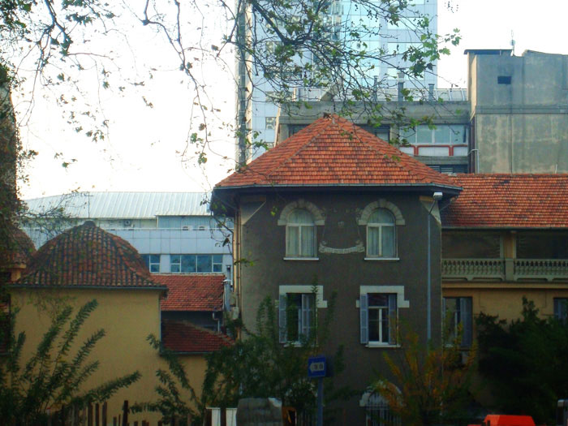
Existing Churches in Izmir, Turkey
ST. POLYCARP
CHURCH

Slide 79
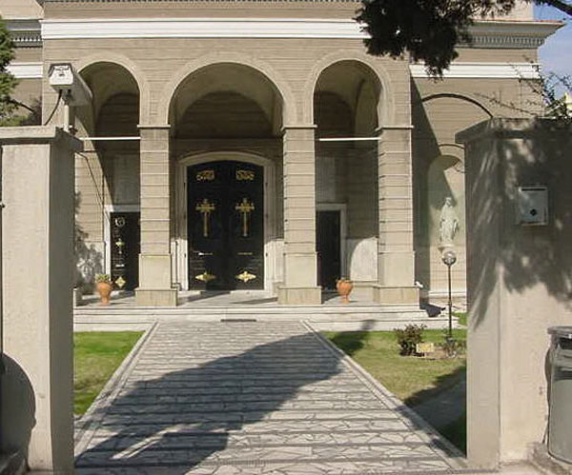
Existing Churches in Izmir, Turkey
ST. JOHN’S
CATHEDRAL

Slide 80
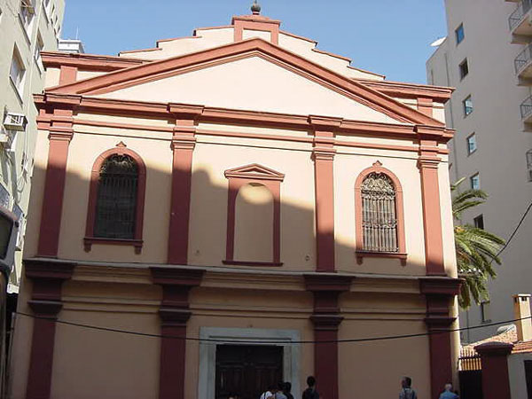
Existing Churches in Izmir, Turkey
ST. MARIA’S
CHURCH

Slide 81
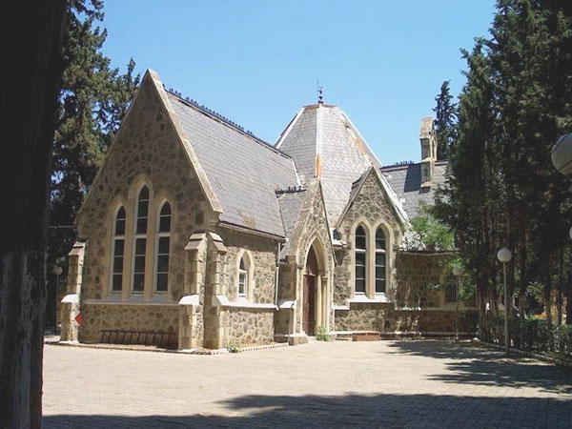
Existing Churches in Izmir, Turkey
ALL SAINTS
ANGLICAN
CHURCH

Slide 82
Rev. 2:12-17: ❸ The Church at PERGAMOS
PERGAMOS is otherwise called PERGAMUM and the name means “Elevation & Marriage”
The city was an independent kingdom for many centuries but in 133 B.C. it became a part of the Roman Empire
It was a large wealthy city and the capital of Asia Minor (since 282 B.C.)
There was a huge Temple to Zeus on the Acropolis that overlooked the whole city. It was also shaped like a throne

Slide 83
Rev. 2:12-17: ❸ The Church at PERGAMOS
It boasted of the largest library in the Roman world outside of Alexandria, Egypt. It had over 200,000 manuscript scrolls
Vellum was invented here; which was processed animal skins which were used for writing
It also had a temple to Roma and the Emperor Augustus (A.D. 29) and was the administrative center of the Emperor's cult
It was a city of temples devoted to pagan worship.

Slide 84
Rev. 2:12: ❸ The Church at PERGAMOS
"The One who has the sharp, two-edged sword"
This is the same reference to the glorified Jesus found in Rev. 1:16. It is used in the New Testament for the penetrating power of the word of God and the assurance of judgment. (Rev. 2:16; 2 Thess. 2:8; Heb. 4:12).
The two-edged sword had a twofold bearing: 1) A searching power so as to convict and convert some; and (2) To convict and condemn others.

Slide 85
Rev. 2:13: ❸ PERGAMOS’ Commendation
These believers faced strong local governmental and demonic pressure. Jesus knew them and their perilous situation.
"where Satan's throne is" … There have been several possible interpretations of this phrase:
1. It could refer to the large throne of Zeus which was located in Pergamos.
2. It could refer to the god of healing, Asclepios, whose symbol was a serpent.

Slide 86
Rev. 2:13: ❸ PERGAMOS’ Commendation
3. It seems that the whole city looked like a giant throne because of the Acropolis which stood hundreds of feet above the city itself.
4. It could be a reference to the local organization to promote emperor worship, which was very powerful in Pergamos.
* Snakes were associated with the worship of gods

Slide 87
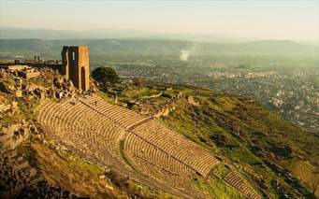
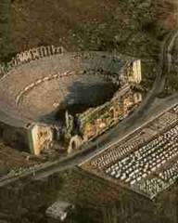
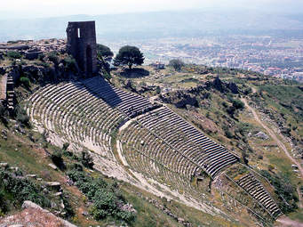

Slide 88
Rev. 2:13: ❸ PERGAMOS’ Commendation
Jesus commends the Pergamos church for being steadfast and true in the very center of Satan’s domination. They remained constant in the heat of persecution and Antipas was mentioned as an example of faithfulness. Who this Antipas was we cannot tell. We only know that he was a Christian, and probably bore some office in the Church, and became illustrious by his martyrdom for the cause of Christ. He was either one of the church members or someone who was brought to Pergamos for trial, and was definitely killed for his faith.

Slide 89
Rev. 2:14-15: ❸ PERGAMOS’ Criticism
Balaam was a prophet who found himself unable to curse the Israelites, therefore what he did instead was to instruct Balak (king of Moab) to corrupt the Israelites through immorality and idolatry; so that God eventually judged them. Balaam’s doctrine was the teaching of compromise. The doctrine of the Nicolaitans followed the same idea of compromise; teaching that Christian liberty meant license to commit sensual sins. They sacrificed to idols & mixed pagan rituals with Christian ceremonies. The Ephesus church hated it (2:6), while the Pergamos church embraced it.

Slide 90
Rev. 2:16: ❸ PERGAMOS’ Counsel
Jesus calls them to repentance coupled with a warning of judgment if they do not repent. He would come against the church for tolerating them, but his opposition would be principally directed against the Nicolaitanes themselves. The church always suffers when it cuddles offenders in its bosom! If the church would repent, or if it would separate itself from the evil, then the Saviour would not come against them.
“With the sword of my mouth”: Christ would give the order, and they would be cut as if by a sword…Judgment by the Word.

Slide 91
Rev. 2:17: ❸ PERGAMOS’ Compensation
“…Will I give to eat of the hidden manna….”
Manna was God's supernatural provision for the children of Israel during the Wilderness Wandering Period. Hence Christ promises true spiritual food; the food that nourishes the soul. The idea is, that the souls of those who "overcame," or who gained the victory in their conflict with sin, and in the persecutions and trials of the world, would be permitted to partake of that spiritual food which is laid up for the people of God, and by which they will be nourished for ever.

Slide 92
Rev. 2:17: ❸ PERGAMOS’ Compensation
"and I will give him a white stone"
This stone, also called Tessera, had many usages in the Ancient Near East.
1. It could be used for a ticket to special banquets
2. It could be used to vote for acquittal by a jury
3. It could be used as a symbol of victory for an athlete
4. It could be used to show the freedom of a slave.

Slide 93
Rev. 2:17: ❸ PERGAMOS’ Compensation
There has been a great variety of opinion in regard to the meaning of the white stone, and almost no two expositors agree. Illustrations of its meaning have been sought from Grecian, Hebrew, and Roman customs, but none of these make it any easier to interpret.
A white stone was regarded as a token of favour, prosperity, or success. As such, it would denote that the Christian to whom it is said to be given would merit the favour of the Redeemer, and would have a token of his approval.

Slide 94
Rev. 2:17: ❸ PERGAMOS’ Compensation
“and in the stone a new name written, which no man knows except he that receives it.”
The name written on this stone would be designed also as a token or pledge of his favour--as a name engraved on a signet or seal would be a pledge to him who received it. A name indicating a new relation, new hopes and triumphs. Probably the name here referred to is the name of the Redeemer or the Christian. It would be some name which he would understand and appreciate, and which would be a pledge of acceptance.

Slide 95
Rev. 2:17: ❸ PERGAMOS’ Compensation
“and in the stone a new name written, which no man knows except he that receives it.”
The main idea of the white stone is that: The Saviour will give the believer who overcomes, a token of his favour which would have some word or name inscribed on it, and which would be of use to him alone, or known to him only: that is, some secret token which would make him sure of the favour of his Redeemer, and which would be unknown to others.

Slide 96
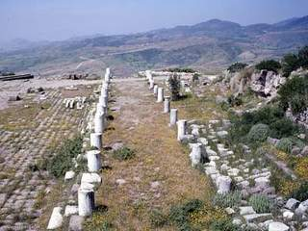
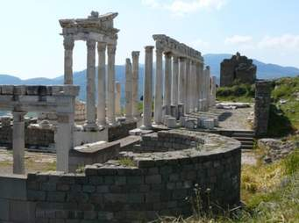
Where is PERGAMOS Now?

Slide 97
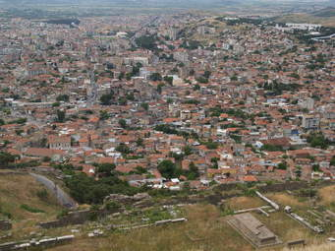
PERGAMOS is now Bergama, Turkey

Slide 98
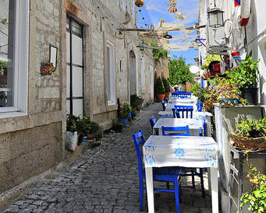
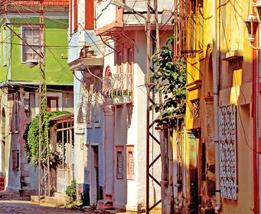
PERGAMOS is now Bergama, Turkey

Slide 99
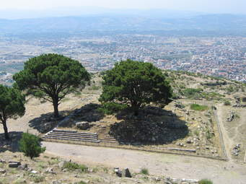
PERGAMOS is now Bergama, Turkey

Slide 100
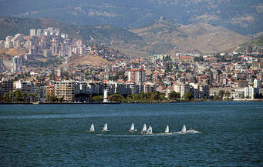
PERGAMOS is now Bergama, Turkey

Slide 102
Rev. 2:18-29: ❹ The Church at THYATIRA
Thyatira means: “Unweary sacrifice”
Thyatira was located on a major road between Pergamum and Sardis which continued on to Philadelphia and Laodicea
It was a small trading city that was famous for the following industries: wood, wool & dye. Lydia (Acts 16:14), a seller of purple cloth, was from this city.
It had a large Greek population & several temples to false gods like (Apollo) – the sun god & (Diana) – the love goddess

Slide 103
Rev. 2:18: ❹ The Church at THYATIRA
“These things saith the Son of God”… This is the first time, in these letters, that the title of the speaker is mentioned; as in the previous ones, only the attributes of Christ was mentioned. Therefore there is no doubt that it is Jesus and having the authority of the Son of God, He has the right to speak and the right to demand that what he says must be heard… This is the longest letter of the seven

Slide 104
Rev. 2:18: ❹ The Church at THYATIRA
“…Who has eyes like a flame of fire, and His feet are like fine brass (burnished bronze)”
This was another description of Jesus taken from Rev. 1:14-15. It is possible that it was used in connection with Thyatira because this city was also noted for its bronzeware. Note as well the connection to wool in Rev. 1:14 with Thyatira’s wool products. Christ is definitely using these descriptions to personally relate and address the things that are familiar to the city and church.

Slide 105
Rev. 2:19: ❹ THYATIRA’s commendation
Their charity: Love (Agape) - Love to God, and love to man
Their service: Ministry – All kinds of service for God/to man
Their faith: Trust/fidelity in Christ for Salvation & sustenance
Their patience: Endurance - Cheerful endurance of the sorrows of life
Their works*: Labour - They continued in good works and thorough obedience

Slide 106
Rev. 2:19: ❹ THYATIRA’s commendation
*Thy works: The phrase is repeated here, from the first part of the verse, perhaps, to specify more particularly that their works had been recently more numerous and praiseworthy even than they had formerly been. In the beginning of the verse, as in the commencement of each of the letters, the phrase is used, in the most general sense, to denote all that they had done…. I know your works! (Jesus said it 7 times, one for each church)

Slide 107
Rev. 2:19: ❹ THYATIRA’s commendation
*Thy works: In the latter part of the verse, the word seems to be used in a more specific sense, as referring to good works, and with a view to say that the Thyatira church had abounded in works more than they had formerly done…. This church grew better and better, and did more and more for the Lord. Instead of declining, they had increased in good works. Hence the phrase: “And the last to be more than the first” which is linked to their works.

Slide 108
Rev. 2:19: ❹ THYATIRA’s commendation
“And the last to be more than the first”
The works which had been recently performed were more numerous, and more commendable, than those which had been done before. In other words, they were making progress; they had been acting more and more in accordance with the nature and claims of the Christian profession. This is a most honourable commendation, and one which every Christian, and every church, should seek.

Slide 109
Rev. 2:20-21: ❹ THYATIRA’s criticism
“Nevertheless I have a few things against you, because you allow that woman Jezebel, who calls herself a prophetess, to teach and seduce my servants to commit sexual immorality and eat things sacrificed to idols.”

Slide 110
Rev. 2:20-21: ❹ THYATIRA’s criticism
There is an allusion here to the history of Jezebel, and although we do not know who this Jezebel was, yet from the allusion we may take it for granted she was a woman of power and influence in Thyatira, who corrupted the true religion, and harassed the followers of God in that city, as Jezebel did in Israel. Jezebel may not even be her real name, but seems to have been given to her to express her character and influence. Jezebel was the wife of King Ahab; a woman of vast influence over her husband--an influence which was uniformly exerted for evil.

Slide 111
Rev. 2:20-21: ❹ THYATIRA’s criticism
COMPARISON:
Thyatira was just the reverse of Ephesus. Ephesus had much zeal for orthodoxy (doctrine), but little love; while Thyatira was active in faith and love, but insufficient zeal for godly discipline and doctrine.

Slide 112
Rev. 2:20-21: ❹ THYATIRA’s criticism
(Vs. 21) “I gave her space to repent” This alludes to the history of Jezebel. God first sent Elijah to Ahab to pronounce a severe judgment upon him; upon which Ahab showed tokens of repentance, and so God put off his punishment. By the same means punishment pronounced against Jezebel was also put off. Thus God gave her time to repent, which she did not, but instead of that, seduced her sons to the same sins.

Slide 113
Rev. 2:20-21: ❹ THYATIRA’s criticism
Pertaining to the woman at Thyatira… Christ probably gave her some direct and solemn warning of the evil of her course. The error and sin had been of long standing, but He now resolved to bear with it no longer. It is true of almost every great sinner, that sufficient time is given for repentance, and that vengeance is delayed after crime is committed.
Since she did not repent and showed no disposition to abandon her course; it was justified that Christ should rise in his anger and cut her down.

Slide 114
Rev. 2:22: ❹ THYATIRA’s counsel
“I will throw her & her followers into a bed of tribulation”… (suffering, affliction, anguish, persecution or trouble."
This is ironically related to her bed of adultery (teachings about immorality)… In contrast to her bed of pleasure; she will be in a bed of pain.
“Except they repent of their deeds.” It is only by repentance that they could escape such judgment… Once again, the mercies of God is extended even when judgment is pronounced.

Slide 115
Rev. 2:23: ❹ THYATIRA’s counsel
“And I will kill her children” - This does not refer to literal children, but to her followers.
“…and all the churches will know” - This shows that the seven letters were to be read and the truth applied to all the churches, then and now.
"I am He who searches the minds and hearts" - Christ knows the motives and thoughts of all humans
"and I will give to each one of you according to your deeds" Everyone will get what they deserve… We reap what we sow.

Slide 116
Rev. 2:24-25: ❹ THYATIRA’s compensation
“But to you, the rest of you in Thyatira, all who do not hold this teaching and are not the people who have learnt the deep things, as they call them the deep things of Satan -- to you I say that I lay no other burden on you.”…. To all the members of the church; who have not entertained these satanic doctrines; I will not oppose you nor put upon you any new doctrine, but charge you to hold fast the old apostolic doctrine which you have received; persevere until I come to relieve you, and to release you from your persecutions, which will soon be at an end… “Hold fast till I come.”

Slide 117
Rev. 2:26: ❹ THYATIRA’s compensation
In the coming period when Christ shall rule all kingdoms; the saints who overcome shall share Christ’s authority. The evident meaning of what is said here, is that in accordance with the promise made to believers in the New Testament, they will partake in the final triumph and glory of the Saviour and be associated with Christ. Christ assures his servants of their privileged status to one day share in the reign & dominion of his kingdom.

Slide 118
Rev. 2:27: ❹ THYATIRA’s compensation
“And he shall rule them with a rod of iron….” This whole verse is an allusion to Psalm 2:6-9: "Thou shalt break them with a rod of iron; thou shalt dash them in pieces like a potter's vessel..." The allusion in Psalm 2:9 is to the Messiah as reigning triumphantly over the nations, or subduing them under him, and the idea here in Rev. 2:27, as in the previous verse (26), is that his redeemed people will be associated with him in this dominion.

Slide 119
Rev. 2:27: ❹ THYATIRA’s compensation
To rule with a scepter of iron, is not to rule in a harsh and tyrannical way, but with power that is firm and invincible. It denotes a government of strength, or one that cannot be overthrown; one in which the subjects are effectively subdued.
A scepter of iron means a firm and enduring power. Christ shall rule as a shepherd is the meaning of the Greek word [Poimaino]. Thus his rule will not be cruel, but a guardian rule.

Slide 120
Rev. 2:27: ❹ THYATIRA’s compensation
“…As the vessels of a potter shall they be broken to shivers.”
The image here is that of the vessel of a potter--a fragile vessel of clay --struck with a rod of iron, and broken into fragments. That is, as applied to the nations, there would be no power to oppose Christ’s rule; the enemies of his government would be destroyed. Instead of remaining firm and compacted together, they would be broken like the clay vessel of a potter when struck with a rod of iron. So the nations shall be broken in pieces and all become one under the rule of Christ.

Slide 121
Rev. 2:28: ❹ THYATIRA’s compensation
“And I will give him the morning star"
There have been several possible interpretations of this phrase:
1. It was a metaphor for Christ (Rev. 22:16)…Christ himself
2. It could be a token of reward… a really precious gem
3. It could be a the brightest planet -- Venus

Slide 122
Rev. 2:28: ❹ THYATIRA’s compensation
“And I will give him the morning star"
It should be observed that it is NOT said that he would make him like the morning star, as in Dan. 12:3; nor that he would be compared with the morning star, like the king of Babylon in Isa. 14:12; nor that he would resemble a star which Balaam says he saw in the distant future in Num. 24:17. The idea seems to be, that the Saviour would give him something that would resemble that morning star in beauty and splendor…

Slide 123
Rev. 2:28: ❹ THYATIRA’s compensation
“And I will give him the morning star"
…It would seem to denote a bright and brilliant ornament; something which he who "overcame" would be adorned, resembling the bright star of the morning. Perhaps meaning that it would be placed as a gem in his crown and would sparkle bearing some relation to Christ the bright and morning star.

Slide 124
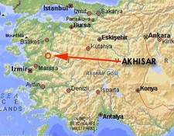
THYATIRA is now Akhisar, Turkey

Slide 125
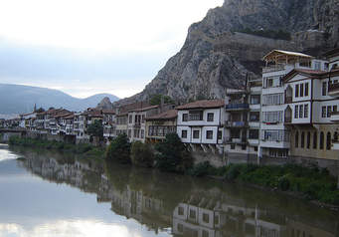
THYATIRA is now Akhisar

Slide 126
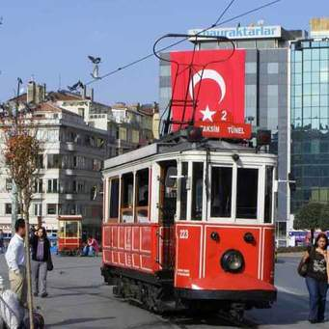
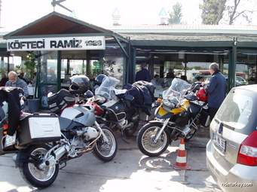
THYATIRA is now Akhisar

Slide 127
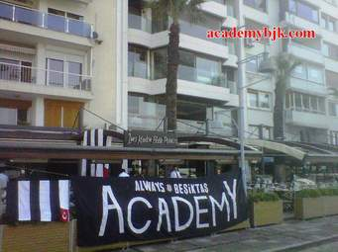
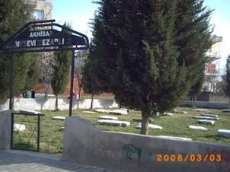
THYATIRA is now Akhisar

Slide 128
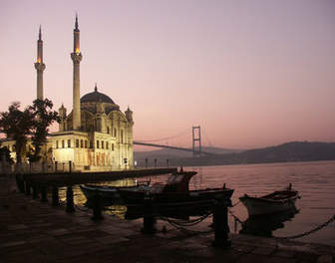
THYATIRA is now Akhisar

Slide 129
THYATIRA is now Akhisar

Slide 131
Rev. 3:1-6: ❺ The Church at SARDIS
Sardis means: “Rest” or “Remnant”
Sardis was about 30 miles south of Thyatira
It was noted for its dyed wool products; the process was invented there, so they claimed
It was a large, wealthy ancient city & the capital of Lydia
It was the center of the worship of Cybele, the mother goddess
The city was characterized by a loose & luxurious lifestyle

Slide 132
Rev. 3:1-6: ❺ The Church at SARDIS
Sardis was thought to be impenetrable because of its superb military position, 1500ft up on a mountain spur. But Cyrus the Great Persian king captured the city by following a secret path up the cliff.
The city of Sardis had greatly declined by the time this letter was written to the church.

Slide 133
Rev. 3:1: ❺ The Church at SARDIS
Verse 1 opens with a combination description of Jesus found in Chapter 1:4 & 1:16. Jesus is described as the one who has the “*seven Spirits of God” and the “seven stars”…. We already know from chapter 1:20 that the seven stars represent the 7 angels or messengers. Therefore Jesus is being described as the one who has entire control over the messengers of the churches and they are subordinate to Him.
* The seven Spirits were discussed in chapter 1; let’s revisit it…

Slide 134
…The Seven Spirits - Seven was a sacred number in the Jewish church: but it did not always imply a precise number. It sometimes is to be taken figuratively, to denote completeness or perfection. The 7 Spirits most likely represent the Holy Spirit & not 7 angels in Rev. 3:1. The angels are never termed spirits in this book. Notice in heaven when all the angels stand up, & the 4 living creatures & the 24 elders worship him that sat on the throne, the 7 spirits neither stand up nor worship (Rev. 4:5, 8,10; Rev. 5:6).
Notes:
Benedictions (1 Cor. 1:3; 2 Cor. 1:2; Gal. 1:3; Eph. 1:2; Phil. 1:2; Col. 1:2; 2 Thess. 1:2; Phile. 1:3

Slide 135
Rev. 3:1: ❺ The Church at SARDIS
“I know your works, that you have a reputation of being alive, but you are dead.”…. An early CRITICISM!
Sardis was famed among the churches for spiritual vitality; yet the Heart-searcher, who sees not as man sees, pronounced the Church to be dead. This was a devastating revelation. They thought they were right with God & spiritually pleasing to Him; but they were not! This Church had a fair reputation, a good outside appearance. But the Spirit saw right through them and every empty appearance vanished before him.

Slide 136
Rev. 3:1: ❺ The Church at SARDIS
Persons may be regular in the outward form of religion and yet destitute of God’s Spirit. The bulk of the members were formalists and hypocrites, yet the church kept up its reputation. How beautiful may a fruit appear on the outside and yet be rotten within. It is possible for professing people to be alive in their own eyes and in the eyes of others; and yet be dead or dying in God's account.

Slide 137
Rev. 3:2: ❺ SARDIS’ Counsel
Be watchful: You have lost ground by carelessness and inattention…Wake up, and stay awake!
Strengthen the things which remain: Whatever graces and Christian life remained… Whatever convictions and good intentions still existed… Whatever measure of the fear of God or a good conscience remained… Then nurture and strengthen them before they disappear entirely.

Slide 138
Rev. 3:2: ❺ SARDIS’ Counsel
For I have not found thy works perfect before God…
I have not found your deeds complete or full. Their works fell short of what was required. They performed duties of all kinds, but no duty was completed. They were constantly beginning, but never brought any thing to a proper end. Their resolutions were empty promises, their strength was feeble, and their light was dim. They probably maintained their reputation before men, but their works were not perfect before God.

Slide 139
Rev. 3:3: ❺ SARDIS’ Counsel
Keep in mind, the teaching which was given to you, and hold on to it and have a change of heart….REPENT. If you do not keep watch, I will come like a thief, and you will have no knowledge of the hour when I will come on you.

Slide 140
Rev. 3:4: ❺ SARDIS’ Compensation
Some believers had not compromised with pagan culture. There were a few persons who had kept themselves free from contamination and moral corruption. They had not defiled themselves by coming in contact with the profane and the polluted. In most cases, when error and sin prevail, there may be found a few who are worthy of the Divine commendation; a few who show that true religion may exist even when the masses are evil. They were like persons clothed in white walking in the midst of the defiled, yet keeping their garment from being soiled.

Slide 141
Rev. 3:4: ❺ SARDIS’ Compensation
And they shall walk with me in white. White is the emblem of innocence & purity, and is appropriately represented as the colour of the garment of the heavenly inhabitants. The persons here referred to had kept their garments uncontaminated on the earth, and as an appropriate reward it is said that they will appear in white garments, walking with Christ in heaven.
For they are worthy. They have shown themselves worthy to be regarded as followers of the Lamb; or, they have a character that is befitting of heaven.

Slide 142
Rev. 3:5: ❺ SARDIS’ Compensation
The same shall be clothed in white raiment.
Whosoever he may be that shall overcome sin and the temptations of this world, shall be admitted to this glorious reward. The promise is made not only to those in Sardis who should be victorious, but to all in every age and every land. The hope that is held out before us, is that of appearing with the Redeemer in his kingdom, dressed in robes expressive of holiness and joy.

Slide 143
Rev. 3:5: ❺ SARDIS’ Compensation
I will not blot his name out of the book of life: That is, they shall be enrolled in it and certainly saved… The names of God’s people are thus represented as enrolled in a book which he keeps a register of those who will live forever. The expression "I will not blot out" means that; the names would be found there on the great day of final account, and would be found there for ever. The statement does not threaten the loss of salvation but rather promises assurance of salvation, that the overcoming believer will never lose it.

Slide 144
Rev. 3:5: ❺ SARDIS’ Compensation
The Lord Jesus keeps a book or register with records of the names of all who shall obtain everlasting life. (Dan. 12:1; Luke 10:20; Phil. 4:3; Rev. 13:8; Rev. 21:27)
A register was kept in ancient cities of their citizens and the names of the dead were then erased. Likewise, those whose names appeared in the book at physical birth (life) but never received eternal life (spiritually dead); are blotted out, or in other words, “not written” in God’s book of heavenly citizens.

Slide 145
Rev. 3:5: ❺ SARDIS’ Compensation
Not that in God's electing decree they were ever in His book of life; but according to human conceptions, the religious supposed their names were in the book. (*See Rev. 17:8)
* Rev. 17:8 seems to indicate that certain names were NEVER written in the book even from the foundations of the world
“Many are enrolled on the list of the call to salvation, but shall not be found in the book of the chosen.”

Slide 146
Rev. 3:5: ❺ SARDIS’ Compensation
I will confess his name… I will acknowledge that this person is my true disciple, that this is one of my faithful servants and soldiers; and a member of my body.
Jesus will acknowledge his saints in the presence of the Father and the angels of Father God (Matt 10:32, Luke 12:8)

Slide 147
SARDIS in ruins

Slide 148
SARDIS in ruins

Slide 149
SARDIS in ruins

Slide 150
SARDIS in ruins

Slide 151
SARDIS in ruins

Slide 152
SARDIS is now SART, Turkey

Slide 153
SARDIS is now SART, Turkey

Slide 154
SARDIS is now SART, Turkey

Slide 155
SARDIS is now SART, Turkey

Slide 156
SARDIS is now SART, Turkey

Slide 158
Rev. 3:7-13: ❻ The Church at Philadelphia
Philadelphia was the youngest (newest) of the seven cities
Its name means ‘brotherly love’
The city’s founder, Attalus II, named it after his favourite brother Eumenes. He established Philadelphia to spread the Greek language and way of life
The city was susceptible to severe earthquakes, hence many of its inhabitants lived outside the city limits.
Many gods were worshipped there, but its chief god was Dionysus, the god of wine

Slide 159
Rev. 3:7-13: ❻ The Church at Philadelphia
Philadelphia was located on a plateau and was protected by water. This made it a highly desirable military position
It was located on a major trade route to Sardis and it was flourishing
It was located in a fine agriculture area, especially for grapes
It was also a center for the Emperor's cult which was possibly the source of much of the Churches' persecution in the provinces.

Slide 160
Rev. 3:7-13: ❻ The Church at Philadelphia
Philadelphia was destroyed by a huge earthquake in 17(A.D.) which also destroyed ten other major cities of the area. However, the after-shocks continued in this area and the population moved to the surrounding countryside.

Slide 161
Rev. 3:7: ❻ The Church at Philadelphia
Description of Jesus not identical to verses in Chapter one
He that is holy: In whom holiness dwells, and from whom all holiness is derived.
He that is true: He who is the fountain of truth; who cannot lie; from whom all truth proceeds
He that has the key of David: A key is the emblem of authority and knowledge; the key of David is the regal right or authority of David.

Slide 162
Rev. 3:7: ❻ The Church at Philadelphia
He that has the key of David: The language is that which properly denotes authority or control--as when one has the key of a house, and has unlimited access to it; and the meaning here is, that as David is represented as the king of Israel residing in a palace, so Christ who has the key to His palace has regal authority. Compare Isaiah 22:22 from which passage the language is borrowed, but with a far higher application. To have the key of David's house, is to exercise supreme dominion there.

Slide 163
Rev. 3:7: ❻ The Church at Philadelphia
…the key of David, he that opens…and shuts.. A master of a family, or a prince, has one or more keys, where he can open and shut all the doors of his house or palace. So did King David have a key, a token of right and sovereignty. Even more so does King Jesus, the Son of David, have the key of the spiritual city of David, the New Jerusalem; the supreme right, power, authority, ownership and access to his own mansions… Hence only Christ opens and shuts the door, or determines who shall enter in, or be shut out… because he is the key master.

Slide 164
Rev. 3:7: ❻ The Church at Philadelphia
…the key of David, he that opens…and shuts… APPLICATION
The house of David represents the Church, and the continual promise of David's kingdom belongs to Christ. The church of which David was a type now presents Christ as the head of the church who has absolute power over the church, because he is Lord of it… and having this key of the church in his own hand, Christ opens, and none can shut it; and shuts it and none can open it: that is, he can open and shut it, when he wills.

Slide 165
Rev. 3:8: ❻ Philadelphia’s commendation
They kept God’s Word
They kept Christ’s name: remained loyal & true to Jesus
* “They had a little strength” (Dunamis: Miraculous power, might)… The little strength may be saying they were few in numbers, or that they had little authority or influence, or not much vigor or energy, or little outward human strength… Hence he gave them an open door of opportunities for ministry, communion with God, access to the heavenly palace, blessings, etc… it was like God gave them a blank cheque!

Slide 166
Rev. 3:9: ❻ Philadelphia’s compensation
Behold, I will make them. That is, I will arrange matters so that this shall occur. The phrase implies that he had power to do this and will compel them.
Them of the synagogue of Satan, which say they are Jews…Who profess to be Jews, but are really of the synagogue of Satan (Rev. 2:9). The meaning is that, though they were of Jewish affiliation and boasted much of being Jews, they were really under the influence of Satan, and their assembly deserved to be called his "synagogue."

Slide 167
Rev. 3:9: ❻ Philadelphia’s compensation
Behold, I will make them to come and worship before thy feet. The word rendered worship here, means properly to fall prostrate; and then to pay respect, or to worship in the proper sense, as this was commonly done by falling prostrate.
If it is used here in the sense of Divine worship, it means that the opposers would be constrained to come and worship God "before them (Philadelphia saints)," or in their very presence.

Slide 168
Rev. 3:9: ❻ Philadelphia’s compensation
Behold, I will make them to come and worship before thy feet.
If it is used in the more general sense of paying respect, then it means that the opposers would be constrained to show the saints honor and respect. They would be constrained to acknowledge that they were the children of God, or that God regarded them with his favour. God can at any time humble the most bitter persecutors of his people, and make them their servants. So that the opposers will know that God loves his church & he has not forsaken them. Those whom God loves, their bitterest foes shall be compelled to honor.

Slide 169
Rev. 3:10: ❻ Philadelphia’s compensation
Because thou hast kept the word of my patience… “Because you have kept my command or instructions to persevere… Because you have shown the patience which I required… I will keep you from or protect you in the midst of a world-wide judgment.”
The Philadelphia church had endured their trials; hence Jesus promised them that in return He will keep them in the future trials that shall come upon the world. It will be a time of trial; but the promise of being kept in it is made, and the hope of being delivered out of it is given.

Slide 170
Rev. 3:10: ❻ Philadelphia’s compensation
“THE HOUR OF TEMPTATION…”
The hour denotes the short time of its duration but does not mean a literal hour.
It refers to a season or time of fiery trial, apparently in the shape of severe persecution… An appointed season of affliction and temptation… Some great crisis of trial and sorrow which should come on all the world.

Slide 171
Rev. 3:10: ❻ Philadelphia’s compensation
“THE HOUR OF TEMPTATION…”
The hour of temptation may refer to the outpouring of God’s wrath on the world. The Believers will be spiritually protected from various demonic attacks and plagues (Rev. 9:4) and those who persevere will obtain eternal life (Rev. 14:12–13).

Slide 172
Rev. 3:10: ❻ Philadelphia’s compensation
“THE HOUR OF TEMPTATION…”
It may refer to the great tribulation period because it describes an event that the whole world will go through. Revelation chapters 6-18
(Zeph. 1:14-18; Rev. 7:13-14)

Slide 173
Rev. 3:10: ❻ Philadelphia’s compensation
Specifically referring to the Philadelphia Church; Christ kept them from the great tribulation by taking them out of this world thru death unto their restful home in heaven (Rev. 14:12-13).
Generally referring to the entire Church; Christ is going to keep his church from the wrath to come by taking us out of this world thru the rapture unto our restful home in heaven (1 Thess. 4:14 – 1 Thess. 5:11).

Slide 174
Rev. 3:10: ❻ Philadelphia’s compensation
"to test those who dwell on the earth" That is, such persecutions will be the means of trying and proving those who profess Christianity, and showing who were sound and thorough Christians and who were not. This phrase is used to refer to a settled state of unbelievers…those who are of earth, (earthy, worldly). "Dwell" implies that their home is earth, not heaven.
These earth-dwellers are repeatedly mentioned in the book of Revelation. (Rev. 6:10; 8:13; 11:10; 13:8, 12, 14; 17:8).

Slide 175
Rev. 3:11: ❻ Philadelphia’s compensation
"I am coming quickly" - This is a continuing emphasis upon the immediacy of the Lord's coming (Rev. 1:1, 3; 2:16; 22:7,12,20). The early church expected the immediate return of the Lord
"crown" This is another reference to the stephanos crown mentioned to Smyrna in Rev. 2:10. It was a reward for faithfulness. The truth which is taught here is, that by negligence or unfaithfulness in duty we may be deprived of the glory which we might have obtained if we had been faithful to our God and Saviour.

Slide 176
Rev. 3:12: ❻ Philadelphia’s compensation
Philadelphia was in an earthquake area; the metaphor of a pillar conveyed the concept of stability. Prominent citizens' names were inscribed on the pillars of the temples in Philadelphia. The term "temple" here is a term (naos) from the verb "to dwell" and was used of the place where deity's very presence dwelt. The overcoming believers will never have to leave God's presence… This may be a metaphor because apparently there will be no temple in the new age (Rev. 21:22).

Slide 177
Rev. 3:12: ❻ Philadelphia’s compensation
“write upon him the name of my God”– As in belonging to God in a peculiar sense. So that the nature and image of God shall appear visibly upon him.
“name of the city of my God” -- As in one of heaven’s citizens… Perhaps a land title to dwell in the New Jerusalem.
“my new name” – As in belonging to Christ but a name only known to God that would be hereafter revealed and made the believer's own. Christ's name written on him denotes he shall belong to Christ alone.

Slide 178
Philadelphia is now ALASEHIR, Turkey

Slide 179
Philadelphia is now ALASEHIR, Turkey

Slide 180
Philadelphia is now ALASEHIR, Turkey

Slide 181
Philadelphia is now ALASEHIR, Turkey

Slide 182
Philadelphia is now ALASEHIR, Turkey

Slide 183
Philadelphia is now ALASEHIR, Turkey

Slide 184
Philadelphia is now ALASEHIR, Turkey

Slide 185
Rev. 3:14-22: ❼ The Church at Laodicea
Laodicea was one of three cities in the Lychus River valley (the other cities were Colossae and Hierapolis)
Churches were founded in each of these three cities, probably by Paul's convert, Epaphras.
Laodicea was founded by the Seleucid ruler, Antiochus II, who named it after his wife, Laodice in 250 b.c.
It was located on a militarily defensible site; on a major east/west trade route.

Slide 186
Rev. 3:14-22: ❼ The Church at Laodicea
Laodicea was noted as a banking center.
It was located in a fertile agricultural region, especially suited for raising a special black sheep for which it became famous worldwide.
It mass-produced a black outer garment called a "trimeta.“
It had a very large Jewish population.
The city was the site of a medical school which was noted for its ear ointment and eye powder.

Slide 187
Rev. 3:14-22: ❼ The Church at Laodicea
Laodicea was a wealthy city and was able to rebuild itself in AD 60 without the help of Rome.
The name of the town means “judgment of the people.”
The church was like the city who put its trust in material things instead of spiritual things.
The city was a center for the worship of the healing god Asclepios.
Near Laodicea were hot mineral springs whose water could be drunk only when hot; because when lukewarm it was nauseating

Slide 188
Rev. 3:14: ❼ The Church at Laodicea
These things saith the Amen - firm; sure … The term "Amen" is a form of the OT word for "believe" or "faith". It usually emphasizes faithfulness or trustworthiness.
“the faithful and true witness” - This is presenting the idea implied in the word Amen in a more complete form, but substantially the same thing is being referred; that Christ is a witness for God and he is true & faithful (Reference from Rev. 1:5).

Slide 189
Rev. 3:14: ❼ The Church at Laodicea
…“the beginning of the creation of God”…
The term "beginning" (Greek, archē) has two connotations: (1) start or (2) origin, source. Meaning that Christ was the Beginner of all creation, the originating instrument; he caused the universe to exist -- that is, he was the author of all things. Christ is the head and governor of all creatures: the king of the creation. Jesus is the origin and first cause by which all creatures, beings and things had their beginning.

Slide 190
Rev. 3:15-16: ❼ The Criticisms
"you are neither cold nor hot" This may be an allusion to the lukewarm water that the people of this city had to drink because of the local hot springs. They were a “lukewarm” Church. They were neither heathens nor Christians---neither good nor evil---neither led away by false doctrine, nor thoroughly addicted to that which is true.
“I would thou wert cold or hot” That is, you should be decided; I wish you would choose a side. Which side are you on?

Slide 191
Rev. 3:15-16: ❼ The Criticisms
“So then because thou art lukewarm” Alluding to the fact that lukewarm water nauseates. This luke-warmness was most offensive to Christ, and hence the Lord declares that they shall be rejected like nauseous food or insipid water. This is not the loss of salvation, but the loss of effective ministry or the church could even cease to exist.

Slide 192
Rev. 3:17-18: ❼ The Criticisms
Verses 17 and 18 are a historical allusion to Laodicea as a center of banking, a center for dyed wool, and a center for eye salve. The tragedy of their prosperity was that they thought they had so much when they had so little.
You think you are rich (banking) BUT I say you are poor
You think you are can see (eye salve) BUT I say you are blind
You think you are clothed (textile) BUT I say you are naked

Slide 193
Rev. 3:18: ❼ The COUNSEL
To buy of me - Without money or price.
Gold purified in the fire - True, living faith, which is purified in the furnace of affliction. Faith that shall stand in every trial: so gold tried in the fire is here understood. But it may also mean pure and undefiled religion
White raiment - True holiness; Holiness of heart and life.
Eye salve - Spiritual illumination; that ye may receive the enlightening influences of my Spirit, that ye may be convinced of your true state.

Slide 194
Rev. 3:19: ❼ The COUNSEL
As many as I love… So it was the love that Christ still had for them that induced him to reprimand them and to counsel them.
Be zealous therefore, and repent… Be earnest, strenuous, ardent in your purpose to exercise true repentance, and to turn from the error of your ways. Lose no time; spare no labour, that you may obtain mercy that it shall not be necessary to bring upon you severe discipline.

Slide 195
Rev. 3:19: ❼ The COUNSEL
The truth taught here is that, when the professed followers of Christ have become lukewarm in his service, they should waste no time in returning to him, and seeking his favour again. As sure as he has any true love for them, if this is not done, he will bring upon them some heavy calamity, to rebuke them for their errors, and to recover them to himself. But if they were never genuine they will be turned away from Christ.

Slide 196
Rev. 3:20: ❼ The Counsel & COMPENSATION
To see the real force of this language, we must remember how disgusting and offensive their conduct had been to Christ. And yet he was willing, notwithstanding this, to receive them to his favour; more so, he stood and pleaded with them that he might be received with the hospitality that would be shown to a friend or stranger. It is taken from an act when we approach a dwelling, and, by a well-understood sign--knocking--announce our presence, and ask for admission. The act of knocking implies two things: (a) That Christ desires admittance; and (b) that we who own the house have the liberty to open the door or not, as we please

Slide 197
Rev. 3:20: ❼ The Counsel & COMPENSATION
Christ desires to be admitted to our friendship; and he recognizes our freedom in the matter. He does not impose himself upon us, nor does he employ force to find admission to the heart. If admitted, he comes and communes with us; if rejected, he turns quietly away--perhaps to return and knock again, or perhaps never to come back.

Slide 198
Rev. 3:21: ❼ The COMPENSATION
Will I grant to sit with me in my throne…That is, they will share his honours and his triumphs. They shall reign with Christ.
To sit with me…in a state of high and eternal exaltation and blessedness.
The result of Christ overcoming the Father was that he was exalted to be a Prince and a Savior [Acts 5:31], and to sit at the right hand of the Majesty of the heavens [Heb. 8:1]. As Christ was exalted, so he will exalt all his saints who win the victory over sin and temptation

Slide 199
“COMMITTED TO THE END”

Slide 200
OUTLINE OF REVELATION
❶ THE THINGS WHICH YOU HAVE SEEN (Chap. 1)
- The risen Christ
THE THINGS WHICH ARE (Chap. 2-3)
- The letters to the seven Churches
THE THINGS WHICH SHALL BE (Chap. 4-22)
- Tribulation - Throne in heaven - Scroll in heaven - SEALS
- The saints - TRUMPETS - The little scroll - Two Witnesses
- Antichrist & False prophet - BOWLS - Babylon
- CHRIST’S COMING - Millennium - Eternal state

Slide 202
Revelation Chapter 4 God’s Throne Room

Slide 203
Revelation 4:1
“After this”… After these things; that is, after what John had seen, and after what he had been directed to record in the preceding chapters… How long after these things this occurred, he does not say--whether on the same day, or at some subsequent time. The scene, however, is changed. Instead of seeing the Saviour standing before him (chapter 1) the scene is transferred to heaven, and he is permitted to look in upon the throne of God, and upon the worshippers there.

Slide 204
Revelation 4:1
“A door was opened”… That is, there was apparently an opening in the sky, like a door, so that he could look into heaven.
“And the first voice which I heard”... That is, the first sound which he heard was a command to come up and see the glories of that world. It resembled the former voice of Jesus in Rev. 1:10 in that it was "like the sound of a trumpet."

Slide 205
Revelation 4:1
“Come up hither”... To the place where the voice seemed to proceed; that is heaven. (A similar call was later given to the 2 witnesses in Rev. 11:12)
“And I will show you things which must be hereafter."
The reference is to future events; and the meaning is, that there would be disclosed to John, events that were to occur at some future period.

Slide 206
Revelation 4:2
“I was in the spirit”… John became a spirit and had an out of body experience (see Rev. 1:10; 17:3; 21:10): John was completely raptured in vision into the heavenly world.
“… a throne was set in heaven” – not placed, but was situated, the word set literally means "lay.“
“…one sat on the throne” – Who is it that sat on the throne… God the Father or God the Son?

Slide 207
Revelation 4:2
It was God the Father on the throne:
When the Son, "the Lamb," is introduced in Rev. 5:5-9, a new song is sung which distinguishes the Sitter on the throne from the Lamb, "Thou hast redeemed us to God." Rev. 5:13 shows the distinction of 2 being worshipped “…Unto Him that sits upon the throne, and unto the Lamb.”
Jesus actually makes his grand entrance in chapter 5 (not chap. 4) as the one who was worthy to open the book and loose the seals.

Slide 208
Revelation 4:3
There is no description of the Divine Being, to point out any likeness, shape or dimensions. The description rather aims to point out the surrounding glory and splendor of the almighty Father
He who was seated on the throne had an appearance like a jasper and sardine stone; and around or encircling the throne there was a rainbow of the color of an emerald.

Slide 213
Revelation 4:4
“And upon the seats I saw four and twenty elders sitting”...
Many various opinions have been entertained in respect to who these 24 elders were, who appeared sitting around the throne, and to question why the number twenty-four is mentioned. Instead of examining those opinions at length, it will be better to present, in a summary manner, what seems to be probable in regard to the intended reference….

Slide 214
Revelation 4:4
These elders have a regal character, or are of a kingly order. This is apparent because they are represented as sitting on "thrones," and because they have on their heads "crowns of gold.” They are designed to symbolize or represent some class of persons. They are most likely human beings, and are designed to have some relation to the race of mankind, and somehow to connect the human race with the worship of heaven.

Slide 215
Revelation 4:4
The 24 elders could be:
The representatives of God's people under the Old and New Testament dispensations, twelve for each, answering to the twelve tribes of Israel, and the twelve apostles of Christ.
The most holy of all the former ages, representing the whole body of the saints.
There were 24 courses of Jewish priests; so possibly representing Israel

Slide 216
Revelation 4:4
The 24 elders could be:
(4) Representatives of the church glorified in heaven. Royal ones, for they are crowned; priestly ones, and therefore clothed in white. Like the elders in the synagogues and in the early assemblies of Christians, these 'older men' are in some way representative of the church.

Slide 218
Revelation 4:5

Slide 219
Revelation 4:5

Slide 220
Revelation 4:5

Slide 221
Revelation 4:5

Slide 222
Revelation 4:6

Slide 224
Revelation 4:7

Slide 225
Revelation 4:7

Slide 226
Revelation 4:7

Slide 227
Revelation 4:7

Slide 228
Revelation 4:7

Slide 229
Revelation 4:7-8

Slide 230
Revelation 4:9

Slide 231
Revelation 4:10-11

Slide 232
Revelation 4:10-11

Slide 233
Revelation Chapter 5 God’s Throne Room

Slide 234
Revelation 5:1
A book written within and on the back side: That is, the book was full of solemn contents within, but it was sealed; and on the back side was more contents. It might have been a labeled book, or one written on each side of the skin; which was not usual. It was customary to write only on one side of the paper or vellum, for the sake of convenience in reading the volume as it was unrolled. This book was more likely a scroll, written on both sides to denote the fullness of its contents, rolled up and sealed with seven seals.

Slide 235
Revelation 5:1

Slide 236
Revelation 5:1

Slide 237
Revelation 5:1

Slide 238
Revelation 5:2

Slide 239
Revelation 5:5
The Lion of the tribe of Judah… Jesus Christ, who sprang from this tribe, as his genealogy proves.
The Root of David: This expression connects Jesus directly as a descendant from David who was the great and glorious monarch of Israel, and Jesus now having the right to occupy his throne as one who rules over the people of God. Also included is the idea of Christ being the root and origin of David. Christ is both "the branch" of David, and "the root" of David… David's descendant and David's Lord.

Slide 240
Revelation 5:6

Slide 241
Revelation 5:6

Slide 242
Revelation 5:7

Slide 243
Revelation 5:7

Slide 244
Revelation 5:8

Slide 245
Revelation 5:8

Slide 246
Revelation 5:9
Thou-hast redeemed us to God-out of every-nation: It appears, therefore, that the living creatures and the elders represent the aggregate of the followers of God; or the Christian Church in all nations, and among all kinds of people, and perhaps through the whole compass of time: and all these are said to be redeemed by Christ's blood, plainly showing that his life was a sacrificial offering for the sins of mankind.

Slide 247
Revelation 5:10
Christ has made us a Kingdom of Priests in the service of our God, and we shall reign upon the earth.
The idea clearly is, in accordance with what is so frequently said in the Scriptures, that the dominion on the earth will be given to the saints; that is, that there will be such a prevalence of true religion, and the redeemed will be in rulership with Christ, that the affairs of the nations will be in their hands.
(Rev. 1:6; 20:6)

Slide 248
Revelation 5:11
These angels are represented as joining in the chorus with redeemed mortals.
…and the number of them was ten thousand times ten thousand, and thousands of thousands: that is, an infinite or innumerable multitude
Ten thousand times ten thousand is already one hundred million; plus thousands of thousands added to it; makes it many, many angels!

Slide 249
Revelation 5:12

Slide 250
Revelation 5:13
All parts of the creation, animate and inanimate, are represented here as giving praise to the Lord Jesus, because by him all things were created. We find the whole creation gives precisely the same praise, and in the same terms, to Jesus Christ, who is undoubtedly meant here by the Lamb just slain as they give to GOD who sits upon the throne. With these four regions of the world, agrees the fourfold word of praise. What is in heaven, says blessing; what is on earth, honour; what is under the earth, glory: what is on the sea, strength; is unto him.

Slide 251
Revelation 5:13-14
The song of adoration that began with the living creatures and elders, and was then taken up by the angels, now spreads itself through the whole created universe; and as the echo of it comes back to the throne of God, the living creatures say, Amen, and the elders fall down and worship.

Slide 252
Revelation Chapter 6

Slide 253
Revelation Chapter 6
THE SIX SEALS (Tribulation period)
1. White Horse of cold war (Vs.1-2)
2. Red Horse of war (Vs. 3-4)
3. Black Horse of famine (Vs. 5-6)
4. Pale Horse of death (Vs. 7-8)
5. Martyred Saints (Vs. 9-11)
6. Cosmic Disturbances (Vs. 12-17)

Slide 254
Revelation 6:1
The former chapter acquainted us with Christ receiving the sealed book. Now in chapter 6 Christ (The Lamb) was going to open the book… seal by seal. Christ reveals unto John the deep counsels of God. The preparation made for John's vision of the seals was that he was standing afar off and heard a voice like thunder proceeding out of the mouth of one of the four beasts, who performed the office of a public crier, saying… “come and see.”

Slide 255
Revelation 6:2 - “first seal”

Slide 256
Revelation 6:2
There are several features of the 1st rider that grab our attention:
1. The horse… 2. His white color… 3. The rider… 4. His crown 5. His bow &… 6. His mission.
It is certain that none of these features would have been named if they did not possess a significance.
What do each of these symbols mean?

Slide 257
Revelation 6:2
(1) The horse: The horse was not normally used by the Jews or Orientals as an animal of burden. The ox and the ass were devoted to that office, while the horse was reserved for war. Whenever the horse is mentioned by the prophets it will be found in connection with war-like employments. Hence this symbol points to a period of war, though it does not declare whether the conflict is carnal or spiritual, or whether it is peaceful or disastrous.

Slide 258
Revelation 6:2
(2) The white color: As there are three more horses in succession under the three following seals, each has a different color, thus the color must have a meaning. White must have a different significance from red, or black, or pale. White is the color of prosperity, of happiness, and triumph.

Slide 259
Revelation 6:2
(3) The crown: "There was a crown given to him." This crown is not "the diadem" (diadema) but the "garland crown" (stephanos). The garland or wreath crown was given as a reward for victory in battle, for great achievements or for victory in games. Jesus makes appearances in both crowns at different occasions. In Rev. 14:14 He will wear a golden garland crown (stephanos) & then in Rev. 19:12 He will wear many kingly crowns (diadema).

Slide 260
STEPHANOS

Slide 261
DIADEMA

Slide 262
Revelation 6:2
(4) The rider: His significance is due to his arms, his crown, and the white horse he rides. It is enough to state here that he represents either some conqueror, or a conquering age. A major debate is determining who the rider is?

Slide 263
Revelation 6:2
Who is the rider?
Some say: Jesus Christ or Anti-Christ or an angel
Verdict: UNCERTAIN
Why Christ? He rides a white horse in Rev. 19:11
Uncertainty of Christ: 1) Christ’s role in chapter 6 was that of opening the seals & He was seen in heaven during the seal revelations (6:14-16) 2) He wears two different crowns (6:2) “Stephanos” but (19:11) “diadema”

Slide 264
Revelation 6:2
Why Anti-Christ? He will rise to power & prominence during that period & have the same motive to conquer. The method of conquest does not seem to be open hostilities; because peace is not removed from the earth until the 2nd seal is opened. That’s why it is labeled the cold war because it corresponds with the delusion of peace & safety that the Anti-Christ will bring at the beginning of the tribulation.
Uncertainty of Anti-Christ: Why white? Who crowns him?
When all other identities are uncertain; it could very well be an ANGEL!

Slide 265
Revelation 6:2
(5) The bow: He is armed with a usual weapon of war in that age. The bow was a weapon of war; a symbol of military might & power. The bow may simply signify that the rider is a great, warlike figure, or there may be a special significance in the fact that he is armed with a bow instead of a sword or spear.

Slide 266
Revelation 6:2
(6) His mission: “And he went forth conquering and to conquer” - That is; He aimed at nothing else; he lived only to conquer and to rule over people. This rider went out with the intention to defeat, subdue and to set up a kingdom on the earth. No warfare is described so it would seem like a silent, one-sided kind of war.

Slide 267
Revelation 6:3-4 - “SECOND seal”

Slide 268
Revelation 6:3-4 - “SECOND seal”

Slide 269
Revelation 6:4
What did the rider come on?
A RED HORSE!
RED: Representing bloodshed
What did the rider carry?
A GREAT SWORD!
SWORD: Symbolizing death, murder, carnage

Slide 270
Revelation 6:4
What did the rider do?
He removes peace from the earth & people will begin to war against each other. People will literally slaughter each other.

Slide 271
Revelation 6:4
“…power was given to him that sat thereon to take peace from the earth, and that they should kill one another…”
This would seem to indicate that peace and tranquility existed before & that such peace and tranquility were now taken away, and were succeeded by confusion and bloodshed; and that the particular form of that confusion was civil unrest, producing mutual slaughter. The sword is an emblem of war, of slaughter & of authority and is here used as signifying that that period would be characterized by carnage.

Slide 272
Revelation 6:5-6 - “THIRD seal”

Slide 274
Revelation 6:5
What did the rider come on?
A BLACK HORSE!
BLACK: Representing - Distress, Calamity, Hardships
What did the rider carry?
A SCALE!
SCALE: Symbolizing - Scarcity, Harsh economy, Starvation

Slide 275
Revelation 6:6
What did the rider do?
He brings scarcity to the land; which normally follows war. An announcement is made of how food will be rationed. The word translated measure, was a Grecian measure, nearly equal to a quart. Normally a penny was a day’s wage for a rural worker & it could buy about 10 quarts of wheat or 30 quarts of barley). Under these scarce conditions the same wage will buy only 1 quart of wheat & 3 quarts of barley.) There will be one tenth the normal supply of food.

Slide 276
Revelation 6:6
“Hurt not the oil & wine”…
This was a commandment to spare these items from scarcity… to not include them on the ration list. (Example of similar phrase Rev. 9:4) Even though these items were not to be items affected by the scarcity, they may very well become scarce commodities due to poor distribution & hoarding.

Slide 277
Revelation 6:7-8 - “FOURTH seal”

Slide 278
Revelation 6:7-8 - “FOURTH seal”

Slide 279
Revelation 6:8
What did the rider come on?
A PALE HORSE!
PALE (Pale green): corpse, death
What did the rider come with?
He had the name of death
Hell came with him

Slide 280
Revelation 6:8
What did the rider do?
Destroy one-fourth of the earth with:
Sword (probably war)
Hunger (famine & starvation)
Death (probably plagues, diseases)
Beasts (wild animals on earth)

Slide 281
Revelation 6:8
“DEATH & HELL”
Death claims the physical or material part of the persons.
Hell claims the spiritual or immaterial part of the persons

Slide 282
Revelation 6:9-11- “FIFTH seal”

Slide 283
Revelation 6:9-11- “FIFTH seal”
The 5th seal depicts actions in heaven that result from certain happenings on earth. There are a group of martyrs in heaven who were martyred on the earth. They are most likely saints who were saved in the early part of tribulation when the judgment of the 4 seals were being poured out.

Slide 284
Revelation 6:9-11- “FIFTH seal”
The state of things represented here would seem to be, that there was persecution raging on the earth. Many saints had been put to death, and their souls had gone to heaven, where they pleaded that their cause might be vindicated, and that their oppressors and persecutors might be punished. To this the answer from God was that: “vindication could not occur immediately because there were others who were yet be called to suffer as they did, and they must wait until all that number was completed.” But in token of God’s approval, they should be clothed in white robes.

Slide 286
Revelation 6:9-11- “FIFTH seal”
Vs. 9: The reason they were killed was because of their belief in God & His Word and for taking a stand for their faith. They were faithful witnesses during the tribulation in the face of opposition. As soon as they died they were received into heaven & they were pictured as under an altar maybe because they had sacrificed their lives for the cause of Christ.

Slide 287
Revelation 6:9-11- “FIFTH seal”
Vs. 10: John heard, a loud cry, saying, How long?
They were crying out to God for justice, for him to vindicate them in the eyes of those who took their lives. This cry implies a zeal for the glory of God, a desire that God would clear their innocence, and make known his justice among men. That he would abolish the kingdom of Satan, and consummate the kingdom of Christ, making all his enemies to become his footstool. Their cry here was a desire for vindication of God's holiness, truth & justice which he himself had promised.

Slide 288
Revelation 6:9-11- “FIFTH seal”
Vs. 11: God responds by saying they will have to wait for a little while until others die and His program be fulfilled. That is, till these persecutions were passed through, and the number of the martyrs was complete. However, they are given white robes to signify their redeemed & glorified state. White robes were given to every one of them as the reward of their sufferings and services…it’s as if God said, "Though the time is not yet come to satisfy your desires in the final ruin of Satan's kingdom, yet it shall be well with you in the mean time, you shall walk with me in white, and enjoy my glory in heaven."

Slide 289
Revelation 6:12-17 - “sixth seal”
COSMIC DISTURBANCES
Of the
Earth
&
Galaxies

Slide 290
Great earthquake
Sun became black
Moon became red
Vs. 12

Slide 291
Stars fall to the earth
Vs. 13

Slide 292
Vs. 13

Slide 293
Vs. 14
Sky rolled back
Mountains & islands dislocated

Slide 294
Everyone hides in fear
Vs. 15-17

Slide 295
Revelation Chapter 7

Slide 296
Revelation 7
John saw 4 angels standing in the four quarters of the earth, and holding the winds and the storms that they should not blow on the earth, until the servants of God should be sealed in their foreheads. The idea is that of sudden destruction about to burst on the world, which, if unrestrained, would apparently bring on destruction of all things. But this judgment is held back until those who are the true servants of God shall be designated by sealing. This also discloses those who will be saved among the Jews and the Gentiles.

Slide 297
Revelation 7:1

Slide 298
Revelation 7:1
…Standing on the four corners of the earth… This language is, of course a mode of speaking of the earth. It was a common method to describe the earth as a vast plain, having four corners, those corners being the cardinal points--north, south, east, and west.
…Holding the four winds of the earth… The angels here are represented as "holding" the winds. They held them back before it sweeps over the earth & produces far- spread destruction.

Slide 299
Revelation 7:1
…Holding the four winds of the earth… It is not suggested that the angels had caused or created the wind, but only that they now restrained and controlled it. The essential idea is, that they had power over those winds, and that they were now exercising that power by keeping them back when they were about to spread desolation over the earth.

Slide 300
Revelation 7:1
…that the wind should not blow on the earth, nor on the sea, nor on any tree…
The angels were preventing evil from every quarter… earth, sea & tree; keeping the whole of the land free from evil. The sea and the land constitute the surface of the globe, and the language here denotes that there would be a universal calm. …nor on any tree… To injure it. The language here used connotes a state of profound quiet; as when we say that “it is so still that not a leaf of the trees moves.”

Slide 301
Revelation 7:1
“No leaf shall stir, nor ripple rise, until the redeemed are sealed and saved. The agencies of destruction shall lie down like lions in their dens till the elect are secure, and then they will leap forth to destroy the ungodly.” – Charles Spurgeon

Slide 302
Revelation 7:2-3

Slide 303
Revelation 7:2
This angel can be seen as the chancellor or official representative of the supreme King, and ascends from the east… from the rising of the sun. This angel comes with the authentic & authoritative seal of God and is under direct orders to administrate the duties of the other 4 angels.
And he cried with a loud voice as if he had authority to command, and as if the four winds were about to be let forth upon the world.

Slide 304
Revelation 7:2
The seal was a mark of ownership. Some understand it to be an external visible sealing, by setting a mark upon their foreheads for preservation. While others understand this seal to be internal by sanctification; an inward holiness which guards against temporal or spiritual judgments.
The seal imports preservation and security from danger. God will seal his servants that the destruction coming upon others may escape them; that they will be kept from judgment and danger.

Slide 305
Revelation 7:3
Hurt not the earth, neither the sea… Let the winds be restrained until what is here designated shall be done. These destroying angels were commanded to suspend the work of destruction until the servants of God could be rendered secure.
Till we have sealed the servants of our God. The use of the plural "we" seems to denote that he did not expect to do it alone. Who were to be associated with him, we do not know; but the work was evidently such that it demanded the agency of more than one.

Slide 306
Revelation 7:3
In their foreheads… A mark placed on the forehead would be easily seen and would be something which could at once be recognized if destruction should spread over the world. It was a custom in the east, and indeed in the west too, to stamp with a hot iron the name of the owner upon the forehead or shoulder of his slave.
The seal was most likely an actual, literal mark on their foreheads (Ezek. 9:4-6; Rev. 9:4; 14:1; 22;4)

Slide 307
Revelation 7:4-8
And there were sealed an hundred and forty and four thousand (144,000) of all the tribes of the children of Israel. In regard to this number, the main question is, whether it is meant to be the literal number or whether it was symbolic????????

Slide 308
Revelation Chapter 7

Slide 309
Revelation 7:9
“After these things"--that is, after I saw the vision of the 144,000 Jews; I had another vision. As a matter of fact, the vision seems to be transferred from earth to heaven--for the multitudes which he saw appeared "before the throne" of God in heaven. The object of this vision is to encourage saints who are despairing in seasons of persecution, and when the number of true Christians seems to be small; the assurance is that an immense host will be redeemed from our world, and be gathered triumphant before the throne.

Slide 310
Revelation 7:9
These innumerable saints were saved through the *preaching of the gospel, not from among the Jews only, but from all nations; showing the spiritual progress of the gospel during the events that have been set forth.
* The gospel will be spread in various ways & by various persons such as: 144,000 Jews; 2 witnesses (11:3) an angel (14:6) any form of writing or literature available (bible, tracts, books etc.)… any form of electronic device (cellphone, computer, tablet)… any form of social media/recordings (YouTube, DVD)

Slide 311
Revelation 7:9
John saw…
“A great multitude”: a crowd of people; a large company, a great number of people
“Which no man could number”: ‘innumerable’ or ‘numberless’ ... It would appear to be a number beyond computation. This representation is in strong contrast with a very common opinion that only a few will be saved.

Slide 312
Revelation 7:9
John saw…
“Of all nations”: (ETHNOS) - races, tribes, especially foreign (non-Jewish) races… usually, by implication pagans-Gentiles, heathens.
This implies two things:
That the gospel would be preached among all nations &
That even when they accept God they would retain their national characteristics

Slide 313
Revelation 7:9
John saw…
“Kindreds”: This word properly refers to those who descended from a common ancestry, and hence denotes a race or lineage…an offshoot from race or clan…a clan or division within a nation. Here it would seem to refer to a smaller class than a nation--the different clans of which a nation might be composed.

Slide 314
Revelation 7:9
John saw…
“People”: This word refers properly to people or a community as a mass, without reference to its origin or any of its divisions. This word would be used by one who should look on an assembled group of people as a mere mass of human beings, with no reference to their difference of clanship, origin or language.

Slide 315
Revelation 7:9
John saw…
“Tongues”: Various languages. This word would refer also to the inhabitants of the earth with respect to the fact that they speak different languages. The use of the word tongues or languages, would be, not as divided into nations; not with reference to their lineage but as divided by speech.
The meaning of the whole, is that; persons from all parts of the earth will be among the redeemed.

Slide 316
Revelation 7:9
These saints stood before God the Father & the Son
They were clothed in white robes: The emblems of innocence & righteousness, uniformly represented as the garments of the inhabitants of heaven.
They had palms in their hands: Palms are symbols of joy & victory. It was an emblem of triumph over sin, Satan, the world, and the whole host of spiritual enemies.

Slide 317
Revelation 7:10
In loud voices they were exclaiming, "It is to our God who is seated on the throne, and to the Lamb, that we owe our salvation!"
Here the idea is that; their deliverance from sin, danger, persecution, and death, was to be ascribed only to God.

Slide 318
Revelation 7:11-12
All the angels were standing in a circle around the throne and around the Elders and the four living creatures, and they fell on their faces in front of the throne and worshipped God. Here, all are named, but specifically, the angels worship and join in praising God for the blessed scene they have just beheld. The meaning is, that the angels stood in the outer circle, or outside of the elders and the four living creatures. The angels rejoice with the triumphant saints and they now appropriately unite with the redeemed in adoring and praising God.

Slide 319
Revelation 7:13
“One of the elders answered” …The word answer usually means to reply to something which has been said. In the Bible, however, the word is used in the beginning of a speech, where nothing has been said--as if it were a reply to something that might be said on the subject; or to something that is passing through the mind of another. The question is asked, that the proposer (the elder) may have the opportunity of answering it… "Who are these people clothed in the long white robes? And where have they come from?"

Slide 320
Revelation 7:14
And I said to him, “My lord, you know." So he said to me, "These are the ones who came out of the great tribulation, and washed their robes and made them white in the blood of the Lamb.
The simple meaning of the phrase "thou knowest" is that; he who had asked the question must be better informed than the person to whom he had proposed it. It is, on the part of John; a modest confession that he did not know and that he was about to find out from the elder who had that knowledge.

Slide 321
Revelation 7:14
“These are they which came out of great tribulation” The word rendered “tribulation” is a word of general character, meaning affliction, though perhaps there is here an allusion to persecutions of every kind. The sense, however, would be better expressed by the phrase great trials. It most likely refers to the Tribulation period (Matt. 24:21-29; Dan.12:1-2)
“And have washed their robes…” They obtained their pardon and purity, through the blood of the Lamb.

Slide 322
Revelation 7:15
Because they are washed in the blood of the Lamb, they are before the throne…admitted to the immediate presence of God.
“And serve him day and night in his temple” That is, they serve God continually or constantly. Day and night constitute the whole of time, and this expression, therefore denotes constant and uninterrupted service. The phrase "to serve him in his temple" refers undoubtedly to heaven, regarded as the temple or holy dwelling-place of God.

Slide 323
Revelation 7:15
“Shall dwell among them”: This word properly means to tent or to pitch a tent; and in the New Testament, to dwell as in tents. The meaning here is, that God would dwell among them as in a tent, or would have his abode with them. So in heaven there will be the consciousness always that God dwells there among his people, and that the redeemed are gathered around him in his own house.

Slide 324
Revelation 7:16
In heaven, they will not be subjected to hunger & thirst anymore, for there will be no want that will not be supplied.
“Neither shall the sun light on them” The word “light” means “fall on” and the reference is to the intense and burning heat of the sun. Excessive heat of the sun, can cause great pain or sudden death (sun stroke). Therefore they are being encouraged that the scorching heat of the sun, will never affect or afflict them in heaven.

Slide 325
Revelation 7:17
Instead of hunger & starvation, Jesus shall feed his saints
Instead of dying of thirst, Jesus shall give his saints living waters to drink
Instead of sweltering heat, sweat & tears, Jesus will wipe away all sweat & tears and give his saints comfort
In heaven Jesus will remove all sorrows, pain & discomfort and fill his saints with perfect joy for ever.

Slide 326
Revelation Chapter 8

Slide 327
Revelation 8:1
This verse concludes the record of the opening of the seals. The 7th & final seal was now open; which was about to usher in the 7 trumpets.
Silence in heaven for half an hour: Indicating quiet for a short time… an eager expectation of what was to follow.

Slide 328
Revelation 8:2

Slide 329
Revelation 8:2

Slide 330
Revelation 8:2
The Seven angels: Messengers prepared to do the will of God. The angels who act as God’s immediate ministering servants. They apparently stand in the presence of God ready to do His bidding (Matt. 18:10; Luke 1:19)
Seven trumpets: Instruments of alarm & proclamation, and indications of approaching wars and desolations.

Slide 331
Revelation 8:3

Slide 332
Revelation 8:3
“And another angel came and stood at the altar, having a golden vessel for burning incense (perfume); and there was given to him much perfume, so that he might put it with the prayers of all the saints on the golden altar which was before the throne.”
“golden censer”: The fire-pan, made for the purpose of carrying fire, on which to burn incense in time of worship.

Slide 333
Revelation 8:3
There seems to be a reason to suppose that the incense that was offered in the ancient worship was designed to be a symbolic representation of the prayers of saints, for it was the custom for worshippers to be engaged in prayer at the time the incense was offered by the priest.
And there was given unto him much incense: A large quantity was given to him, because the occasion was one on which many prayers might be expected to be offered.

Slide 334
Revelation 8:3
“That he should offer it with the prayers”. "add it to." OR "that he should give it with"-- The idea is that, when the prayers of the saints ascended, the angel would also burn the incense, that it might go up at the same moment and be symbolic of the saints’ prayers -- All this is represented as a temple service, and the altar of incense is placed before God’s throne, as it was in the tabernacle and temple. God is represented as occupying the mercy-seat in the holy of holies, and the altar of incense is in the holy place.

Slide 335
Revelation 8:4

Slide 336
Revelation 8:5

Slide 337
Revelation 8:5
The angel’s action in this verse is designed to show that, notwithstanding the prayers that would be offered; great and fearful calamities would come upon the earth; which was symbolized by casting the censer on the earth. The symbol of the scattered ashes/coals indicated that terrible judgments were about to come upon the world. Voices--earthquake; were all symbols and precursors of the coming judgments… They were emblems of God's dreadful judgments, which are immediately to follow.

Slide 338
Revelation 8:6

Slide 339
Revelation 8:7 – 1st TRUMPET

Slide 340
Revelation 8:7
Hail storm mixed with fire & blood

Slide 341
Revelation 8:7 – 1st TRUMPET

Slide 342
Revelation 8:7 – 1st TRUMPET

Slide 343
Revelation 8:8-9 – 2nd TRUMPET

Slide 344
Revelation 8:8-9 – 2nd TRUMPET
A huge fiery mountain cast into sea
A third of the sea becomes blood
A third of sea creatures died
A third of sea vessels destroyed

Slide 345
Revelation 8:8-9 – 2nd TRUMPET

Slide 346
Revelation 8:10-11 – 3rd TRUMPET

Slide 347
Revelation 8:10-11 – 3rd TRUMPET
A huge fiery star cast into the fresh waters (rivers, streams, fountains; etc.)
A third of the waters become bitter (toxic or poisonous)

Slide 348
Revelation 8:12 – 4th TRUMPET

Slide 349
Revelation 8:12 – 4th TRUMPET
A third of the sun, moon & stars darkened

Slide 350
Revelation 8:12 – 4th TRUMPET
And at the sounding of the fourth angel, a third part of the sun, and of the moon, and of the stars was made dark, so that there was no light for a third part of the day and of the night.
Then the fourth angel blew; and a third of the sun and a third of the moon and a third of the stars were darkened, so that a third of them was eclipsed, and for a third part of the day there was no light, and at night it was the same.

Slide 351
Revelation 8:12 – 4th TRUMPET
This probably meant:
The output, display (brightness) or power of the sun, moon and stars will be reduced by one-third… like a partial eclipse
One third or a part of the day and night will be dark due to the partial eclipse

Slide 352
Revelation 8:13
And I saw, and I heard an angel flying in the middle of heaven, saying with a great voice, “Woe, woe, woe, to those dwelling on the land from the rest of the voices of the trumpet of the three messengers who are about to sound.”

Slide 353
Revelation Chapter 9

Slide 354
Revelation 9:1 – 5th TRUMPET

Slide 355
Revelation 9:1 – 5th TRUMPET
“a star from heaven”: A star is a symbol of a leader. It is referring to some kind of intelligent being of rank and influence…. good and bad angels are sometimes called stars (Job 38:7; Isa. 14:12) A star is a personification of an angel, supposed by some scholars to be a fallen angel… Satan? (Luke 10:18) Or by others a good angel ✓ (Rev. 20:1)

Slide 356
Revelation 9:1 – 5th TRUMPET
“key of the bottomless pit”: The word bottomless – “abussos”– abyss means properly without any bottom. The word pit – “phrear” denotes properly a well, or a pit for water dug in the earth and then any pit or cave. The bottomless pit is the under-world particularly the abode of some evil spirits (Luke 8:31; Rev. 17:8). This is represented often as a dark prison-house, enclosed with walls, and accessible by gates or doors.

Slide 357
Revelation 9:1 – 5th TRUMPET
These gates or doors are fastened, so that none of the inmates can come out, and the key is in the hand of the keeper or guardian. The abyss was a deep, dark place whose bottom was unknown. Having the key to this, is to have the power to confine those who are there, or to permit them to go at large. The meaning here is, that this master-spirit would have power to release the Spirits from these dark regions.

Slide 358
Revelation 9:2 – 5th TRUMPET
And he opened the abyss and a smoke went up from it, like the smoke of a great oven; and the sun and the air were made dark because of the smoke.
The meaning here is that the pit, as a place of confinement which harbored evil spirits, was burning and consequently it emitted smoke and vapor as soon as it was opened.

Slide 359
Revelation 9:2 – 5th TRUMPET

Slide 360
Revelation 9:2 – 5th TRUMPET

Slide 361
Demonic Locusts

Slide 363
Revelation 9:3,7-10 – 5th TRUMPET
Description of Demonic Locusts:
Tails like scorpions (with sting) (Vs. 3 & 10)
Shaped like horses (Vs. 7)
Crowns of gold on their heads (Vs. 7)
Faces like men (Vs. 7)
Hair like women (Vs. 8)
Teeth like lions (Vs. 8)
Breastplates of iron (Vs. 9)
Wings sound like chariots (Vs. 9)

Slide 364
Revelation 9:4 – 5th TRUMPET
Do not hurt the grass--any tree; This was contrary to the nature of natural locusts, showing that these locusts represent cruel enemies sent by God to scourge those persons which have not the seal of God; such as are not true Christians, and have rejected divine truth. Thus this fifth trumpet proves to follow the sealing in Rev 7:1-3, under the sixth seal. None of the saints are hurt by these locusts.

Slide 365
Revelation 9:5-6 – 5th TRUMPET
(Vs. 5) Their mission was not to kill, but to cause awful agony for five months; and this agony was like that which a scorpion inflicts when it stings a person.
(Vs. 6) In those days people will seek death, and will in not find it. They will desire to die, and death will flee from them.

Slide 366
Revelation 9:11 – 5th TRUMPET
Abaddon (Hebrew): A destroying angel
Apollyon (Greek): Destroyer
* An angel does not have to be evil to Destroy things (Exo. 12: 23; 2 Sam. 24:16-17; 1 Chron. 21:12-16; 1 Cor. 10:10)

Slide 367
Revelation 9:11-12 – 5th TRUMPET
And they have over them a king - One by whom they are peculiarly directed and governed.
The names signify a particular being... By this he is distinguished from the dragon, whose proper name is Satan.
(Vs. 12) The first Woe has passed; and still there are two more Woes to come!

Slide 368
Revelation 9:13 – 6th TRUMPET

Slide 369
Revelation 9:13 – 5th TRUMPET
And I heard a voice from the four horns of the golden altar which is before God. In the language here used there is an allusion to the temple, but the scene is evidently laid in heaven. The temple in its arrangements was designed, undoubtedly, to be a symbol of heaven (Rev. 8:3). The golden altar stood in the holy place, between the table of shew-bread and the golden candlestick. This altar was ornamented at the four corners, and overlaid throughout with gold.

Slide 370
Revelation 9:14 – 5th TRUMPET

Slide 371
Revelation 9:14 – 5th TRUMPET
Loose... It would seem that power was given to the sixth angel to loose the 4 angels in addition to his office of blowing the trumpet. But if the 6th angel did not literally loose them; the meaning still is, that the effect of his blowing the trumpet would be the same as if angels that had been bound should be suddenly loosed and allowed to go forth over the earth.

Slide 372
Revelation 9:14 – 5th TRUMPET
The general meaning here is that, in the vicinity of the river Euphrates, there were mighty powers which had been bound or held in check, which were now to be let loose upon the world…. Some power that seemed to be kept back by an invisible influence, was now suddenly let loose and allowed to accomplish the purpose of desolation mentioned in the subsequent verses.

Slide 373
Revelation 9:15 – 5th TRUMPET
An hour--a day--a month--a year; that is, 391 days, and the twelfth part of a day
For to slay the third part of men… The meaning here is, that these angels will spread desolation over about a third part of the world. The desolation would be so widespread that it would seem to encompass a third of the world.

Slide 374
Revelation 9:16 – 5th TRUMPET
The number of the armies of the horsemen was two hundred million. I heard the number of them.
They were so numerous that John did not pretend to be able to estimate the number himself, for it was beyond his power of computation; but he heard it stated that there were “200 million” of them.

Slide 375
Revelation 9:17,19 – 5th TRUMPET

Slide 376
Revelation 9:17,19 – 5th TRUMPET

Slide 377
Revelation 9:17,19 – 5th TRUMPET

Slide 378
Revelation 9:18 – 5th TRUMPET
By these three. Three things-- referring to the fire, the smoke, and the brimstone.
Those immense numbers of horsemen would sweep over the world, and a full third part of the race of men would seem to fall before them.

Slide 379
Revelation 9:20-21 – 5th TRUMPET
And the rest of the people, who were not put to death by these evils, were not turned from the works of their hands, but went on giving worship to evil spirits, and images of gold, silver, brass, stone and wood; which have no power of seeing or hearing or walking. They didn't repent of their murders, nor of their sorceries, nor of their sexual immorality, nor of their thefts.

Slide 380
Revelation Chapter 10

Slide 381
Revelation 10
An angel descends from heaven, and the attention of John is for a time turned from the trumpet judgments (a pause between the 6th & 7th) to this new vision that appeared on the earth. The angel appears with a small volume in his hand. This book is not closed and sealed like the one in chapter 5, but was “open” so that it could be read. Such a book would indicate some new message or revelation from heaven; and the book would be a symbol of something that was to be accomplished.

Slide 382
Revelation 10:1-2
Clothed with a cloud
Crowned with a rainbow
Clutching a little book
Face shone like the sun
Feet like fire
Feet stand on sea & land

Slide 384
Revelation 10:1-2
“Another mighty angel” John had before seen mighty angels, hence he could have been referring to any of the following: The 6 angels who blew the trumpet in Chapter 8 OR the mighty angel who opened the bottomless pit in Chapter 9… OR even the strong angel mentioned as far back as Chapter 5:2. He now sees another mighty angel, different from them, and apparently having no connection with them, coming from heaven to accomplish some important purpose before the 7th angel should give the final blast.

Slide 385
Revelation 10:1-2
The angel is here characterized as a "mighty" angel one of strength and power; implying that the work to be accomplished by his mission demanded the presence of one of the higher orders of the heavenly inhabitants.
His right foot upon the sea, and his left-on the earth: To show that he had the command of each, and that his power was universal; all things being under his feet.

Slide 386
Revelation 10:1-2
“The little book”: The word used here – BIBLARIDION occurs nowhere else in the New Testament except in Rev.10:8-10. The word was evidently chosen here to denote something that was peculiar in the size or form of the book, or to distinguish it from that which would be designated by the ordinary word employed to denote a book. The word properly denotes a small roll or volume; a little scroll. It is evident that something was intended by the size of the book, or that it was designed to make a distinction between this and that which is indicated by the use of the word book in the other parts of the Bible

Slide 387
Revelation 10:1-2
“The little book”: It was at least implying that it was something different from what was seen in the hand of him that sat on the throne in Rev. 5:1… that was clearly a large volume; this litte book was so small that it could be taken in the hand, and could be represented as eaten Rev. 10:9-10. A book as such, carried in the hand of an angel coming down to the world, would be an indication that something of importance was to be communicated to men, or that something was to be accomplished by the agency of a book.

Slide 388
Revelation 10:3
“And cried with a loud voice, as when a lion roared”
The lion is the monarch of the woods, and his roar is an image of terror. The point of the comparison here seems to be the loudness with which the angel cried, and the power of what he said to awe the world--as the roar of the lion keeps the dwellers in the forest in awe.

Slide 389
Revelation 10:3
“Seven thunders uttered their voices…”:
Each thunder containing a revelation of some coming event… In distinct words, each after the other. Those who spoke these words were glorious, heavenly powers, whose voice was as the loudest thunder.

Slide 390
Revelation 10:4
The words were heard by John, but they were not to be imparted by him to others in this book of Revelation. These are the only things of all which he heard that he is commanded to keep secret.
The meaning here is that, he was not to record those things, but what he heard he was to keep to himself as if it was placed under a seal which was not to be broken.

Slide 391
Revelation 10:5-7

Slide 392
Clothed with a cloud
Crowned with a rainbow
Clutching a little book
Face shone like the sun
Feet like fire
Feet stand on sea & land

Slide 393
Revelation 10:5-7
The angel confirms with an oath the power and purpose of God to take His rightful inheritance. The affirmation made in the oath is that the mystery of God will be revealed soon… there shall be delay no longer. The idea is that the mystery will be finished when the 7th angel sounds the trumpet. God will manifest and execute his plans.

Slide 395
Revelation 10:8-9
“Go and take the little book that is open”… Take it out of the angel’s hand, and do with it as you are commanded. There is a very strong resemblance between this passage and the account contained in Ezek. 2:9-10 - 3:1-3. Ezekiel was directed to go to the house of Israel and deliver a Divine message whether they would listen or not; and in order that he might understand what message to deliver, there was shown to him a roll of a book, written inside and outside.

Slide 396
Revelation 10:8-9
Ezekiel was commanded to eat the roll and he found it to be "in his mouth as sweet as honey."
John’s circumstance was slightly different in that, though "sweet in the mouth," it made "the belly bitter."

Slide 398
Revelation 10:8-9
Eat it up!: a symbol for attentively reading, thoroughly understanding and diligently considering what the book foretold.
It shall make thy belly bitter: The book would possibly contain lamentations, mourning and woes. Information that would be unpleasant… hard to swallow and hard to digest!

Slide 399
Revelation 10:8-9
It shall be in thy mouth sweet as honey: Honey is sweet to the mouth, but sometimes turns into bile in the stomach. The reception of the revelation would bring joy, but the sorrows predicted therein would bring grief. The thought that God would be glorified gave him the sweetest pleasure. Yet afterwards the belly (or carnal natural feeling) was embittered with grief at the prophecy of the coming judgments.

Slide 400
Revelation 10:8-9
The revelations of the secrets of the future are sweet to one at first, but bitter and distasteful to our natural man when we learn of the calamities to follow.

Slide 402
Revelation 10:10
And as soon as I had eaten it, my belly was bitter
The effect immediately followed that as soon as John was made acquainted with the contents of the book requiring him to deliver some message of woe and wrath; it would seem that it would be painful to deliver. In addition; those who would receive it, would go through some bitter persecutions and trials.

Slide 403
Revelation 10:10-11
The reception of the revelation was pleasant, but its contents filled him with distress.
You are to give word again of what is coming in the future to the peoples and nations and languages and kings.
The meaning is, that, as a consequence of consuming the little book and its contents, he would be called to proclaim Divine truth, or to make the message of God known to mankind.

Slide 404
Revelation Chapter 11

Slide 405
Revelation 11:1
And there was given to me a measuring rod: and the angel said, Go up and take the measurement of the house of God and the altar and the worshippers in it.

Slide 406
Revelation 11:1
A reed: This word properly denotes a plant with a jointed hollow stalk, growing in wet grounds. Then it refers to the stalk as cut for use, as a measuring-stick (as in this verse) or a mock scepter or a pen for writing. Here it means merely a stick that could be used for measuring.

Slide 409
Revelation 11:1
Like unto a rod. This word means properly a rod, wand, staff, used either for scourging or for leaning upon in walking or for a scepter. Here the meaning is, that the reed that was put into his hands was like such a rod or staff in respect to size, and was therefore convenient for handling. The word rod also is used to denote a measuring-pole.

Slide 410
Revelation 11:1
The measure is not a human one. John did not make it, nor did any other apostle, nor any man, or body of men. The reed was given to him. It is a divine measure. Whatever is measured is to be compared with a divine standard.

Slide 411
Revelation 11:1
…Arise, and measure the temple, the altar, and them that worship therein…
The state of the church is represented under the figure of a temple measured. John was to take a survey of God’s church, His spiritual temple which consisted of the true worshippers. The measurement shall be applied to those who profess to be Christians. It will be seen whether they come up to the standard or not.

Slide 412
Revelation 11:1
The holy city, Jerusalem, with its temple and court, represents the body of those who profess Christianity. Measuring denotes God's act of acknowledgment and approval. John was directed to take an accurate estimate of the true church of God. The work to be done would be to obtain an exact measurement of what the true church was as distinguished from all other bodies of men.

Slide 413
Revelation 11:1
As the altar was the place of sacrifice – John was to take an estimate of the church with reference to its notions of sacrifice or of their views regarding the sacrifice to be made for sin, and their method of reconciliation with God. Make an accurate assessment of what repentance looks like for the people of God. What is their method of justification?

Slide 414
Revelation 11:1
Those who are in the church as professed worshippers of God were also to be examined. John was to take a correct estimate of their character; of the sincerity of their motives; of their lives, and of the general state of the church considered as worshipping God. Do a close and searching examination on all points in order to ascertain what was the true church and what was necessary to constitute true membership in it.

Slide 415
Revelation 11:2
But omit the court outside the Temple, and do not measure that, for it has been given up to the Gentile nations; and the holy City will be under their feet for three and a half years….

Slide 416
Revelation 11:2
There is undoubtedly reference here to the "court of the Gentiles," as it was called among the Jews--the outer court of the temple to which the Gentiles had access, but they were not permitted to go into the inner court. There is no doubt that the words "the holy city" literally refer to Jerusalem--a city so called because it was the peculiar place of the worship of God.

Slide 417
Revelation 11:2
The times of the Gentiles: The gentiles will overthrow the city of Jerusalem and control the Jewish worship system (Daniel 12:5-9; Luke 21:20-28).
This could possibly refer to the Anti-Christ who leads this gentile assault and demand that worship be given to him (Rev. 13:4-8). The three and a half years could possibly be referring to the last half of the tribulation.

Slide 418
Revelation 11:3
THE 2 WITNESSES
And I will authorize My two witnesses to prophesy for 1,260 days (42 months or 3 ½ years) clothed in sackcloth.
I will grant to my two witnesses the right, or the power, of prophesying, during the time specified .

Slide 419
Revelation 11:4
THE 2 WITNESSES
The olive tree was the source of the oil used to provide for the candlesticks. The candlesticks burning the oil, gave forth light. The symbols imply that during this period of 3 & ½ years; God shall have two agents, bearing divine witness, which shall give forth light to people. These agents shall be filled and sustained by the Holy Spirit.

Slide 420
Revelation 11:4
THE 2 WITNESSES: Who are they?
They are represented by the two olive-trees or symbolized by the two candlesticks. There can be little doubt that there is an allusion here to Zechariah 4. The two olive trees spoken of by Zechariah are the high priests Zerubbabel and Joshua (Zec. 3), which is why some think the 2 witnesses in Revelation are these two.

Slide 421
Revelation 11:4
THE 2 WITNESSES: Who are they?
This representation that the ministers of religion "stand before the Lord" is one that is not uncommon in the Bible. Thus it is said of the priests and Levites (Deut. 10:8) "The Lord separated the tribe of Levi, to stand before the Lord, to minister unto him, and to bless his name,"

Slide 422
Revelation 11:4
THE 2 WITNESSES: Who are they?
The same thing is said of the prophets, as in the cases of Elijah and Elisha: "As the Lord liveth, before whom I stand," (1 Kings 17:1; 18:15; 2 Kings 3:14; 5:16). The representation is that they ministered, as it were, constantly in his presence, and under his eye. Hence the reason why some think the 2 witnesses could be Elijah & Elisha while others even say Moses …Transfiguration

Slide 423
Revelation 11:4
THE 2 WITNESSES: Who are they?
Some have said the two witnesses are Enoch and Elijah because they never saw death, so they returned to do God’s work… to die and rise again.

Slide 424
Revelation 11:4
THE 2 WITNESSES: Who are they?
It could possibly be two angels that take on flesh in order to serve God for this purpose. Note as well that angels also stand in the “literal” presence of God.
(Gabriel - Luke 1:19; other angels – Matt. 18:10… Hebrews 1:14)

Slide 425
Revelation 11:4
THE 2 WITNESSES: Who are they?
It could even be two ordinary ministers who are contemporaries of that time period, who will be given extra ordinary powers by God to prophesy and declare on God’s behalf.

Slide 426
Revelation 11:4
THE 2 WITNESSES: Who are they?
ONLY GOD KNOWS FOR SURE… but what we do know is that… during this period of 3 & ½ years; God shall have two agents, bearing divine witness, which shall give forth light to people. These agents shall be filled and sustained by the Holy Spirit.

Slide 428
Revelation 11:5

Slide 429
Revelation 11:5

Slide 430
Revelation 11:5

Slide 431
Revelation 11:6

Slide 432
Revelation 11:7
The beast therefore represents some devilish power or influence. The Greek word here is [Therion] rendered "beast" (also Rev 13:1; Rev 17:3) denotes a savage wild beast of prey. The beast from the abyss should be distinguished from "the beast coming up out of the sea" (Re 13:1), and from "the beast coming up out of the earth" (Re 13:11). They are all evil spirits but the power of evil manifested in different forms.

Slide 433
Revelation 11:7
Whatever the beast represents that power shall fight against the witnesses and shall slay them for a time.
And when they have come to the end of their witness, the beast which comes up out of the great deep will make war on them and overcome them and put them to death.

Slide 434
Revelation 11:8
The great city. The last part of the verse shows that this was Jerusalem… “…where our Lord was crucified”
Sodom and Egypt. Two names which are typical of great wickedness. In the Scriptures Jerusalem is sometimes spoken of as Sodom. (Jer. 23:14; Ezek. 16:46-56)

Slide 435
Revelation 11:9-10
And the peoples and tribes and languages and nations will be looking on their dead bodies three and a half days, and will not let their dead bodies be buried.
And those who are on the earth will have pleasure and delight over them; and they will send offerings one to another because these two prophets gave great trouble to them.

Slide 436
Revelation 11:11-12

Slide 437
Revelation 11:11-12

Slide 438
Revelation 11:13-14
THE 2nd WOE

Slide 439
Revelation 11:13-14
And just at that time (when the 2 witnesses had ascended)… there was a great earthquake, and a tenth part of the city was overthrown.
7,000 people were killed in the earthquake, and the rest were terrified and gave glory to the God of Heaven.

Slide 440
Revelation 11:13-14
This city would be the seat and center of power… probably Jerusalem… while others have suggested Rome or Babylon
And there were slain in the earthquake 7,000 men… Being a tenth part of the inhabitants, therefore they were 70,000 in all.
And the rest - The remaining 63,000 worshipped God

Slide 441
Revelation 11:13-14
The 2nd Woe is past; the 3rd Woe will soon be here.

Slide 442
Revelation 11:15 7th TRUMPET

Slide 443
Revelation 11:15
There were great voices in heaven:
All the heavenly host of angels and redeemed human spirits, joined together to magnify God; that he had utterly triumphed over His enemies and rendered his people glorious. This will be truly the case when the kingdoms of this world become the kingdoms of God.

Slide 444
Revelation 11:15
The grand consummation had come, the period so long anticipated and desired when God would reign on the earth, would soon be a reality and this lays the foundation for joy and thanksgiving in heaven. The sole reign over this world would become that of the Lord Jesus. All the kingdoms of the earth, being many in themselves, would be brought under the one scepter of Christ.

Slide 445
Revelation 11:16-17
Then the 24 elders who sit on thrones in the presence of God, fell on their faces and worshipped God (As they did before in Rev. 4:10; 5:8; 7:1 and will do again in 19:4)
… Saying, “We give you praise, O Lord God Almighty (Ruler of all) who is and who was; because you have taken up your great power and are ruling your kingdom.”

Slide 446
Revelation 11:18
And the nations were angry: They were enraged against God. This they had shown by their opposition to his laws; by persecuting his people; by slaying his witnesses; by all the attempts to destroy his authority on the earth. The reference here seems to relate to the whole series of events leading up to the final establishment of Christ’s kingdom on the earth. Referring to all the efforts to throw off his government. At this period of glorious triumph, it was natural to look back to those dark times when the "nations raged” but are now humbled.

Slide 447
Revelation 11:18
And thy wrath is come…
That is, the time when God will punish them for all that they had done in opposition to Him and when the wicked shall be cut off. There will be in the setting up of the kingdom of God, some manifestation of His wrath against the powers that opposed it; or something that will show his purpose to destroy his enemies and to judge the wicked.

Slide 448
Revelation 11:18
And the time of the dead, that they should be judged.
The dead more than likely refers to the unbelieving dead. Those departed souls that were not saved when they were alive are normally called “the dead;” in contrast to believers who were called “the dead in Christ.” Hence this could be in reference to the White Throne Judgment when all the unbelieving dead will be judged. (2 Tim. 4:1; Rev. 20:12-13)

Slide 449
Revelation 11:18
And that thou should give reward unto thy servants.
In the final winding up of human affairs God will bestow the long-promised reward on those who have been his faithful servants…the righteous. The righteous will be publicly acknowledged as the people of God. Rev. 21-22
The prophets: All who in every age, have faithfully proclaimed the truth. The faithful preachers of God.

Slide 450
Revelation 11:18
And to the saints:
To all who are holy--under whatever dispensation, and in whatever land, and at whatever time that they may have lived. Then will be the time when in a public manner, they will be recognized as belonging to the kingdom of God, and as being the saints of God.

Slide 451
Revelation 11:18
And them that fear thy name:
Another way of designating God’s people… All His sincere followers.
Small and great: Young and old; low and high; poor and rich. The language is designed to comprehend all of every class who have a claim to be numbered among the people of God… persons of all classes will be found among God’s people.

Slide 452
Revelation 11:18
And should destroy them which destroy the earth:
That is, all who have in their conquests, spread desolation over the earth; and who have persecuted the righteous and all who have done injustice and wrong to any class of persons. All the authors and aggressors of bloody wars will be destroyed.

Slide 454
Revelation 11:19
And the temple of God was opened in heaven. The temple of God at Jerusalem was a pattern of the heavenly one. In that temple God was supposed to reside by the visible symbol of his presence--the Shekinah glory -- in the holy of holies. Thus God dwells in heaven, as was the holy temple on earth. When it is said that heaven was open, the meaning is that John was permitted to look into heaven, the abode of God, and to see him in his glory.

Slide 455
Revelation 11:19
And there was seen in his temple the ark of his testament. The very interior of heaven was laid open and John was permitted to witness the heavenly ark of the everlasting covenant… The ark of the covenant appearing in the heavenly temple was the symbol of God's holiness and testified of the glorious presence of God.

Slide 456
Revelation 11:19
…And there were lightnings, and voices, and thunderings, and an earthquake, and great hail…
These elements were symbolic manifestations of the awesome presence of God and of His Divine majesty and glory. Similar manifestations were evident in Rev. 4:5 and 8:5.

Slide 457
Revelation 11:19
…And there were lightnings, and voices, and thunderings, and an earthquake, and great hail…
These great commotions were intended to introduce the upcoming vision in chapter 12 which is properly a continuation of the 11th chapter, and should be read in connection with it.

Slide 458
CHAPTER 12

Slide 459
Revelation CHAPTER 12 OUTLINE
The woman clothed with the sun and in labour (1-2)
The great red dragon waiting to devour the child as soon as he is born (3-4)
The woman delivers a son who is caught up unto God and she flees to the wilderness (5-6)
The war in heaven between Michael and the dragon (7-8)

Slide 460
Revelation CHAPTER 12 OUTLINE
The dragon and his angels are overcome and cast down to the earth and the whole heavenly host give glory to God (9-11)
The dragon, full of wrath at his defeat, persecutes the woman (12-13)
The woman flees to the wilderness, where the dragon attempts to pursue her and makes war with her seed (14-17)

Slide 461
Revelation CHAPTER 12
Who does the dragon represent?
Who does the child represent?
Who does the woman represent?

Slide 462
Revelation 12
It is very difficult to know how to interpret this chapter. Some try to interpret it in historical terms only; but I believe this is both a historical allusion to the birth of Christ and a futuristic look at the tribulation of the saints. This chapter is what we call a dualism of:
Christ & His people VERSUS Satan & his followers

Slide 463
Revelation 12:1

Slide 464
Revelation 12:1

Slide 465
Revelation 12:1

Slide 466
Revelation 12:1
Clothed with the sun, and the moon under her feet, and on her head a crown of twelve stars
These figurative expressions bear a resemblance to Joseph's dream: the sun was his father; the moon, his mother; the 11 stars, his brothers. In this case the only difference was 12 stars possibly representing the 12 tribes of Israel. Therefore this woman adorned in distinct apparel could very well represent Israel.

Slide 467
Revelation 12:1
Israel seems to be the most plausible answer; based on the allusions in other verses:
Delivered a man child: Jesus came from Israel (Vs. 5)
Woman fled into the wilderness : 40 years wondering (Vs. 6)
Make war with the remnant of her seed: Jewish remnant (Vs. 17)
Israel was described as a woman giving birth in Mic. 4:7-10

Slide 468
Revelation 12:2
…and the woman was crying out in the pains and agony of childbirth.
Birth pains were used as a symbol for:
Expected but sudden events
The pain or problems associated with an expected event
The beginning of something new with great potential

Slide 469
Revelation 12:2
The expectation of Jesus’ birth, brought both joyful anticipation to His followers and strong apprehension from His opposers. The devoted Jews who looked for the birth of the Messiah welcomed his birth but the skeptics rejected him and some, like King Herod, tried to kill Jesus at his birth. Therefore there was great anticipation but much opposition surrounding the birth of Christ… including the trials Mother Mary encountered before the delivery of Jesus.

Slide 470
Revelation 12:3

Slide 471
Revelation 12:3

Slide 472
Revelation 12:3

Slide 473
Revelation 12:3
This undoubtedly describes the devil or Satan and is confirmed to be so in verse 9.
This is a description of evil and power. The horns and heads symbolize great power & influence… and the crowns represent the evil one's attempt to usurp Christ's royal place.

Slide 474
Revelation 12:3
And behold a great red dragon…
The word rendered dragon (DRAKON) occurs in the New Testament only in the book of Revelation where it is uniformly rendered as dragon. The word properly means a fabulous kind of serpent or a large serpent.
In all these places (Rev. 12:3-4,7,9,13,16-17; 13:2,4,11; 16:13; 20:2) reference is made to the same being… SATAN.

Slide 475
Revelation 12:3
…Having seven heads...
It was not unusual to attribute many heads to monsters, especially to fabulous monsters, and these greatly increased the terror of the animal. The seven heads would somehow denote power, or seats of power. Such a number of heads increase the terribleness and the vitality of the monster.

Slide 476
Revelation 12:3
…seven heads & ten horns...
The seven heads & ten horns are explained in Rev. 17:3,9-13… where the seven-headed beast appears again. The 7 heads represent 7 kings which rule over 7 kingdoms. The 10 horns represent 10 kings which will rule over 10 kingdoms which did not exist yet.
Similar descriptions of a 10 horned beast is found in Daniel 7:7-8, 20 & 24

Slide 477
Revelation 12:3
…and seven crowns upon his heads...
His seven crowns upon his head denote his regal power, which he holds by usurping authority. This would merely denote that kingly or royal authority was claimed. The crowns speak to the fact that Satan will overpower some people and places in the world. Even if he has to take it by force; but of course his power and rule will be short-lived (Vs. 12)

Slide 478
Revelation 12:4

Slide 479
Revelation 12:4

Slide 480
Revelation 12:4
"his tail swept away a third of the stars of heaven and threw them to the earth"
The context most likely refers to angels (Dan. 8:9-11; 2 Peter. 2:4; Jude 1:6). Falling angels are a commonly referred to as falling stars in apocalyptic literature. Hence it is depicting that Satan influenced or persuaded a third of the angelic hosts to follow him.

Slide 481
Revelation 12:4

Slide 482
Revelation 12:4
“…And the dragon stood before the woman, that when she had delivered, he might devour the child”
This child refers to the promised Messiah, Jesus Christ himself. Satan wanted to thwart God's plans at every level. He wanted to destroy Jesus in order to ruin the universal plan of salvation. Satan wanted to hinder the kingdom of Christ from spreading abroad… this he tried by using king Herod but failed.

Slide 483
Revelation 12:4

Slide 484
Revelation 12:4
The devil's great design is to crush every good thing in the beginning, to nip grace in the bud, to kill the infant church in the cradle. He is therefore said to stand before the woman to prevent all possibility of her child's escape. But though he stood before her, he had no power to hurt or touch either mother or child… God protects and preserves his own!

Slide 485
Revelation 12:5
Christ’s birth is stated in verse 5. He is described as the ultimate ruler of the nations. Then Christ’s ascension is mentioned without reference to His life and death. The reason for this omission is simply that the point of the passage is Satan’s war against Christ. Satan failed to destroy Christ at His birth and the fact that Christ ascended, proves that he failed to destroy Christ during His life and in His death. The ascension is proof of Satan’s failure and Christ’s victory.

Slide 486
Revelation 12:5
Notice how John moves from the incarnation (historical account) of Jesus to the eschatological (Futuristic account) reign.
“…who is to rule all the nations with a rod of iron”
This is an allusion to Psalm 2:9 and is referring to the Messianic rule of Jesus to come one day. As the evil one now rules the nations, a new leader has come and will ond day completely reign.

Slide 487
Revelation 12:5
“and her child was caught up to God and to His throne”
John, in the book of Revelation, does not discuss Jesus' earthly life or death. He moves theologically from the incarnation to the exaltation. The focus of Revelation is the glorified & exalted Christ. This is not meant to diminish Jesus' role as the sacrificial lamb for the sins of the world, but to focus on His role of ushering in the eternal kingdom.

Slide 488
Revelation 12:6
“And the woman fled into the wilderness.."
More than likely this is an allusion to the Exodus of Israel, that is; the time of wilderness wanderings. During this time, God provided all of their needs and was intimately present with them.

Slide 489
Revelation 12:6
“…Where she hath a place prepared of God…”
A place where she might be safe, and might be kept alive… The meaning is that during that time when Israel was wondering in the wilderness, due to their own disobedience; Israel was still the object of God’s Divine protection and care.

Slide 490
Revelation 12:6
“…that they should feed her there a thousand two hundred and threescore days.”
(1,260 days): This same period of time is referred to in several different ways & passages, which equals to about three and a half years. In the same vein, three and a half can be an exact time period; but it is sometimes used symbolically of a limited but indefinite period of persecution… Hence the wilderness wonderings.

Slide 493
Revelation 12:7
The seat of this warfare is said to be heaven. It was a conflict between the powers of good and evil…of light and darkness. This shows a conflict in the spiritual world to confirm the “wrestling match against principalities & powers” (Eph. 6:12). War in heaven is a seeming contradiction in terms, yet true! This account puts some things into perspective to help us understand how fallen angels came about and there whereabouts now.

Slide 494
Revelation 12:7
"Michael" : There are only two named angels in the Bible (Michael & Gabriel). Michael is named as the angel of the nation of Israel in Dan. 10:13,21 and 12:1. He is called an archangel in Jude 1:9. Michael’s name means "who is like God." Michael is represented as the archangel having other angels under him. All the statements in the Bible suppose that the heavenly hosts are distributed into different ranks and orders.

Slide 495
Revelation 12:7
“Michael and his angels ... the dragon ... and his angels”
It was fitting that, as the rebellion arose in heaven from unfaithful angels and their leader, so they should be encountered and overcome by faithful angels and their leader. The nature of this warfare is not stated; it is beyond mortal vision. The weapons that were used and in what way the battle was engaged, are points on which we have no knowledge. The most important thing to know is that: good prevailed over evil!

Slide 496
Revelation 12:8

Slide 497
Revelation 12:8

Slide 498
Revelation 12:8
Satan has already been defeated twice: once in his attempt to kill the Child (Rev. 12:4) and now in his attempt to storm the throne of God (Rev. 12:7-9); he will also be defeated in his attempt to wipe out the people of God on earth.

Slide 499
Revelation 12:8
“…there was no longer a place found for them in heaven"
This implies that Satan and his followers have been in heaven & had access to heaven for some time. (Job 1-2; Zechariah 3:1-2;1 Kings 22:19-23). They were cast out so that they were never seen any more in heaven.

Slide 500
Revelation 12:9
“And the great dragon was cast out.”
There is an allusion in the language here to what actually occurred in some far-distant period of the past, when Satan was ejected from heaven, there can be no reason to doubt. Our Saviour seems to refer to such an event in the language which he uses when he said “I beheld Satan as lightning fall from heaven”(Luke 10:18) “Now is the judgment of this world: now shall the prince of this world be cast out.” (John 12:31)

Slide 501
Revelation 12:9
Even if the time period is uncertain for some.. the subject leads us to suppose that at some time there was a revolt among the angels, and that the rebellious ones were cast out of heaven.
“Great Dragon” indicates Satan’s fierce nature and his towering & overpowering appearance.

Slide 502
Revelation 12:9
“That old serpent” … 2 Cor. 11:3 & Rev. 20:2 are the other places where Satan is explicitly identified with the serpent of Genesis 3. This passage is proof that the real tempter of Eve was the devil, who assumed the form of a serpent. The word ‘old’ here, refers to the fact that his appearance on earth was at an early stage of the world's history and that he had long been employed in the work which is here attributed to him. “Serpent” indicates his crafty nature.

Slide 503
Revelation 12:9
“Called the Devil”: the Greek, for "accuser," or "slanderer."
“Satan”: the Hebrew for "adversary," especially in a court of justice.
"who deceives the whole world“: This describes the mission of the evil one. His character is that of a deceiver; whose agency extends over all the earth

Slide 505
Revelation 12:9
"he was cast out into the earth" The term “cast out” is used several times in this context and in other portions. It literally means to “throw down aggressively;” which means that Satan was literally kicked out of heaven.
The earth then becomes the realm of Satan's activities
And his angels were cast out with him. They share the same lot as their leader.

Slide 509
Revelation 12:10
After Michael and his angels' victory over the dragon and his angels, here follows a solemn thanksgiving for the devil's downfall. The saints in heaven rejoice in this song of confidence and triumph. When they speak of God, they say our God: and when they speak of the saints below, they say our brethren: indeed they constitute and make up one body, one family, one household: the whole family of heaven and earth is one.

Slide 510
Revelation 12:10
“Now is come salvation”
This song of victory is because of the final triumph of the gospel over the powers of evil. It depicts complete deliverance from the power and influence of Satan. The loud voice of triumph is said to be heard in heaven, to show that the Christian religion was now exalted to heaven and throne of God. The Lamb has overcome!

Slide 511
Revelation 12:10
“Now is come… strength”
“Strength”: ‘DUNAMIS’ – Miraculous Power; might
Now is the mighty power of God manifested in casting down and subduing the great enemy of the saints.

Slide 512
Revelation 12:10
“Now is come… the kingdom of our God”
The reign of God that was now established among men; and God would henceforth rule.
The dispensation of the kingdom begins with the return of Christ to the earth to rule for 1,000 years and ends when Christ has delivered the kingdom to His Father.
(1 Cor. 15:23-26)

Slide 513
Revelation 12:10
“Now is come… the power of his Christ”
“Power” – ‘EXOUSIA’: Authority; delegated influence,
jurisdiction, right.
Christ is the anointed one of the Father; that is, anointed to rule the kingdom as the Messiah. Jesus is the one appointed by the Father that was set apart to rule over the world.

Slide 514
Revelation 12:10
“…the accuser of our brethren is cast down…”
This shows that the voice was not an angel but apparently redeemed saints, possibly the martyrs of Rev. 6:9-11.
The accuser: To be a plaintiff; one who blames another or charges another with a crime or offence.

Slide 515
Revelation 12:10
“…the accuser of our brethren is cast down…”
The phrase "of our brethren" refers to the people of God; and the meaning here is, that one of the characteristics of Satan is that he is an accuser of the righteous; that he is employed in bringing charges against them, affecting their character and destroying their influence. Satan has often sought to persecute and destroy Christ's servants by false accusations.

Slide 516
Revelation 12:10
“…which accused them before our God day and night”
The meaning is, that Satan accuses saints in the very presence of God. He never ceases to bring these accusations and seeks to convince the world that there is no sincerity in the church, and no reality in religion. (Job1:9; 2:5; Zech. 3:1)
Satan is a continual accuser but Christ is a continual mediator.

Slide 517
Revelation 12:11
“… And they overcame him by the blood of the Lamb”
“They” … meaning the saints on earth who were being accused by Satan.
Here is given the reason why the followers of Christ prevailed at this time against Satan. It was because they fought against the devil in the power of God. They overcame him by the blood of the Lamb - by claiming & proclaiming salvation in Christ, they had the victory.

Slide 518
Revelation 12:11
“… And they overcame him by the blood of the Lamb”
The Lord Jesus--the Lamb of God. The blood of Christ was the means by which they were redeemed, and it was by virtue of the blood of Jesus that they were enabled to achieve the victory. Christ himself achieved a victory over Satan by his death and it is in virtue of the victory which he thus achieved that we are now able to triumph over our great foe.

Slide 519
Revelation 12:11
“… And by the word of their testimony”
The faithful testimony which they bore of the truth. They adhered to the truth in their sufferings; they declared their belief in it, even in the pains of martyrdom, and it was by this that they overcame the great enemy. John says that he saw it in a vision that the persecuted saints bore a faithful testimony to the truth, and that the great enemy was overcome.

Slide 520
Revelation 12:11
“… And they loved not their lives unto the death”
And loving not their lives, they freely gave themselves up to death. They did not hold on to their lives but were willing to die for the cause of Christ. They did not shrink back when threatened with death, but remained firm in their attachment to their Saviour, and left their dying testimony to the truth and power of Christianity.

Slide 521
Revelation 12:12
“Be glad then, O heavens, and you who are in them. But there is trouble for the earth and the sea: because the Evil One has come down to you, being very angry, having the knowledge that he has but a short time.”
And of the sea. Those who inhabit the islands of the sea, and those who are engaged in sea commerce. The meaning is that the world (the dwellers of the land and on the sea) would have occasion to mourn.

Slide 522
Revelation 12:12
“..Because he knoweth that he hath but a short time”
Satan knows that his time is limited in which he will be permitted to wage war with the saints on the earth. The end of days was at hand… This period extends from his casting out of heaven to him being cast into the abyss & then finally into the lake of fire.

Slide 523
Revelation 12:13
Satan will be confined to earth and he will therefore use that opportunity to persecute Israel (the woman). He will unleash his wrath on the Jewish nation because he was unable to conquer Jesus and no longer able to travel to heaven.

Slide 524
Revelation 12:14
The eagle wings are symbolic of God's protection and provision (Exod. 19:4; Deut. 32:11-12; Ps. 36:7; 57:1; 9 & Isa. 40:31). The eagle is the most powerful of birds and among the most rapid in flight. The meaning here is that the woman is represented as prepared for a rapid flight; so prepared as to be able to outrun her pursuer, and to reach a place of safety. (Matthew 24:14-21)

Slide 525
Revelation 12:14
God will take care of his chosen nation, Israel, by preserving them from the fatal attacks of Satan: to the woman were given the wings of a great eagle, for flight into the wilderness …that is, God will provide for Israel’s safety and protection in the time of trouble by way of evasion. The place she flies to for safety, namely the wilderness, is called her place because it is prepared or appointed by God for her safety.

Slide 526
Revelation 12:14
The wilderness is seen as a place of divine protection. A wilderness or desert is often represented as a place of safety from pursuers. Thus David (1 Sam. 23:14-15) is represented as fleeing into the wilderness from the persecutions of Saul. So Elijah (1 Kings 19:4) fled into the wilderness from the persecutions of Jezebel.
The simple idea here is that whatever opposition Israel will come upon; they will find a refuge.

Slide 527
Revelation 12:14
The word here rendered nourished is the same which occurs in Rev 12:6, which is rendered feed. It means to feed, nurse or nourish the young of animals; to sustain by proper food. The meaning here is that Israel would be kept alive. It is not mentioned by whom this would be done, but it is evident that God would ensure it. During this long period in which Israel would be under God’s witness protection program; the nation will not become extinct.

Slide 528
Revelation 12:14
“…a time, and times, and half a time…”
The same as three and half years ➔ forty-two months ➔ 1260 days…. Which is the last part of the tribulation.
(Daniel 12:5-9)
Some commentators have suggested that this wilderness refuge will be the currently deserted city of Petra located in southern Palestine

Slide 529
Revelation 12:15

Slide 530
Revelation 12:15
“And the serpent cast out of his mouth water as a flood after the woman…”
A literal interpretation would mean that Satan will attack the Jews with a flood in an effort to drown them or to flush them out of their wilderness refuge.
A figurative interpretation could mean that the flood represents: great multitudes of nations and peoples OR heresies, false doctrines & corrupt opinions

Slide 532
Revelation 12:16
“And the earth helped the woman, and the earth opened her mouth, and swallowed up the flood …”
A literal interpretation would mean that God will cause the earth to open up (possibly an earthquake) to swallow the water & once again deliver his people
A figurative interpretation could mean that God would consume the opposing nations or quench the heresies and once again defend his chosen people

Slide 533
Revelation 12:17
Satan was angry that he lost another battle so he continued the warfare by seeking to destroy Israel’s seed.
The remnant of her seed… representing those who did not flee to the wilderness but remained faithful to the truth of the gospel. These were the rest of Israel’s offspring. They were children of God who trusted Christ as their Lord and Savior.

Slide 534
CHAPTER 13

Slide 537
Revelation 13:1
“…I saw a beast coming up out of the sea…"
This beast was first mentioned without description in Rev. 11:7 as coming out of the abyss also in Rev. 17:8. There are other references (Rev. 13:14,15; 15:2; 16:13; 15:8); which all seem to refer to "the Antichrist" which is also called "the man of lawlessness" in 2 Thess. 2:3-4.

Slide 538
Revelation 13:1
“…coming up out of the sea…"
The beast rises from the sea… the sea here may represent nations of people according to Rev. 17:15. Or the sea could be used as a distinct element in order to distinguish the 1st beast from the 2nd beast who arises out of the land. Thereby showing that it is two distinct beasts coming from two different locations.

Slide 539
Revelation 13:1
“…having seven heads and ten horns, and upon his horns ten crowns…"
The same description of this beast is found in Rev. 12:3 and 17:3,8… confirming the Antichrist’s affiliation to Satan; because Satan was also described as having 7 heads & 10 horns. But Satan will give the Antichrist power and authority to rule nations in the world.

Slide 540
Revelation 13:1
…seven heads & ten horns...
The seven heads & ten horns are explained in Rev. 17:3,9-13… where the seven-headed beast appears again. The 7 heads represent 7 kings which rule over 7 kingdoms. The 10 horns represent 10 kings which will rule over 10 kingdoms.
Similar descriptions of a 10 horned beast is found in Daniel 7:7-8, 20 & 24

Slide 541
Revelation 13:1
7 kings which rule over 7 kingdoms & 10 kings which will rule over 10 kingdoms… would lead us to suppose that there were administrations or forms of dominion, or dynasties which will exist at that time. In other words, the Antichrist would be the chief leader of a confederation of world leaders.

Slide 542
Revelation 13:1
“…and upon his horns were ten crowns...”
Note the difference that Satan in Rev. 12: 3 has 7 heads with 7 crowns upon them but the Antichrist will have 10 crowns upon 10 horns. Satan will give the Antichrist power and he will rule over many nations and by extension the world. The antichrist will be like a one-world leader over the earth at this particular time.

Slide 543
Revelation 13:1
“…and upon his heads the name of blasphemy”
The Greek manuscripts are equally divided between the plural "names" and singular "name". They cannot decide which is original.
Whichever is true, this could be an allusion to Daniel 11:36-37. These blasphemous titles are connected with the claim of deity or evil titles.

Slide 544
Revelation 13:1
“…and upon his heads the name of blasphemy”
Singular “NAME”: To ascribe to a man what belongs to God alone is blasphemy. The Antichrist will ascribe to himself a name that claims to be deity… not on his horns, nor on one head, but on all heads. The beast himself will bear that name and will demand to be worshipped as God.

Slide 545
Revelation 13:1
“…and upon his heads the name of blasphemy”
Plural “NAMES”: If these heads should arrogantly claim divine honors, not belonging to them, these would be names of blasphemy. These heads are said to be seven kings. Sometimes kings have claimed to be gods, such as the Roman Emperors, who claimed divine honors and required men to worship their statues and to offer them sacrifices.

Slide 546
Revelation 13:2

Slide 547
Revelation 13:2

Slide 548
Revelation 13:2
Daniel saw 4 beasts in succession (Dan. 7:3-7,) all different, yet succeeding each other. John saw the 1st beast which was one beast, but had similar animal-like features as in Daniel’s vision.
They have major similarities but shades of differences which invite different opinions as to the beast’s identity.

Slide 549
Revelation 13:2
"And the dragon gave him (The Antichrist) his power and his throne and great authority"
Satan will give the Antichrist power, a throne and great authority to do works of evil and persecute the saints. This speaks of a Satanically-inspired power. The beast is not Satan, but he will be a supernaturally empowered human manifestation or incarnation of the Devil.

Slide 550
Revelation 13:3

Slide 551
Revelation 13:3
“And I saw one of his heads, as it were wounded to death. ❶ The phrase "wounded to death" could mean that it received a mortal wound that would have been fatal if it had not been healed. A blow was struck that would have naturally killed the Antichrist, but there was something that prevented the fatal result. John does not say by whom the wound was inflicted, nor does he describe the nature of the wound.

Slide 552
Revelation 13:3
“And I saw one of his heads, as it were wounded to death. ❷ The same description of the Lamb being slain to death in Rev. 5:6 is the same Greek term used here. And since Christ died, it appears that the antichrist will actually die. But his wound will be healed which can only mean restoration to life. In Rev. 11:7 he is seen as coming out of the abyss which coincides with restoration to life. So he dies, descends to the abyss and returns to life on earth. (DISCUSS)

Slide 553
Revelation 13:3
It is unlikely that the antichrist will actually be resurrected, but he may give the appearance of having been resurrected. Satan has supernatural abilities, but he is not powerful enough to resurrect people from the dead. Only God can create life; the devil cannot. The devil has great power to deceive people; he is a master magician. With his vast knowledge of God, man, and the universe, he is able to perform counterfeit miracles.

Slide 554
Revelation 13:3
Satan will likely engage in a miracle in healing the wounded (but not the dead) antichrist, or engage in some kind of masterful deception, or perhaps a combination of both. In any event, the antichrist will appear to be resurrected from the dead. If Satan pulls off some kind of counterfeit resurrection, he may blind people’s minds so that they accept this as an indication of the antichrist’s power and deity and subsequently worship him.

Slide 555
Revelation 13:3
The Antichrist will be no more dead than was the apostle Paul. But just as the citizens of Lystra thought Paul was dead, so the Antichrist will be thought dead. Just as Paul’s spirit departed from his body and was taken to heaven, where he received further revelations, so the antichrist’s spirit may depart from his body and be taken into the abyss. The antichrist’s spirit could then return from the abyss re-enter what appears to be a dead body, and give the appearance of a resurrection from the dead.

Slide 556
Revelation 13:3
“And I saw one of his heads, as it were wounded to death. Notice John says that "one of the heads" --that is, one of the seven heads--was wounded. This deadly wound was given to him on his head by the sword possibly war Rev. 13:14. Which could mean one of the confederates or one of the dynasties was dealt a heavy blow. Or it could be specifically referring to the Antichrist; who will suffer major damage or harm to his physical body or figuratively to his government.

Slide 557
Revelation 13:3
“…and his deadly wound was healed...”
The symbolism implies that a mortal wound was inflicted on the power represented by the beast; and when he was about to perish his power or life was restored miraculously.

Slide 558
Revelation 13:3
“…and all the world wondered after the beast”
The word “wondered” here used, means properly, to be astonished; to be amazed; then to wonder at; then to admire and follow. The world "worshipped" the beast; and the general idea is, that the beast received such a universal reverence or inspired such universal awe, that people chose to follow him.

Slide 560
Revelation 13:4
“The people worshiped the dragon (Satan), for he had given his authority to the beast, and they worshiped the beast (Antichrist), saying, "Who is like the beast, and who can fight against it?"

Slide 561
Revelation 13:4
People will worship the antichrist because of two reasons:
His uniqueness: “Who is like unto the beast?”
His might: “Who is able to make war with him?”

Slide 562
Revelation 13:5
“…and there was given unto him…”
There are several passive verbs which imply that power & authority were given by Satan (Vs. 2) and ultimately permission & authorization were given by God for the antichrist to perform his tasks… Observe verses 5-7
The beast got his power by the dragon, through the permission of God. This could not have happened if God did not allow it; God is in total control. (Rev. 17:13,17)

Slide 563
Revelation 13:5
“…a mouth speaking great things and blasphemies …”
The system of worship supported by the beast is a system of blasphemy. These arrogant claims may consist in the assertion of a Divine right; in the power assumed over the liberty, the property, and the consciences of the people. The beast will usurp the commandments of God and subject men's consciences to his control. (Daniel 7:8,11; 11:36)

Slide 564
Revelation 13:5
42 months is approximately 3 & ½ years…This is the same period that was mentioned in Rev. 11:2-3 & 12:6
This is evidently the latter part of the tribulation period and signifies the dominion of the antichrist over the world at that appointed time. Therefore authority will be given to the antichrist to carry out his tyranny on earth for about 3 & ½ years. Notice that he has a time limitation… that means God is in control!

Slide 565
Revelation 13:6
Three kinds of blasphemy are named: (1) against God; (2) against his tabernacle; (3) against those to whom God has opened his tabernacle. This attempt of the antichrist is one of religious domination:
He will blaspheme the name of God
He will blaspheme the dwelling place of God
He will blaspheme the dwellers of God’s place

Slide 566
Revelation 13:7
This is a political act of the antichrist to try to take over the world and eradicate the believers who could oppose him. He will be allowed to make war with the saints and overcome them. Overcome indicates that he will kill them. His ability to make war will be permitted by God and he will be limited to 3 ½ years.
His dominion was also one that seemed universal, and he claimed rule over all kindreds, tongues & nations.

Slide 567
Revelation 13:8
"All who dwell on the earth" : This is a recurring phrase referring to unbelievers in Revelation (Rev. 3:10; 6:10; 8:13; 11:10; 13:8,12,14; 17:8)… which helps to clarify who will worship the antichrist and who will not. Because it states that these dwellers of the earth… “whose names are not written in the book of life”… will worship the beast… clarifying that the antichrist followers are all unsaved people and not saints.

Slide 568
Revelation 13:9
"If anyone has an ear, let him hear" … This was a recurrent theme in the letters to the seven churches. It is a first class conditional sentence which the author uses to get the attention of the reader. The fact that these phrases related to the churches in the early chapters seems to imply that the next phrase in verse 10 is directed to the people of God. Therefore verse 9 is alluding to verse 10.

Slide 569
Revelation 13:10
Rev. 13:9 and the end of Rev. 13:10 refer to the people of God. Verse 9 is a call to serious attention. An important principle is about to be announced in verse 10… it is the principle of retribution. Verse 10 contains words of great comfort. The believers are encouraged to hold out until the end.

Slide 570
Revelation 13:10
This verse may be an allusion to God's judgment. The only question is; to whom was the phrase directed?
1) To persecutors to assure them that they will one day be accountable before God for their choices and actions
2) To Christians to encourage them to remain faithful

Slide 571
Revelation 13:10
“If any one is eager to lead others into captivity, he must himself go into captivity. If any one is bent on killing with the sword, he must himself be killed by the sword. Here is an opportunity for endurance, and for the exercise of faith, on the part of God's people.”

Slide 572
Revelation 13:10
“If any man sends others into prison, into prison he will go: if any man puts to death with the sword, with the sword will he be put to death. Here is the quiet strength and the faith of the saints.”

Slide 573
Revelation 13:10
The meaning is: "Whatsoever a man sows, that shall he also reap". "With what measure a man metes, it shall be measured to him again" The beast and his followers will lead the saints captive, then the beast shall finally be made captive; if they slay with the sword, so shall they be slain. This assurance that God will in the end, right all the wrong things done to the saints; gives them faith and patience.

Slide 574
Revelation 13:10
The statement is general. The general truth is that men will be dealt with according to their character and their treatment of others. Nations that are characterized by war and conquest will be subject to the evils of war and conquest– they will share the same lot which they have brought on others. This is clearly intended to refer to the power or government of the beast (Antichrist).

Slide 575
Revelation 13:10
The time will come when the persecutors will be destroyed. God will render vengeance to his enemies. Till then, his people, while active and persevering in duty, should wait with patience. When persecutors of God's people have gone as far as He sees fit and have accomplished what he intended, he will turn his hand against the persecutors and punish them according to what they deserve.

Slide 576
Revelation 13:10
Here is the patience and the faith of the saints…
Here is the reason why the saints should be patient & steadfast in tribulation. Because God will one day take the Antichrist captive and confine him to the lake of fire... Knowing this should bring patience and faith to sustain the saints who endure these persecutions.
The same idea occurs in Rev. 14:9-13

Slide 579
Revelation 13:11
The 2nd beast rises from the earth and is thereby distinguished from the 1st beast who came from the sea; also note the usage of the phrase “another beast.”
The appearance of the 2nd beast is also different from the 1st beast. The 2nd beast has only 2 horns while the 1st beast has 10 horns. The 2 horns suggest that the 2nd beast will have some strength & authority but not much reign & rule as the 1st beast which had 10 horns.

Slide 580
Revelation 13:11
Two horns like a lamb . . . spoke like a dragon.
The lamb may allude to an appearance of meekness or innocence… which may indicate the character of the 2nd beast as an imitation of the lamb of God (Jesus). This beast is no meek & weak person as he speaks as a dragon. Thereby alluding to his association and representation of Satan. His approach will be subtle & sneaky to woo people and then strike like a snake.

Slide 581
Revelation 13:12
The aim of the 2nd beast, otherwise called the false prophet (Rev. 16:13; 19:20; 20:10) is to promote the worship of the 1st beast, the antichrist. At no time in his career, will the false prophet promote himself; his interests are always concerned with the antichrist. The verse declares that his power is as great as the antichrist but he uses it to promote & push the agenda of the antichrist.

Slide 582
Revelation 13:12
And he exercises all the power of the first beast before him… (Rev. 19:20)
Meaning that the false prophet promoted the antichrist in the very presence of the antichrist… before his very eyes… It was done for the antichrist to behold and wallow in his pomp and pride.

Slide 584
Revelation 13:13
And he does great wonders…
“wonders”… This word is commonly employed to denote miracles, signs or tokens.
The false prophet will cause fire from the sky to come down to the earth.
The phrase "in the sight of men" implies that this would be done publicly.

Slide 586
Revelation 13:14
And his power of leading astray the inhabitants of the earth is due to the miracles which he has been permitted to work in the presence of the antichrist. And he told the inhabitants of the earth to erect a statue to the antichrist who had received the sword-stroke and yet had recovered.

Slide 589
Revelation 13:15
The Greek word for “life” used in this verse is actually “pneuma” which means breath, wind or spirit. Therefore this could be a supernatural miracle performed by the false prophet thru the power of Satan that actually gives life to the image. Or it could be a technologically advanced operation performed by the false prophet to give the appearance of real life and speech to the image.

Slide 594
Revelation 13:16
And he makes all persons.. low and high, rich and poor, free persons and slaves, to have a mark (brand, stamp, tattoo) put upon their right hands or upon their foreheads…As the saints were sealed unto God in Rev. 7:3, here the evil one mimics God's action by marking his own. The Greek word implies an animal brand or an impression made by a stamp like a seal on a government document.

Slide 595
Revelation 13:17
The mark of the beast relates to the buying and selling of food, conducting business and possibly employment. The antichrist will claim jurisdiction over the traffic & trade of the world and make it tributary to his own purposes. This is represented by saying that no one might "buy or sell" except by his permission; and it is clear that where this power exists, there is absolute control over the wealth of the world.

Slide 596
Revelation 13:17
They had to have THE MARK…

Slide 597
Revelation 13:17
…Or THE NAME…

Slide 598
Revelation 13:17
…Or THE NUMBER

Slide 599
Revelation 13:18
THE NUMBER OF A MAN

Slide 600
THE CHARACTER
AND
NATURE OF
THE ANTICHRIST

Slide 601
THE NUMBER OF A MAN

Slide 602
The Antichrist: Character & nature
HE IS A MAN
Rev. 13:18 Here is wisdom. Let him that hath understanding count the number of the beast: for it is the number of a man; and his number is Six hundred threescore and six.
2 Thess. 2:3 Let no man deceive you by any means: for that day shall not come, except there come a falling away first, and that man of sin be revealed, the son of perdition
He is not a ‘super being’ or a demon, this is going to be a man. This also tells us his gender… he will be male not female.

Slide 603
The Antichrist: Character & nature
HE WILL BE THE MAN OF SIN
2 Thess. 2:3 Let no man deceive you by any means: for that day shall not come, except there come a falling away first, and that man of sin be revealed, the son of perdition*
There will be no limits to the conceit and evil intentions of this dictator’s perverted character. He is called the son of *death and destruction. He will be the lawless one, meaning; a morally bad person who rejects the righteousness of God's laws. Disobedience, immorality, rebellion, violence and utter selfishness will be manifestations of this man of sin.

Slide 604
THE
MAN
BEHIND
THE
MASK

Slide 605
The Antichrist: Character & nature
HE WILL CLAIM TO BE GOD & DEMAND WORSHIP
2 Thess. 2:4 …Who opposeth and exalteth himself above all that is called God, or that is worshipped; so that he as God sitteth in the temple of God, shewing himself that he is God.
He will be the self-declared God of this world. After he has been honoured as world messiah for 3½ years he will proceed to the most extreme form of rebellion against God by declaring himself to be God and by demanding the worship of all people (Rev. 13:8, 12).

Slide 606
The Antichrist: Character & nature
HE WILL BE A BLASPHEMER
Dan. 7:25 And he shall speak great words against the most High, and shall wear out the saints of the most High, and think to change times and laws: and they shall be given into his hand until a time and times and the dividing of time.
Dan. 11:36 And the king shall do according to his will; and he shall exalt himself, and magnify himself above every god, and shall speak marvellous things against the God of gods, and shall prosper till the indignation be accomplished: for that that is determined shall be done.
Rev. 13:6 And he opened his mouth in blasphemy against God, to blaspheme his name, and his tabernacle, and them that dwell in heaven.

Slide 608
The Antichrist: Character & nature
HE WILL DISPLAY MIRACULOUS POWERS
Rev. 13:2 And the beast which I saw was like unto a leopard, and his feet were as the feet of a bear, and his mouth as the mouth of a lion: and the dragon gave him his power (Dunamis) and his seat, and great authority
2 Thess. 2:8-9 And then shall that Wicked [one] be revealed… Even him, whose coming is after the working of Satan with all power and signs and lying wonders
He will be a notorious occult practitioner who will make use of the great powers given to him by Satan

Slide 609
THE
WOLF
IN
SHEEP’S
CLOTHING

Slide 610
The Antichrist: Character & nature
HE WILL BE THE GREAT DECEIVER
2 Thess. 2:9-10 Even him, whose coming is after the working of Satan with all power and signs and lying wonders And with all deceivableness of unrighteousness in them that perish; because they received not the love of the truth, that they might be saved.
He will be without integrity. Through political fraud he will gain a position of leadership, and by the use of clever diplomacy (political lies) he will become world leader (Dan. 9:27). He will be the big briber. Double standards, bribery and corruption will be the order of the day in his wicked regime.

Slide 611
The Antichrist: Character & nature
HE WILL CONTROL THE WORLD’S ECONOMY
Rev. 13:16-17 And he causeth all, both small and great, rich and poor, free and bond, to receive a mark in their right hand, or in their foreheads: And that no man might buy or sell, save he that had the mark, or the name of the beast, or the number of his name.
Whoever rules the world’s goods, rules the unsaved world. When people start getting hungry, they will do almost anything to keep from starving. Even submit to an ungodly ruler. He causes everyone to receive a mark so that they can’t even buy food or any goods at all unless they have his mark upon them.

Slide 612
THE CHARACTER
AND
NATURE OF
THE ANTICHRIST

Slide 613
The Antichrist: Character & nature
HE WILL NOT HAVE A DESIRE FOR WOMEN
Dan. 11:37 Neither shall he regard the God of his fathers, nor the desire of women, nor regard any god: for he shall magnify himself above all.
DOES THIS MEAN THE ANTICHRIST WILL BE A HOMOSEXUAL???
Desire here means: delight, goodly, pleasant, precious… meaning; the antichrist will not delight in women, he will not be pleased or pleasured by women and he will not see women as precious.

Slide 615
THE CHARACTER
AND
NATURE OF
THE ANTICHRIST

Slide 616
The Antichrist: Character & nature
HE WILL RULE THE EARTH FOR A TIME
Rev. 13:5 & 7 And there was given unto him a mouth speaking great things and blasphemies; and power was given unto him to continue three & a half years… And it was given unto him to make war with the saints, and to overcome them: and power was given him over all kindreds, and tongues, and nations.
Dan. 7:25 And he shall speak great words against the most High, and shall wear out the saints of the most High, and think to change times and laws: and they shall be given into his hand for three & a half years

Slide 617
The Antichrist: Character & nature
HE WILL BEHEAD THE SAINTS
Rev. 20:4 And I saw thrones, and they sat upon them, and judgment was given unto them: and I saw the souls of them that were beheaded for the witness of Jesus, and for the word of God, and which had not worshipped the beast, neither his image, neither had received his mark upon their foreheads, or in their hands; and they lived and reigned with Christ a thousand years.
The Antichrist will set up a system to systematically behead those who profess allegiance to Christ.

Slide 618
The Antichrist: Character & nature
HE WILL DESECRATE GOD’S TEMPLE
Daniel 9:27And he shall confirm the covenant with many for one week: and in the midst of the week he shall cause the sacrifice and the oblation to cease, and for the overspreading of abominations he shall make it desolate, even until the consummation, and that determined shall be poured upon the desolate.

Slide 619
THE CHARACTER
AND
NATURE OF
THE ANTICHRIST

Slide 620
The Antichrist: Character & nature
HE WILL BE VERY WEALTHY
Daniel 11:43 & 45 But he shall have power over the treasures of gold and of silver, and over all the precious things of Egypt: and the Libyans and the Ethiopians shall be at his steps. And he shall plant the tabernacles of his palace between the seas in the glorious holy mountain; yet he shall come to his end, and none shall help him.

Slide 621
The Antichrist: Character & nature
HE WILL BE A PSYCHOPATH
At times he will seem exceedingly friendly and charming when he deceives people – to the extent that no one will believe that there is anything evil in him. But there will also be times when the dark side of his character will be manifested and he will commit the most unimaginable cruelties. During the first half of the tribulation period the charming aspect of his personality will be dominant. In the second 3½ years, the dark and vicious aspect of his character will be openly seen. Because of his lack of moral principles he will be completely unpredictable.

Slide 622
The Antichrist: Character & nature
HE WILL MAKE WAR AGAINST CHRIST
Rev. 19:19 And I saw the beast, and the kings of the earth, and their armies, gathered together to make war against him that sat on the horse [CHRIST], and against his army.

Slide 624
The Antichrist’s doom & destiny
Rev. 19:20 And the beast was taken, and with him the false prophet that wrought miracles before him, with which he deceived them that had received the mark of the beast, and them that worshipped his image. * These both were cast alive into a lake of fire burning with brimstone.
* The Antichrist will be one of the first persons to be cast into the lake of fire. His doom & destiny is the lake of fire

Slide 625
THE ANTICHRIST WILL BE CONDEMNED TO A PLACE OF NO RETURN

Slide 626
Revelation Chapter 14

Slide 627
Revelation 14
OVERVIEW
➔ The Lamb on mount Zion, his company and their character (Vs.1-5)
➔ An angel flying in the midst of heaven with the everlasting Gospel (Vs. 6-7)
➔ A second angel proclaims the fall of Babylon (Vs. 8)
➔ A third angel announces God's judgments against those who worship the beast or his image (Vs. 9-11)

Slide 628
Revelation 14
➔ The patience of the saints and the blessedness of them who die in the Lord (Vs. 12-13)
➔ The man on the white cloud with a sickle, reaping the earth (Vs. 14-16)
➔ The angel with the sickle commanded by another angel, who had power over fire to gather the clusters of vines of the earth (Vs.17-18)

Slide 629
Revelation 14
➔ They are gathered and thrown into the great winepress of God's wrath, which is trampled outside the city, and blood runs for approximately 200 miles (Vs. 19-20)

Slide 630
Revelation 14
INTRO
In the previous chapters (12 & 13) there is a description of the woes and sorrows which would come upon the saints, and which would threaten to destroy them. It was proper that this gloomy picture should be relieved, and accordingly, chapter 14 is thrown in, to comfort the hearts of those who would see those troublesome times.

Slide 631
Revelation 14
INTRO
There were bright scenes beyond, and it was important to direct the believer’s attention to them, that the hearts of the sad might be consoled. Chapter 14 therefore contains a succession of symbolical representations designed to show the ultimate result of all these things; which is… ultimate and certain victory for Christ & His followers.

Slide 632
Revelation 14
INTRO
This vision opens with John seeing a Lamb and 144,000 persons worshipping on Mount Zion. John next heard a great sound like that of many waters and the sound of loud thunder; followed by the sound of harpers playing harps and singing a new song. This scene was yet another depiction of the heavenly worship services that take place before the throne of God.

Slide 633
Revelation 14:1
“A Lamb" - This is a reference to Jesus Christ (Rev. 5:6,12-13; 13:8; Isa. 53:7; John 1:29; 1 Pet. 1:18-19).
"Mount Zion” - There have been various theories attempting to identify this mount. But this Zion mentioned here is more than likely…
* The heavenly city – Heavenly Jerusalem (Hebrews 11:16; 12:22-23; Gal. 4:26)

Slide 634
Revelation 14:1
* Zion was literally the southern hill in the city of Jerusalem. It was a name also given to the entire city. Jerusalem was the seat of the Divine worship on earth & it became an emblem of heaven--the dwelling-place of God. The scene of the vision is in heaven. It is a vision of the ultimate triumph of the redeemed; designed to encourage the saints in view of the trials they had endured, and trials which were yet to come.

Slide 635
Revelation 14:1
“The 144,000” – Who are they???
This is the same group in Rev. 7:3-8
These would be the 144,000 Jews who were previously sealed on earth but now in heaven. Their mission of witnessing was completed and they were now portrayed with their Saviour in heaven.

Slide 636
Revelation 14:1
“The 144,000 had HIS Father's name written in their foreheads”
The mark of the Father's name upon the forehead denotes both the precious esteem which God has of his people and also signifies God’s ownership of them. The actual name is not mentioned but it is clear that it will be a name that God the Father is associated with; whether known or unknown. (SEE Rev. 3:12)

Slide 637
Revelation 14:2
"I heard a voice from heaven like many waters"
These descriptive phrases were used of God's voice in Ezek. 43:2, of Jesus' voice in Rev. 1:15, and of the heavenly multitudes' voices in Rev. 19:6. It was so loud that it could be heard from heaven to earth. No comparison could express this more sublimely than to say that it was like the roar of the ocean. Such was the voice of 144,000 saints along with the heavenly band.

Slide 638
Revelation 14:2
"I heard a voice from heaven like thunder"
These voices were as the loud sound of thunder
“& I heard the voice of harpers harping with their harps”
John heard singing & musical instruments together… it was a glorious choir!
VOICE (Phone): an address (for any purpose); to articulate; tone; noise; sound.

Slide 639
Revelation 14:3
“…And no man could learn that song but the 144,000...” None could understand it except this chosen group. None could understand the song but those who had been redeemed. Not even the angels can understand that song, for they do not know what it is to be redeemed by the blood nor to have washed their robes white in the blood of the Lamb.

Slide 640
Revelation 14:4
“These are they which were not defiled with women…”
The word here rendered defiled (MOLUNO) is a word that cannot be applied to the marriage relationship. It means properly to soil or to stain. The word defiled here denotes that they were not guilty of illicit intercourse with women. They are presented as unmarried, unspotted virgins to their Lord and Saviour Christ.

Slide 641
Revelation 14:4
“These are they which were not defiled with women…”
The word defiled here does not occur anywhere else in the New Testament, therefore it should not be applied to that which is lawful and proper. In other words; it should not be construed as an expression against marriage and in favour of celibacy. It is a word that is properly expressive of illicit intercourse: of impurity and unchastity of life.

Slide 642
Revelation 14:4
“For they are virgins…”
Virgins (PARTHENOS): Unmarried persons.
The meaning of the word denotes a virgin and hence it is used to denote that which is chaste and pure. These were men who were selected by God to live a special life of celibacy.

Slide 643
Revelation 14:4
“These are they which follow the Lamb...”
This is another characteristic of those who are redeemed; that they are followers of the Lamb of God. That is, they are his disciples; they imitate his example; they obey his instructions; they yield to his laws; they receive him as their counselor and their guide.

Slide 644
Revelation 14:4
“These were redeemed from among men, being the first-fruits unto God”
The meaning here would seem to be, that the 144,000 were not to be regarded as the whole of the number that was saved, but that they were representatives of a redeemed group. They had the same characteristics which all the redeemed will have; they were a pledge that all the redeemed would be there.

Slide 645
Revelation 14:4
First-fruits mean that the 144,000 Jews were a token offering to God; which indicates that a larger harvest will follow. The first converts of a country are called first-fruits of the larger number to be won.
The 144,000 are the first-fruits of what group?
Apparently they indicate the harvest of many other Israelites who will turn to the Lord at the end of the Tribulation & during the Millennium.

Slide 646
Revelation 14:4
Israel's 144,000 elect will be the first-fruits of a bigger harvest… the other Jewish saints are the full harvest. The 144,000 is part & parcel of a whole body of Jewish believers who will one day be redeemed in that dispensation.

Slide 647
Revelation 14:5
“And in their mouth was found no deceit, for they are without fault before the throne of God.”
No deceit, fraud, hypocrisy was detected in them. They were sincerely and truly what they professed to be--the children of God. This is the last characteristic which is given of the 144,000.

Slide 648
Revelation 14:5
The word here rendered without fault means, properly, spotless, without blemish. They were pure & perfect as they stood before the throne of God in heaven… "having washed their robes, and made them pure in the blood of the Lamb." It will be certainly true that all the saints who will stand before the throne of God will be in fact, pure, for nothing impure or unholy shall enter the throne of God in heaven.

Slide 649
Revelation 14:6

Slide 650
Revelation 14:6

Slide 651
Revelation 14:6
“And I saw another angel…”
This must of course mean a different angel from the one mentioned before.
“Fly in the midst of heaven…” In the air; so as to appear to be moving along the face of the sky. This angel is represented as flying to denote the rapidity with which the gospel would spread through the world in that future period.

Slide 652
Revelation 14:6
The phrase, “everlasting gospel” is found only here. It is significant that the "gospel" here is for those who live (dwell) on earth and this is used often in Revelation of unbelievers. Consider this as God’s last call & invitation to salvation to those who have never heard. Some see this as a fulfillment of Matt. 24:14 and Mark 13:10.

Slide 653
Revelation 14:6
The gospel is here called everlasting or eternal…
(a) Because its great truths have always existed and is conformed to eternal truth.
(b) Because it will forever remain unchanged--not being liable to fluctuation like the opinions held by men.
(c) Because its effects will be everlasting--in the redemption of the soul and the joys of heaven.

Slide 654
Revelation 14:6
“preach to every nation & kindred & tongue & people” To all classes and conditions of people; to all persons without any distinction or exception. The gospel will be preached to all persons without any reference to their rank, their character, or their complexion. As the former angel "flying through the midst of heaven" in Rev 8:13 announced "woe," now this angel "flying in the midst of heaven" will announce “joy.”

Slide 655
Revelation 14:7
“Fear God”. Reverence, honour & obey God. Render homage not to the beast, to his image, or to any idol, but to the only true God. This is the substance of the gospel--its end and design-- to turn people from all forms of idol worship and superstition, to the worship of the only true God.

Slide 656
Revelation 14:7
“For the hour of his judgment is come”
The time had come for God’s judgment to be unleashed on the beast & on those who worship him. When God causes his gospel to spread through the world, there will be a solemn judgment on the Antichristian power which had resisted his truth and persecuted his saints, and on the fall of that power, God’s own kingdom will be set up on the earth.

Slide 657
Revelation 14:8

Slide 658
Revelation 14:8
This is the first time that the word Babylon occurs in this book, though it is repeatedly mentioned afterwards in Rev. 16:19; 17:5; 18:2,10,21. Babylon was a well-known city on the Euphrates and was the head of the heathen world in the days of its pride and glory. The general characteristics of the actual Babylon were: proud, haughty, insolent and oppressive.

Slide 659
Revelation 14:8
However; the Babylon mentioned here, could not be the literal or actual Babylon on the Euphrates, for the whole representation here is of something future, and the literal Babylon had long since disappeared. Babylon became the emblem or the symbol of all who were oppressive, especially those who persecuted the Jews & Saints.

Slide 660
Revelation 14:8
The literal Babylon was no more; but the name might be properly used to denote a similar power. The application of the term Babylon in this context is to liken it to some power that had the same general characteristics which the literal Babylon possessed.
The figurative Babylon ultimately represents all the human nations or societies that are organized and functioning with no regard for God.

Slide 661
Revelation 14:8
“It is fallen”: An event appeared in the vision, as if a mighty city fell to rise no more.
“It is fallen”: This is repeated to give emphasis to the declaration & express the certainty of its destruction. “That great city”: The expression used here denotes that the city here referred to, was a great super-power of its time… Some say it is Rome, but whichever it is; it will be a great city or nation, and will have a great fall!!

Slide 662
Revelation 14:8
“…Because she made all nation, drink of the wine.
This language is probably taken from Jer. 51:7
Babylon here is represented as a female, in accordance with the usual custom of the writers when speaking of cities. Babylon is compared to a harlot holding in her hand a wine-cup of wrath, and making all nations drunk with it… she allures and intoxicates them.

Slide 663
Revelation 14:8
“…Because she made all nation, drink of the wine…”
This is an imagery to denote the influence of a great and corrupt city, and especially a city corrupt in its religion and devoted to idolatry and superstition. The meaning is that the mystic Babylon, by seducing the nations to commit spiritual fornication, it brings upon them the wrath of God.

Slide 664
Revelation 14:8
The word "fornication" here is used to denote spiritual uncleanness; that is heathen and superstitious rites and observances. The term is often used in the Scriptures as applicable to idolatry and superstition. The general meaning here is: the city would employ all forms of allurements to bring the nations to the worship of the beast and his image, and that the "wrath" of God would be poured out on account of these abominations.

Slide 665
Revelation 14:8
The design of this verse is to impart consolation by the assurance that this great enemy--this mighty, formidable, persecuting power--would be entirely overthrown.

Slide 666
Revelation 14:9
And a third angel came after them, saying with a loud voice, If any man gives worship to the beast and his image, and has his mark on his forehead or on his hand…

Slide 667
Revelation 14:10
…To him will be given of the wine of God's wrath which is ready unmixed in the cup of his wrath and he will have cruel pain, burning with fire before the holy angels and before the Lamb…

Slide 668
Revelation 14:10

Slide 669
Revelation 14:11

Slide 670
Revelation 14:11
…And the smoke of their pain goes up for ever and ever; and they have no rest day and night, who give worship to the beast and his image, and have on them the mark of his name.

Slide 671
Revelation 14:11

Slide 672
Revelation 14:11

Slide 673
Revelation 14:12
Sometimes patience or perseverance is expressed as a reward for faithfulness; the text therefore may be understood as: Here is the reward of the perseverance of the true Christians; for although they die for the testimony of Jesus, they shall be vindicated… (See13:10)
The thought that the enemies who oppress them and torture them will be finally overcome, gives the saints patience to endure and the hope of future vindication.

Slide 674
Revelation 14:12
The design of this portion of the chapter (Vs. 9-12) is to encourage Christians in their trials by the assurance that this formidable Antichristian power would be overthrown, and that all the enemies of God would receive their just doom and judgment. The final overthrow of the wicked is necessary to the triumph of justice, truth & holiness; and there is consolation & comfort in the belief that Christ will ultimately triumph.

Slide 675
Revelation 14:13
(BBE) And a voice from heaven came to my ears, saying, “Put in writing, There is a blessing on the dead who from now on come to their end in the Lord: yes, says the Spirit, that they may have rest from their troubles; for their works go with them.”

Slide 676
Revelation 14:13
(WNT) “And I heard a voice speaking from Heaven. It said, “Write as follows: Blessed are the dead who die in the Lord from this time onward. Yes, says the Spirit, let them rest from their sorrowful labours; for what they have done goes with them.”

Slide 677
Revelation 14:13
And I heard a voice from heaven… A voice that spoke from heaven… (possibly the Holy Spirit or Christ)
Saying unto me, Write… Make a record of this truth. John was engaged in making a record of what he saw in vision; he was now instructed to make a record of what he heard. This passage may be referred to as a proof that he wrote this book as the heavenly revelations were made to him, and not afterwards from memory.

Slide 678
Revelation 14:13
Blessed are the dead which die in the Lord
This refers to persons who trusted Christ while they were alive and then their time of death had come, but the exact time of this death is uncertain. Though the time element is uncertain, it is important to know that the death of God's saints is precious in His sight.

Slide 679
Revelation 14:13
…the dead which die in the Lord from henceforth…
Some say the dead will be ever blessed. In other words some believe that the phrase from henceforth is referring to the dead being blessed from now on. The day they leave the body they are happy with Christ. They enter immediately into rest and are blessed.

Slide 680
Revelation 14:13
…the dead which die in the Lord from henceforth…
Some say it is designed to comfort those saints who would die as martyrs. Possibly referring to the time period when John was living. Therefore it is referring to the believer who dies after John’s writing or during the time period. In other words, any believer who dies from the time of this utterance or from this point onward; has a special reward waiting for them.

Slide 681
Revelation 14:13
“Blessed are the dead which die in the Lord.”
But their condition was not to be regarded as one of misfortune, but of blessedness and joy, for they would die for an honourable cause; they would emerge from a world of sorrow and they would rise to eternal life and peace.

Slide 682
Revelation 14:13
“Blessed are the dead which die in the Lord.”
The design therefore of the verse, is to impart consolation and support to those who would be exposed to a martyr's death and to those who in times of persecution, would see their friends exposed to such a death. It may be added that the declaration here made is true still, and ever will be. It is a blessed thing to die in the Lord.

Slide 683
Revelation 14:13
That they may rest from their labours.
The word here rendered labour means properly wailing, grief, to beat, and hence a beating of the breast as in grief. The word also denotes toil & effort.
It is here used in the sense of wearisome toil in doing good, in working for Christ, in evangelizing souls & in defending the truth. From such toils the redeemed in heaven will be released.

Slide 684
Revelation 14:13
And their works do follow them.
By works is meant the rewards which accompany their good works; that is, the fruit of their works. The rewards or the consequences of their works will follow them to the eternal world. The word works here is being used for the results of their works. It is an encouragement for labour and a support in the trials of life. Though they will rest, their labors are not lost; their works will follow them to eternity and speak on their behalf.

Slide 687
Who is he that sat on the cloud?

Slide 688
Revelation 14:14
It could be a powerful angel BECAUSE…
This entire chapter & specific passage, is a series of angelic activities (Rev. 14:15,17,18)
Angels will gather and separate people at the end-time: some for blessing and some for judgment. (Matthew 13:39-42, 49-50)
Another angel commands him, which makes the 1st seem subordinate to the 2nd (Rev. 14:15)

Slide 689
Revelation 14:14
It could very well be Jesus Christ BECAUSE…
He is described as the son of man and usually that term was used to describe Jesus, not angels. The term was appropriated by the Saviour, and was the favourite term by which he chose to speak of himself (Daniel 7:13-14; Matthew 16:27; 24:30-31; 26:63-64; Rev. 1:7; 13)

Slide 690
Revelation 14:14
It could very well be Jesus Christ BECAUSE…
He is wearing a golden crown (stephanos: a victor’s crown) indicating a conqueror; which is appropriate to him as king. It was mainly in virtue of his kingly power and office that the work was to be done.
The angel who spoke to Christ in Vs. 15… It can be interpreted as an announcement or message from God rather than a command from the angel.

Slide 691
Revelation 14:14
“… in his hand a sharp sickle”
The word sickle here means a crooked knife for gathering the harvest. A sickle is a circular instrument which compasses or surrounds the crop when it is to be cut down.

Slide 697
Revelation 14:15
“And another angel came out of the temple, crying with a loud voice to him that sat on the cloud…”
Note that John sees another angel and identifies it as an angel in contrast to his identification of the son of man in Vs. 14. Note therefore, that in this chapter (& book), when John sees an angel he identifies them as angels (Vs. 6, 8-9, 15,17,18) but when John sees Jesus he distinguishes Him from angels (Vs. 1, 14-16)

Slide 698
Revelation 14:15
“And another angel came out of the temple…”
Note “the another angel” is a continuance from the 3rd angel mentioned in Vs. 9 hence this would now be a 4th angel being introduced in this chapter. There a six (6) angels mentioned in chapter 14. That would be 3 angels in verses 6-9 and then 3 more angels in verses 15-19.

Slide 699
Revelation 14:15
“And another angel came out of the temple…”
The angel came, as it were, from the immediate presence of God; for the temple was regarded as his peculiar dwelling-place. The angel came from the dwelling-place of God signifying that he was the bearer of a message from God.

Slide 700
Revelation 14:15
“…crying with a loud voice to him that sat on the cloud”
The command was borne directly from God by the angel to Jesus Christ, to go forth and reap the great harvest of the world. It is not a command of the angel, but a command from God the Father to the Son. This is in accordance with all the representations in the New Testament, that the Son submitted to the Father’s will & performed the work which was given him. (John 5:19; 10:18; 12:49; 14:31) ➔ Matt. 24:36; Mark 13:32

Slide 701
Revelation 14:15
“THE HARVEST OF THE EARTH”
This "harvest" refers to the righteous--the fruit of the good seed sown by the Saviour and his ministers. The time alluded to here is the end of the world, when the affairs of earth will soon come to a climax. The design is to state that the Redeemer will one day, gather his saints in a great and glorious harvest.

Slide 703
Revelation 14:16
“THE HARVEST OF THE EARTH”
There will be a gathering first of the ripened harvest of the elected saints of God.
Thrust in his sickle on the earth… To cut down the harvest; that is, to gather his people to himself.
And the earth was reaped… As far as the righteous were concerned… The end had come; the saints were redeemed and taken home.

Slide 704
Revelation 14:17
“THE HARVEST OF THE VINE”
And another angel… This angel came for a different purpose; having a commission immediately from God: the cutting down of the enemies of God. Another angel comes forth with a sickle in his hand. Christ & his angels were the great reapers of the righteous harvest. They that are Christ's are gathered by him at his coming, but the wicked are gathered by another, here presented as a reaper angel.

Slide 705
Revelation 14:18
“THE HARVEST OF THE VINE”
Here is the judgment of the ungodly. The gathering of them is left to an angel, who cuts them off roughly when they are ripe for the taking.
Which had power over fire… This angel comes forth from the altar where fire was kept burning. Fire is an emblem of punishment & destruction. He bids the angel who holds the sickle to begin his work.

Slide 706
Revelation 14:18
“THE HARVEST OF THE VINE”
And gather the clusters of the vine of the earth
This portion of the earth is represented by a vineyard in which the grapes were to be gathered and crushed. The image employed here is to denote the destruction of the wicked. The time had come; for they were ripe for punishment.

Slide 708
Revelation 14:19
“THE HARVEST OF THE VINE”
“…cast it into the great winepress of the wrath of God”
That is, the wine-press where the grapes are crushed, and where the juice, resembling blood, flows out. It is used as a symbol to denote the destruction of the wicked in the last day. The place or kingdom where God executes his judgments on the workers of iniquity.

Slide 709
Revelation 14:20
“THE HARVEST OF THE VINE”
“And the winepress was trodden outside the city, and out of it came blood reaching the horses' bridles for a distance of 200 miles.”
“And the grapes were crushed under foot outside the town, and blood came out from them, even to the head-bands of the horses, two hundred miles.”

Slide 711
Revelation 14:20
“THE HARVEST OF THE VINE”
This is what John saw. .. The pressed juice of the grapes ran out red like blood, and ran in a mighty stream, deep as the bridle bits of the horses about 200 miles. This is designed to represent a great slaughter. The idea is that there would be a slaughter so great, as it were, to produce a lake or sea of blood… It is symbolic of the terrible judgment of the wicked in that day.

Slide 712
Revelation 14:14-20
“THE TWO (2) HARVESTS”
Both saints and sinners will continue in the world until they are fully ripe: one for endless joy, and the other for endless woe. The saints will be taken first (1st Harvest: vs. 14-15) and then comes the gathering of the wicked (2nd Harvest: vs. 18-20). God will preserve the righteous from destruction and reserve the unrighteous for destruction. (Matthew 13: 24-30, 36-43, 49-50; 16:27; 24:27-31; 25:31-34,41)

Slide 713
RAPTURE | 2nd Coming
Christ does not appear on the earth (The action is up ↑) Christ comes in the air (1 Thess. 4:14-17) | Christ appears to all the earth (The action is down ↓) Christ comes to the earth (Revelation 19:11-16)
Christ comes for His bride to take her to heaven (1 Thess. 4:14-17) | Christ returns with His bride to set up His Kingdom (Revelation 19:11-16)
The Tribulation is about to begin & Church age believers receive their glorified bodies (1 Corinthians 15:50-54) | The Millennial Kingdom is about to begin & Trib. saints receive their glorified bodies (Rev. 7:9-15; 20:4-6)
It is related to the church (1Thess 4:13-18) | It is related to the world (Matt 24:1-14)

Slide 714
RAPTURE | 2nd Coming
A private event witnessed by believers only (1 Thessalonians 4:17) | A public event witnessed by everyone (Matt. 24:30; Revelation 1:7)
Occurs prior to the beginning of the Tribulation (Rev. 3:10; 1 Thess. 5:9; 2 Thess. 1:6-9) | Occurs at the end of the Tribulation (Matthew 24:27-31)
Happens in a moment: twinkling of an eye (1Cor 15:52) | Happens slow enough to be visible to the eye (Zech. 14:1-4; Rev. 1:7)

Slide 715
Revelation Chapter 15

Slide 716
Revelation Chapter 15 summary
The writer sees a new sign or wonder in heaven. Seven angels appear, having the seven last plagues that fill up or complete the wrath of God; representing the wrath that is to come upon the beast, or the complete overthrow of his Antichristian power. Those who had "gotten the victory over the beast," now appear standing on a sea of glass, rejoicing and rendering thanks for the assurance that this great enemy of the saints was now to be destroyed.

Slide 717
Revelation Chapter 15 summary
The writer sees the interior of the temple opened in heaven, and the 7 angels, having 7 plagues to execute their commission. They come clothed in pure & white linen & girded with golden girdles. One of the 4 beasts before the throne gives them the 7 golden vials full of the wrath of God, to empty them upon the earth--that is, to bring upon the beast the predicted destruction. The temple is immediately filled with smoke, so that no one might enter; that is, no one could approach to make intercession, because the destruction of this great enemy's power is now certain.

Slide 719
Revelation 15:1
And I saw another sign in heaven.
The word sign here is the same which in Rev. 12:1 & 13:13 is rendered wonder and wonders, and in Rev. 13:14; 16:14; 19:20 which is rendered miracles. This is the third in a series of signs John saw in heaven. So John saw another wonder or extraordinary symbol in heaven as he had seen two other times in Rev. 12:1 & 13:13. Great and marvellous… fitted to excite admiration

Slide 720
Revelation 15:1
…having the seven last plagues…
The word “plagues” means properly a wound caused by a stripe or blow. The meaning in the passage before us is a stripe or blow inflicted by God; calamity or punishment. The word "last" signifies the winding up of the affairs regarding the beast and his image. These were the plagues which would come finally upon the beast which would terminate his existence.

Slide 721
Revelation 15:1
…For in them is filled up the wrath of God.
All the expressions of God’s judgment towards that oppressive and persecuting power will be completed by the pouring out of the contents of these vials. They are called the last plagues because they are the final plagues which are sent upon the beast and its image; they bring the series to a close.

Slide 723
Revelation 15:2
"I saw something like a sea of glass" This was first mentioned in Rev. 4:6 and it seems to be a metaphor for God's holiness.
“mingled with fire” Either a spacious glassy plain around the throne, from which fiery sparkles were continually emitted OR possibly the reflection of light upon the glassy plain produced the colours of the most vivid rainbow which resembled glistening flames.

Slide 724
Revelation 15:2
Another glorious vision of the redeemed in heaven is granted to the apostle, to show that during all this period of judgment; God was still gathering home his faithful servants to the rest and blessedness of his presence. These saints which stood before God are probably those which came out of the great tribulation & antichristian era (perhaps related to harvest 14:16). They are now seen in heaven, redeemed & triumphant.

Slide 725
Revelation 15:3
“They sing the song of Moses”
A song of thanksgiving and praise, which Moses taught the Hebrew people to sing after their deliverance from Egyptian bondage. That which Moses sang was found in Exodus 15 when he and the Israelites, by the miraculous power of God, had gotten safely through the Red Sea, and saw their enemies all destroyed.

Slide 726
Revelation 15:3
There is an obvious relationship here in referring to the "song of Moses," because the circumstances are very similar. The occasion of the redemption from the Antichristian power, had a strong resemblance to the rescue from Egyptian bondage. It might not even be that identical song of Moses, but as Moses taught the people to celebrate their deliverance with a hymn of praise, these redeemed would celebrate their delivery & redemption in a similar manner.

Slide 727
Revelation 15:3
And the song of the Lamb…
This hymn was now sung in honour of the Lamb as their great deliverer. They were praising and adoring God for his deliverance of his people from the bondage of sin by Christ, and for his victories over all their foes. Here the redeemed, standing on the crystal sea, sings a song of deliverance, an old song to a new tune; the song of the Lamb, their Redeemer.

Slide 728
Revelation 15:4
What man is there who will not have fear before you, O Lord, and give glory to your name? because only you are holy; for all the nations will come and give worship before you; for your righteousness has been made clear. All should fear and worship this true God, because he is just and true and holy; and his saints should love and obey him, because he is their King; and they and all people should acknowledge his judgments, because they are made manifest.

Slide 729
Revelation 15:5
And after that I looked.
After I had seen in vision the redeemed celebrating the praises of God, I saw the preparation made for the execution of these purposes of judgment.
And, behold, the temple of the tabernacle of the testimony.
Not the whole temple, but only that part to which this name was given.

Slide 730
Revelation 15:5
And, behold, the “temple of the tabernacle of the testimony”
The same phrase came naturally to be applied to the temple in Jerusalem. It is called the "tabernacle of testimony," because it was a testimony or witness of the presence of God among the people--that is, it served to keep up the remembrance of God. The most holy place in the temple was opened; that which is the particular residence of God himself.

Slide 731
Revelation 15:5
This was regarded as the peculiar dwelling-place of God; and it was this sacred place, usually closed from all access, that now seemed to be opened, implying that the command to execute these purposes came directly from God himself. It was thrown open to the view of John, so that he was permitted to look upon the very dwelling-place of God. From his holy presence now came forth the angels to execute his purposes of judgment

Slide 732
Rev. 15:6

Slide 733
Revelation 15:7

Slide 734
Revelation 15:8

Slide 736
Revelation 16:1
In chapter 15 there was set down the preparation of the work of God; now in chapter 16 is delivered the execution of it. A command is issued from the temple to the seven angels, to go and execute the commission with which they were entrusted. The command most likely comes from God who is now giving the edict to the 7 angels to go forth and unleash His wrath.

Slide 737
Revelation 16:1
The Greek word for vial means “a broad shallow cup, bowl or goblet… having more width than depth.”
The English word ‘vial’, carries a different connotation, meaning a thin, long bottle of glass, used particularly by physicians. The word would be better rendered bowl or goblet in English, and is probably the representation of bowls which were used in the temple service.

Slide 738
BOWL
VIALS

Slide 739
Revelation 16

Slide 740
Revelation 16:2 – 1st BOWL

Slide 741
Revelation 16:3 – 2ND BOWL
BLOOD
ON
THE
SEA

Slide 742
Revelation 16:3 – 2ND BOWL

Slide 743
Revelation 16:3 – 2ND BOWL

Slide 744
Revelation 16:4-7 – 3RD BOWL
BLOOD ON THE FRESH WATERS

Slide 745
Revelation 16:8 – 4TH BOWL

Slide 746
Revelation 16:8 4TH BOWL
And the fourth angel poured out his vial upon the sun…
Toward the sun, or so as to reach the sun. The effect was as if it had been poured upon the sun, giving it an intense heat, and thus inflicting a severe judgment upon men. The idea is that a scene of calamity and woe would occur as if the sun should be made to pour forth such intense heat that men would be "scorched."

Slide 747
Revelation 16:8 4TH BOWL
…and power was given unto him to scorch men with fire
The language used here is personification. The “sun” was personified or depicted as a being; as if increased power was given to its rays. The notion of intense or consuming heat is implied in the word; and the reference here is to some calamity that would be well represented by such an increased heat of the sun.

Slide 748
Revelation 16:9 – 4TH BOWL

Slide 749
Revelation 16:10-11 – 5TH BOWL

Slide 750
Revelation 16:10 5TH BOWL
In Rev. 13:2, it stated that the seat of Satan and his power was given to the beast. This seems to refer to the capital city of his one world government. The phrase “the seat of the beast” means the seat or throne which the representative of that power occupied. It was the center of the beast’s power, authority and influence; the central point or place of the Antichrist’s dominion.

Slide 751
Revelation 16:10 5TH BOWL
The previous bowl judgments had been preparatory to the 5th bowl; because the "seat"-- the home, the center of the power of the beast had not yet been reached. Here, however, there was a direct blow aimed at that power, which was still not yet the final overthrow, for that is reserved for the pouring out of the last bowl. All that is represented here is a heavy judgment which was merely preliminary to that final overthrow.

Slide 752
Revelation 16:10 5TH BOWL
“…and his kingdom was full of darkness”
There was confusion--disorder--distress; for darkness is often the symbol of calamity. This bowl did not destroy, but certainly distressed the Antichrist. It filled his kingdom with the darkness of misery and trouble. As an evidence of this distress, it is said here that they gnawed their tongues for pain.

Slide 753
Revelation 16:10 5TH BOWL
“… they gnawed their tongues for pain”
This is a most significant expression of anguish. The word rendered gnawed does not occur elsewhere in the New Testament, nor is the expression elsewhere used in the Bible; but its meaning is plain--it indicates deep sorrow & horror. Some pain was due to the previous plagues (referenced in Vs. 2 & 11) but it was compounded by the darkness.

Slide 754
Revelation 16:11 – 5TH BOWL

Slide 755
Revelation 16:11 5TH BOWL
Verse 11 shows that each new plague was accompanied with the continuance of the preceding plagues. In other words; there was an accumulation, not a mere succession of plagues.
The verse also indicates that these unbelievers recognized the source and reason for their pain, but would not repent and turn to God almighty!

Slide 756
Revelation 16:12-16 – 6TH BOWL

Slide 757
Revelation 16:12 – 6TH BOWL
The 6th judgment will dry up the Euphrates River which was previously turned to blood. The Euphrates River actually forms the eastern border of Palestine and is represented as a barrier to prevent the passage of "the kings of the East" on their way to the West. Therefore, this actual drying up of the river will be done by God to facilitate the crossing of the armies of the kings of the east as they march to the final war of Armageddon.

Slide 758
Revelation 16:12 – 6TH BOWL
The persons here referred to as "kings of the East" were ready to make a movement towards the West, over the Euphrates, and would do this if this obstruction were not in their way. Who these "kings of the East" are is not said. The natural interpretation is, that they are the kings that preside over the countries of the eastern hemisphere. Why there was a proposed movement to the West is not said; but it might have been for conquest.

Slide 759
Revelation 16:12 – 6TH BOWL
The far greater part of the Turkish empire lies on this side of the Euphrates River. It was the place where the Turkish power and empire began which furnished the city with wealth, provisions, and all sorts of accommodations. Therefore some interpret the drying up of the Euphrates as a prophecy of the destruction of the Turkish monarchy and of idolatry, and that a way will be made for the return of the Jews.

Slide 761
Is it 1 frog out of each mouth?

Slide 762
Revelation 16:13 – 6TH BOWL
Is it 3 frogs out of each mouth?

Slide 763
Revelation 16:13 – 6TH BOWL
The "three unclean spirits like frogs…"
The term "unclean spirit" is used in the NT gospels to refer to demons. Why are they characterized as frogs?
1. This is another reference to the Egyptian plagues
2. Frogs are a symbol of evil
3. Frogs represent anything vile and unclean

Slide 764
Revelation 16:13 – 6TH BOWL
There is an alliance of three powers described as the dragon, the beast, and the false prophet. From their mouths came three unclean spirits, like frogs, who go forth to the kings of the earth, rally their forces under the banners of the three allied powers, and march them to the battle of the great day of the Almighty.
Their nature ➔ spirits; their quality ➔ unclean; their number ➔ three; their likeness ➔ frogs.

Slide 765
Revelation 16:14 – 6TH BOWL
They are the spirits of demons, and perform marvels; they go to kings all over the world, to assemble them for the battle on the Great Day of Almighty God.

Slide 766
Revelation 16:14 – 6TH BOWL
“For they are the spirits of devils.”
The Greek is "demons." They are demonic influences, and will show forth false miracles by which to deceive men. They will marshal their forces for the last conflict. The drying up of the Euphrates will prepare the way for this battle.
Which go forth unto the kings of the earth. Which will particularly affect and influence kings and rulers.

Slide 767
Revelation 16:14 – 6TH BOWL
…And of the whole world. It might be represented as affecting the whole world.
…to gather them. To unite and combine them that it might be represented as an assembling of the hosts for battle.
That great day of God when he will inflict full vengeance on his foes. The final conflict for the kingship of the world. (Refer to Rev. 19:11-21)

Slide 768
Revelation 16:12-16 6TH BOWL
The 6th judgment will dry up the Euphrates River which was previously turned to blood. The Euphrates River actually forms the eastern border of Palestine and is represented as a barrier to prevent the passage of "the kings of the East" on their way to the West. Therefore, this actual drying up of the river will be done by God to facilitate the crossing of the armies of the kings of the east as they march to the final war of Armageddon.

Slide 769
Revelation 16:15 – 6TH BOWL
Here is a sudden but timely warning to put everyone on their guard, when this sudden and generally unexpected tribulation should take place. This is designed evidently to admonish saints to watch, or to be in readiness for his coming --since, whenever it would occur, it would be at a time when they were not expecting him.

Slide 770
Revelation 16:15 – 6TH BOWL
The essential idea here, is the duty of vigilance. We are to be awake to duty and to danger; we are not to be found sleeping on our post; we are to be ready for death--ready for the coming of the Son of man.
“…so that he will not walk about naked and men will not see his shame” It refers not to the loss of salvation, but to believers who will be ashamed of their activities and unholy lifestyle at Jesus' Second Coming.

Slide 771
Revelation 16:16 – 6TH BOWL
And he gathered them together. Who gathered them?
Some suppose that it means that God gathered them together; others suppose that it was the sixth angel; others that it was Satan; others that it was the antichrist; and others that it was Jesus Christ.

Slide 772
Revelation 16:16 – 6TH BOWL
In verse 14 the spirits are represented as going forth into the whole world for the purpose of gathering the nations together for the great battle, and it is natural to suppose that the reference in verse 16 is to them here as having accomplished what they went forth to do; that is, to gather the troops. Thus an evil spirit, or the antichrist or Satan himself would most likely fit the role of the gatherer in this context.

Slide 773
Revelation 16:16 – 6TH BOWL
Note However that Rev. 19:19 identifies the beast (the antichrist) as the one leading the army for the battle of Armageddon. Hence it could very well be the Antichrist that gathered the army and then lead the army into battle.
OR … Someone else gathered the army (Ex. Satan) while the antichrist led the army as a general.

Slide 774
Revelation 16:16 – 6TH BOWL

Slide 776
Revelation 16:16 – ARMAGEDDON
The word Armageddon occurs nowhere else in the New Testament. It seems to be formed from the Hebrew language – “Har Megiddo” meaning; Mountain or Hill of Megiddo. Megiddo is a city and territory in the tribe of Manasseh, bordering on Issachar and Asher, and was made famous by the overthrow of king Josiah when he "came to fight in the valley of Megiddo" (2 Chron. 35:22; Zec. 12:11).

Slide 777
Revelation 16:16 – ARMAGEDDON
Megiddo had been originally one of the royal cities of the Canaanites (Josh. 12:21) and was one of those of which the Israelites were unable for a long time to take possession. It was rebuilt and fortified by Solomon (1 King 9:15) and Ahaziah king of Judah fled there when wounded by Jehu, and died there (2 Kings 9:27). It was Megiddo that Deborah and Barak destroyed Sisera and his host (Judges 5:19) and it was in a battle near Megiddo that Josiah was slain by Pharaoh-nechoh, (2 Kings 23:29-30; 2 Chron. 35:20-25).

Slide 778
Revelation 16:16 – ARMAGEDDON
The word "mountain" in the term Armageddon--" Mountain of Megiddo"-- seems to have been used because Megiddo was in a mountainous region, but the battles were fought in an adjacent valley. Megiddo was distinguished for being the place of decisive conflict and hence it became an emblem of a decisive battle-field; apparently it will be the place of a major battle in the future end time events.

Slide 779
Revelation 16:16 – ARMAGEDDON
The Hebrew word Megiddo seems to mean a place of troops. Megiddo comes from a root word, gadad: "cut off," and means slaughter. Armageddon signifies the city or the mountain of Megiddo; to which the valley of Megiddo was adjoined. Hence Armageddon is a symbolic name for a place of great slaughter.

Slide 780
SO

Slide 781
Revelation 16:16 – ARMAGEDDON
Armageddon is the prophesied location of a gathering of armies for a battle during the end times. It will be a decisive battle between the forces of evil and the forces of good; which will take place in the valley of Megiddo. Armageddon is the final war between the forces of God and Satan's rule over the earth. What we are to expect as the fulfillment of this battle is that there will be a rallying of the armies of Satan which will stand in opposition to the kingdom (army) of God.

Slide 782
So
where
is Megiddo now?

Slide 786
So where is Megiddo now?

Slide 791
Revelation 19:11-21

Slide 792
Revelation 16:17-21 – 7TH BOWL

Slide 793
Revelation 16:17 – 7TH BOWL
And there came a great voice out of the temple of heaven. The voice of God… From the throne (Rev. 4:2; 21:6) This shows that it was the voice of God, and not the voice of an angel… Saying, It is done. The series of judgments is about to be completed; the dominion of the beast is about to come to an end for ever. The meaning here is, that that destruction was so certain, that it might be spoken of as now accomplished.

Slide 794
Revelation 16:18 – 7TH BOWL
And there were voices, and thunders, and lightnings… Accompanying the voice that was heard from the throne. These accompaniments seem to be elements that are associated with the presence of God especially around His throne; as this is the 4th time these elements are being mentioned in the book. (Rev. 4:5; 8:5; 11:19)

Slide 795
Revelation 16:18 – 7TH BOWL

Slide 796
Revelation 16:18 – 7TH BOWL
A great earthquake
A mighty agitation, shaking and rupturing such as was never seen before. This earthquake was described as great: “MEGAS” meaning high, large, loud, massive or expansive… also mighty meaning vast in magnitude. The earth will experience extensive damage from this “mother of all earthquakes.” Society will be upheaved to its very foundations and shaken to its very core.

Slide 797
Revelation 16:19 – 7TH BOWL
The great city: Some say Jerusalem, others say Rome… Most say its the city of Babylon or the mighty power that represented Babylon… a spiritual Babylon. (The same verse mentions “great Babylon”---“great city” )
The division into three parts could be in reference to its destruction. Here it can be implied that the whole city was broken into three portions because of the great earthquake.

Slide 798
Revelation 16:19 – 7TH BOWL
Some interpret that the 3 parts is in reference to Jerusalem and suppose that the allusion is to the divisions or 3 factions of that city. Others suppose that 3 parts refers to a division of the Roman empire. Others in reference to the spiritual Babylon, think that it probably means that, in the time of the final ruin of that power, there will be a threefold judgment. Thus it is not improbable to represent the city as divided into 3 parts to suit a threefold succession of judgments.

Slide 799
Revelation 16:19 – 7TH BOWL
In other words… if this great city is really divided into three sections then the three sections of the great city will still fall. Or if it is the great earthquake that breaks down or splits the city into three parts; then the great city will still fall.

Slide 800
Revelation 16:19 – 7TH BOWL
And the cities of the nations fell...
Those cities in alliance with the great city, or under the control of that central power, also fell. As the capital fell, the dependent cities fell also. The cities of the nations that were in league with that great city, will share the same fate. These with Babylon represent the centers of the power and influence of Satan, the beast, false prophet, and all their anti-christian associates.

Slide 801
Revelation 16:19 – 7TH BOWL
and great Babylon came in remembrance before God...
That is, for purposes of punishment. It had been permitted to carry on its purposes, and to practice its abominations, unchecked. Now the time had come when all that it had done was to be remembered, and the long-suspended judgment was to fall upon it.
To give unto her the cup of the wine To punish or to destroy her

Slide 802
Revelation 16:20 – 7TH BOWL
Every island and mountain was "moved out of its place" in Rev 6:14; but here “every island fled away, and the mountains were not found”
Islands and mountains denote earthly powers. Perhaps the meaning is that the border lines between states and nations shall pass away and the earth shall be flattened like one big plate.

Slide 803
Revelation 16:21 – 7TH BOWL

Slide 804
Revelation 16:21 – 7TH BOWL

Slide 805
Revelation 16:21 – 7TH BOWL
The weight of the stones represents the awful severity of the judgments. No suffering; however great or long continued, will bring these wicked sinners to repentance or lead them to submit to God and obey him. Instead they will blaspheme against God. They will perish in their impenitence.

Slide 806
Revelation Chapter 17

Slide 809
Revelation 17-18
These two chapters (17-18) describe in detail the destruction of Babylon whose fall was mentioned earlier in Rev. 14:8 and 16:19. They present a concept of a fallen world system (Symbolic of Babylon) that is antagonistic towards God. Revelation 17-18 uses figurative & symbolic language to describe the fall of a world empire of Johns' day. However this same arrogant, materialistic anti-God world system is present in every age.

Slide 810
Revelation 17-18
The problem is that every generation of believers has tried to force Revelation into its day! This Babylonian system will also ultimately manifest itself as an end-time ruler and world empire. Revelation has 1st century relevance, every century relevance, and last century relevance. It is best not to push the details. It had meaning to 1st century hearers & it will have meaning right up to the last generation.

Slide 811
Revelation 17-18
For the great majority of the generations of believers some things will remain mysteries. It is much better to assert the central truths of chapters 17 & 18 instead of trying to solve the mysteries that are not conclusive. If and when the details become literal and relevant to the last generations of persecuted believers at that time; they will not need a commentator to tell them because when it comes to pass all will be made clear!

Slide 812
Revelation 17
This chapter properly commences with a more detailed description of the judgment inflicted on the formidable antichristian power referred to in chapter 16. The image in this chapter is that of a harlot, or abandoned woman on whom severe judgment is brought for her sins. The action is delayed and this chapter has the appearance of an explanatory episode.

Slide 813
Revelation 17
Chapter 17 is designed to give a more clear and definite idea of the character of that formidable antichristian power on which the judgment was to descend. After the pouring out of the seven bowls, John has a further vision of the same great persecuting power whose doom has been foretold. The emphasis in Chapter 17 is on the political and religious aspects of Babylon.

Slide 814
Revelation 17
The judgment of the great whore, which sits on many waters (Vs1- 2)
Her description, name, and conduct (Vs.3-6)
The angel explains the mystery of the woman, the beast, 7 Heads and 10 Horns (Vs. 7-18)
The victory of the lamb (Vs. 14)
The punishment of the whore (Vs. 16)

Slide 815
Revelation 17:1
And there came one of the seven angels which had the seven vials. Reference is again made to these angels in the same manner in Rev. 21:9. No particular one is specified. The general idea seems to be that to those 7 angels was entrusted the execution of the last things or the winding up of affairs of the reign of God; and that the communications of those last events were made through these angels.

Slide 816
Revelation 17:1
These angels had symbolized the overthrow of Babylon by their bowls. This one will now show John the events of Babylon’s overthrow in greater detail. The next two chapters relate to Babylon’s fate.
The woman mentioned here is called a great whore, to denote her excessive sinfulness & the nature of her idolatry. She is also represented as sitting upon many waters, to show the vast extent of her influence.

Slide 817
Revelation 17:1
Idolatrous worship is frequently represented in Scripture under the character of a whore or whoredom. It is not uncommon in the Scriptures to represent a city under the image of a woman; in like contrast, a pure and holy city under the image of a virgin or chaste woman. Thus a corrupt, idolatrous and wicked city under the image of an abandoned or lewd woman is here represented.

Slide 818
Revelation 17:1
…That sits upon many waters
These waters are said to represent the nations of people. Waters are often used to symbolize nations. This denotes the widespread influence that the woman (Babylonian system) will have on the world at that time. Rev. 17:15 explains this: “…The waters which you saw, where the whore sits, are peoples, and multitudes, and nations, and tongues.”

Slide 819
Revelation 17:2
The kings of the earth have committed fornication
The Kings have committed spiritual fornication with her by their idolatrous devotion to her service. The meaning is that the woman (Symbolic Babylon) was unfaithful to God, idolatrous & corrupt; and had seduced the rulers of the earth and led them into the same kind of unfaithful & idolatrous practice.

Slide 820
Revelation 17:2
Made drunk with the wine of her fornication
An allusion to the wine-cup which harlots gave to their deluded subjects and her subjects have drunk dreadfully deep into the doctrine of her abominable errors. The meaning is that the inhabitants of the earth will be deluded, corrupted, and made wretched by her errors, vices and control.

Slide 821
Revelation 17:3-4

Slide 822
Revelation 17:3-4

Slide 823
Revelation 17:3
So he carried me away in the spirit... John seemed to himself, to be carried away; or the scene which he is about to describe was made to pass before him as if he were present. John was not in one continued trance, but at several times he was in the spirit. It was as if his mind was raptured. His outer body was in one place but his inner being was raised up & transported to witness divine objects represented to him in the visions.

Slide 824
Revelation 17:3
What did John see?
A woman
Sitting on a scarlet coloured beast
(The word scarlet properly denotes a bright red colour. So either the beast was itself naturally of this colour, or it was covered with trappings of this colour)

Slide 825
Revelation 17:3
What did John see?
Full of names of blasphemy
(All covered over with blasphemous titles and names; for its opposition to God is now about to develop itself in all its intensity)
Having 7 heads & 10 horns

Slide 826
Revelation 17:4
What did John see?

Slide 827
Revelation 17:4
What did John see?

Slide 828
Revelation 17:4

Slide 831
Revelation 17:5
MYSTERY BABYLON ?? Rome??
It is expressly and popularly stated that this woman, that great city; is likely to be the city of Rome. And the design here is to represent Rome as an abandoned female. A harlot is also the appropriate symbol of an apostate church hence some think the woman not only represents Rome the city, but also the Roman apostate church.

Slide 832
Revelation 17:5
MYSTERY BABYLON ?? Rome??
The fact that Babylon took the people of God (Judah) into exile, Babylon became a synonym or symbol for an evil, imperial world power. In John's day, this power was Rome, hence another reason some think it is Rome. Some say the description of the woman in scarlet & purple colors matches the color of cloaks & robes that Roman popes & other clergy still wear today. Hence they think this spiritual Babylon is symbolic of Rome.

Slide 835
Revelation 17:5
MYSTERY BABYLON ?? Babylon??
Even though many interpret the prophecies of Jeremiah 50 & 51 to mean that Babylon will never be rebuilt. Others believe this mystery Babylon to be actual Babylon and that it will be rebuilt and ready for this future event. Some feel that Babylon will be rebuilt somewhere in the region of ancient Babylon. Or that Babylon on the Euphrates river in Iraq might become the capital of the Babylon system in chapters 17-18.

Slide 837
Revelation 17:5
Note carefully that in these passages; Babylon is depicted as both a city and a system representing the religious and political order of that time.
"on her forehead a name was written“
Note that Roman prostitutes wore a band with either their own name or the name of their owner on their foreheads.

Slide 838
Revelation 17:5
“…on her forehead a name was written…”
This may be a historical allusion to John's day or in the context of Revelation; it may be a reference to the marking of the forehead of unbelievers which mimics God's sealing of believers. It was made prominent and public, as if written on the forehead in bold letters.

Slide 840
Revelation 17:5
“…on her forehead a name was written…”
This inscription being written upon her forehead is intended to show that she is not ashamed of her false doctrines & lewd behavior, but publicly professes and glories in them before the nations: she has indeed a whore's forehead and is not ashamed. The title on her head properly indicates her character.

Slide 841
Revelation 17:5
“… Mystery, Babylon the Great..”
Note that the word “mystery” used here is not an adjective but a noun. Which means mystery is a part of the name or title. By the use of the word mystery, it probably implies that it is not the actual city Babylon that was located on the Euphrates river. Instead it is a secret use of the word to symbolize or represent another place… perhaps Rome!!

Slide 842
Revelation 17:5
“… Mystery, Babylon the Great..”
Mystery here seems to be used to denote that there was something hidden, obscure or mysterious about the name that was adopted. Mystery apparently indicates the symbolic character of her name. There was something hidden or concealed under the name. In other words; the name Babylon was not to be taken literally but symbolically.

Slide 843
Revelation 17:5
“… the mother of harlots...”
…Not only a harlot, but the mother of harlots. This spiritual Babylon will be the parent, ringleader, patroness and nourisher of many daughters that will loosely practice and follow her sinful ways.
The word harlot is used at least 50 times to describe spiritual fornication; that is, the corrupt doctrine and practices of the people of Israel and Judah.

Slide 844
Revelation 17:5
Harlotry symbolizes the apostasy of ‘professing’ believers. The fact that harlotry is normally used (with the rarest exceptions) to describe a falling away from God, implies that the Scarlet Harlot is the symbol of a faithless, apostate religious organization. Note too that it is the mother of other false religions which have followed her ways. The Metropolis of the Empire will be the mother of harlotry and of the world's idolatries.

Slide 845
Revelation 17:5
“… and abominations of the earth.”
This empire will be the promoter of lewdness by her institutions and abominable things will be practiced and prevail on the earth. Evil practices of every kind, both spiritual and fleshly; will be carried out in an extensive and intense way.

Slide 847
Revelation 17:6
The meaning here is that this persecuting power will shed the blood of the saints. The warfare in which so much blood was shed was directed against the saints of God. It is expressive of the vast multitude of saints who will be put to death, because they would not yield to the seductions of the Babylonian system.

Slide 848
Revelation 17:6
“I wondered with great admiration”
John certainly did not admire her as expressed in the modern English sense. Instead he was astonished at her appearance; at her clothing and at the things which were significantly symbolized by her.

Slide 849
Revelation 17:7
“And the angel said to me, Why were you surprised? I will make clear to you the secret of the woman, and of the beast on which she is seated, which has the seven heads and the ten horns.”
The angel noticed the reaction of John as he stood fixed in astonishment. Thus the angel responded to John’s reaction with settling words: "I will explain what the symbols mean. I will reveal the hidden meanings…"

Slide 850
Revelation 17:8

Slide 851
Revelation 17:8
This account of the beast in verse 8 has a triple description of him.
“The beast that thou sawest was, and is not”… and in the close of the verse the same phrase adds, “and yet is”
Therefore you have 3 dimensions or 3 time capsules of the beast ---
“ the beast that was, and is not…and yet is.”

Slide 852
Revelation 17:8
There are three things affirmed here:
Firstly, that “it was” – implies that the beast had an existence before.
Secondly, that “it is not” – implies that at some point the beast became extinct.
Thirdly, that “it yet is” - implies that the beast would be revived that it might be said that it still exists.

Slide 853
Revelation 17:8
The "beast" here referred to is the same that was described in chapter 13:1-3… which is the Antichrist.
And shall ascend out of the bottomless pit…
The meaning here is that the Antichrist would seem to come up from the underworld. It would appear at one time to be extinct, but would revive again as if coming from the world where Satan presides.

Slide 854
Revelation 17:8
The time when the beast "is not" could be referring to the time when it received “the deadly wound.” The healing of its wound answers to its ascending out of the bottomless pit. The Antichristian power will return worse than ever with satanic powers from hell. His kingdom will rise again with diabolical strength and fury. But he will not reign long: soon after his ascent… he will go into perdition for ever…

Slide 855
Revelation 17:8
…And go into perdition...
The beast’s end will be destruction. The Antichristian kingdom will not be permanent, but will be overthrown and destroyed. The word perdition here is properly rendered destruction, but nothing is indicated of the nature of the destruction that would come upon it.

Slide 856
Revelation 17:8
…they that dwell on the earth shall wander…
The ungodly shall admire and worship the pomp and pride of evil. It will be so contrary to the regular course of events and so remarkable; that it will excite the attention and surprise of the unbelievers. But those whose names are written in the book of life will have their affection fixed on their Lord, and will not be deceived.

Slide 857
Revelation 17:9
“Here is the mind which has wisdom”
In other words: This calls for a mind that has wisdom… The angel said to John: What I am about to tell you requires wisdom and understanding… And then the angels tells John that: The seven heads are seven mountains on which the woman sits.

Slide 858
Revelation 17:9
This verse has been almost universally considered to allude to the seven hills upon which Rome originally stood. But it has been objected that modern Rome is not so situated, and that, consequently, pagan Rome is intended in this prophecy. Many interpret verse 9 as an allusion to Rome because Rome was indeed built on seven hills. This phrase appears in many ancient writings to describe the city of Rome.

Slide 859
Revelation 17:9
This typifies all seats of evil power and political influence. In this sense, the number (seven) of the mountains symbolizes universal power.

Slide 860
Revelation 17:10
“And they are seven kings: five of them have fallen, and the one is still reigning. The seventh has not yet come, but when he comes he must continue for a short time.”

Slide 861
Revelation 17:10
7 kings would lead us to suppose that there were administrations or forms of dominion, or dynasties which will exist at that time. The Antichrist would be the chief leader of a confederation of world leaders. And Rome would be considered as the headquarters of the Antichristian empire where all the delegation would be sent forth.

Slide 862
Revelation 17:10
“… five are fallen…”
This obviously refers to empires or kingdoms that once ruled but no longer reign. But the uncertainty continues as to who they are exactly. Could it be former Roman emperors or simply powerful nations that have come through history like Egypt, Assyria, Babylon, Persia & Greece? The “one that is” could be alluding to Rome as it was the dominant empire in John’s time.

Slide 863
Revelation 17:10
“… and the other is not yet come; and when he cometh, he must continue a short space”
The sixth one is to be succeeded by another (which is the 7th) in the same line, or occupying the same dominion. When that form of dominion is set up; his dominion will be of short duration. Whichever empire this is… its reign will be short-lived.

Slide 864
Revelation 17:11
The eighth in the succession of kingdoms would be the Antichristian kingdom. The Antichrist springs out of the seven and is a part of the other seven empires. The eighth is not merely one of the 7 restored, but a new power or person proceeding out of the seven, and at the same time embodying all the God-opposed features of the previous seven. The eighth is the embodiment of all seven.

Slide 865
Revelation 17:11
It was "of the seven;" that is, he belongs to them… a continuation of the same power which they exercised before him. He had the characteristics and strength of all seven. It was a prolongation of the same power. The beast had the same central seat and the same central headquarters – possibly Rome. It extended over the same territory and it embraced sooner or later the same nations.

Slide 866
Revelation 17:11
It will “go into perdition”… Now mentioned twice (Vs 8)
The doom of the antichrist and his kingdom will be sure and sudden. He will not escape destruction. One day the enemy will be crushed. This dominion would not be extended to a ninth, tenth or eleventh reign but would finally expire under the eighth.

Slide 867
Revelation 17:12
Rev. 17:12 refers to end-time world leaders, but without specificity; hence there is difficulty in identifying these leaders. We know that they represent or denote ten kings; that is, 10 kingdoms or powers… “Which have received no kingdom as yet”… But they were not in existence nor reigning when John wrote. It seems that these ten kings or kingdoms are to be contemporaries with the antichrist in his last or eighth dominion.

Slide 868
Revelation 17:12
“…one hour...”
It cannot be supposed that this is to be taken literally. The meaning is that this would be brief and temporary. It denotes a short period of time… one time only… a definite season or time of short duration. A similar expression is used to describe the tribulation period in Rev. 3:10 when it was called the “hour of temptation.”

Slide 869
Revelation 17:13
These have one mind... They are united in the promotion of the same objective.
And shall give their power and strength unto the beast. They all will give their warlike power and royal authority to the beast. They shall lend their influence to the support of the antichrist and become the upholders of that kingdom. They will become the beast’s dependent allies.

Slide 870
Revelation 17:14
These will make war against the Lamb, and the Lamb will overcome them, because he is the Lord of lords and King of kings; and those who are with him are named, marked out and true.
They will fight with the Lamb, but the Lamb will conquer them, for he is Lord of lords and King of kings; so, too, will those with him who have received the Call and are chosen and faithful.

Slide 871
Revelation 17:15
Here the angel proceeds and goes on farther in the explanation of the vision. The waters represent a multitude of people. They would be composed of different nations and would be of different languages. These are symbolical of the many nations and races which will support the Babylonian system.

Slide 872
Revelation 17:16
It seems to refer to internal strife among the forces of evil. This infighting was a strategy of God (as indicated by the next verse17). At one stage evil was united and then evil becomes divided. This indicates some great change in their feelings and policy. At one stage they were in league with the Babylon system and then in an instant they became enemies of the state. The 10 kingdoms will turn against the city & the system.

Slide 873
Revelation 17:16
…And shall make her desolate and naked
They shall strip her (that powerful city & system) of all her power and all her attractiveness.
And shall eat her flesh …Shall destroy her
And burn her with fire …Another image of total destruction.

Slide 874
Revelation 17:17
For God hath put in their hearts to fulfil his will In regard to the destruction of this mighty power… The kings would be employed as God’s agents to bring about His designs. Kings and princes are under the control of God and whatever may be their own designs, they are in fact employed to accomplish God’s purposes and are instruments in His hands. They acted harmoniously in their support of the powerful city, and so they will be united in its final destruction.

Slide 875
Revelation 17:18
The context suggests an anti-God power structure symbolized as a city. Whichever city it is, will continue to be debated; but the point is that, the city represents the existence of a governmental system totally apart from God.
This great city is mentioned in Rev. 16:19 and it is possibly alluding to Rome as many believe it to be so.

Slide 876
Revelation Chapter 18

Slide 877
Revelation 18
The present chapter contains a vision of the fall of the mystic Babylon expressed in magnificent imagery.
This prediction concerning Babylon is threefold. The first is a plain and simple foretelling of Babylon’s ruin in verses 2-3. The second is a figurative prediction by the circumstances in verses 4-20. The third is a confirmation of the destruction by sign in verses 21-24.

Slide 878
Revelation 18
SUMMARY OF REVELATION 18
The Fall of Babylon Decreed. The People of God Commanded to Come Out of Babylon. The Kings of the Earth Lament Over Babylon’s Fall. The Merchants and Traffickers Also Lament; while the saints rejoice at her fall.

Slide 879
Revelation 18
BRIEF OUTLINE
Another angel from heaven proclaims the fall of mystical Babylon (1-3).
A voice from heaven admonishes the people of God, lest they partake of her plagues (4-8).
The lamentations over Babylon (9-19).
The saints called upon to rejoice in her ruin (20-24).

Slide 880
Revelation 18
The fall of the great city Babylon, otherwise represented as the woman who sat upon the beast, has been symbolized in the pouring out of the seven vials. The 17th chapter describes her, shows her general character, points out the sources of her support and how these shall finally become her destroyers.

Slide 881
Revelation 18
The 18th chapter borrows language and imagery from the destruction of the ancient Babylon, the oppressor of Israel, especially from the prophets Isaiah and Jeremiah, in order to describe the overthrow of the spiritual Babylon. Chapter 18 refers to a period of desolation which shall precede spiritual Babylon’s final overthrow.

Slide 882
Revelation 18:1
“I saw another angel coming down from heaven, having great power (authority)…”
This was a tremendously powerful angel, he was one of the higher rank or order of angels. The term "authority" (exousia) is not used for any other angel in this book. In Matt. 28:18 Jesus said all authority was given to Him in Heaven & earth… in John 5:27 the Father’s authority was given to Jesus to execute Judgment.

Slide 883
Revelation 18:1
“…and the earth was lightened with his glory.”
Glorious light was a usual representation that accompanied the heavenly beings (Compare Luke 2:9)
This angel was described by the place from which he came; namely from heaven… by the authority with which he came; a commission from God… and by the effect of his appearance; representing the bright and glorious displays of God's power.

Slide 884
Revelation 18:2
The language here is taken from the description of Babylon in Isa 13:20-22. Verse 2 portrays the prediction of Babylon’s ruin & contains both the fall of Babylon and the cause of it. Babylon’s fall is first declared by the angel and then the greatness of the fall is shown here by the events, when he says it shall be a dwelling place of demons and a prison of every unclean spirit, and a prison of every unclean and hateful bird.

Slide 885
Revelation 18:2
“And is become the habitation of devils”…
This is in allusion to the common opinion that some demons inhabited abandoned cities & old ruins.
“And the hold of every foul spirit”… “Hold”: A watch-post or station. That is to say, the demons kept guard there; they were stationed there; they haunted the place.

Slide 886
Revelation 18:2
“And a cage of every unclean and hateful bird.”…
That is to say, the foul birds would live there. The word translated "cage" is the same which is rendered "hold." Certain birds are often said to roam about in ruined cities as was said of demons. This verse describes the city as desolate and indwelt with the demonic forces & detestable birds.

Slide 887
Revelation 18:2
The idea is that of destruction & condemnation; and the meaning here is that spiritual Babylon will be reduced to a state of utter desolation resembling that of the real or former Babylon. This great city will be destroyed & abandoned, and become the abode of these unclean beings. The fall of Babylon was already declared (Rev. 14:8; 16:19; 17:16) but now it is developed. This picture is intended to portray her utter desolation.

Slide 888
Revelation 18:3
" For all nations have drunk of the wine of the wrath of her fornication…"
This phrase is an allusion to the OT prophecy of the destruction of Babylon (Jer. 51:7). This is given as a reason why this utter ruin had come upon Babylon. She had enticed and corrupted the nations of the earth, leading them into estrangement from God, and into pollution and sin.

Slide 889
Revelation 18:3
“And the kings of the earth have committed fornication with her”… That is to say spiritual idolatry: they joined with her in her idolatrous worship. Spiritual Babylon would be the means of seducing other nations from God and leading them into sinful practices. Babylon is represented as a rich, powerful, and luxurious harlot, enriching the nations by her commerce, while she corrupts them by her spiritual fornications.

Slide 890
Revelation 18:3
“…and the merchants of the earth are waxed rich through the abundance of her delicacies [Luxuries].”
The merchants of the earth have grown rich through her excessive luxury…The traders of the earth had their wealth increased by the power of her evil ways. This is an allusion to the major problem of fallen mankind and it describes the self-centeredness and materialism of an end-time, anti-God world system.

Slide 891
Revelation 18:4
“And I heard another voice from heaven…”
John does not say whether this was the voice of an angel, but the idea seems to be that it is the voice of God. The words “my people” connote ownership or belonging to the same group; hence it would be naturally logical to ascribe that it was God addressing His people… the saints living in that era.

Slide 892
Revelation 18:4
It is an imperative which speaks of the urgency of God's people to not be caught up in this fallen world system. It was a call to come out from among them and be separate, come out and not participate. It was a call to come out of the way, lest they be affected by the wrath of God… So that they might not be involved in the destruction that would come upon Babylon. It could have been both a moral separation & a local departure.

Slide 893
Revelation 18:5
The meaning is not that the sins of this mystical Babylon were like a mass or pile so high as to reach to heaven, but that it had become so prominent as to attract the attention of God. Their sins had become so great and enormous that the long-suffering of God must give place to his justice. Often in the Bible, when God remembers (brings to the forefront of His mind) the acts of the wicked it results in judgment.

Slide 894
Revelation 18:6
“Reward her even as she rewarded you…”
It is not said to whom this command is addressed, but it would seem to be to those saints who had been persecuted and wronged. The time will come when God will inflict deserved vengeance on the persecutors of the saints. This is an allusion to the truth that we reap what we sow.

Slide 895
Revelation 18:6
“…And double unto her double according to her works.” That is to say: bring upon Babylon, double the amount of calamity which she has brought upon others; take full vengeance upon her. This ungodly empire will receive in double portion, whatever it has meted out to others. Let her drink abundantly of the wine of the wrath of God and let the quantity administered to her be doubled.

Slide 896
Revelation 18:7
“How much she hath glorified herself... ” The city was proud, boastful, arrogant. This was true of ancient Babylon that she was proud and haughty; and it has been no less true of mystical Babylon.
“…and lived deliciously” The word used here means "to live strenuously, rudely," as in English, "to live hard;" and then to revel, to live in luxury and riot. They lived in all kinds of lavishness and wantonness.

Slide 897
Revelation 18:7
“... so much torment and sorrow give her ”
Let her punishment correspond with her sins. .. give her now an equal measure of torture and misery… in the same measure give her pain and weeping. This is expressing substantially the same idea which occurs in the previous verse (6).

Slide 898
Revelation 18:7
“... I sit a queen & am no widow & shall see no sorrow ”
It alludes to the self-sufficiency and pride, which may have been the cause of the fall of this end-time world system. The problem is arrogant independence! “I sit a queen” was indicative of pride & an asserted claim to rule. “And am no widow”… I am not in the condition of a widow--a state of depression, sorrow, and mourning. All this indicates security and self-confidence.

Slide 899
Revelation 18:7
“…And shall see no sorrow”
This is indicative of a city that felt that there was nothing to be feared and no opposition to worry about. This city felt that they were indestructible and unconquerable. The spiritual Babylon will have an inflated ego of themselves, thereby thinking that they will not lose anything… in essence they believed that their city & system will last forever.

Slide 900
Revelation 18:8
“Therefore shall her plagues come in one day…” They shall come at the same time-- so that all these terrible judgments shall seem to be poured upon her at once. Death, by the sword of her adversaries; mourning on account of the slaughter; and famine, the fruits of the field being destroyed. In consequence of her pride, arrogance, and luxury, and of the calamities that she has brought upon others; she shall be destroyed.

Slide 901
Revelation 18:8
“Death, mourning & famine & she shall be utterly burned with fire” This expression and those which follow are designed to denote the same thing under different images. The general meaning is, that there would be utter and final destruction. It would be as if death should come and cut off the inhabitants. The city shall be burned to the ground; for strong is the Lord God who has judged her. God has ample power to bring all these calamities upon this city.

Slide 902
Revelation 18:9
This verse commences the description of the lamentation over the fall of the mystical Babylon. That is, those who have been seduced by her from the true God, and have been led into practical idolatry. The kings of the earth seem to be represented as among the chief mourners, because they had derived important aid from the power which was now to be reduced to ruin.

Slide 903
Revelation 18:9
“…Shall bewail her, and lament for her.”
Because their ally is destroyed, and the source of their power is taken away. There will be mourners. Those who have sinned with her or profited from her will bewail her fall. The destruction of such a powerful empire and imperial system will astonish kings, but they will be both unable and unwilling to interfere.

Slide 904
Revelation 18:10
“Watching from far away, for fear of her punishment, saying, Sorrow, sorrow for Babylon, the great town, the strong town! for in one hour you have been judged.”
The picture represents these mourners looking from a great distance, afraid to approach nearer. Beholding her desolations with wonder and astonishment, utterly unable to afford her any kind of assistance. Not daring to approach to attempt to rescue and save her.

Slide 905
Revelation 18:10
“…For in one hour is thy judgment come”
The phrase “one hour” is used to emphasize the suddenness and swiftness of the judgment. Destruction will come suddenly upon the spiritual Babylon. The phrase is not designating a certain time frame but a sudden act of God that will be swift and sure.

Slide 906
Revelation 18:11
The second set of persons who passionately lament and bitterly bewail spiritual Babylon's downfall and destruction, are the merchants who traded in and with the city. Observe the bitter lamentation…but for what? Not for their sins, their luxury, or idolatry, but for the loss of their market and merchandise only. This city was the trade center for their merchandise and now they were losing money. Their business would be affected.

Slide 907
Revelation 18:12-13
Cargoes of gold and silver, of jewels and pearls, of fine linen, purple and silk, and of scarlet stuff; all kinds of rare woods, and all kinds of goods in ivory and in very costly wood, in bronze, steel and marble; and cinnamon and spice and incense and perfume and frankincense and wine and olive oil and fine flour and wheat and cattle and sheep, and cargoes of horses and chariots and slaves and human lives.

Slide 908
Revelation 18:14
And the fruits that thy soul lusted after: Referring to any kind of fruit that would be brought for trade into the city which would be regarded as an article of luxury. Are departed from thee: That is, they are no more brought for sale into the city…And all things which were dainty and goodly: These words characterize all kinds of fancy furniture and clothing which were bright or splendid… They would no longer be found at that city.

Slide 909
Revelation 18:15
The lamentation of the kings over the fall of the city was given in verses 9-14. Now the lamentation of the merchants is given and they are also represented as standing afar off… Not wanting to be near the city for fear that they might also be caught in the destruction.

Slide 910
Revelation 18:16-17
Weeping aloud and sorrowing, and saying, `Alas, alas, for this great city, which was brilliantly arrayed in fine linen, and purple and scarlet stuff and beautified with gold, jewels and pearls… “Look at what it has come to now…because in one hour so much riches were made waste!”
For in one hour. In a very brief period--so short that it seemed to them to be but one hour.

Slide 911
Revelation 18:17
Every shipmaster: Captains of vessels; some think pilots are meant, and this is most likely to be the meaning of the original word... And all the company in ships: The crowd or passengers aboard… And sailors: Common seamen… And as many as trade by sea: In any kind of craft, whether employed in a near or a remote trade… Many sailors and sea traders will witness this spectacle but will do so from a distance as the kings & merchants

Slide 912
Revelation 18:18
They stood at a distance, and as they saw the smoke from the burning city, they cried, "'What city can compare with this great city?'
What city is like unto this great city? In her destruction. What calamity has ever come upon a city like this?

Slide 913
Revelation 18:19
And they cast dust on their heads… A common sign of lamentation and mourning among the Orientals.
By reason of her costliness. .. The word rendered costliness means properly: preciousness, magnificence, expensive merchandise. “And they threw dust on their heads and were crying out, weeping and mourning, saying, 'Woe, woe, the great city, in which all who had ships at sea became rich by her wealth, for in one hour she has been laid waste!'

Slide 914
Revelation 18:20
The fall of this bad city was cause of grief to bad men. But as this city was a persecutor of the godly, and an enemy to the works of God… angels, apostles, and prophets are called to rejoice over her fall. Kings, merchants, and seamen who had been enriched by trade with her, would have occasion to mourn. But not so for they who had been persecuted by her. The great oppressor of the saints and the corrupter of the world, was now destroyed & thus reason for rejoicing.

Slide 915
Revelation 18:21

Slide 916
Revelation 18:21
This symbolical act implies an utter destruction of the spiritual Babylon… An emblem of the utter ruin of the city; an indication that the city would be as completely destroyed as that stone was covered by the waters. “With force”--as the stone was thrown into the sea; so it would not be a natural decline, but sudden destruction by divine power. This was to represent the violence of her fall, and that she should never rise again.

Slide 917
Revelation 18:22-23
Verses 22-23 describe the activities of everyday life that once occurred in the city. But God's judgment will bring an end to this godless society & their corrupt lifestyle.

Slide 918
Revelation 18:24
This city was the persecutor and murderer of prophets and of righteous men. This empire was responsible for the death of many saints of God and now justice was served… God will avenge His people. The persecution of Christians by rulers, people, civil or otherwise, is never overlooked or forgotten by God. It is an aggravated sin, which in due time he will surely punish.

Slide 919
Revelation Chapter 19

Slide 920
Revelation 19
This chapter begins with John hearing the multitude of the heavenly hosts rejoicing over the fall of Babylon, and sees the bride, the Lamb's wife, clothed in white linen, ready for the consummation of her marriage to her Lord. After this he has another vision of the final conflict between Christ and the powers of darkness, which ends in their utter overthrow and the ushering in of the millennial kingdom.

Slide 921
Revelation 19:1-2
After these things there came to my ears a sound like the voice of a great band of people in heaven, saying, Praise to the Lord; salvation and glory and power be to our God: because true and righteous [are] His judgments, because He did judge the great whore who did corrupt the earth in her whoredom, and He did avenge the blood of His servants at her hand.

Slide 922
Revelation 19:3-4
…And her smoke rose up for ever and ever
This is an image of final ruin… a continual evidence of God's judgments executed on this idolatrous city; and the imagery used is to indicate that it shall never be restored… And the twenty-four Elders and the four living creatures fell down and worshipped God who sat on the throne; saying: “Amen” and “Hallelujah!”

Slide 923
Revelation 19:5
And a voice came out of the throne…A voice seemed to come from the very midst of the throne. It is not said by whom this voice was uttered. It cannot be supposed, however, that it was uttered by God himself, for the command which it gave was this: "Praise our God," For the same reason it seems hardly probable that it was the voice of Jesus, unless it is supposed that Jesus identifies himself with the redeemed saints and speaks of the Father as his God.

Slide 924
Revelation 19:5
It would seem more probable that it was a responsive voice that came from those nearest the throne (angel, elder, creature), calling on all to unite in praising God in view of what was done. The meaning then would be that all heaven was interested in the triumph of the saints and that one portion of the dwellers there called on the others to unite in offering thanksgiving.

Slide 925
Revelation 19:5
All ye his servants… All in heaven and earth that have occasion for thankfulness.
And ye that fear him… Those who reverence and obey God.
Both small and great… All of every class and condition-poor and rich--young and old; those of humble background and those of exalted rank.

Slide 926
Revelation 19:6
Then I heard what seemed to be the shout of a great multitude, like the sound of many waters, and like the sound of loud peals of thunder, crying-- 'Hallelujah! For the Lord is King, our God, the Almighty.
The last enemy of the saints is destroyed & God now truly reigns. Therefore it is proper that He should be praised as the All-powerful God-- for He has shown that he can overcome all his enemies, and bring the world to his feet.

Slide 927
Revelation 19:7
“The marriage of the Lamb"
The word "Lamb" has an O.T. sacrificial connotation. This phrase links a sacrifice element with a communal ceremony. The relation of Christ to the church is often in the Scriptures represented under the image of marriage. It is therefore proper to represent the true church as a pure bride, the Lamb's wife and the final triumph of that church as a joyous marriage.

Slide 928
Revelation 19:7
The meaning is that the church was now to triumph and rejoice in the permanent union with her glorious Lord. The church has been engaged to Christ as a chaste virgin, but now he takes her into full union with himself, and thus gives her rest from all her conflicts and sufferings. .. His wife; representing the multitude of his faithful followers.

Slide 929
Revelation 19:7
And his wife hath made herself ready…
By putting on her beautiful clothing and ornaments. All the preparations had been made for a permanent and uninterrupted union with its Redeemer and the church was henceforth to be recognized as his beautiful bride.

Slide 930
Revelation 19:8
And to her was granted…
It is not said here by whom this was granted, but it is perhaps implied that this was conferred by the Saviour himself on his bride.
That she should be arrayed in fine linen, clean and white. White has, perhaps, in all countries been the usual colour of the bridal dress--as an emblem of innocence & purity… which is hereby meant for the church.

Slide 931
Revelation 19:8
For the fine linen is the righteousness of saints… The fine linen represents the righteousness of the saints. It must be implied here that this is not their own righteousness, for it is said that this was "given" to the bride. It is the gracious bestowment of the Lord; and the reference here must be to that righteousness which they obtain by faith--the righteousness which results from justification through the merits of the Redeemer.

Slide 932
Revelation 19:9
The marriage is one thing (Vs. 7) and the marriage-supper is another (Vs. 9). The marriage-supper follows the marriage. Blessed are they which are invited to the supper (wedding reception) because it therefore means that they have gone thru the wedding ceremony. They were worthy to partake in the reception because they were made ready by the ceremony.

Slide 933
Revelation 19:10
“I fell down before his feet to worship him. And he said to me, "Look! Don't do it! I am a fellow bondservant with you and with your brothers who hold the testimony of Jesus. Worship God…”

Slide 934
Revelation 19:10
“…the testimony of Jesus is the spirit of prophecy”
The (evidence, report, witness) of prophecy should point to Jesus.
Jesus is the focus of this prophecy. Jesus is the very breath of these prophecies.
What you learn from these prophecies will reveal more about Jesus Christ.

Slide 935
Revelation 19:11-16
THE RETURN OF THE KING: THE 2nd COMING OF CHRIST

Slide 936
Revelation 19:11
The bridegroom in the previous paragraph is now further revealed as an all-conquering warrior. This describes Jesus' coming as the Jews expected Him the first time… as a powerful military general. A white horse is is an emblem of the triumph of Christ. FAITHFUL and TRUE are characters of Christ. The terms "Faithful and True" in Hebrew convey trustworthiness. Notice in this passage that Jesus is not designated by his real name, but by his attributes & titles.

Slide 937
Revelation 19:11
And in righteousness he doth judge…
All his acts of judgment in determining the destiny of people are righteous…
And make war… That is, the war which he wages is not a war of ambition; it is not for the mere purpose of conquest; it is to save the righteous, and to punish the wicked.

Slide 938
Revelation 19:12

Slide 939
Revelation 19:12
"His eyes were as a flame of fire…" This is a description of Jesus from Rev. 1:14 and 2:18.
"On His head are many crowns" This refers to royal crowns. Jesus has more crowns than…
The rider on the white horse (Rev. 6:2)
Satan (the red dragon of Rev. 12:3)
The beast (Anti-Christ of Rev. 13:1)

Slide 940
Revelation 19:12
The many crowns that Jesus Christ was wearing denoted the multitude of his conquests and the extent of his dominion. The many diadems (crowns) were indicative of Jesus’ universal reign. It is not said how these were worn or arranged on his head--perhaps the various diadems worn by kings were in some way wreathed into one crown.

Slide 941
Revelation 19:12
John saw a name "written," but did not know its meaning or perhaps he did not know the language that it was written in… It is therefore a name which will only be understood and revealed when that time comes.

Slide 943
Revelation 19:13
He was clothed with a robe dipped in blood, and His name is called The Word of God.
The blood on His "vesture" was perhaps a symbolical reminder of Christ’s own blood which was shed at the cross.
The Word is both a person (the Living Word of God, Jesus) and a message (the written Word of God, the Bible).

Slide 946
Revelation 19:14
The armies which were in heaven…
Either: Angels OR Saints… Angels AND saints.
But whoever the army comprises, one thing is certain… the Captain of the army is Jesus Christ. The army quite likely is composed of saints since the clothing they are wearing is exactly the same as described in verse 8.

Slide 947
Revelation 19:15
And out of his mouth goes a sharp sword
Allusion to this sword from Christ’s mouth was referenced earlier in the book (Rev. 1:16; 2:12,16). The sword seems to be the emblem of a work of destruction which Christ will declare and pronounce upon his foes by the very word out of his mouth. It refers to the avenging & consuming power of Christ to destroy his enemies with one command from his mouth.

Slide 948
Revelation 19:15
With a rod of iron… He shall execute the severest judgment on the opposers of his truth.
He treaded the winepress… As the grapes are trodden to excrete the juice, so his enemies shall be bruised and beaten, so that their blood shall be poured out. It means here that Jesus’ enemies would be certainly crushed before him--as grapes are crushed under the feet of him that treads in the wine-press.

Slide 951
Revelation 19:16
"on His thigh a name written" :
The thigh was the place that a sword normally hung
The thigh was the place that the garment was most clearly seen on horseback
The thigh was the strongest muscle of his body and was symbolic of His might

Slide 952
Revelation 19:16
The custom here alluded to that of inscribing the name or rank of distinguished individuals on their garments, so that they might be readily recognized. Hence Jesus’ title was written on his robe to declare who he was.
King of kings, and Lord of lords… indicating his universal and supreme dominion.

Slide 955
Revelation 19:17
And I saw an angel standing in the sun… A different angel evidently from the one which had before appeared to John. The number of angels that appeared to John in this book, was very great, and each one came on a new errand or with a new message. Why the angel has his place in the sun is not stated, for there does not appear to be anything more intended by this than to give grandeur and impressiveness to the scene.

Slide 956
Revelation 19:17
Saying to all the fowls that fly in the midst of heaven… That is, to all the birds of prey--all that feed on flesh--such as hover over a battle-field.
Come and gather yourselves together…
All this imagery is taken from the idea that there would be a great slaughter, and that the bodies of the dead would be left unburied to the birds of prey.

Slide 957
Revelation 19:17
Unto the supper of the great God.
As if the great God were about to give the birds a feast from the carcasses of those slain. It is called “God’s supper” because He gives it; and the image is merely that there would be a great slaughter of his foes, as is specified in the following verse. The imagery is taken from Ezek. 39:17-20, where God invites the birds & wild beasts to come to the table which He has provided.

Slide 958
Revelation 19:18
“That you may feast on the flesh of kings and the flesh of generals and the flesh of mighty men, on the flesh of horses and their riders, and on the flesh of all mankind, whether they are free men or slaves, great men or small.”

Slide 959
Revelation 19:19
And the kings of the earth, and their armies, gathered together.. There is allusion here to the same assembling of hostile forces which is described in Rev. 16:13-14, for the great decisive battle that is to determine the destiny of the world--whether the Messiah or Antichrist shall reign. There can be no doubt that the writer in these passages designed to refer to the same event... “The battle of Armageddon”

Slide 960
Revelation 19:20

Slide 961
Revelation 19:21

Slide 962
Revelation 19:21
Which sword proceeded out of his mouth.
They were cut down by a word. They fell before Christ as He spoke, as if they were slain by a sword. Perhaps this indicates that the effect that is to be produced when these great powers shall be destroyed is that they will be subdued by the very word of the Son of God.

Slide 963
CHAPTER 20

Slide 964
CHAPTER 20: BACKGROUND
In the previous chapter (19) an account is given of the final destruction of two of the most formidable enemies of the saints… the antichrist and the false prophet. But one obstacle remains to be removed—that is… Satan. Two have been subdued; the conquest over the other remains… Satan is to be arrested and bound for a thousand years. He is then to be released for a time, and afterwards finally destroyed, and at that period the end will come.

Slide 965
CHAPTER 20: BACKGROUND
After the mighty conflict, John beholds the results of the glorious victory. Spiritual Babylon, the beast and its secular allies are overwhelmed & overcome in the battle of Armageddon… They have disappeared from earthly history. The dragon… that devil, still exists, but his power is broken, and he is now to meet the results of his disastrous failure.

Slide 966
CHAPTER 20: outline
Satan is bound for a thousand years (Vs. 1-3)
Saints reign with Christ - The 1st Resurrection (Vs. 4-6)
Satan is loosed at the end of 1000 years - The gathering of Gog and Magog & nations; their attack on the saints & their destruction (Vs. 7-9)
The Devil Cast into the Lake of Fire (Vs. 10)
The Great White Throne Judgment (Vs. 11-15)

Slide 967
CHAPTER 20: overview
Chapter 20 comprises the following parts:
I. The binding of Satan: An angel comes down from heaven, with the key of the bottomless pit, and a great chain in his hand, and seizes the dragon, and casts him into the pit, that for a thousand years he should deceive the nations no more. The great enemy of God and his cause is made a prisoner, and is restrained from making war in any form. The way is prepared for the peace and triumph which follow.

Slide 968
CHAPTER 20: overview
II. The millennium: John sees thrones and persons sitting on them; he sees the souls of those who were beheaded for Jesus & those who had not worshipped the beast, living and reigning with Christ for the duration of 1000 years. This he calls the first resurrection; and on all such he says; the second death has no power. This is properly the millennium – which is the 1000 year period when the principles of true Christianity will have dominance on the earth.

Slide 969
CHAPTER 20: overview
III. The release of Satan: After the thousand years of peace and triumph have expired, Satan will be released from his prison, and will be permitted to go out and deceive the nations which are in the four quarters of the earth, and gather them together to battle. There will be again an outbreak of sin on the earth, and a conflict with the principles of Christianity. An innumerable multitude of opposers will be marshaled for the conflict by the author of all evil… Satan.

Slide 970
CHAPTER 20: overview
IV. The final judgment of Satan & destruction of his power: After the temporary and partial outbreak of evil, Satan and his hosts will be entirely destroyed. The destruction will be as if fire should come down from heaven to devour the assembled hosts… and Satan, the leader of evil, will be cast into the same lake of fire where the beast and false prophet are… to be tormented forever.

Slide 971
CHAPTER 20: overview
V. The final judgment: This closes the earthly scene. Henceforward the scene is transferred to heaven. The last judgment is the winding up of the earthly affairs. The enemies of the saints are all destroyed & now comes the judgment of the great day, when the dead shall stand before God; when the sea shall give up its dead; when death and hell shall give up the dead that are in them; when the records of human actions shall be opened, and all shall be judged according to their works… and all who are not found written in the book of life shall be cast into the lake of fire.

Slide 973
Revelation 20:1
“Then I saw an angel coming down from heaven…”
This angel is possibly one of the designated executors of the Divine justice, who receives criminal spirit beings and keeps them in prison, and delivers them up to be tried and executed. The key of the prison and the great chain he carried imply that this angel was one who was entrusted with great responsibility.

Slide 974
Revelation 20:1
“Then I saw an angel coming down from heaven, holding the key of the abyss…”
This is similar to the angel who had the key to the abyss in Rev. 9:1-3,11… It is interesting that Satan is bound by an unnamed angel. We have seen two "keys" in Revelation. Jesus has the keys to Death and Hell in Rev. 1:18 & the angel who had the key to the abyss in Rev. 9:1. The term "key" is metaphorical for "authority over."

Slide 975
Revelation 20:1
“…the key of the abyss…”
The term "abyss" is the Greek word for "depth" (the bottomless pit). It seems to be the prison of demonic spirits (Rev. 11:7; 17:8). It may be synonymous with "Tartarus" as the place of confinement for all evil spirits.

Slide 977
Revelation 20:2
“the dragon, that old serpent, which is the Devil & Satan”
These fourfold titles of the evil one are emphasized to define precisely who is being bound and who will later be thrown into the lake of fire (Rev. 20:10). This links the Beginning (Genesis 3) with the End (Revelation 20-22)

Slide 978
Revelation 20:2
“…and bound him a thousand years”
Satan will be placed under confinement for 1,000 years. Therefore it may be that this removal of evil and temptation provides a setting that will be similar to the Garden of Eden. Not only will mankind be spared temptation from Satan, they will enjoy the presence of the Glorified Messiah for an extended period.

Slide 980
Revelation 20:3
“…and he threw him into the abyss, and shut it and sealed it over him”
There are five verbs (Vs. 2-3) related to the binding of Satan by this unnamed angel: (1) "he laid hold of"; (2) "bound him"; (3) "cast him"; (4) "shut it"; and (5) "sealed it."
All of these imply a complete removal of Satan's control & influence.

Slide 981
Revelation 20:4
“And I saw thrones, and they sat upon them…”
There has been much discussion among commentators about how many groups are mentioned in this verse…
Some see one group
Some see two groups
Some see three groups

Slide 982
Revelation 20:4
For those who see one group then it would mean that these were saints who were martyred for the cause of Christ, who died during the great tribulation period and did not worship the antichrist; hence they were killed for their faith because they rejected the regime of the antichrist... And now they were seen as reigning with Christ on thrones.

Slide 983
Revelation 20:4
For those who see two groups then it would mean that the 1st group that was on the throne was possibly the resurrected church age saints now coming to rule and reign with Christ… And the 2nd group could be the martyred tribulation saints who rejected the antichrist and were now resurrected to join in the millennial reign with Christ.

Slide 984
Revelation 20:4
For those who see three groups then it would mean that the 1st group on the throne was possibly the church age saints now coming to partake in Judgment with Christ. The 2nd group could be saints who were martyred for their faith in Jesus Christ.
While the 3rd group were tribulation saints who refused to worship the antichrist and died for that cause.
ALL groups are still included in the millennial reign.

Slide 985
Revelation 20:4
John saw thrones with persons sitting on them, but without stating who they were that sat on them. It is not the throne of God that is now revealed, for the word is in the plural sense, though the writer does not hint how many thrones there were. It is indicated, however, that these thrones were placed with some reference to pronouncing a judgment, for it is immediately added, "and judgment was given unto them."

Slide 986
Revelation 20:4
There is considerable resemblance in many respects, between this statement “and judgment was given unto them” and the verses mentioned in Daniel 7: 9; 22 & 27. John sees thrones placed with reference to a judgment as if they were presiding over something. The time when this was to occur was during the thousand year millennial reign.

Slide 987
Revelation 20:4
Note that the word judgment or the act of judging does not always mean sentencing or condemnation, but it also carries the connotation of “ruling or presiding over a group of people or governing in a just & fair manner.” Therefore the judging that will take place in the millennium speaks to governance rather than a life sentence. The persons on whom this judgment is to be passed are not specified in this verse...

Slide 988
Revelation 20:4
… However the Bible mentions some judgment settings which include the participants that are involved:
Saints shall judge Israel (Matt. 19:28; Luke 22:30)
Saints shall judge the world (1 Cor. 6:2)
Saints shall judge fallen angels* (1 Cor. 6:3)
* Unsure of what the judging of angels will look like

Slide 989
Revelation 20:4
“…I saw the souls of them that were beheaded for the witness of Jesus & for the word of God…”
The martyrs were sometimes killed for the word of God in general; sometimes particularly for the testimony of Jesus. While they confessed the name of Christ; they were put to death for their attachment to Christ. This descriptive of martyrs could refer to all generations of martyrs from the time of Jesus’ death to the tribulation.

Slide 990
Revelation 20:4
“…and which had not worshipped the beast, neither his image, neither had received his mark upon their foreheads, or in their hands…”
They had remained faithful to the principles of true Christianity and had resisted all the attempts made to seduce them from the faith. They resisted the temptations and allurements in the times of the antichrist. These statements obviously link this group of believers to the tribulation period as there can be no doubt which era they fit in.

Slide 991
Revelation 20:4
“…and they lived and reigned with Christ a thousand years.”
And they lived - Their souls and bodies were re-united; they came to life again. They were restored to life to occupy their glorified bodies in order to occupy the earthly habitation for a thousand years.
2 Timothy 2:12
Revelation 1:6; 5:8-10
Revelation 20:6

Slide 992
Revelation 20:5
“No one else who was dead; rose to Life until the thousand years were at an end. This is the First Resurrection.”
The unsaved dead will not be raised at this time as they will be raised at the conclusion of the thousand years. This is the first resurrection: The resurrection of the saints and martyrs. It is called the first resurrection in contradiction to the second & last resurrection, when all the dead will be literally raised up from their graves, and assembled for the White Throne judgment.

Slide 993
Revelation 20:6
On such the second death hath no power. The "second death" is properly the death which the wicked will experience in Rev 20:14. The meaning here is, that all who are here referred to as having part in the first resurrection will be secure from that damnation. It will be one of the blessed privileges of being a believer that there will be absolute security against DEATH in any and every form.

Slide 996
THE Millennial kingdom
The Bible speaks of the conditions during the millennium as an ideal environment, physically and spiritually. It will be a time of universal peace, prosperity, joy and comfort. It will be a time of obedience, holiness, truth, justice and the knowledge of God. Christ will rule as King. Nobles and governors will also rule and Jerusalem will be the political center of the world.

Slide 997
Some Scriptures describing the Millennial kingdom
Isaiah 11:1-12
Isaiah 32:1; 15-18
Isaiah 65: 17-25
Jeremiah 31: 31-34
Micah 4:1-7

Slide 999
Revelation 20:7
“And when the thousand years are expired, Satan shall be loosed out of his prison”
Satan is loosed at the end of the thousand years and goes out and deceives the nations; and the peace that existed will now be disturbed and a most dreadful war is on the horizon. Satan will be permitted again to tempt people & stir them up to unite in opposing Christ, and he will attempt to exterminate the saints.

Slide 1000
Revelation 20:7
The earth shall have its golden age but it shall not last forever. Satan will be loosed for a little season and wickedness shall revive; the great adversary will somewhat regain his influence over our race. But Satan’s moment will be short. He shall be loosed only "for a little season" (Rev. 20:3). It will only be for a short period, but Satan will use the little time he has to deceive the nations and assemble an army.

Slide 1001
Revelation 20:8
…Which are in the four quarters of the earth…
It is implied here that the deception would not be confined to one spot or portion of the world, but would extend afar. This also implies that the earth would not be entirely converted to Christianity (not everyone will be saved) and it proves that the character of many* human hearts will not be changed during the millennial kingdom. * “…the number of whom is as the sand of the sea.”

Slide 1003
Revelation 20:8
Gog and Magog. The name Gog occurs as the name of a prince, in Ezek. 38:2-3,16; 39:1,11. "He is an invader of the land of Israel, the chief prince of Meshech and Tubal," (Ezek. 38:2). Magog is also mentioned in Ezek. 38:2, "the land of Magog;" and in Ezek. 39:6, "I will send a fire on Magog." As the terms are used in the Old Testament, the representation would seem to be that Gog was the prince/leader of a people called Magog.

Slide 1004
Revelation 20:8
All that is to be understood is that John means to say that at the time referred to… there will be formidable enemies who might be compared with (the dreaded leader Gog & his dwellers in the land of Magog)… who will invade the Holy land and wage war against Christ and his saints. It is simply mirroring the dreaded leader Satan and his army who will wage war on Christ and His saints.

Slide 1006
Revelation 20:9
And the army went up over the face of the earth, and surrounded the camp of the saints, and the well loved city (Jerusalem): and fire came down out of heaven and destroyed them.
And they marched across the length of the earth and surrounded the camp of the saints and the beloved city (Jerusalem); but fire came down from heaven and consumed them.

Slide 1012
Revelation 20:11
This verse commences the description of the final judgment, which will conclude chapter 20. The first thing seen in the vision is the throne of the Judge. The things that are specified in regard to it are that it was great, and that it was white… “Great” means that the throne was massive & high or elevated. The latter expression “white” means that it was splendid or shining.

Slide 1013
Revelation 20:11
“…And him that sat on it…”
The reference here, undoubtedly, is to the Lord Jesus Christ, the final Judge of mankind (John 5:22-23) and the scene described is that which will occur after His millennial rule… This means that Jesus will be sitting on many thrones so no wonder he wears many crowns.

Slide 1014
Revelation 20:11
“…From whose face the earth and heaven fled away…”
…from whose presence they departed… The word may be used here to denote more strictly his face--as illuminated and shining like the sun. (Rev. 1:16 describes Christ in this manner… “And his countenance was as the sun shines in his strength.” )

Slide 1018
Revelation 20:11
“…and there was found no place for [heaven & earth]” When the Son of God shall descend in his glory to judge the world… the earth and all other worlds shall seem to vanish. The image expresses in the most emphatic manner the idea that they entirely disappeared. Other passages indicate that heaven & earth will dissolve which is now the fulfillment of such in verse 11. (Isa. 34:4; 51:6; Matt. 24:35; Heb. 1:10-12; 2 Peter 3:10-13)

Slide 1020
Revelation 20:12
“…the dead, small and great…”
All ranks, degrees, ages, sizes and conditions of people. The fair meaning in this place is that all the dead would be there… All the wicked who had died from the time of Adam to Christ's second return and all the wicked who had died during and after the millennium shall then have their eternal portion assigned to them.

Slide 1022
Revelation 20:12
“…the dead, small and great…”
This is the resurrection of 'the rest of the dead' mentioned in verse 5… because the saints (the redeemed) were already raised from among the dead 1,000 years before and have been ruling with Christ during that period. Therefore the dead here refers to all unbelievers.
Review & compare verses 5-6 with verses 12-15 and note that there are two resurrections… one for believers and one for unbelievers (John 5:28-29)

Slide 1023
Revelation 20:12
“…And the books were opened…”
That is, the books containing the record of human deeds (when they were alive). The representation here is… all that people have done is recorded, and that it will be exhibited on the final trial and will constitute the basis of the last judgment.

Slide 1024
Revelation 20:12
“…another book was opened, which is the book of life…”
This book of life contains the record of the names of all who shall enter into eternal life or into heaven. John saw not only the general books opened containing the records of the deeds of people, he also had a glimpse of the roll of those who were the followers of the Lamb.

Slide 1025
Revelation 20:12
“…And the dead were judged out of those things which were written in the books...”
A record was made of their deeds. The final judgment will proceed on the record that has been made. It will not be arbitrary or random, and will not be determined by rank, condition or profession…but it will be according to the record.

Slide 1026
Revelation 20:12
“The books of works”: Is the books of reckoning; the testimony of their actions & their works.
The books contain the records of human deeds by which they will be judged. Each person will get what they deserve. They will be judged by what they have done hence their own works will condemn them… “They were judged according to their works” (mentioned twice – Last phrase in verse 12 & 13)

Slide 1027
Revelation 20:13
“And the sea gave up the dead which were in it...”
The sea (the bodies of water) gave up all the bodies who had been drowned in it and all those who died in naval combat, who had no other grave but the water. All that had been buried in the depths of oceans… This includes all who were swept off by the flood and all who have perished by shipwreck & any other imaginable deaths.

Slide 1028
Revelation 20:13
“…and death and hell delivered up the dead which were in them...”
Death is here personified and represented as a keeper of deceased human beings; it probably could be referring to the grave. Where as the sea (watery grave) gave up the dead; so does death (earthly grave) give up the dead. Water and earth would be the two main receptacles which capture the remains of dead bodies.

Slide 1029
Revelation 20:13
“…and death and hell delivered up the dead which were in them...”
…All the dead came from all regions where they were scattered--on the land and in the sea.
“Hell”- Hades: the place of separate spirits.
The sea and death (grave) kept the bodies of all these human beings; while hades held their spirits.

Slide 1030
Revelation 20:13
In order that they may be judged and punished according to their works, their bodies and spirits must be reunited… hell therefore gives up the spirits; and the sea and the earth give up the bodies… Thus all the keepers of the material & immaterial parts of the unbelieving dead will play their role in ushering unbelievers into the presence of the almighty judge, Jesus Christ.

Slide 1031
Death & Hell

Slide 1032
Revelation 20:14
Death was now abolished, and the place for separated spirits (hell) was no longer needful. All dead bodies and separated spirits were rejoined, consequently the existence of death & hell was no longer necessary.
This is the fulfillment of 1 Corinthians 15:24-26

Slide 1033
Revelation 20:15
The second death is the condemnation, and the final death and ruin of those whose names are not found written in the book of life. This is the significance of being cast into the lake of fire; the eternal prison house.
Rev 21:8 But the fearful, and unbelieving, and the abominable, and murderers, and whoremongers, and sorcerers, and idolaters, and all liars, shall have their part in the lake which burns with fire and brimstone: which is the second death.

Slide 1034
Revelation 20:14
“THE SECOND DEATH”
The first death consisted in the separation of the spirit from the body for a season; the second death is the separation of body and spirit from God for ever. The first death is that from which there may be a resurrection; the second death is that from which there can be no recovery. By the first death the body is destroyed during time; by the second death, both body and spirit are being destroyed through eternity.

Slide 1037
Revelation 20:15
The book of life will determine who goes into the lake of fire; not the books of works.
Their names are not in the book of life because they rejected God’s salvation & by the same token God will reject them and cast the unbelievers into an eternal lake of fire.

Slide 1038
THE END

Slide 1039
CHAPTER 21

Slide 1040
Revelation 21:1
Chapter 21 relates to scenes beyond the judgment, and are descriptive of the happy and triumphant state of the redeemed saints, when all its conflicts have ceased and all its enemies have been destroyed. The chapter reveals the prophecy of the future estate (eternal state) of the saints in heaven after the last judgment. That happy state is depicted under the image of a beautiful city of which Jerusalem was the emblem.

Slide 1041
Revelation 21:1
Jerusalem was regarded as the peculiar dwelling-place of God and to the Hebrews it became the natural emblem or symbol of the heavenly world. Therefore, under the form of a new heaven and a new earth, John sees the new Jerusalem descending from heaven. Thus the new earth becomes the dwelling-place of God; and death, suffering and sorrow are done away for ever.

Slide 1043
Revelation 21:1
“…a new heaven and a new earth…”
The new creation will be like the initial creation. God, mankind and all natural creation will fellowship and rejoice again! The Bible begins with God and mankind in perfect fellowship in a garden (Genesis 1-2); and so the Bible will end with God and mankind in a garden setting (Revelation 21-22).

Slide 1044
Revelation 21:1
“… for the first heaven and the first earth were passed away…” They had passed away by dissolving and a renovated universe had taken their place.
“… and there was no sea…” The seas and oceans occupy about three-fourths of the surface of the globe, and prevent the world from being occupied by people. The idea seems to be, the whole world will be inhabited and no space will be made for the seas to occupy.

Slide 1046
Revelation 21:2
Here it refers to the residence of the redeemed, the heavenly world, of which Jerusalem was the type and symbol. It is here represented as coming down from God out of heaven. It is a representation of the heavenly state under the image of a beautiful city that was built by God and came from God. Prepared as a bride adorned for her husband. The purpose here is to represent it as exceedingly beautiful. It is also common in Scriptures to compare a city with a beautiful woman.

Slide 1047
Revelation 21:3
Behold, the tabernacle of God is with men.
The tabernacle, as is commonly used in the Scriptures, refers to the sacred tent erected in the wilderness & was regarded as the peculiar dwelling-place of God. The meaning here is, that God would now dwell with the redeemed, as if in a tabernacle, or in a house specially prepared for his residence among them. It is expressive of God’s intimate and perpetual communion with His people.

Slide 1048
Revelation 21:3
And they shall be his people.
God will acknowledge them in this public way as his own and will dwell with them as such.
And God himself shall be with them.
Shall be permanently with them; shall never leave them.
And be their God. God shall manifest himself in such a manner that there shall be no doubt.

Slide 1049
Revelation 21:4
Under the former heaven and on the former earth, there was death and sorrow, crying and pain; all which caused many tears: but now pain and sorrow are gone away, and the saints have everlasting life and joy. No sorrow or travail of any kind shall ever enter within the walls of the city. The cry of anguish shall never be uttered, hearts shall never be broken, no tear shall ever dim the eye, and death shall be unknown. The new Jerusalem will be painless, tearless, deathless & sinless.

Slide 1051
Revelation 21:5
And he that sat upon the throne said: Most likely Jesus Christ Behold, I make all things new: A new heaven and new earth and an order of things to correspond with that new creation. The former state of things when sin and death reigned will be changed, and the change must extend to everything… making all things new! And he said unto me, Write... Make a record of these things, for they are founded in truth and they are worthy to be believed.

Slide 1052
Revelation 21:6
…It is done...
The great drama is finished, and what was intended is now completed. Jesus on the cross said, "It is finished." The meaning in the passage before us evidently is that the great work is accomplished; the arrangement of human affairs is complete. The redeemed are gathered in; the wicked are cut off; truth is triumphant, and all is now complete--prepared for the eternal state of things.

Slide 1053
Revelation 21:6
I am Alpha and Omega, the beginning and the end… This language makes it certain that the speaker here is the Lord Jesus, for it is the very language which he uses of himself in Rev 1:11. Since it is applied to Jesus here, it proves that he is Divine, for in the following verse (7) the speaker says that he would be a God to him who "overcomes." The meaning here is that the plan for setting up a kingdom in the lost world began in me, and it ends in me… Jesus Christ.

Slide 1054
Revelation 21:6
…I will give unto him that is athirst of the fountain of the water of life freely… This is an imagery often used in the Scriptures to represent salvation. It is compared with a fountain that flows in abundance where all may freely quench their thirst. The freeness and the fullness of salvation will be one of the most striking things that will be reiterated & celebrated when the hosts of the redeemed will be welcomed into their eternal dwelling place.

Slide 1055
Revelation 21:7
He that overcometh shall inherit all things…
He who continues steadfast in the belief and practice of the truth to the end; will enjoy all things…
(An Overcomer is a Believer: 1 John 5:4-5) The extent and latitude of the promise is that the overcomer shall receive all the blessings and benefits, all the joys and comforts that are necessary to make him perfectly and perpetually happy.

Slide 1056
Revelation 21:7
He shall inherit all things, NOT merit or earn all things. An inheritance is an estate freely given by the father to his children. The word literally means to be an heir or to obtain an inheritance. Therefore it is not speaking of rewards and crowns that one will earn but eternal blessings that the overcoming believer will inherit as a privilege because they are a child of God. God will bestow upon them all the blessings which are His unmerited favours toward his children.

Slide 1057
Rev 2:7 He that hath an ear, let him hear what the Spirit saith unto the churches; To him that overcometh will I give to eat of the tree of life, which is in the midst of the paradise of God.
Rev 2:11 He that hath an ear, let him hear what the Spirit saith unto the churches; He that overcometh shall not be hurt of the second death.
Rev 2:17 He that hath an ear, let him hear what the Spirit saith unto the churches; To him that overcometh will I give to eat of the hidden manna, and will give him a white stone, and in the stone a new name written, which no man knoweth saving he that receiveth it.
Rev 2:26 And he that overcometh, and keepeth my works unto the end, to him will I give power over the nations:

Slide 1058
Rev 3:5 He that overcometh, the same shall be clothed in white raiment; and I will not blot out his name out of the book of life, but I will confess his name before my Father, and before his angels.
Rev 3:12 Him that overcometh will I make a pillar in the temple of my God, and he shall go no more out: and I will write upon him the name of my God, and the name of the city of my God, which is new Jerusalem, which cometh down out of heaven from my God: and I will write upon him my new name.
Rev 3:21 To him that overcometh will I grant to sit with me in my throne, even as I also overcame, and am set down with my Father in his throne.

Slide 1060
Revelation 21:8
After a description given of the celestial happiness of the righteous at the day of judgment, here follows the eternally miserable condition of the wicked; and eight several sorts of sinners are summed up, who shall be excluded out of heaven. This is not to say that some believers have not committed these sins but that their lives are not characterized by these sins. This seems to be a literary technique to show the eternal difference between the saved and the lost.

Slide 1061
Revelation 21:8
Although only 8 sorts of sinners are mentioned in verse 8, yet all others who live and die unrepentantly in any known sin of whatever kind; are certainly included… Their damnation is implied as well as these: for whoever lives in the habitual practice of any known sin, without converting from it unto God, is certainly in a state of damnation.

Slide 1063
Revelation 21:9
This is one of the angels of the bowls of the wrath of God. It is possibly the same angel who had shown John, Babylon the harlot, (Rev. 17:1) that is now showing him in contrast, new Jerusalem the Bride… The angels did their work as wrath angels before the judgment and are now seen engaged in other work as good news angels.

Slide 1064
Revelation 21:9
“…I will show thee the bride, the Lamb's wife.”
The angel was expressing to John: “I will show you what represents the redeemed church, now to be received into permanent union with its Lord; as a bride about to be united to her husband.”

Slide 1066
Revelation 21:10
The angel gave John a glimpse of the city by placing him where he could have a clear view of it as it came down from heaven. The elevated position gave John an opportunity to behold the new Jerusalem in its glory.

Slide 1068
Revelation 21:11
The word here rendered light in verse 11 occurs nowhere else in the New Testament except in Phil. 2:15. It means a light-giver, and connotes the idea of a window. It is used here to denote the brightness or shining of the Divine glory. We cannot fathom all the details of the city’s splendor, but the verse is designed to show that the new Jerusalem exhibited a splendor such as mortal eye has never seen.

Slide 1069
Revelation 21:11
“…like unto a stone most precious…”
The light was described as a stone of the richest or most costly nature… A jasper that was clear as crystal. There are various kinds of jasper--red, yellow, brown, brownish yellow, green, etc. The word crystal here is used to show that the form of jasper referred to by John was clear and bright.

Slide 1070
Revelation 21:11
A crystal is perfectly clear, the oriental jasper is a beautiful sea-green. The stone that is here described is represented as a perfectly transparent jasper, being as unclouded as the brightest crystal and the most precious of its species. The light of this city is intense and splendid. If the jasper color is green then the city will be tinged with a greenish glow. If the jasper is red then the city will be tinged with a reddish glow….

Slide 1076
Revelation 21:12
[The city] had a great high wall, in which were twelve gates; and at these gates there were twelve angels, and there were names inscribed on the gates, the names of the twelve tribes of the Israelites.

Slide 1078
Revelation 21:12
The city had twelve gates… Three on each side…. (Vs. 13: “There were three gates on the east, three on the north, three on the south, and three on the west”)
The number of the gates correspond to the number of the tribes of the children of Israel. The names of the twelve tribes of Israel were written on the gates; which was symbolic & representative of the true Israel and shows that all who belong to the true Israel will enter.

Slide 1079
Revelation 21:12
…And at the gates twelve angels…
The angels were probably stationed there as guards to the New Jerusalem. Their business seems to have been to watch the gates that nothing improper should enter. But since all improper, evil & unwanted guests would have been duly cast into the lake of fire; these angels should be seen more as guards of honor rather than security guards!

Slide 1080
Revelation 21:14
And the wall of the city had twelve foundations.
Probably twelve stones; but note that it is not said whether these foundations were twelve rows of stones placed one on top another under the city & extending round it, OR whether they were twelve stones placed at intervals.

Slide 1081
EITHER layers of foundation stones one on top of the other

Slide 1082
OR intervals of
foundationstones side by side

Slide 1083
Revelation 21:15
“Now he who was speaking to me [the angel] had a measuring-rod of gold, with which to measure the city and its gates and its wall.”
The object of this measuring is to show that the city has proper architectural proportions and to measure every part of the city in order to ascertain its exact dimensions.

Slide 1084
Revelation 21:16
“The City is square; the length and the width are the same. The angel measured with his rod; and it was twelve thousand furlongs in length & width & height; and all dimensions were equal.”
This city was approximately 1,500 miles (2.64m yards) long, wide and high. Note that John did not say that this was the measurement of the buildings; rather it was the parameters or boundaries of the city.

Slide 1085
Revelation 21:17
“Then he measured the wall; it was one hundred and forty-four cubits, as men measure, that is as the angel measured.”
12 is the square root of 144. This is twelve multiplied by itself: for twelve times twelve equals to one hundred and forty-four (12 x 12 = 144). So the walls were approximately 65 meters or 72 yards thick.

Slide 1086
Revelation 21:17
“…the measure of a man, that is, of the angel.”
The measure usually employed by men… This is said in order to prevent any mistake as to the size of the city. It is an angel who makes the measurement and without this explanation, others might think that he used some measure not in common use among men. It was an angel who measured the city, but the measure which he employed was that in common use among men.

Slide 1087
This city is the ultimate version of the Jewish temple.
12 gates
12 angels at the gates
The gates feature the names of the 12 tribes of Israel
12 foundations of precious stone
The foundations feature the names of the 12 apostles
The city is 12,000 furlongs long, wide, and high (1500 miles or 2.64 million yards)
Walls 144 cubits thick [12=sqr] (65 meters or 72 yards)

Slide 1088
The number 12 can be found in 187 places in God's word. Revelation alone has 22 occurrences of the number. The meaning of 12, which is considered a perfect number, is that it symbolizes God's power and authority, as well as serving as a perfect governmental foundation. It can also symbolize completeness or the nation of Israel as a whole.

Slide 1089
Rev. 21:18 And its wall is made of jasper; but the city is of pure gold, like pure glass.

Slide 1090
Revelation 21:18
“The construction of its wall was of jasper; and the city was pure gold, like clear glass…. The wall was built of jasper, while the city was pure gold, clear as glass.”
The material of the wall of the City was jasper, and the City was built of pure gold, which shone like clear glass. The solid fabric of the wall was jasper; and the city itself was made of gold, resembling transparent glass. The material of the wall & building was most precious and glittering.

Slide 1091
Revelation 21:18
The oriental jasper is exceedingly hard, and almost indestructible. Pillars made of this stone have lasted some thousands of years and appear to have suffered scarcely anything from the hands of time. The golden city would be so bright that it would seem to be glass reflecting sunbeams. These symbols indicate that the city is beautiful and rich beyond conception. The costliest materials known to mortals are named in order to give us some idea.

Slide 1092
Revelation 21:19-20

Slide 1094
Revelation 21:19-20
JASPER: A stone very hard, some species of which are of a sea-green colour; but it is generally a bright reddish brown.

Slide 1095
Revelation 21:19-20
SAPPHIRE: This is a stone of a fine blue colour, next in hardness to the diamond.

Slide 1096
Revelation 21:19-20
CHALCEDONY: This stone is an uncrystallized gem, having a luster nearly like wax; of which there are four species:
1. The bluish white; this is the most common sort.
2. The dull milky vein; this is of little worth.
3. The brownish black; the least beautiful of all.
4. The yellow and red; the most beautiful, as it is the most valuable of all.

Slide 1097
Revelation 21:19-20
CHALCEDONY:

Slide 1098
Revelation 21:19-20
EMERALD: This is of a bright green colour without any mixture, and is one of the most beautiful of all the gems. The true oriental emerald is very scarce.

Slide 1099
Revelation 21:19-20
SARDONYX: This is of a dark colour, in which is a plate of bluish white and sometimes red.

Slide 1100
Revelation 21:19-20
SARDIUS: The sardius or sardine stone, is a precious stone of a blood-red colour.

Slide 1101
Revelation 21:19-20
CHRYSOLITE: The gold stone. It is of a dusky green with a cast of yellow. It is a species of the topaz.

Slide 1102
Revelation 21:19-20
BERYL: This is a gem of a bluish green colour.

Slide 1103
Revelation 21:19-20
TOPAZ: A pale green with a mixture of yellow. It is considered by the mineralogists as a variety of the sapphire.

Slide 1104
Revelation 21:19-20
CHRYSOPRASUS: A precious stone of greenish golden colour, like apple-green or a grass-green look.

Slide 1105
Revelation 21:19-20
JACINTH: It is the same word as hyacinth & denotes properly the well-known flower of that name, usually of a deep purple or reddish blue. Here it denotes a gem of this colour.

Slide 1106
Revelation 21:19-20
AMETHYST: A gem generally of a purple or violet colour, composed of a strong blue and deep red.

Slide 1108
Revelation 21:21
“And the twelve gates were twelve pearls, each of the gates made of a single pearl, and the street of the city was pure gold, transparent as glass.”
“The twelve gates were twelve pearls. Each one of the gates was made of one pearl. The street of the city was pure gold, like transparent glass.”

Slide 1114
DOES THIS IMAGE REMIND YOU OF SOMETHING?

Slide 1123
Revelation 21:22
“And I saw no temple therein….” There was no specific structure erected & designated for the worship of God in this city. Because the city was all one great temple built in honour of God’s name, where worship ascended from every part of it. The saints in glory will need no particular place or time consecrated to the worship of God; because everywhere will be a place of worship… Uninterrupted, immediate, direct communion with God and the Lamb will supersede all ordinances.

Slide 1124
Revelation 21:22
“…. The Lord God and the Lamb are the temple of it”
God and the Lamb were present in the city….. everywhere and every spot was holy. The Father & Son will be all-sufficient to surround the city and sanctify it and all that are inside. God is “all in all.” The whole of the New Jerusalem will be an abode of praise. No particular portion will be set apart for public worship, but in all places God will be adored, and every portion of it devoted to God.

Slide 1125
Revelation 21:23
“…. NO SUN… NO MOON… ”
The glory of the Father and Son is all the illumination that is needed. The visible splendour of God’s glory will make one perfect eternal day. The direct light of God the Father and God the Son will make the saints independent of the sun and moon. The glory of God is infinitely brighter than the shining of the sun.
(Isaiah 60:19-20; Rev. 22:5)

Slide 1127
Revelation 21:24
“And the nations of them which are saved… ”
It represents all the saints from all the tribes and nations who make up the people of God. The redeemed of all nations will enjoy the light of the city. This is a very significant phrase as it represents the composition of people who will be in heaven. It accounts for the fact that anyone from anywhere can be saved and having been saved; they will all be in heaven. (Rev. 5:9; 7:9-10, 14:6)

Slide 1128
Revelation 21:24
“…and the kings of the earth do bring their glory and honour into it”
All the kings of the earth who once had regard only to their glory, having been converted, now in the new Jerusalem, will bring their glory into it & bestow upon the Almighty all the glory due to Him. The idea is that all the “saved” leaders or kings will give honor to the king of kings. All who were earthly dignitaries shall give honor to God in the New Jerusalem.

Slide 1129
Revelation 21:25
The gates are never shut… This implies, first, that the city has no fear of any foes. These have all been conquered and subdued. The struggles have ended forever and no enemies remain to invade this happy home. It also implies, in the second place, that the saints can always enter. There is always free admittance to those who have the right to enter in through the gate into the city.

Slide 1130
Revelation 21:25
While the city will be their permanent dwelling place, the dwellers will not be prisoners. The universe will be open to them. They will be permitted to go forth and visit other places in God’s new creation of heaven & earth… and survey the works of God in all parts of his dominions. Gates are for protection from enemies. The perpetually open gates symbolize perfect safety.

Slide 1131
Revelation 21:25
It will be all day…all splendour. When it is said that there would be no night there, it means that there will be no literal darkness and nothing which represents dark or night: no calamity, no sorrow, no worries, no bereavement, no fear, no evil and no death.

Slide 1132
Revelation 21:26
All that was truly glorious and excellent in the earth… the converted nations, shall be gathered in the city; and will form one Bride…one great big family. All which can contribute to making this city honourable and glorious shall be found in it… that is, the precious saints of God. All nations are represented as contributing to increase its glory. The City of God will have the best of all the nations.

Slide 1134
Revelation 21:27
“And there shall in no wise enter into it…”
This strong language denotes the absolute exclusion of all that is specified in the verse. It means here that nothing will be found in that blessed abode which is unholy or sinful. It will be a pure world. This heavenly blessedness will be enjoyed only by saved people; and as such, they are registered or recorded in the Lamb’s book of life as those who are to inherit eternal life.

Slide 1135
CHAPTER 22

Slide 1136
Revelation 22:1
The phrase "water of life" means living or running water, like a spring or fountain, as contrasted with a stagnant pool. The allusion here is probably to the first Eden, where a river watered the garden (Gen. 2:10) and so this is a description of Eden recovered or Paradise regained. The river does not spring up from the ground, but flows from the throne of God and the Lamb. The essential thought in its flowing from the throne is that all the happiness & peace of heaven proceeds from God.

Slide 1137
Revelation 22:1
A pure river of water of life: This representation signifies the pure, abundant, everlasting blessings which God, through Christ, will bestow upon his people in heaven.
Out of the throne of God and of the Lamb: This signifies that the blessedness of the righteous in heaven comes immediately from God and Christ, and is therefore unfailing and everlasting.

Slide 1138
Revelation 22:1
The water of life symbolizes the uninterrupted continuance of life which the saints will receive. It is a symbol of the eternal life flowing from the Son of God as a fountain, which has been bestowed upon all who dwell in the heavenly city. It is ever fresh from God… it’s life is fullness of joy, as well as perpetual vitality. It is like pure crystal, free from every taint and corruption.

Slide 1139
Revelation 22:2
“In the midst of the street of it…”
The “it” here is referring to the city which was described in the previous chapter. Hence the statement could be read: In the middle of the street of the city there was a river where the tree of life was situated.
The city did not only have a river passing through it, but it was pervaded by streets.

Slide 1143
Revelation 22:2
“And on either side of the river was the tree of life…”
This tree of life was EITHER a specially shaped tree with a trunk that is shaped like an arch; in order to be on either side of the river. OR the trunk was situated in the middle of the river which still makes the tree on either side of the river. It all depends on your perspective of the statement “on either side of the river.”

Slide 1146
Revelation 22:2
Nevertheless, if we are not sure of the visual effects of the tree of life… this one thing is sure… The tree of life is the central tree in this blessed Paradise, of which all saints can partake… and it is the emblem or symbol of immortality.

Slide 1147
Revelation 22:2
“…which bare twelve manner of fruits…”
The idea is not that there are twelve kinds of fruit on the same tree, for that is not implied in the language used by John. The literal rendering is, “producing twelve fruits.” The phrase "manner of" has been introduced by the translators without authority. The idea is, that the tree bore every month in the year, or bore fruit twelve times a year, every month, so that there were twelve fruit-harvests.

Slide 1148
Revelation 22:2
It was not like a tree that bears but once a year or in one season only, but it constantly bore fruit--it bore every month. The idea is that of abundance, not variety. The supply never fails; the tree is never barren. The tree is constantly producing fruit. The proper translation is "producing twelve fruits, yielding or rendering its fruit in each month." Thus there is indeed a succession of fruit-crops, but it is the same kind of fruit.

Slide 1149
Revelation 22:2
“and the leaves of the tree were for the healing of the nations”
We are not to suppose that there will be sickness and a healing process in heaven for that idea is expressly excluded in Rev 21:4. Since there will be no curse there will be no need for a cure. Hence the idea being expressed here is that the tree of life indicates or symbolizes abundant blessing of some sort. It represents their continuing health, not restoring of it.

Slide 1150
Revelation 22:2
The river and the tree are symbols of the life bestowed by the grace of God. The river flows from the throne of God and the Lamb; from the fountain where life and immortality come. The tree bears its fruit at all times, so that the supply never fails. Everything about the tree is healthy.

Slide 1151
Revelation 22:3
As there shall be no more sinning against God, so there shall be no more curse of God upon the people; for they shall be all his servants, and serve him. Our first parents came under the curse by sinning against their Maker in paradise; these shall never transgress against God, therefore neither they nor the earth shall be cursed.

Slide 1152
Revelation 22:4
They will be constantly in his presence and be permitted continually to behold his glory. Saints shall dwell in God’s presence and have free, constant, and blissful access to Him… and have communion with him. His name--in their foreheads: Christ’s name will be seen and known of all who are his chosen, called, justified, and glorified people. Each of them shall be openly acknowledged as God's own property.

Slide 1153
Revelation 22:5
God will be to them all in all, and in him they have all, enjoy all, and expect all for ever and ever. God will be the light, as His glory will shine like the sun. (Rev. 21:23)
….They shall reign forever and ever.
They shall be Christ's assistants in the rule of the glorified earth forever.

Slide 1154
Revelation 22:6
The book is now being concluded, hence from verse 6 to the end of the chapter is regarded as the epilogue. ❶ The angel affirms the truth of all that had been spoken (6-11). ❷ Jesus Christ confirms what has been affirmed, and pledges himself for the fulfillment of all the prophecies contained in it (12-17). ❸ John cautions his readers against adding or diminishing, and concludes with the apostolic blessing (18-21).

Slide 1155
Revelation 22:6
“And he said unto me…”
…Which is the angel who had showed John the vision of the New Jerusalem. As these visions are now at an end, the angel comes to John directly, and assures him that all these things are true--that there has been no deception of the senses in these visions, but that they were really Divine disclosures of what would soon and certainly occur.

Slide 1156
Revelation 22:6
“…These sayings are faithful and true...” (3 times in Rev)
These communications… all that has been disclosed to you by symbols or in direct language; I can attest to the fact that they are accurate and reliable.
“…And the Lord God of the holy prophets…”
The same God who inspired the ancient prophets is the same God who has sent me (an angel) to declare to you John (his servant) these prophetic revelations.

Slide 1157
Revelation 22:6
“…To show unto his servants...” To all his servants, that is, to all his people, by using John as the medium to communicate it to the rest of the saints. The revelation was made to John and he was to record it for the good of the whole church. “…The things which must shortly be done.” The beginning of which must soon occur… because the series of events extended into distant ages and even into eternity.

Slide 1158
Revelation 22:7
“Behold, I come quickly, blessed is he that keeps the sayings…”
The words here used are undoubtedly the words of Jesus Christ, although they are apparently repeated by the angel. Jesus used similar statements in Rev. 1:3; 3:11; 22:12, 20…. The obvious sense, is that they were used by the angel as the words of Jesus. The angel was an appointed messenger who was speaking on behalf of Christ who commissioned him. (22:16)

Slide 1159
Revelation 22:8
“And I John saw these things, and heard them…”
John was testifying and attesting to the fact that he saw all the revelations that were disclosed by pictures, visions and symbols; and that he heard all the parts that were communicated by direct revelation. And as he had done on a former occasion (Rev 19:10); John attempts to worship an angel, being entirely overcome by the extraordinary nature of the revelations made to him.

Slide 1160
Revelation 22:8
John perhaps fell down to worship the angel as a superior being, to express his gratitude and give him thanks for the communications he had made to him.
Or could it be that John began to think that this was another manifestation of Jesus Christ (because the angel had said… “behold I come quickly”)???

Slide 1161
Revelation 22:9
I am thy fellow servant.
Evidently this was an angel and yet he speaks of himself as a "fellow-servant" of John. That is, he was engaged in the service of the same God; he was endeavouring to advance the same cause, and to honour the same Redeemer. This angel demonstrated humility that he was a messenger & servant of Jesus Christ just like John.

Slide 1162
Revelation 22:9
Here the angel says that he belonged to the general rank of the prophets and was no more entitled to worship than any of the prophets had been. Like them, he had been commissioned to disclose important truths in regard to the future; but as the prophets, even the most eminent of them, were not regarded as entitled to worship on account of the communications which they had made… and no more was he as an angel.

Slide 1163
Revelation 22:10
The idea of sealing of some prophecies meant that they should make the record sure and unchangeable; that they should finish it, and store it away for future ages to be recalled; so that in distant times when the events were fulfilled, they could be compared with the prophecy; that it could be verified that there was exact correspondence between the prophecy and the fulfillment of it.

Slide 1164
Revelation 22:10
These prophecies would not be immediately produced until needed, but would pertain to & be used by future ages. (Daniel 8:26; 12:4,9; Rev. 10:4)
On the other hand, most prophecies which John had received, though they were futuristic prophecies which extended to the end of the world and even into eternity; they were to be revealed so that they could be of immediate use in consoling the saints.

Slide 1165
Revelation 22:10
John therefore was directed not to seal up the prophecies; he was not to store them away for them to be opened later in distant ages; but to leave them open, so that persecuted saints might have access to them, and might in times of persecution and trial have the assurance that the principles of their faith would finally triumph… In other words John was told: “Do not seal this as something to be reserved for future use, but publish them for the present benefit of all.”

Slide 1166
Revelation 22:10
“…For the time is at hand…”
That is, they are soon to commence. It is not implied that they would be soon completed. The idea is that, as the scenes of persecution were soon to open upon the church, it was important that the church should have access to these prophecies to sustain it in its trials and to give it a blessed hope.

Slide 1167
Revelation 22:11
“Let the wrong-doer continue to do wrong; the filthy-minded man continue to be filthy; the righteous man continue to act righteously; and the holy-minded man continue to be holy.”
THERE ARE TWO (2) SCHOOLS OF THOUGHT REGARDING THIS VERSE

Slide 1168
Revelation 22:11
This verse stands between the two announcements: "The time is at hand," and "Behold, I come quickly." It can be understood as a solemn admonition or warning; to mean… If after all these revelations, some choose to continue in sin, let them do so. But let the righteous persevere in living righteously… for the day is at hand when Jesus shall come to reward every one according to their works.

Slide 1169
Revelation 22:11
The statement is therefore not an imperative, but a warning to any recipient in their present dispensation …before the judgment period. Therefore he that is fixed in injustice and unrighteousness, let him go on; for in the future judgment he shall reap what he has sown. But the holy and true, let them be encouraged to press on; they will be rewarded for their faithfulness.

Slide 1170
Revelation 22:11
“Let the wrong-doer continue to do wrong; the filthy-minded man continue to be filthy; the righteous man continue to act righteously; and the holy-minded man continue to be holy.”
Many, however, prefer to understand the verse as announcing the unchangeable condition of men's character after the day of judgment. The time of fulfillment will come so suddenly that there will be no opportunity for repentance and change.

Slide 1171
Revelation 22:11
This perhaps refers to the scenes after the judgment, and must be intended to affirm an important truth in regard to the condition of men in the future state. It is more than likely alluding to the eternal state of mankind which will be set in one direction or the other after judgment.

Slide 1172
Revelation 22:11
When these end time events are consummated, everything will be fixed and unchanging; that all who were then found to be righteous would remain so for ever; and those who were impenitent, impure and wicked, will never change their character or condition; as it will be too late…
No turning back for the saints and no turn around for the sinners.

Slide 1173
Revelation 22:12
“Behold, I come quickly…”
I Jesus will return to establish my cause, to comfort, support & reward my followers… and to punish the wicked. The design of this verse seems to be to impress on the mind the solemnity of the truth that the condition hereafter will soon be fixed, and to lead men to prepare for it.

Slide 1174
Revelation 22:13
The idea here is that, Jesus Christ will show that He is the first and the last --the beginning and the end. He originated the whole plan of salvation so He will determine its closure. He formed the world and He will conclude its affairs. From the beginning thru to the end; Christ will be recognized as the same supreme God who was, is & will be presiding over all things and controlling all beings. Christ is the self-existent, independent, unchanging & eternal God.

Slide 1175
Revelation 22:14
…That they may have right to the tree of life…
That they may be entitled to approach the tree of life; that this privilege may be granted to them. It is not a right in the sense that they have merited it, but in the sense that the privilege is conferred on them as one of the rewards of God… that they will be entitled to this honour.

Slide 1176
Revelation 22:14
…That they may have right to the tree of life…
The word ‘right’ used here is ‘exousia’-- rendered power; which means: authority, jurisdiction, liberty (John 1:12). In this case it is by grace that one would have such liberty… all the right which they have to the tree of life is founded on the fact that God has been pleased graciously to confer it on them.

Slide 1177
Revelation 22:14
When Adam broke the commandment, he was driven from the tree of life. They who "keep his commandments" shall eat thereof. They would not be forbidden to approach that tree as Adam was, but would be permitted always to partake of it.
And may enter in through the gates into the city: The New Jerusalem…They would have free access there; they would be permitted to abide there forever.

Slide 1178
Revelation 22:15
“Outside are the dogs, and those who make use of evil powers, those who make themselves unclean, and the takers of life, and those who give worship to images, and everyone whose delight is in what is false.”
The word "without" means that they would not be admitted into the heavenly city. All these characters are specified in Rev 21:8 as excluded from heaven. The only change is that those who "love and make a lie" are added to the list.

Slide 1179
Revelation 22:15
Outside the gates of the city of the New Jerusalem, are all filthy and unclean sinners, all cruel and bloody persecutors, all idolaters and all liars; all raging and furious enemies of Christ… these shall be shut out of heaven as dogs are shut out of the house; and shut into hell to be imprisoned with devils and damned spirits to lie for ever in that everlasting lake of fire.

Slide 1180
Revelation 22:16
“I Jesus have sent mine angel...”
Here the Saviour appears expressly as the speaker-- ratifying and confirming all that had been communicated by using the angel as His messenger.
“…to testify…in the churches...” - To testify directly and immediately to the seven churches in Asia Minor… And then remotely and ultimately to all churches to the end of time.

Slide 1181
Revelation 22:16
I am the root and the offspring of David.
Christ is the offspring of David in relation to His human nature. Christ is the seed of David according to the flesh. Jesus took of the stock of David, becoming heir to the Jewish throne. Jesus was the offspring of David according to the promise in the Scripture that the Messiah should be descended from David. (Isaiah 11:1-5,10; Jeremiah 23:5; Mathew 1:6, 16-17; Luke 1:32; Romans 1:3; Hebrews 7:14-17; Revelation 5:5)

Slide 1182
Revelation 22:16
“…and the bright and morning star.”
It is not uncommon to compare a prince, a leader, a teacher, with that of a bright and beautiful star. Jesus perhaps was referring to himself as “the star out of Jacob" (Numbers 24:17). Christ is like the bright morning star, who will put an end to the night of ignorance, sin and sorrow… and usher in an eternal day of light, purity, and joy.

Slide 1183
Revelation 22:17
This verse is called 'the great invitation' because of its great offer, its mercy and its universality. The design of this verse is to give the offer of salvation. It contains the invitations of mercy to mankind; and leaves on the mind at the close of the book, a deep impression of the ample provision which has been made for the salvation of a fallen race. Nothing could be more appropriate at the close of this book, and at the close of the whole Bible, than to announce that salvation is free to all & that whosoever will come to the Savior can be saved.

Slide 1184
Revelation 22:17
“The Spirit and the bride say come…”
The Spirit is to be understood as the Holy Ghost and the bride should be understood as the church in general… every true believer in particular.
“…And let him that heareth say, come…”
Let all who are privileged with reading and hearing the word of God, say come. Hearers can become believers & believers can become witnesses.

Slide 1185
Revelation 22:17
“..And let him that is athirst come. And whosoever will...”
This is a definite invitation to salvation. Whoever desires salvation, as the weary traveller desires a cooling fountain to quench his thirst, let him come as freely to the gospel as that thirsty pilgrim would stoop down at the fountain and drink. Everyone who is inclined to come, anyone who has a sincere wish to be saved, is assured that he may have eternal life.

Slide 1186
Revelation 22:18-19
The object of verses 18-19 is to guard the book against being corrupted by any change. It would seem that as early as the time of John; books were liable to be corrupted by additions or omissions, or that at least there was felt to be great danger that mistakes might be made by the carelessness of transcribers.

Slide 1187
Revelation 22:18-19
The reference here is to the book of Revelation only--for at that time the books that now constitute the Bible were not collected into a single volume. This passage therefore should not be implied as referring to the whole of the sacred Scriptures. However, the principle is applicable to the entire Bible (as supported by other passages). No one has a right to change any part of a revelation which God makes to man; to presume to add to it, or to take from it, or in any way to modify it. (Duet. 4:2; 12:32; Prov. 30:5-6; Psalm 12:6-7; Matt. 5:18-19)

Slide 1188
Revelation 22:18-19
It was a common literary practice of the O.T. to have severe warnings addressed to those who might be tempted to tamper with God's word. Some say… this passage was not meant to be taken literally as it is more of a strong overstatement of the seriousness of altering God's message. It does not refer to believing interpreters or scribes who pray earnestly and seek God's will, but it referred to false teachers who add, change, or delete the words of Scripture.

Slide 1189
Revelation 22:18
“.. If any man shall add unto these things, God shall add unto him the plagues that are written in this book”
If anyone shall give any other meaning to these prophecies or any other application than God intends; that person shall have the plagues mentioned in this book, as their judgment. He that adds to this book, then plagues shall be added to him. These "plagues" refer to the numerous methods described in this book in which God would use to bring severe judgment.

Slide 1190
Revelation 22:19
“if any man shall take away from the words of the book…”
If any man shall lessen this meaning, curtail the sense, reduce the content or omit some portions of these prophecies; then God shall take away his part out of the book of life. This could also include denying or explaining away the words of prophecy. To do either is a deadly sin. To tamper with the Divine word in any way is sinful. He that takes away from this book, then blessings shall be taken away from him.

Slide 1191
Revelation 22:19
“…God shall take away his part out of the book of life…”
Perhaps there is a hidden implication here that those who take away from Scriptures are most likely, persons who professed to be Christians, and supposed that their names were in the book of life. In fact, most of the corruptions of the sacred Scriptures have been attempted by those who have professed some form of Christianity but are not in actuality, born again.

Slide 1192
Revelation 22:19
“…God shall take away his part out of the book of life…”
Perhaps the meaning is not that their names had been written in the book of life in the first instance, but that God would take away the part which persons might have “thought they had”, or which they professed to have in that book. Such corruption of the Divine Scriptures would show that they had no true conversion in the first place and they would be excluded from heaven.

Slide 1193
Revelation 22:19
“…God shall take away his part out of the book of life…”
OR maybe the book of life could be understood as a birth register containing all the names of every living soul from the beginning of humanity to its end and those who accept Christ as Savior remain enlisted while those who reject Christ and His Word are blotted out of the book?? (See verses referring to blotting out) Exo. 32:32-33; Deut. 29:20; Psalm 9:5; 69:28; Rev. 3:5

Slide 1194
Revelation 22:19
“…and out of the holy city, and from the things which are written in this book”
The one who tampers with the Bible would not be permitted to enter that new Jerusalem city; he will have no part among the redeemed. The promises that are made, the blessings that are in store and the glories that are described in this book; will not be bestowed on anyone who attempts to corrupt the Word of God. Such a person is unworthy of any inheritance!!

Slide 1195
Revelation 22:20-21
Verse 20 is a divine confirmation from Christ who both authenticates the veracity of the book and affirms his “soon-coming-return”… Then John himself responds to Christ’s statement as an affirmative. John then closes the book of Revelation in verse 21,with a benediction of blessing to all.

Slide 1196
THE
END…

Slide 1197
…OR
IS IT
JUST
THE BEGINNING
Revelation 1:7

