Slide 1
The mark of the beast
&
The Antichrist

Slide 2
THE MARK OF THE BEAST
Is the Covid-19 vaccine the mark of the beast?
Is the mark of the beast a literal mark or some kind of modern technology?
Can you accidentally or unknowingly accept the mark of the beast?

Slide 3
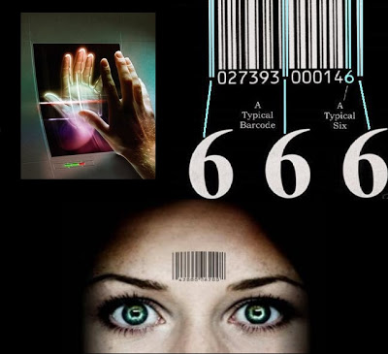
Is the mark of the beast a literal mark or some kind of modern technology?

Slide 4
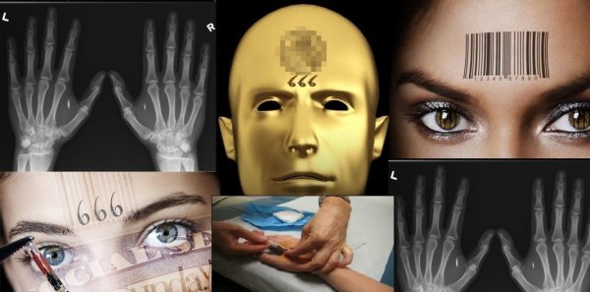

Slide 5
Revelation 13:16-18
(Vs. 16)
And he makes all persons.. low and high, rich and poor, free persons and slaves, to have a mark put upon their……… right hands OR upon their…… foreheads

Slide 6
MARK (Charagma): A scratch or etching, stamp (as a badge of servitude), engraving.
The word here rendered mark occurs 9 times in the N.T. (8 times in Revelation & 1 time in Acts 17:29 where it is rendered graven). The word properly means something graven or sculptured.
The Greek word implies an animal brand OR an impression made by a stamp like a seal on a government document OR an engraving like a tattoo. Anyone of these methods is applied to the skin.

Slide 7
RIGHT HAND OR FOREHEAD:
A mark in these places was used to denote some kind of stamp or I.D. in the case of a servant on whose hand the name of the master was impressed; or a soldier on whom a mark was impressed denoting the army or group to which he belonged. It was no uncommon thing to mark slaves or soldiers in this way; and the design was either to denote ownership or rank, or to prevent them from escaping undetected.

Slide 8
RIGHT HAND OR FOREHEAD:
The mark will be indelibly inscribed either on the right hand or the forehead of people, to show that they who bare it pledge allegiance to the antichrist and are subject to his authority--- as a slave is to his master, or a soldier to his commander. There will be a mark of distinction; something which would designate with entire certainty, those persons who belong to the antichrist.
(See Rev. 14:9 & 20:4 for supporting verses)

Slide 9
The saints of God have a mark too!
 A holy remnant in Jerusalem
(Ezekiel 9:4)
 144,000 Jews (Revelation 7:3; 9:4; 14:1)
 ALL saints in new bodies (Rev. 3:12; 22:4)

Slide 10
Revelation 13:17
And that no one might buy or sell, except they have the mark, or the name of the beast, or the number of his name.

Slide 11
The mark of the beast relates to the buying and selling of food, conducting business and possibly employment. The antichrist will claim jurisdiction over the traffic & trade of the world and make it tributary to his own purposes. This is represented by saying that no one might "buy or sell" except by his permission; and it is clear that where this power exists, there will be absolute control over the wealth of the world.

Slide 12
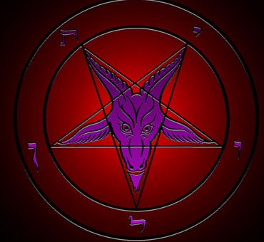
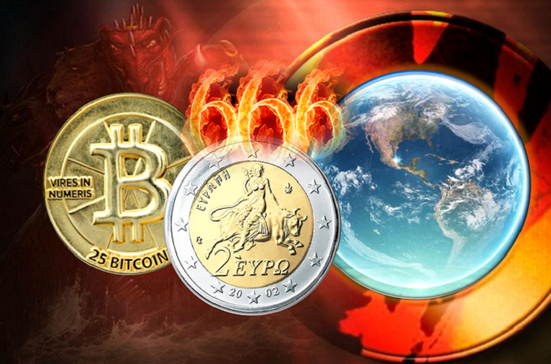
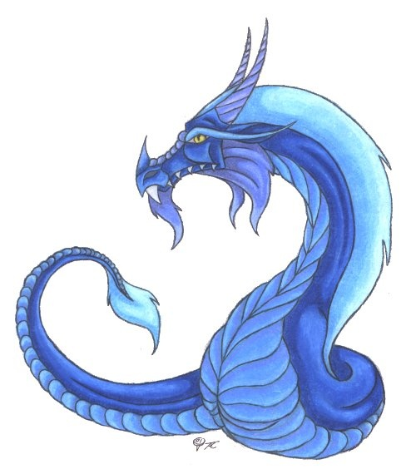
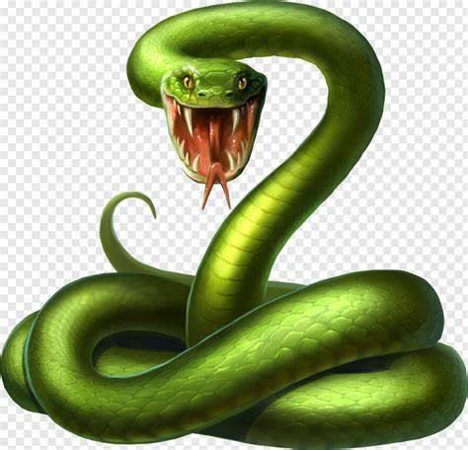
They had to have THE MARK…

Slide 13
…Or THE NAME…

Slide 14
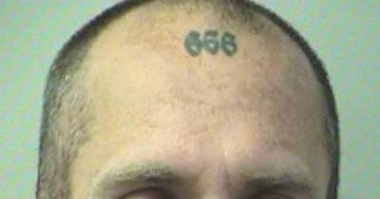
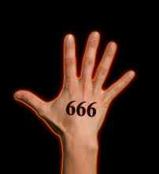
…Or THE NUMBER

Slide 15
Revelation 13:18
Here is wisdom. Let him that hath understanding count the number of the beast: for it is the number of a man; and his number is Six hundred threescore and six.
(KJV)

Slide 16
Revelation 13:18
Here is wisdom. Let him who has understanding calculate the number of the beast, for it is the number of a man: His number is six hundred and sixty-six.
(NKJV)

Slide 17
Revelation 13:18
This calls for wisdom: let him who has understanding reckon the number of the beast, for it is a human number, its number is six hundred and sixty-six.
(RSV)

Slide 18
Revelation 13:18
Here there is need for discernment. Let him who has the ability compute the number of the Beast; for the number indicates a man's name. Its number is six hundred and sixty-six.
(TCNT)

Slide 19
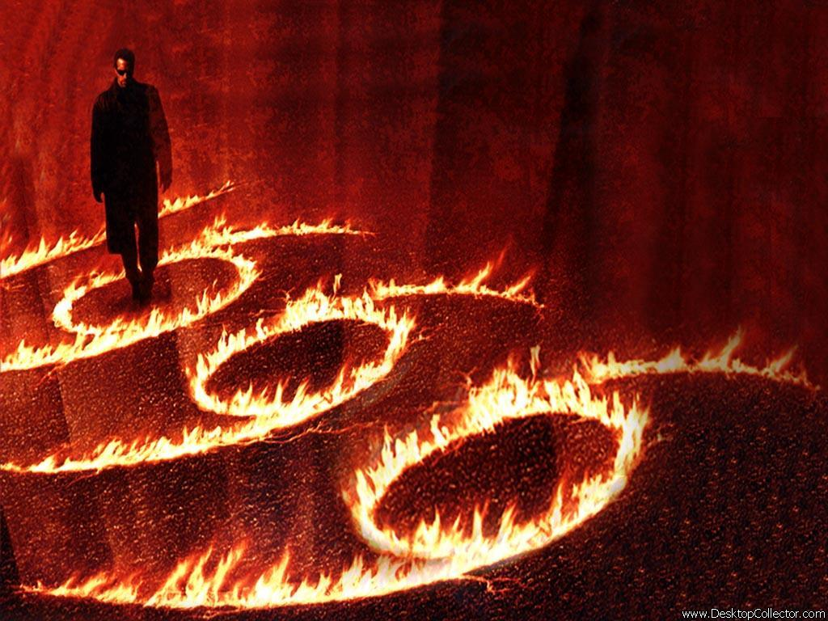
THE NUMBER OF A MAN

Slide 20
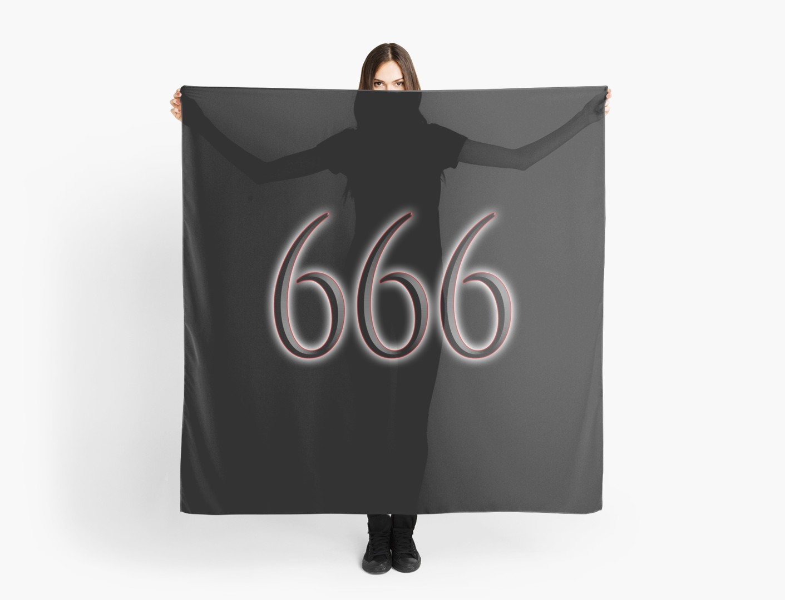
THE MARK OF THE BEAST
Can you accidentally or unknowingly accept the mark of the beast?

Slide 21
Can you accidentally or unknowingly accept the mark of the beast?
Revelation 13:3-9
Revelation 14:6-11
Revelation 19:20
Revelation 20:4
This group made a decision to worship the Devil & the Antichrist
This group made a decision to worship the true God – Jesus Christ

Slide 22
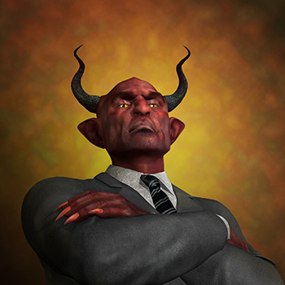
THE CHARACTER
AND
NATURE OF
THE ANTICHRIST

Slide 23
HE IS A MAN
Rev. 13:18 Here is wisdom. Let him that hath understanding count the number of the beast: for it is the number of a man; and his number is Six hundred threescore and six.
2 Thess. 2:3 Let no man deceive you by any means: for that day shall not come, except there come a falling away first, and that man of sin be revealed, the son of perdition
He is not a ‘super being’ or a demon, this is going to be a man. This also tells us his gender… he will be male not female.

Slide 24
HE WILL BE THE MAN OF SIN
2 Thess. 2:3 Let no man deceive you by any means: for that day shall not come, except there come a falling away first, and that man of sin be revealed, the son of perdition*
There will be no limits to the conceit and evil intentions of this dictator’s perverted character. He is called the son of *death and destruction. He will be the lawless one, meaning; a morally bad person who rejects the righteousness of God's laws. Disobedience, immorality, rebellion, violence and utter selfishness will be manifestations of this man of sin.

Slide 25
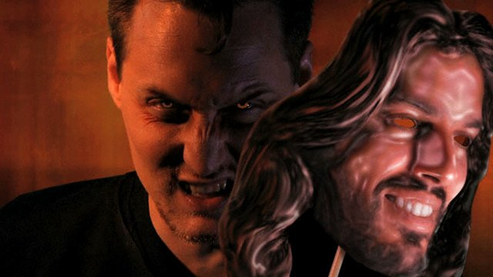
THE
MAN
BEHIND
THE
MASK

Slide 26
HE WILL CLAIM TO BE GOD & DEMAND WORSHIP
2 Thess. 2:4 …Who opposeth and exalteth himself above all that is called God, or that is worshipped; so that he as God sitteth in the temple of God, shewing himself that he is God.
He will be the self-declared God of this world. After he has been honoured as world messiah for 3½ years he will proceed to the most extreme form of rebellion against God by declaring himself to be God and by demanding the worship of all people (Rev. 13:8, 12).

Slide 27
HE WILL BE A BLASPHEMER
Dan. 7:25 And he shall speak great words against the most High, and shall wear out the saints of the most High, and think to change times and laws: and they shall be given into his hand until a time and times and the dividing of time.
Dan. 11:36 And the king shall do according to his will; and he shall exalt himself, and magnify himself above every god, and shall speak marvellous things against the God of gods, and shall prosper till the indignation be accomplished: for that that is determined shall be done.
Rev. 13:6 And he opened his mouth in blasphemy against God, to blaspheme his name, and his tabernacle, and them that dwell in heaven.

Slide 29
HE WILL DISPLAY MIRACULOUS POWERS
Rev. 13:2 And the beast which I saw was like unto a leopard, and his feet were as the feet of a bear, and his mouth as the mouth of a lion: and the dragon gave him his power (Dunamis) and his seat, and great authority
2 Thess. 2:8-9 And then shall that Wicked [one] be revealed… Even him, whose coming is after the working of Satan with all power and signs and lying wonders
He will be a notorious occult practitioner who will make use of the great powers given to him by Satan

Slide 30
HE WILL BE THE GREAT DECEIVER
2 Thess. 2:9-10 Even him, whose coming is after the working of Satan with all power and signs and lying wonders And with all deceivableness of unrighteousness in them that perish; because they received not the love of the truth, that they might be saved.
He will be without integrity. Through political fraud he will gain a position of leadership, and by the use of clever diplomacy (political lies) he will become world leader (Dan. 9:27). He will be the big briber. Double standards, bribery and corruption will be the order of the day in his wicked regime.

Slide 31
HE WILL CONTROL THE WORLD’S ECONOMY
Rev. 13:16-17 And he causeth all, both small and great, rich and poor, free and bond, to receive a mark in their right hand, or in their foreheads: And that no man might buy or sell, save he that had the mark, or the name of the beast, or the number of his name.
“Whoever rules the world’s goods, rules the world.” When people start getting hungry, they will do almost anything to keep from starving. Even submit to an ungodly ruler. He causes everyone to receive a mark so that they can’t even buy food or any goods at all unless they have his mark upon them.

Slide 32
HE WILL NOT HAVE A DESIRE FOR WOMEN
Dan. 11:37 Neither shall he regard the God of his fathers, nor the desire of women, nor regard any god: for he shall magnify himself above all.
Desire here means: delight, goodly, pleasant, precious… meaning; the antichrist will not delight in women, he will not be pleased or pleasured by women and he will not see women as precious.
COULD THIS MEAN THAT THE ANTICHRIST MIGHT BE A HOMOSEXUAL???

Slide 33
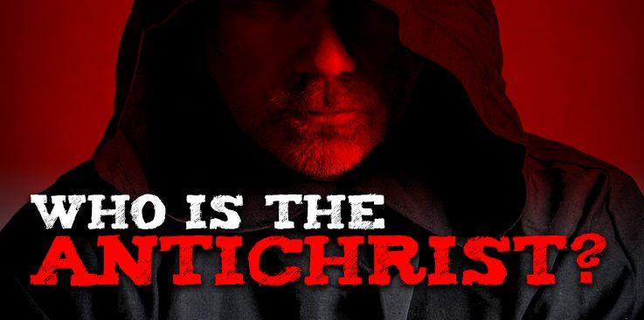

Slide 34
HE WILL RULE THE EARTH FOR A TIME
Rev. 13:5 & 7 And there was given unto him a mouth speaking great things and blasphemies; and power was given unto him to continue three & a half years… And it was given unto him to make war with the saints, and to overcome them: and power was given him over all kindreds, and tongues, and nations.
Dan. 7:25 And he shall speak great words against the most High, and shall wear out the saints of the most High, and think to change times and laws: and they shall be given into his hand for three & a half years

Slide 35
HE WILL KILL THE SAINTS
Rev. 20:4 And I saw thrones, and they sat upon them, and judgment was given unto them: and I saw the souls of them that were beheaded for the witness of Jesus, and for the word of God, and which had not worshipped the beast, neither his image, neither had received his mark upon their foreheads, or in their hands; and they lived and reigned with Christ a thousand years.
The Antichrist will set up a system to behead those who profess allegiance to Christ.

Slide 36
HE WILL DESECRATE GOD’S TEMPLE
Daniel 9:27 And he shall confirm the covenant with many for one week: and in the midst of the week he shall cause the sacrifice and the oblation to cease, and for the overspreading of abominations he shall make it desolate, even until the consummation, and that determined shall be poured upon the desolate.

Slide 37
HE WILL BE VERY WEALTHY
Daniel 11:43 & 45 But he shall have power over the treasures of gold and of silver, and over all the precious things of Egypt: and the Libyans and the Ethiopians shall be at his steps. And he shall plant the tabernacles of his palace between the seas in the glorious holy mountain; yet he shall come to his end, and none shall help him.

Slide 38
HE WILL MAKE WAR AGAINST CHRIST
Rev. 19:19 And I saw the beast, and the kings of the earth, and their armies, gathered together to make war against him that sat on the horse [CHRIST], and against his army.

Slide 39
The Antichrist’s doom & destiny
Rev. 19:20 And the beast was taken, and with him the false prophet that wrought miracles before him, with which he deceived them that had received the mark of the beast, and them that worshipped his image. * These both were cast alive into a lake of fire burning with brimstone.
* The Antichrist will be one of the first persons to be cast into the lake of fire.
His doom & destiny is the lake of fire

Slide 40
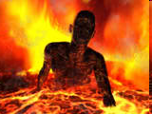
THE ANTICHRIST WILL BE CONDEMNED TO A PLACE OF NO RETURN

