Slide 2
What happens at the point of death?
Is death the end of it all?
Do people really go anywhere when they die?
Do people remain in the grave?
Where do people go after death?

Slide 3
What happens at the point of death?
Death is separation of spirit/soul from the body
Genesis 3:19
Ecclesiastes 3:20-21; 8:8; 12:7
Luke 23:46 (Jesus Christ)
Acts 7: 59-60 (Stephen)

Slide 4
What happens to people who do NOT die?
Instead of separation there is transformation
1 Corinthians 15:35-54
1 Thessalonians 4:17
EXCEPTIONS:
Enoch (Genesis 5:24; Hebrews 11:5)
Elijah (2 Kings 2:11-12)

Slide 5
DISCUSSION
Is death the end of it all?
Do people really go anywhere when they die?
Do people remain in the grave?

Slide 6
Where do people go after death?
The spirit/soul of the Believer goes to heaven
- The spirit/soul of the Unbeliever goes to hell

Slide 7
2 Samuel 12:21-23
Daniel 12:2
Matthew 25:41, 46
Luke 16:22-26; 23:43
John 14:1-3
2 Corinthians 5:8
1 Thessalonians 4:14-17
Revelation 6:9-11; 11:10-12

Slide 8
THE SOUL & THE SPIRIT
God created ALL spirits & souls
Isaiah 57:16 For I will not contend for ever, neither will I be always wroth: for the spirit should fail before me, and the souls which I have made.
Zechariah 12:1 ¶ The burden of the word of the LORD for Israel, saith the LORD, which stretcheth forth the heavens, and layeth the foundation of the earth, and formeth the spirit of man within him

Slide 9
THE SOUL & THE SPIRIT
ALL spirits & souls come from God & ALL belong to God
Genesis 2:7
Job 33:4; 34:13-15
Psalms 104:29-30
Ecclesiastes 12:7
Ezekiel 18:4-9, 20, 27

Slide 10
THE SOUL & THE SPIRIT
God is a Spirit and has a Soul
SPIRIT: John 4:24; 2 Corinthians 3:17
SOUL:
Leviticus 26:11
Isaiah 42:1
Jeremiah 32:41
Zechariah 11:8
Matthew 12:18 (Matthew 26:38)

Slide 11
DEFINITION OF SOUL
SOUL – Nephesh (Hebrew O.T.):
Used very widely in a literal or figurative sense (bodily or spiritually); breath. A soul is any… body, creature, spirit, life, person or self.
SOUL – Psuche (Greek N.T.):
Breath (by implication) spirit, life, heart, mind or person.
“The soul is the substantial entity in each person which lives, feels, thinks & wills. It is the personality & essence of who one is as a person”

Slide 12
THE SOUL
A soul consists of the non-physical elements of a person. While God appears to have a soul based on the scriptures; God’s soul may not function the same as a human soul. The concept of whether or not God has a soul depends upon what we consider a soul to be.
If we consider personhood to mean that one has a soul, then God has a soul because He has a mind, will and emotions.

Slide 13
THE SOUL
The Heavenly Father & the Holy Spirit are not human beings… they are Spirit beings. While they have emotions, will & intellect, they do not have a created soul like humans do.
However, the Father & the Spirit are whole persons. If we are talking about God’s soul, then it is reflective of God’s personhood & moral attributes.

Slide 14
DEFINITION OF SPIRIT
SPIRIT – Ruwach (Hebrew O.T.):
Wind or breath; life, unsubstantial or immaterial. A rational being (including its expression and functions)… possessing a mind.
SPIRIT – Pneuma (Greek N.T.):
A current of air… breath. The rational soul or mental disposition. Superhuman, an angel, demon, or (divine) God, Christ's spirit, the Holy Spirit:--ghost, life.

Slide 17
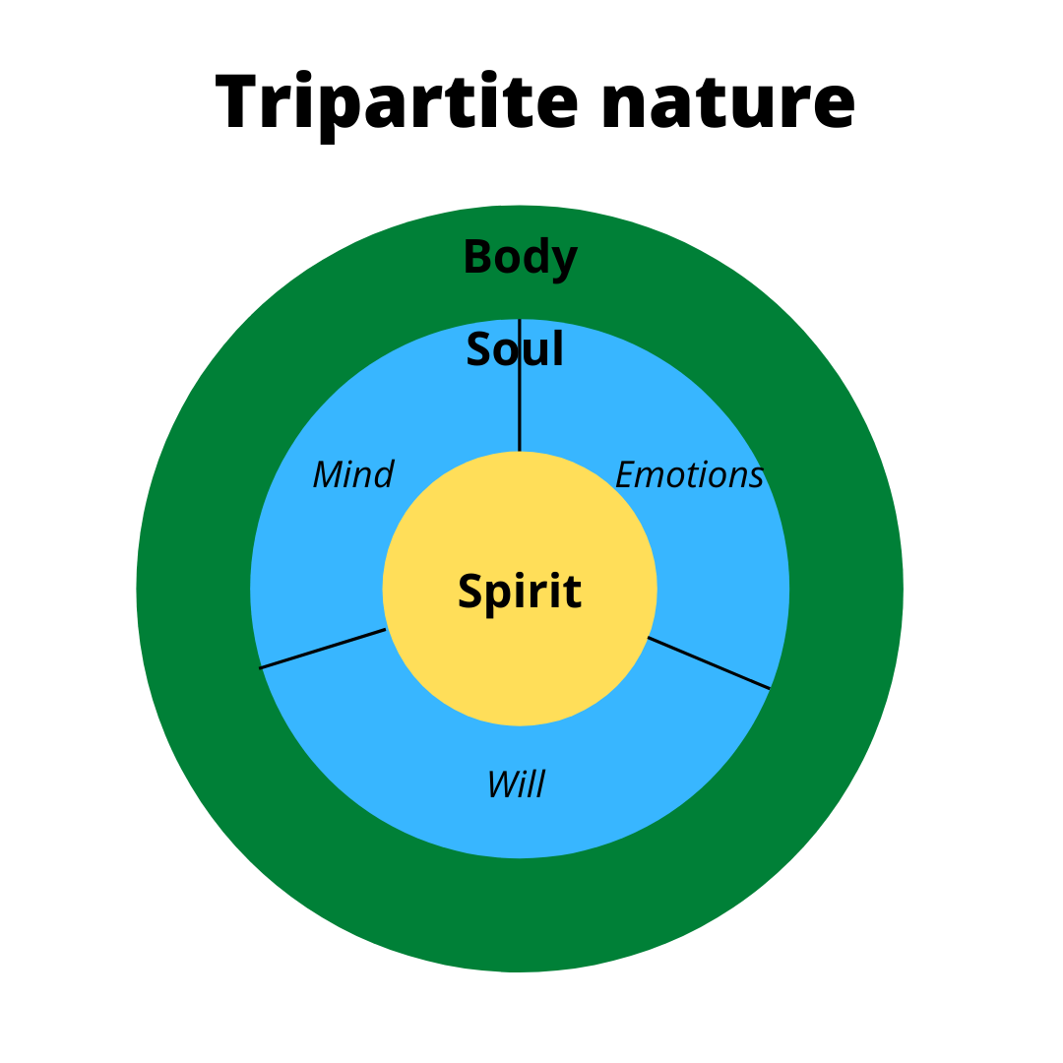

Slide 18
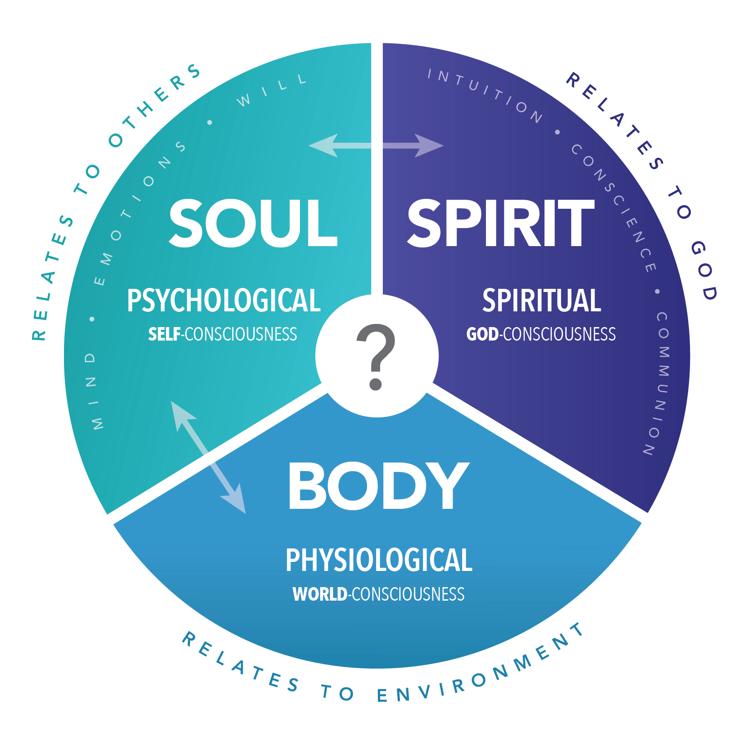
HUMAN

Slide 19
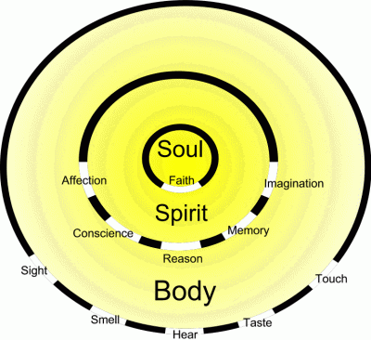

Slide 20
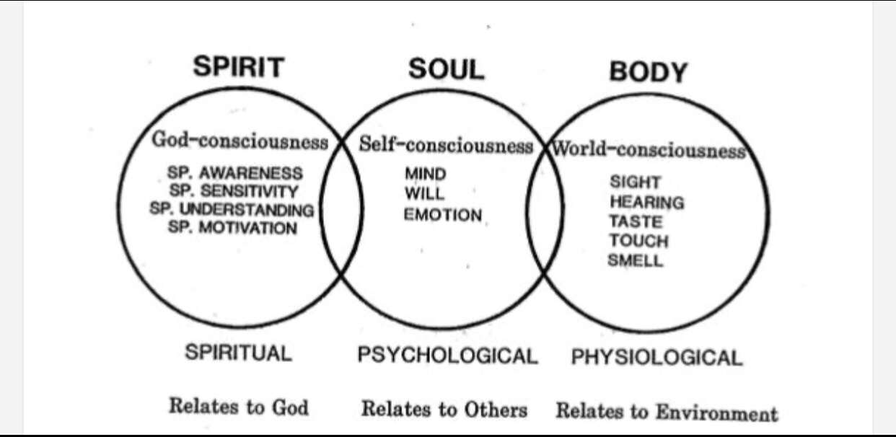

Slide 22
Scriptural evidence of tri-part human
Genesis 2:7
And the LORD God formed man of the dust of the ground [Body], and breathed into his nostrils the breath of life [spirit]; and man became a living soul.

Slide 23
Scriptural evidence of tri-part human
1 Thessalonians 5:23
¶ And the very God of peace sanctify you wholly; and I pray God your whole spirit and soul and body be preserved blameless unto the coming of our Lord Jesus Christ.

Slide 24
1 Thess. 5:23 proves that the soul and the spirit are not the same thing. It tells us that human beings are composed of three parts—spirit, soul, and body.
In Greek, the conjunction and in the phrase spirit and soul and body indicates these are three different things. The words spirit, soul & body are also three different Greek words.
The body is clearly distinct from the soul; in the same way, the soul is also distinct from the spirit.

Slide 25
Scriptural evidence of tri-part human
Hebrews 4:12
For the word of God is quick, and powerful, and sharper than any two-edged sword, piercing even to the dividing asunder of soul and spirit, and of the joints and marrow [Body], and is a discerner of the thoughts and intents of the heart.

Slide 26
The joints and marrow in our physical body are closely related, but they are distinct and can be separated. In the same way, our soul and our spirit can be divided by the Word of God, showing that they are also distinct from each other.

Slide 27
Distinction of spirit & soul
Now that we’ve seen that the soul and spirit are different, we need to realize their functions are also different. The function of our spirit, the deepest part of our being, is related to the spiritual realm: It enables us to contact and receive God Himself. John 4:24 shows that our spirit is able to contact God: “God is Spirit, and those who worship Him must worship in spirit and in truth.” God being Spirit means His substance is Spirit. Our spirit is the part of our being that corresponds to God and has the ability to contact, fellowship and worship Him.

Slide 28
Distinction of spirit & soul
Our soul is who we are, our personality, and is composed of our mind, our emotion, and our will. God created us with these faculties so we can express to Him. God’s purpose in creating human beings with a spirit and a soul was that they would receive Him in their spirit and express Him through their soul. Luke 1:46-47 shows the different functions of the soul and spirit in Mary’s praise of the Lord.

Slide 29
Distinction of spirit & soul
Luke 1:46-47
And Mary said, my soul doth magnify the Lord, And my spirit hath rejoiced in God my Saviour.

Slide 30
Distinction of spirit & soul
First, Mary’s soul magnified the Lord and then her spirit exalted God. Her praise to God issued from her spirit and was expressed through her soul. Her spirit was filled with joy in God her Savior, and her soul manifested that joy for the magnifying of the Lord. She lived and acted in her spirit, which directed her soul. So the function of our spirit is to contact God and receive God, and the function of our soul is to express to God.

Slide 31
Can the human spirit sin?
Isaiah 29:24
Isaiah 65:14
2 Corinthians 7:1
Ephesians 2:1-2

Slide 32
Where does the spirit go?
Where does the soul go?
Do they go to the same place?
Do they leave the body as one entity?

Slide 33
When the spirit enters the body, life begins! (Genesis 2:7; Luke 8:55; Revelation 11:11)
When the spirit leaves the body, life ends! You are physically dead! (James 2:26)
The spirit returns to God! (Ecclesiastes 12:7; Luke 23:46; Acts7:59)
At death the soul also leaves the body! (Genesis 35:18-20; Luke 12:16-20)
The soul either goes to HEAVEN or HELL! (Psalms 30:3; 49:15; 86:13… Matthew 10:28; Revelation 6:9-11)

