Slide 1
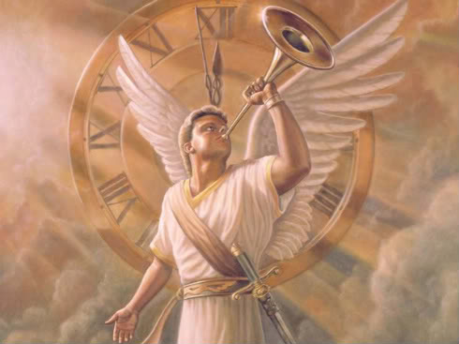
THE END IS NEAR
A LOOK AT END TIMES

Slide 2
The LAST DAYS
The last days refers to the period beginning from Christ’s death, resurrection, ascension and the rapture. Since the rapture has not yet occurred, then we are still living in the last days. The traditional view or belief is that the rapture marks the end of the last days. However, based on Scripture, the last days also includes the period after the rapture which will usher in events such as the great tribulation and the millennial reign.

Slide 3
The LAST DAYS
These passages indicate & describe last days events which occur after the rapture
Isaiah 2:1-5, 11, 17-21
Micah 4:1-7

Slide 4
A look at the LAST DAYS
SOME SIGNS OF THE LAST DAYS
DECEPTION by false teachers
DEPARTURE from the faith
DERISION of the faith
DISPUTES among nations
DEVASTATION of places
DETERIORATION of society

Slide 5
A look at the LAST DAYS
SIGNS OF THE LAST DAYS
DECEPTION by false teachers
There is an increasing number of false teachers in these last days and more persons are going to look to these religious leaders who claim to have a deeper knowledge of Scripture or new revelations outside of Scripture and an exclusive relationship with God. False teachers are some of the most subtle yet most dangerous enemies of the Church of Jesus Christ.

Slide 6
A look at the LAST DAYS
SIGNS OF THE LAST DAYS
DECEPTION by false teachers
Mathew 24: 1-5, 11-12, 23-26
2 Peter 2: 1-3
1 John 2:18-19
1 John 4:1-3

Slide 7
A look at the LAST DAYS
SIGNS OF THE LAST DAYS
DEPARTURE from the faith
This is otherwise called the FALLING AWAY. Some church members fall into this category. In these last days some who professed to be Christians have departed from obedience to the Bible, departed from their commitment to Christ, departed from service & attendance to Church and have demonstrated a major disloyalty to the Christian faith. This sparks a legitimate debate as to whether these persons are saved or not?

Slide 8
A look at the LAST DAYS
SIGNS OF THE LAST DAYS
DEPARTURE from the faith
2 Thessalonians 2:1-3
1 Timothy 4:1-6

Slide 9
A look at the LAST DAYS
SIGNS OF THE LAST DAYS
DISPUTES among nations
Matthew 24:6-10
Mark 13:7-8
Luke 21:9-10
Notes:
Luke 21:9--Commotions: Instability, disorder, confusion, uprisings

Slide 10
A look at the LAST DAYS
SIGNS OF THE LAST DAYS
DISPUTES among nations: WARS
Territorial wars
Terrorist wars
Civil wars
Political wars
Drug wars

Slide 11
A look at the LAST DAYS
DISPUTES among nations
WARS | COMMOTIONS
Russia & Ukraine (2022) | America & Middle East *
Israel & Hamas (2023) | Pakistan & Iran (2024)
Afghanistan & Iran (2023) | China & Taiwan (1950)
Israel & Palestine * | Pakistan & India (1947)
Armenia & Azerbaijan (1991) | Venezuela & Guyana (2023)
Currently, there are approximately 32 countries at war!
Notes:
Israel: Gaza, Lebanon, Yemen, Iraq, Iran, North Korea--- America: Iran, Iraq, Syria,

Slide 12
A look at the LAST DAYS
SIGNS OF THE LAST DAYS
DERISION of the faith
In these last days, some persons will deride (ridicule, mock) the belief that Jesus is coming back. This particular sign is tied to Jesus’ return as it is a specific attack & attempt to try and disregard or discredit the doctrine of Christ’s return.

Slide 13
A look at the LAST DAYS
SIGNS OF THE LAST DAYS
DERISION of the faith
2 Peter 3:1-9
Verse 3:
“Scoffer”… Deriding, ridiculing, insulting comments
“walking after their own lusts”… Led by their own ungodly desires
Verse 4:
Where is the fulfillment of the promise that Jesus will return?
Where are the signs or indications of his coming?

Slide 14
A look at the LAST DAYS
SIGNS OF THE LAST DAYS
DERISION of the faith
Verse 4:
When is Jesus coming? Is he actually going to return? Where is he?
They were implying that the promise of Jesus’ return was not true. They were questioning Christ, Scriptures & the very belief system of the return of Christ.
“all things continue as they were” They say…nothing has changed since the world was created… nature has not changed… the laws of nature remain the same.

Slide 15
A look at the LAST DAYS
SIGNS OF THE LAST DAYS
DERISION of the faith
Jude 1:17-21
Verse 18:
“mockers” – deriders (to laugh at or insult contemptuously); to ridicule; lack of respect…
‘Scoffer’- false teacher
There will be mockers who are led by their own ungodly desires

Slide 16
A look at the LAST DAYS
SIGNS OF THE LAST DAYS
DERISION of the faith
Verse 19:
“separate themselves” – divide themselves from the church… They withdraw themselves from the local body of Christ & sometimes influence others, distract others, mislead others away from truth… They are distinct from others and distinguish themselves as separate from the church.

Slide 17
A look at the LAST DAYS
SIGNS OF THE LAST DAYS
DERISION of the faith
Verse 19:
“sensual” – lower or bestial nature, animal-like behavior… They are under the influence of gross passions and wicked indulgences.
“having not the Spirit” – Not partakers of salvation… not led by the Spirit… not under the Spirit’s guidance

Slide 18
A look at the LAST DAYS
SIGNS OF THE LAST DAYS
DERISION of the faith
Do not worry about how long it is taking for Christ to return because God’s timing is different from ours. He is giving time for people to repent but if they do not repent then judgment is sure.

Slide 19
A look at the LAST DAYS
SIGNS OF THE LAST DAYS
DEVASTATION of places
Many cataclysmic activities are occurring in these last days and will continue to manifest in a more catastrophic way as the last days unfold in the future. These activities or events will mark the return of the Lord as well as the day of the Lord.
They can be categorized as acts of nature caused by God & will include disasters such as: famines, diseases, earthquakes, galactic disruptions, floods, hurricanes & anomalies (abnormal disasters).

Slide 20
A look at the LAST DAYS
SIGNS OF THE LAST DAYS
DEVASTATION of places
Matthew 24:7, 27-30
Mark 13:24-26
Luke 21:25-27
Acts 2:17-21
Joel 2:1-11
Isaiah 13:9-22 (Babylon)

Slide 21
A look at the LAST DAYS
SIGNS OF THE LAST DAYS
DEVASTATION of places
Wildfire Kills at Least 100 in Hawaii
Drought and wind gusts converged on the Hawaiian island of Maui on August 8, 2023 to create the conditions for a series of fires that raged for 3 days before being mostly contained. The blaze eventually took the lives of at least 100 people, staking its claim as one of the deadliest wildfires in U.S. history.

Slide 22
A look at the LAST DAYS
SIGNS OF THE LAST DAYS
DEVASTATION of places
Cyclone kills at Least 145 in Myanmar
Flash floods and winds of up to 130 mph from Cyclone Mocha ripped through Myanmar on May 14, 2023 causing the deaths of at least 145 people. The storm was one of the worst experienced by the Southeast Asian nation in years.

Slide 23
A look at the LAST DAYS
SIGNS OF THE LAST DAYS
DEVASTATION of places
Floods in the DRC take more than 438 Lives
Early May 2023 saw torrential rain fall on the eastern region of the Democratic Republic of Congo, causing flash flooding and mudslides. The flood water killed at least 438 people and left thousands more missing or homeless. Heavy rain and extreme flooding have become increasingly common in Africa in recent years.

Slide 24
DEVASTATION of places
Tropical Cyclone kills at least 679 in Malawi
For 6 days in early March, 2023 heavy rains from Tropical Cyclone Freddy fell upon Malawi and took the lives of at least 679 people, though the actual toll likely exceeds 1,000. While Malawi bore the brunt of the destruction, other countries in southern Africa were not spared. At least 17 people died in Madagascar, and at least 183 died in Mozambique, where 184,000 people were displaced.

Slide 25
A look at the LAST DAYS
SIGNS OF THE LAST DAYS
DEVASTATION of places
Storm kills at least 4,352 in Libya
On Sept. 10, 2023 Storm Daniel smashed into the Mediterranean coastal city of Derna in Libya, bringing with it torrential rain and considerable flooding and bursting two of the city’s dams. As of Oct. 31, 2023 the official toll sits at 4,352 lives lost, with an estimated 8,000 still missing and feared dead.

Slide 26
A look at the LAST DAYS
SIGNS OF THE LAST DAYS
DEVASTATION of places
Earthquake claims at least 157 lives in Nepal
On Nov. 3, 2023 a 5.6-magnitude earthquake struck western Nepal and killed at least 157 people. The mountainous nation is no stranger to seismic activity. One of its most destructive earthquakes took almost 9,000 lives in 2015.

Slide 27
A look at the LAST DAYS
SIGNS OF THE LAST DAYS
DEVASTATION of places
Earthquake in Afghanistan kills at least 1,480
A 6.3-magnitude quake shook western Afghanistan on Oct. 7, 2023 killing at least 1,480 people and injuring thousands more. The disaster compounded already precarious conditions of food insecurity & famine.

Slide 28
A look at the LAST DAYS
SIGNS OF THE LAST DAYS
DEVASTATION of places
Earthquake kills 2,946 in Morocco
A magnitude 6.8 earthquake struck 45 miles southwest of Morocco on Sept. 8, 2023 taking 2,946 lives and injuring 5,674. An official at the country’s National Institute of Geophysics described the quake as the strongest ever recorded in the region.

Slide 29
A look at the LAST DAYS
SIGNS OF THE LAST DAYS
DEVASTATION of places
Earthquake takes over 55,000 lives in Turkey and Syria
On Feb. 6, 2023 a 7.8-magnitude earthquake struck southeast Turkey near the Syria border, followed by a 7.5-magnitude aftershock mere hours later. The disaster took the lives of more than 55,000 people. Most of the dead were Turkish. Turkey’s last 7.8-magnitude quake in 1939 caused more than 32,000 deaths

Slide 30
L A S T D A Y S

Slide 32
THE TRIBULATION
The Tribulation is a future seven (7) year period when God will complete his discipline of Israel and final judgment upon the unbelieving citizens who are living in the world at that time.
The tribulation is a time of distress, misery, affliction and persecution. This time of suffering and death is called the Great Tribulation because its severity will surpass all previous periods of suffering that has ever been experienced throughout human history.

Slide 33
THE TRIBULATION
Within eschatology (the study of future things), the Tribulation refers to the full seven-year period while the “Great Tribulation” refers to the second half of the Tribulation. Thus it is important to note that the Tribulation and the Great Tribulation are not regarded as synonymous terms by some theologians. The Great Tribulation is distinguished from the Tribulation period because the Antichrist will be revealed and the wrath of God will greatly intensify during this time. (SEE DIAGRAM)

Slide 35
THE TRIBULATION
During the tribulation, some of the following events are expected to occur:
Revelation & government of the antichrist
World peace treaty
Destruction of false religion
Attack on true religion
Judgment of earth’s inhabitants
Coalition of kingdoms/nations
Armageddon

Slide 36
THE TRIBULATION
► The Nature of the Tribulation
It is a time of wrath
It is a time of judgment
It is a time of Punishment
► The Purpose of the Tribulation
To pour out judgment on unbelievers
To prepare Israel for the Messiah

Slide 37
THE TRIBULATION
► The Source of the Tribulation
God will be the primary source to execute the 7 seals, 7 trumpets & 7 bowls
Satan will be a secondary source to persecute tribulation saints & Israel
The anti-Christ will be a false source of peace & then a real source of pain & discomfort

Slide 38
THE TRIBULATION
Tribulation simply means "pressure (literally or figuratively): affliction, anguish, burdened, persecution, tribulation, trouble" and can refer to anything from the daily trials of life to very severe trials including persecutions for the faith.
However, when we refer to the Great Tribulation it is a period of tribulation exceeding all others.

Slide 39
THE TRIBULATION
The nature of the Great Tribulation is summed up in the following passages. What we refer to as the Great Tribulation is derived from these Scriptures:
Matthew 24:21
For then there will be a great tribulation, such as has not occurred since the beginning of the world until now, nor ever will.

Slide 40
THE TRIBULATION
Daniel 12:1
At that time . . . there will be a time of distress such as never occurred since there was a nation until that time.

Slide 41
THE TRIBULATION
Revelation 7:14
And he said to me, These are the ones who come out of the great tribulation, and they have washed their robes and made them white in the blood of the Lamb.

Slide 42
THE TRIBULATION
WHY WE BELIEVE THE CHURCH WILL BE RAPTURED (TAKEN) BEFORE THE TRIBULATION?
Scripture implies it:
- 1 Thessalonians 1:9-10 (Rev 6:12-17)
- 1 Thessalonians 5:1-11
- 2 Thessalonians 2:3-14
- Revelation 3:7-13 (2 Peter 2:9)

Slide 43
THE TRIBULATION
WHY WE BELIEVE THE CHURCH WILL BE RAPTURED (TAKEN) BEFORE THE TRIBULATION?
The Church is not mentioned during the tribulation & is also missing in action
The tribulation is a time of God’s wrath so it is likely that God removes His Church to preserve it
Only 144,000 Jews will be preserved (sealed) from the wrath of God, but why not seal the Church as well if they are there? (Rev. 7:1-4)

Slide 44
THE TRIBULATION
WHY WE BELIEVE THE CHURCH WILL BE RAPTURED (TAKEN) BEFORE THE TRIBULATION?
Israel will be purified & restored to become God’s major witnesses in the tribulation but not the Church… how come?
The Church will be judged first, before returning with Christ as His bride and the Judgment will also take some time to preside over. This time period could very well be during the tribulation (1 Peter 4:17-19)

Slide 48
EVENTS OF THE TRIBULATION
The Antichrist signs a covenant for 7 years with the nation of Israel. This is the event that inaugurates the Tribulation period
144,000 Jews sealed to preach the gospel
7 Seals opened and unleashed on the earth
2 Witnesses will testify for 3 ½ years
7 Trumpets blown and unleashed on the earth

Slide 49
EVENTS OF THE TRIBULATION
War in heaven: The devil and his angels cast out of heaven
The antichrist & the devil given dominion for 3 ½ years
The antichrist breaks his covenant with Israel & commits abomination & desecrates the temple
Israel flees from the antichrist for 3 ½ Years

Slide 50
EVENTS OF THE TRIBULATION
2 Witnesses killed & resurrected on the 3rd day
The “false prophet” joins & endorses the antichrist
Mark of the beast is instituted & enforced
7 Bowls poured out and unleashed on the earth
An angel preaches the gospel to the earth
The battle of Armageddon

Slide 51
TRIBULATION: The antichrist treaty
The Final Week of 7 years: This period describes the final week of years of the original 70 weeks of Daniel, which is referring to the 7 Year Tribulation. The antichrist will establish a 7 year Peace Treaty with Israel, thereby confirming the covenant and marking the beginning of the 7 year Tribulation.
The antichrist will make a covenant with Israel & the duration is to be one week or 7 years.

Slide 52
TRIBULATION: The antichrist treaty
The content of the covenant is that the antichrist will guarantee Israel's security for seven years so that they may carry out the Temple sacrifices and offerings unhindered during those seven years. However, after three and a half years, the antichrist will put a stop to that which he guaranteed because he will break his covenant and become Israel’s offender. (Daniel 9:27)

Slide 53
TRIBULATION: The antichrist treaty
What is “the abomination of desolation”?
An abomination is “something that causes disgust or hatred”; and desolation is “a state of complete emptiness or destruction.” Jesus warned that something (or someone) that people detested would stand in the temple someday. When that horror occurred, residents of Judea should seek cover without delay. Other translations speak of “the abomination that causes desolation”, “the sacrilegious object that causes desecration” and “that Horrible Thing.”

Slide 54
TRIBULATION: The antichrist treaty
The Abomination of Desolation appears throughout history and in the age to come. The antichrist figure who sets up an abomination in the place of worship has had a role throughout history. In history, this abomination was an idol; but in the case of the end of days, the antichrist will set himself up as the idol for the people to worship.

Slide 55
TRIBULATION: The antichrist treaty
Jesus spoke of a coming “abomination of desolation” in the Olivet Discourse as He referenced a future event. Jesus referenced Daniel in His words in the Olivet Discourse. The prophet Daniel mentioned the abomination of desolation in three places:
“He will make a firm covenant with many for one week, but in the middle of the week he will put a stop to sacrifice and offering. And the abomination of desolation will be on a wing of the temple until the decreed destruction is poured out on the desolator” (Daniel 9:27).

Slide 56
TRIBULATION: The antichrist treaty
“Forces shall be mustered by him, and they shall defile the sanctuary fortress; then they shall take away the daily sacrifices, and place there the abomination of desolation” (Daniel 11:31)
“From the time that the regular sacrifice is abolished and the abomination of desolation is set up, there will be 1,290 days” (Daniel 12:11)

Slide 57
TRIBULATION: The antichrist treaty
Daniel’s prophecies about the abomination of desolation seemed to have at least a partial fulfillment in 167 BC when a Greek ruler by the name of Antiochus IV desecrated the temple in Jerusalem. Antiochus called himself “Epiphanies” (“illustrious one” or “god manifest”). He set up an altar to Zeus over the altar of burnt offering, and he sacrificed a pig on the altar. Antiochus slaughtered a great number of the Jews and sold others into slavery. And he issued decrees forbidding circumcision and requiring Jews to sacrifice to pagan gods and eat pig meat.

Slide 58
TRIBULATION: The antichrist treaty
What Antiochus did certainly qualifies as an abomination, but it was not a complete fulfillment of Daniel’s prophecy. Antiochus Epiphanies did not enter into a covenant with Israel for seven years; and in Matthew 24 Jesus, speaking some 200 years after Antiochus’ evil actions, spoke of Daniel’s prophecy as having a still future fulfillment.

Slide 59
TRIBULATION: The antichrist treaty
We take the futurist view, which sees the abomination of desolation prophecy as still future. In our view, Jesus was referring to the Antichrist who, in the end times, will establish a covenant with Israel for seven years and then break it by doing something similar to what Antiochus Epiphanies did in the temple. We should also recognize that the breaking of the covenant with Israel and the abomination of desolation will herald the beginning of the worst 3½ years in history.

Slide 60
TRIBULATION: The antichrist treaty
What is “the abomination of desolation by the antichrist”?
It is the image of “the beast,” which will be set up in the temple of Jerusalem. An idol is bad enough, but setting it up in the temple is the height of all blasphemy. Since Satan could not command worship in heaven, he will go to the next best place—the Jewish temple in the Holy City and promote the antichrist as the one to worship instead of Jesus the Christ.

Slide 61
TRIBULATION: The antichrist treaty
The antichrist will desecrate the temple and abolish the daily sacrifice. In other words, not only will he defile the temple, but he will also force the Jews to stop their daily, religious rituals.
Daniel 9:21-27
Daniel 11:29-32
Daniel 12:7-13
Matthew 24:15-21

Slide 62
TRIBULATION: The antichrist treaty
Daniel 11:29-32
(Vs. 29) At a fixed or appointed time he will come back and come into the south; but in the later time it will not be as it was before.
Some think this is either Antiochus Epiphanies or The Anti-Christ… Or both
The south could be referring to Egypt wherein an invasion would take place but it will not be successful as the former expedition.

Slide 63
TRIBULATION: The antichrist treaty
Daniel 11:29-32
(Vs. 30) For those who go out from the west (Chittim/Cyprus) will come against him, and he will be greived and will go back, full of wrath against the holy agreement (covenant); and he will do his pleasure: and he will go back and be united with those who have given up the holy agreement.
He will be grieved and return, and have indignation against the holy covenant & avenge his rage by coming against the people of God the second time… He will be in league with the Jews who will forsake the covenant of the Lord.

Slide 64
TRIBULATION: The antichrist treaty
Daniel 11:29-32
(Vs. 31) And armies sent by him will take up their position and they will desecrate the holy place, and take away or pollute the regular offering and put in its place an unclean thing causing fear.
He will commit abomination in the temple and thereby becoming a major offence to the Jews and their ceremonial rituals & traditions.

Slide 65
TRIBULATION: The antichrist treaty
Daniel 11:29-32
(Vs. 32) And those who do evil against the agreement (covenant) will be turned to sin by his fair words: but the people who have knowledge of their God will be strong and do well.
Those Jews who are not genuine nor committed to their faith, will be influenced by him to commit sin. But the genuine Jews will stand firm and take action, even unto death if needs be.

Slide 66
TRIBULATION: The antichrist treaty
Daniel 12:6-13
(Vs. 7) And I heard the man clothed in linen, who was above the waters of the river; and he held up his right hand and his left hand unto the heavens, and swore by him that liveth for ever that it is for a time, times, and a half; and when the scattering of the power of the holy people shall be accomplished, all these things shall be finished.
“A TIME” is 1 year
“TIMES” is 2 years
“HALF” is 6 months
= 3 ½ YEARS

Slide 67
TRIBULATION: The antichrist treaty
Daniel 12:6-13
(Vs. 7) …and when the scattering of the power of the holy people shall be accomplished, all these things shall be finished.
The whole mystery in respect to the antichrist will be revealed & fulfilled after 3 ½ years.
The angel lifted up both his hands towards the sky… and said, ‘It will continue for three and a half years. Then the enemies of God's holy people will finally lose their power. That will be the end of all these events. (Vs. 7 abbreviated)

Slide 68
TRIBULATION: The antichrist treaty
Daniel 12:6-13
(Vs. 10) The time of trouble will cause many people to become clean and pure. But wicked people will continue to do evil things. Wicked people will not understand what God is doing. But wise people will understand.
When these predictions shall come to pass, the godly shall be "purified" by the foretold trials and shall understand that the end is at hand. Persons will still be saved during the time of tribulation in spite of their difficulties.

Slide 69
TRIBULATION: The antichrist treaty
Daniel 12:6-13
(Vs. 11) People will suffer for 1,290 days (3 ½ years)* during that time of trouble. It will start from the time when people can no longer offer their sacrifices each day in the temple. That is when the enemy will put a disgusting thing (abomination of desolation) that causes trouble in the holy place
After the first 3 ½ years when the antichrist breaks his covenant and commits abomination in the temple; it will usher in the second half of the (great) tribulation which will last for another 3 ½ years, thereby totaling 7 years.

Slide 70
TRIBULATION: The antichrist treaty
Daniel 12:6-13
(Vs. 12) But God will bless all those people who remain faithful until the 1,335 days (3 ½ years) come to an end.
Verse 11 says 1290 days which is approximately 3 years & 5 months
verse 12 says 1335 days which is approximately 3 years & 6 months
The difference is approximately 45 days (1 month & 15 days)

Slide 71
TRIBULATION: The antichrist treaty
Daniel 12:6-13
(Vs. 13)
(Daniel) You yourself must serve God faithfully until the end of your life. You will die. But at the end of time you will rise to live again. Then you will receive the good things that God has prepared for you.

Slide 72
TRIBULATION: The 144,000 Jews
Sealing of 144,000 Jews: 12,000 from each tribe of Israel
(Revelation 7:1-8)
Celebration of the 144,000 Jews: Mission accomplished
(Revelation 14:1-7)

Slide 73
TRIBULATION: The 2 Witnesses
The 2 witnesses prophecy for 3 ½ years, they are killed & then resurrected
(Revelation 11:1-13)
The 2 witnesses will begin a prophetic ministry supported by signs and wonders which will center in the Temple and include messages of judgment and repentance, particularly to Israel.

Slide 74
TRIBULATION: The 2 Witnesses
And I will authorize My two witnesses to prophesy for 1,260 days (42 months or 3 ½ years) clothed in sackcloth. (Rev. 11:3)
God will grant to His two witnesses the right, or the power, of prophesying, during the time specified.

Slide 75
TRIBULATION: The 2 Witnesses
Who are the 2 witnesses?
The 2 witnesses will prophesy for 1,260 days (3 ½ years) which would correspond with the 42 months of judgments described in Rev. 11:2. These 2 witnesses are real people with miraculous powers assigned to preach and witness during the entire first half of the Tribulation.

Slide 76
TRIBULATION: The 2 Witnesses
Who are the 2 witnesses?
(Rev. 11: 4) The olive tree was the source of the oil used to provide for the candlesticks. The candlesticks burning the oil, gave forth light. The symbols imply that during this period of 3 ½ years; God shall have two agents, bearing divine witness, which shall give forth light to people. These agents shall be filled and sustained by the Holy Spirit.

Slide 77
TRIBULATION: The 2 Witnesses
So who are the 2 witnesses?
LIST OF POPULAR SUGGESTIONS:
Elijah
Moses
Enoch
Elisha
Joshua
Zerubbabel
Malachi 4:4-6

Slide 78
TRIBULATION: The 2 Witnesses
It could even be two ordinary ministers who are contemporaries of that time period, who will be given extra ordinary powers by God to prophesy and declare on God’s behalf. ONLY GOD KNOWS FOR SURE… but what we do know is that…God shall have two agents, bearing divine witness, who shall testify to people.

Slide 79
TRIBULATION JUDGMENTS

Slide 82
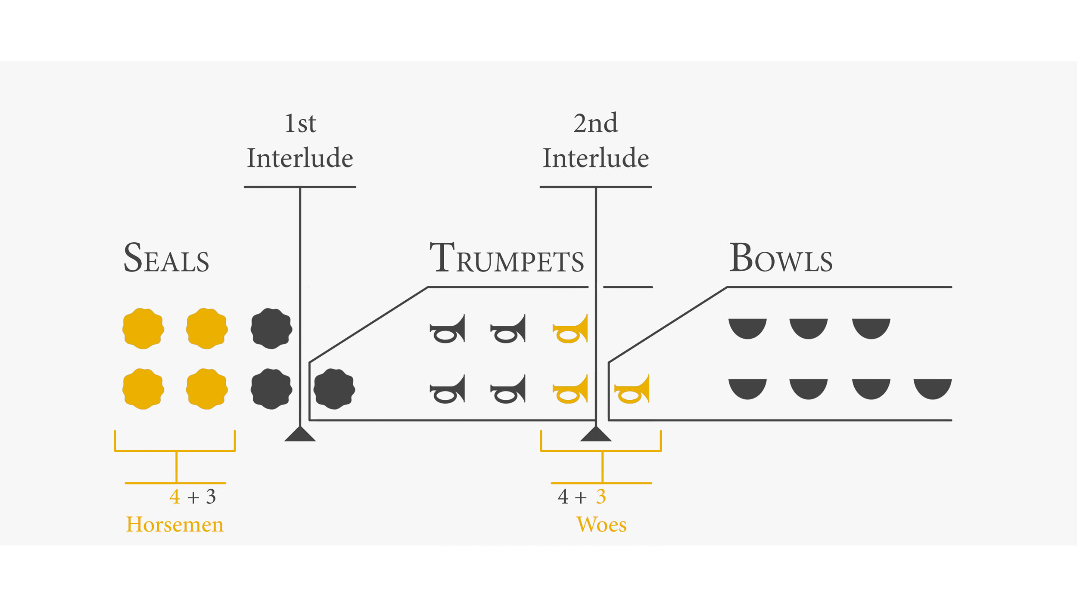

Slide 83
THE SEVEN (7) SEALS
1. White Horse of cold war
2. Red Horse of war
3. Black Horse of famine
4. Pale Horse of death
5. Martyred Saints
6. Cosmic Disturbances
7. Silence: Intro to the 7 trumpets

Slide 84
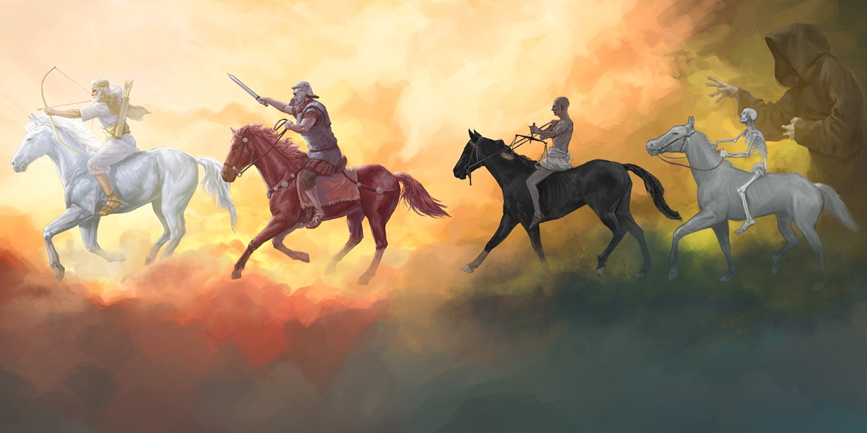
THE FIRST 4 SEALS ARE 4 HORSEMEN

Slide 85
1st SEAL: White Horseman
Revelation 6:2

Slide 86
1st SEAL: White Horseman (Rev. 6:2)
There are several features of the 1st rider that grab our attention:
1) The horse… 2) His white color… 3) The rider… 4) His crown 5) His bow… & 6) His mission.
It is certain that none of these features would have been named if they did not have a significance.
What do each of these symbols mean?

Slide 87
1st SEAL: White Horseman (Rev. 6:2)
(1) The horse: The horse was not normally used by the Jews or Orientals as an animal of burden. The ox and the ass were devoted to that office, while the horse was reserved for war. Whenever the horse is mentioned by the prophets it will be found in connection with war-like employments. Hence this symbol points to a period of war, though it does not declare whether the conflict is carnal or spiritual, or whether it is (false) peace or disastrous.

Slide 88
1st SEAL: White Horseman (Rev. 6:2)
(2) The white color: As there are three more horses in succession under the three following seals, each has a different color, thus the color must have a meaning. White must have a different significance from red, or black, or pale. White is the color of prosperity, of happiness, and TRIUMPH (conquest).

Slide 89
1st SEAL: White Horseman (Rev. 6:2)
(3) The crown: "There was a crown given to him." This crown is not "the diadem" (diadema) but the "garland crown" (stephanos). The garland or wreath crown was given as a reward for victory in battle, for great achievements or for victory in games. Jesus makes appearances in both crowns at different occasions. In Rev. 14:14 He will wear a golden garland crown (stephanos) & then in Rev. 19:12 He will wear many kingly crowns (diadema).

Slide 90
1st SEAL: White Horseman (Rev. 6:2)
(4) The rider: His significance is due to his arms, his crown, and the white horse he rides. It is enough to state here that he represents either some conqueror, or a conquering age.
A major debate is determining who is the rider?

Slide 91
1st SEAL: White Horseman (Rev. 6:2)
WHO IS THE RIDER?
Some say: JESUS CHRIST or ANTI-CHRIST or an ANGEL
Verdict: UNCERTAIN
Why Christ? He rides a white horse in Rev. 19:11
Uncertainty of Christ: Christ’s role in chapter 6 was that of opening the seals & He was seen in heaven during the seal revelations (6:14-16)

Slide 92
1st SEAL: White Horseman (Rev. 6:2)
Why Anti-Christ? He will rise to power & prominence during that period & have the same motive to conquer. The method of conquest does not seem to be open hostilities; because peace is not removed from the earth until the 2nd seal is opened. That’s why it is labeled the cold war because it corresponds with the delusion of peace & safety that the Anti-Christ will bring at the beginning of the tribulation.
Uncertainty of the Anti-Christ: The 3 other riders seem to be spirit beings (angels) sent to do God’s will; so why should this 1st rider be any different?

Slide 93
1st SEAL: White Horseman (Rev. 6:2)
When all other identities are uncertain; it could very well be an ANGEL!

Slide 94
1st SEAL: White Horseman (Rev. 6:2)
(5) The bow: He is armed with a usual weapon of war in that age. The bow was a weapon of war; a symbol of military might & power. The bow may simply signify that the rider is a great warlike figure. Note that it did NOT say bow & arrow, hence there is the deliberation if he carries a bow only to represent conquest without hostility or it is assumed that he carries a bow & arrow to represent conquest with autocracy (dictator).

Slide 95
1st SEAL: White Horseman (Rev. 6:2)
(6) His mission: “And he went forth conquering and to conquer” - That is; He aimed at nothing else; he lived only to conquer and to rule over people. This rider went out with the intention to defeat, subdue and to set up a kingdom on the earth. No warfare is described so it would seem like a silent, one-sided kind of war.

Slide 96
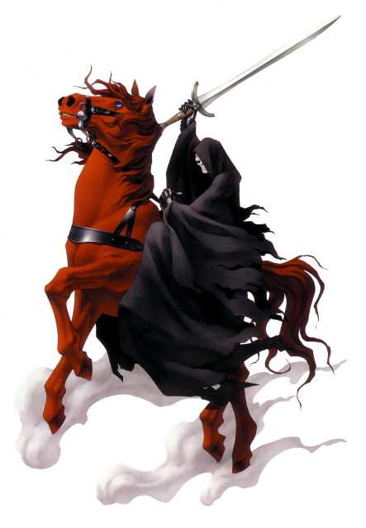
2nd SEAL: Red Horseman
Revelation 6:3-4

Slide 97
2nd SEAL: Red Horseman of War (Rev. 6:4)
What did the rider come on?
A RED HORSE!
RED: Representing bloodshed
What did the rider carry?
A GREAT SWORD!
SWORD: Symbolizing death, murder, carnage

Slide 98
2nd SEAL: Red Horseman of War (Rev. 6:4)
WHAT DID THE RIDER DO?
He removes peace from the earth & people will begin to war against each other.
People will literally slaughter each other.

Slide 99
2nd SEAL: Red Horseman of War (Rev. 6:4)
“…power was given to him that sat thereon to take peace from the earth, and that they should kill one another…”
This would seem to indicate that peace and tranquility existed before & that such peace and tranquility were now taken away, and were succeeded by confusion and bloodshed.

Slide 100
2nd SEAL: Red Horseman of War (Rev. 6:4)
This particular form of confusion could probably be civil unrest which will produce mutual slaughter. The sword is an emblem of war, of slaughter & of authority and is here used as signifying that the period would be characterized by carnage.

Slide 101
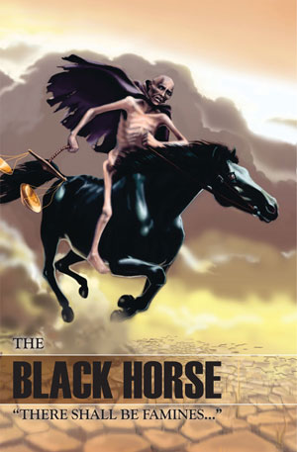
3rd SEAL: Black Horseman
Revelation 6:5-6

Slide 102
3rd SEAL: Black Horse of famine (Rev. 6:6)
What did the rider come on?
A BLACK HORSE!
BLACK: Represents distress, calamity, hardships
What did the rider carry?
A SCALE!
SCALE: Symbolizing Scarcity, Harsh economy, Starvation

Slide 103
3rd SEAL: Black Horse of famine (Rev. 6:6)
What did the rider do?
He brings scarcity to the land; which normally follows war. An announcement is made of how food will be rationed. The word translated measure, was a Grecian measure, nearly equal to a quart. Normally a penny was a day’s wage for a rural worker & it could buy about 10 quarts of wheat or 30 quarts of barley. Under these scarce conditions the same wage will buy only 1 quart of wheat & 3 quarts of barley. There will be one tenth the normal supply of food.

Slide 104
3rd SEAL: Black Horse of famine (Rev. 6:6)
“Hurt not the oil & wine”…
This was a commandment to spare these items from scarcity… to not include them on the ration list. (Example of similar phrase Rev. 9:4) Even though these items were not to be items affected by the scarcity, they may very well become scarce commodities due to poor distribution & hoarding.

Slide 105
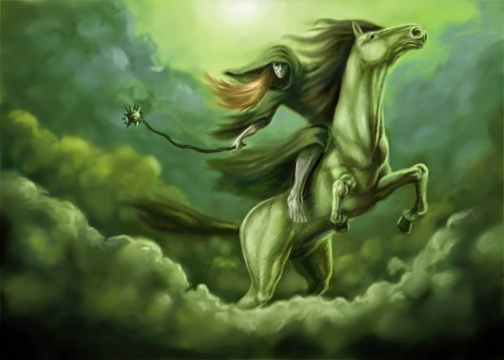
4th SEAL: Pale Horseman
Revelation 6:7-8

Slide 106
4th SEAL: Pale Horse of death (Rev. 6:8)
What did the rider come on?
A PALE HORSE!
PALE (Pale green): Signifies death, corpse
What did the rider come with?
- He had the name of death
- Hell came with him

Slide 107
4th SEAL: Pale Horse of death (Rev. 6:8)
What did the rider do?
Destroy one-fourth of the earth with:
Sword (probably war)
Hunger (famine & starvation)
Death (probably plagues, diseases)
Beasts (wild animals on earth)

Slide 108
4th SEAL: Pale Horse of death (Rev. 6:8)
“DEATH & HELL”
DEATH claims the physical or material part of the persons
HELL claims the spiritual or immaterial part of the persons

Slide 109
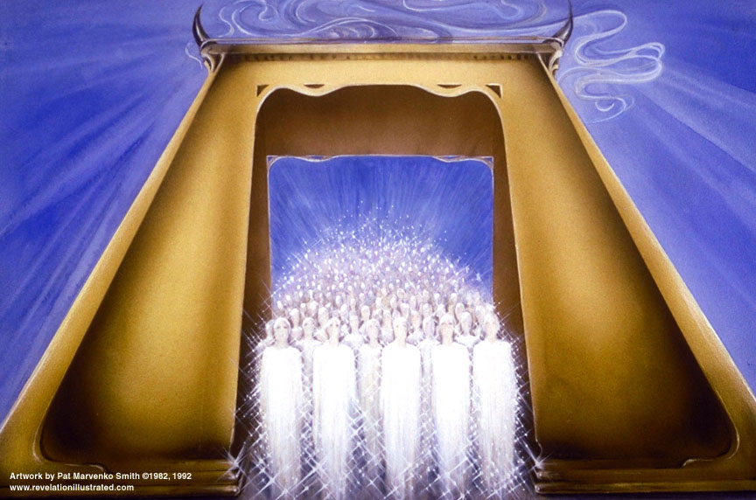
5th SEAL: Souls under the altar
Revelation 6:9-11

Slide 110
5th SEAL: Souls under the altar
The 5th seal depicts actions in heaven that result from certain happenings on earth. There are a group of martyrs in heaven who were martyred on the earth. They are most likely souls who were saved in the early part of tribulation, who were killed for their faith.

Slide 111
5th SEAL: Souls under the altar
The state of things would seem to be, that there was persecution on the earth. Some saints had been put to death, and their souls had gone to heaven, where they pleaded their cause that their oppressors and persecutors might be punished. To this the answer from God was that: “vindication could not occur immediately because there were others who were yet be called to suffer as they did, and they must wait until all that number was completed.”

Slide 112
5th SEAL: Souls under the altar
Vs. 9:
The reason they were killed was because of their belief in God & His Word and for taking a stand for their faith. They were faithful witnesses during the tribulation in the face of opposition. As soon as they died they were received into heaven & they were pictured as under an altar maybe because they had sacrificed their lives for the cause of Christ.

Slide 113
5th SEAL: Souls under the altar
Vs. 10: John heard, a loud cry, saying, How long?
They were crying out to God for justice, for him to vindicate them in the eyes of those who took their lives. This cry implies a zeal for the glory of God, a desire that God would clear their innocence, and make known his justice among men. That he would abolish the kingdom of Satan, and consummate the kingdom of Christ, making all his enemies to become his footstool. Their cry here was a desire for vindication of God's holiness, truth & justice which he himself had promised.

Slide 114
5th SEAL: Souls under the altar
Vs. 11:
God responds by saying they will have to wait for a little while until others die and His program be fulfilled. That is, till these persecutions were passed through, and the number of the martyrs was complete. However, they are given white robes to signify their redeemed & glorified state. White robes were given to every one of them as the reward of their sufferings and services.

Slide 115
5th SEAL: Souls under the altar
God was saying to the martyrs that:
"Though the time is not yet come to satisfy your desires in the final ruin of Satan's kingdom, yet it shall be well with you in the mean time, you shall walk with me in white robes, and enjoy my glory in heaven."

Slide 116
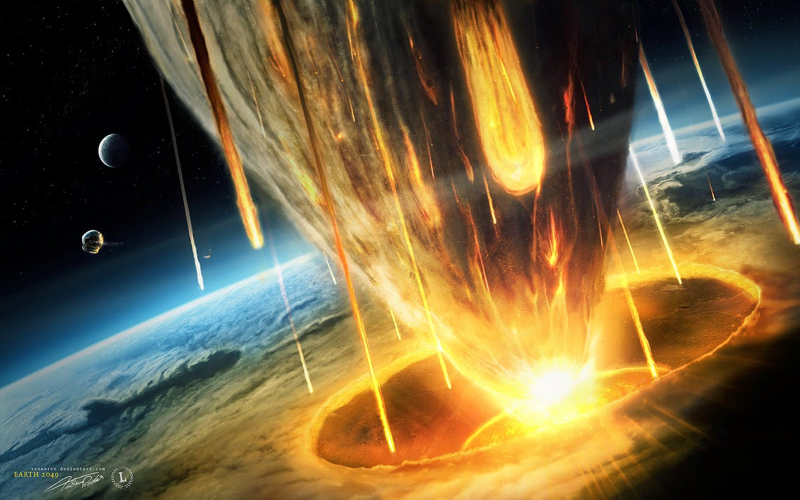
6th SEAL: Cosmic disturbances
Revelation 6:12-17

Slide 117
6th SEAL: Cosmic disturbances
Vs. 12: THREE DISRUPTIONS
Great earthquake
Sun became black
Moon became red

Slide 118
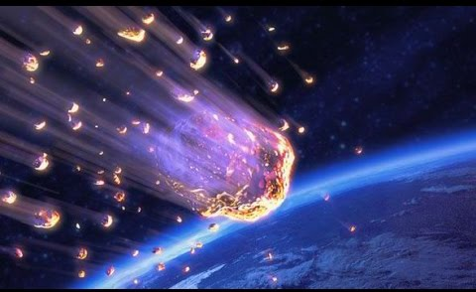
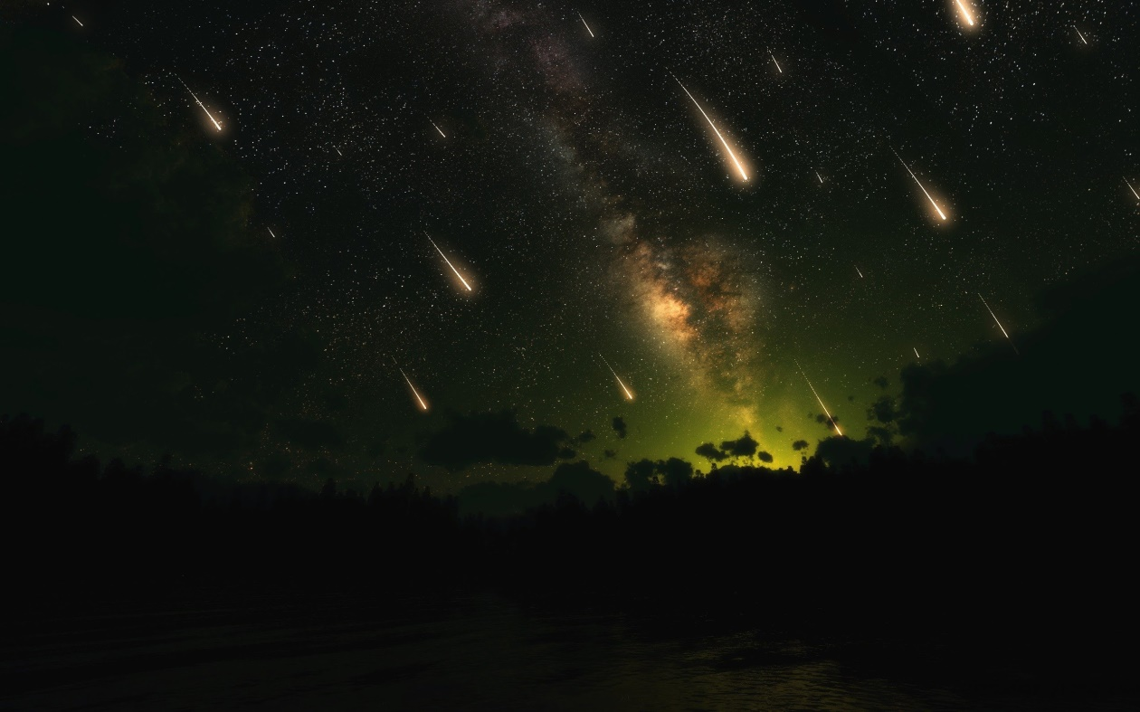
6th SEAL: Cosmic disturbances
Vs. 13: STARS FALL TO EARTH

Slide 119
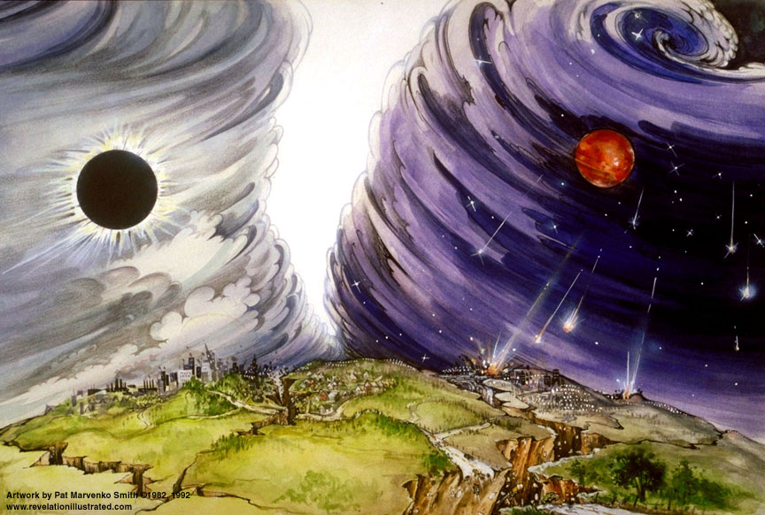
6th SEAL: Cosmic disturbances
Vs. 14:
Sky rolled back
Mountains & islands dislocated

Slide 120
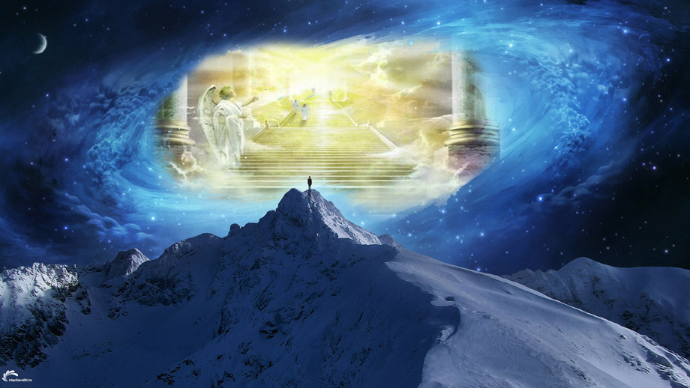
6th SEAL: Cosmic disturbances
Vs. 15-17
Everyone hides in fear

Slide 121
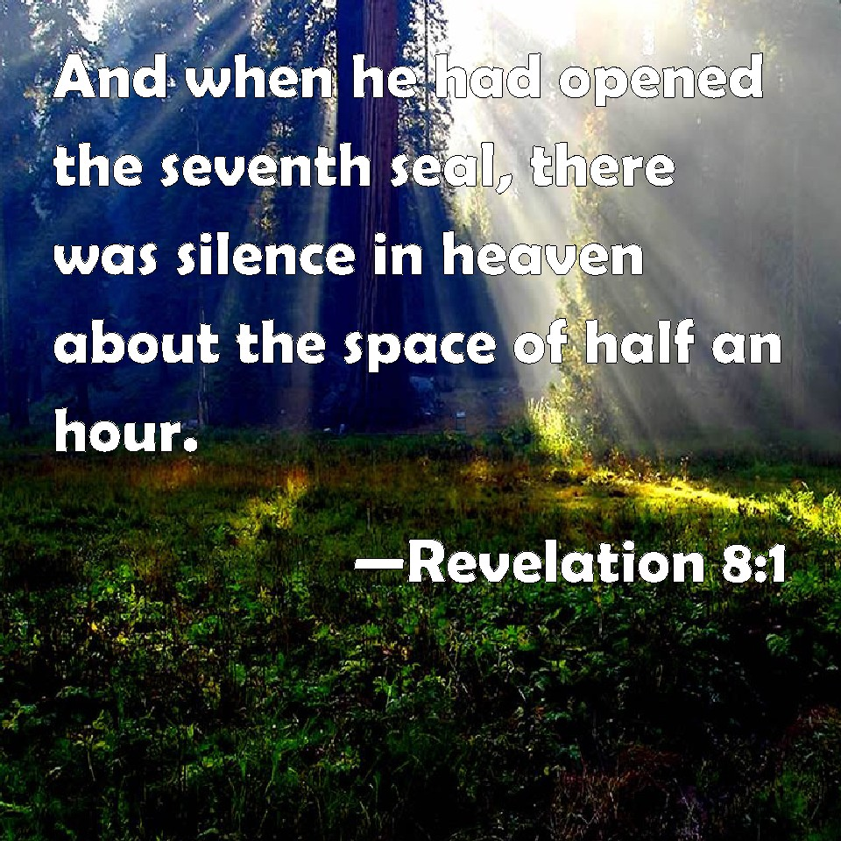
7th SEAL: Silence

Slide 122
7th SEAL: Silence (Rev. 8:1)
This verse concludes the record of the opening of the 7 seals. The 7th & final seal was now open; which was about to usher in the 7 trumpets.
Silence in heaven for half an hour:
Indicating quiet for a short time… an eager expectation of what was to follow…

Slide 123
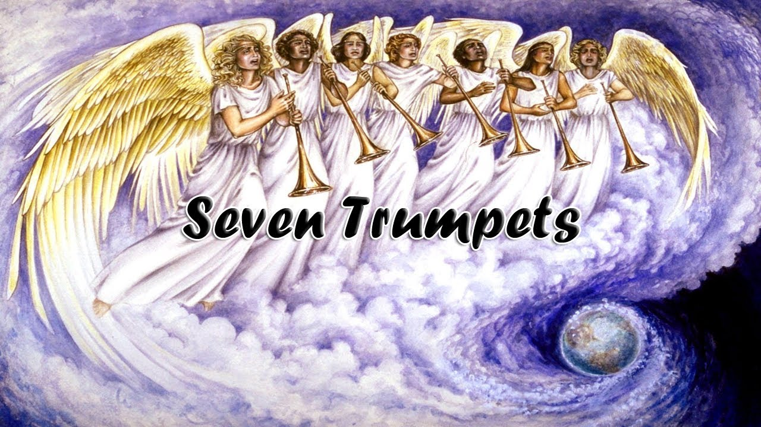

Slide 124
OVERVIEW OF

Slide 125
1st TRUMPET (Rev. 8:7)

Slide 126
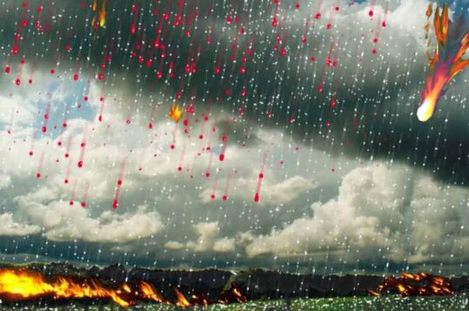
1st TRUMPET (Rev. 8:7)
Hail storm mixed with fire & blood

Slide 128
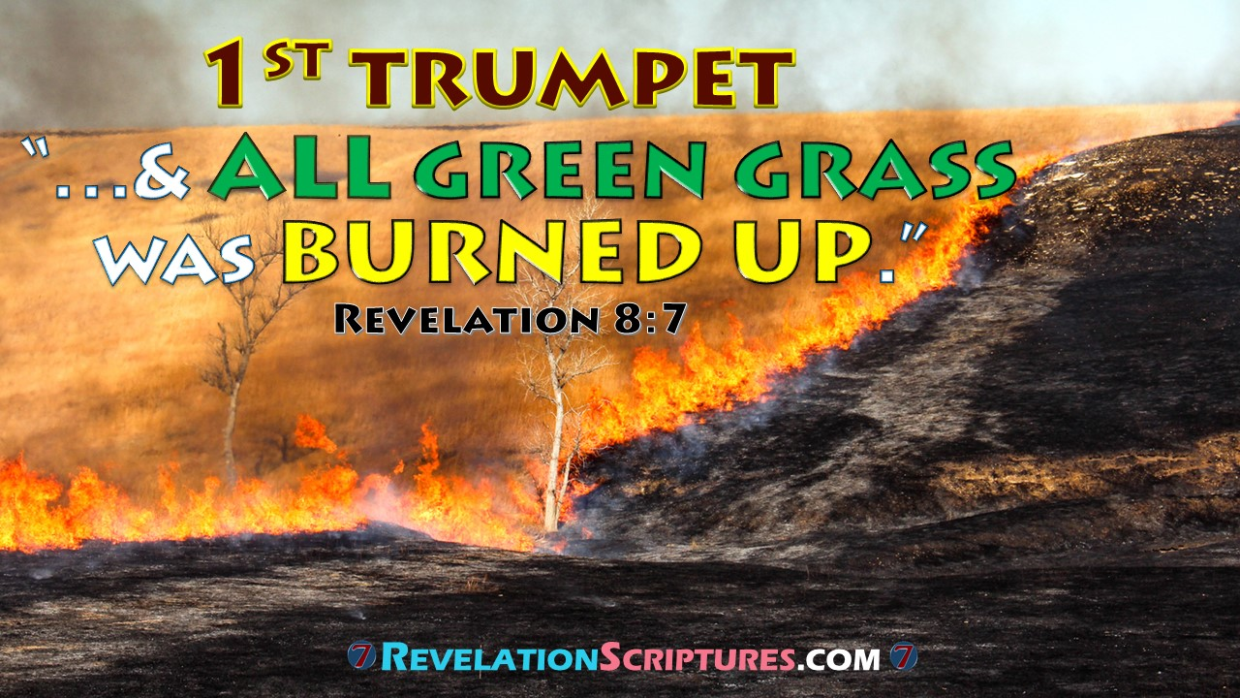

Slide 129
2nd TRUMPET (Rev. 8:8-9)

Slide 130
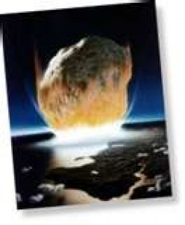
2nd TRUMPET (Rev. 8:8-9)
A HUGE FIERY MOUNTAIN CAST INTO SEA

Slide 131
2nd TRUMPET (Rev. 8:8-9)

Slide 132
3rd TRUMPET (Rev. 8:10-11)

Slide 133
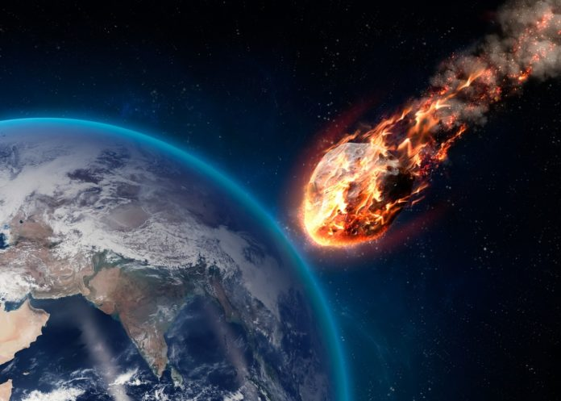
3rd TRUMPET (Rev. 8:10-11)
A huge fiery star cast into the fresh waters (rivers, streams, fountains)

Slide 134
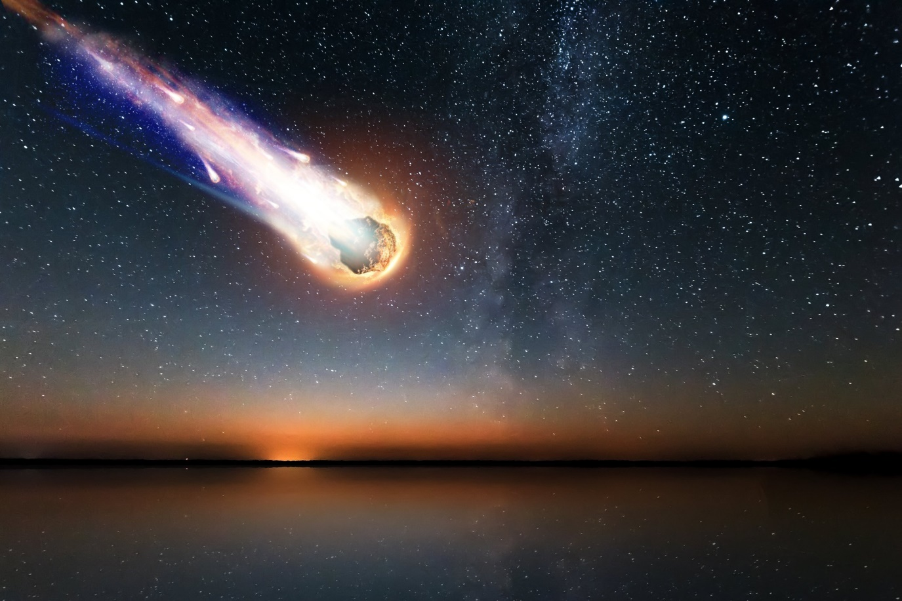
3rd TRUMPET (Rev. 8:10-11)
A third of the waters become bitter (toxic or poisonous)
Many persons will die from the water

Slide 135
4th TRUMPET (Rev. 8:12)

Slide 136
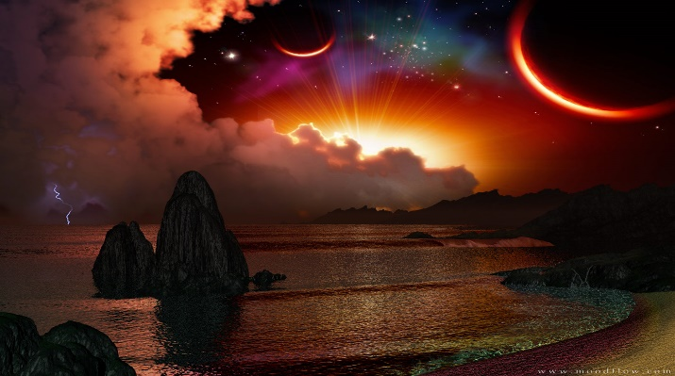
4th TRUMPET (Rev. 8:12)
A third part of the sun, moon & stars darkened

Slide 137
5th TRUMPET (Rev. 9:1-12)

Slide 138
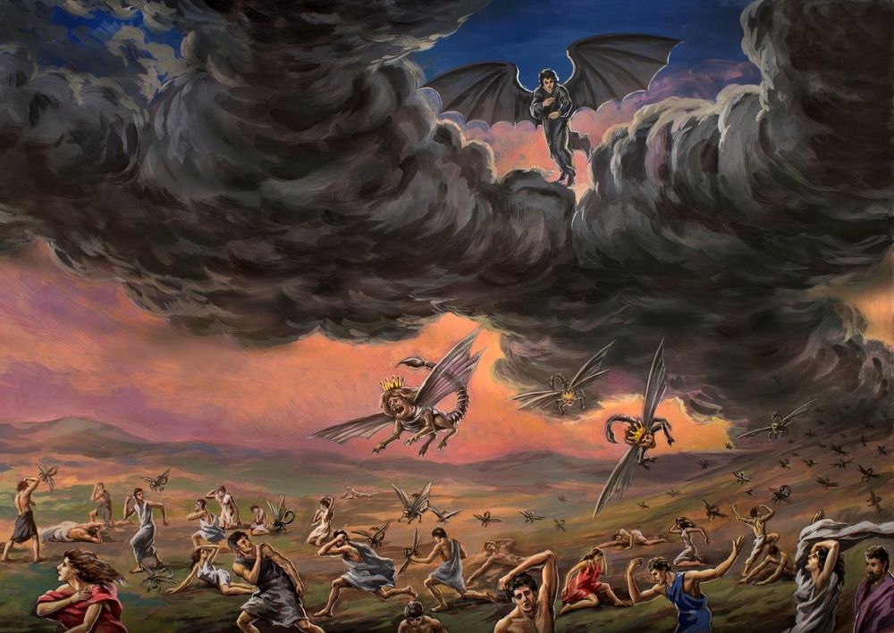
5th TRUMPET (Rev. 9:1-12)
Demonic Locusts
“THE FIRST WOE”

Slide 139
5th TRUMPET (Rev. 9:1)
“A star from heaven”:
A star is a symbol of a leader. It is referring to some kind of intelligent being of rank and influence…. good and bad angels are sometimes called stars (Job 38:7; Isa. 14:12)
A star is a personification of an angel, supposed by some scholars to be a fallen angel… Satan? (Luke 10:18)
Or others say a good angel (Rev. 20:1)

Slide 140
5th TRUMPET (Rev. 9:1)
“key of the bottomless pit”: The word bottomless – “abussos”– abyss means properly without any bottom. The word pit denotes properly a well, or a pit for water dug in the earth and then any pit or cave. The bottomless pit is the under-world particularly the abode of some evil spirits (Luke 8:31; Rev. 17:8). This is represented often as a dark prison-house, enclosed with walls, and accessible by gates or doors.

Slide 141
5th TRUMPET (Rev. 9:1)
These gates or doors are fastened, so that none of the inmates can come out, and the key is in the hand of the keeper or guardian. The abyss was a deep, dark place whose bottom was unknown. Having the key to this, is to have the power to confine those who are there, or to permit them to go at large. The meaning here is, that this master-spirit would have power to release the Spirits from these dark regions.

Slide 142
5th TRUMPET (Rev. 9:1)
And he opened the abyss and a smoke went up from it, like the smoke of a great oven; and the sun and the air were made dark because of the smoke.
The meaning here is that the pit, as a place of confinement which harbored evil spirits, was burning and consequently it emitted smoke and vapor as soon as it was opened.

Slide 143
5th TRUMPET (Rev. 9:4)
Do not hurt the grass--any tree; This was contrary to the nature of natural locusts, showing that these locusts represent cruel enemies sent by God to scourge those persons which have not the seal of God; such as are not true Christians, and have rejected divine truth. Thus this fifth trumpet proves to follow the sealing in Rev 7:1-3, under the sixth seal. None of the saints are hurt by these locusts.

Slide 144
5th TRUMPET (Rev. 9:5-6)
(Vs. 5) Their mission was not to kill, but to cause awful agony for five months; and this agony was like that which a scorpion inflicts when it stings a person.
(Vs. 6) In those days people will seek death, and will not find it. They will desire to die, and death will flee from them.

Slide 145
5th TRUMPET (Rev. 9:3,7-10)
Description of Demonic Locusts:
Tails like scorpions (with sting) (Vs. 3 & 10)
Shaped like horses (Vs. 7)
Crowns of gold on their heads (Vs. 7)
Faces like men (Vs. 7)
Hair like women (Vs. 8)
Teeth like lions (Vs. 8)
Breastplates of iron (Vs. 9)
Wings sound like chariots (Vs. 9)

Slide 146
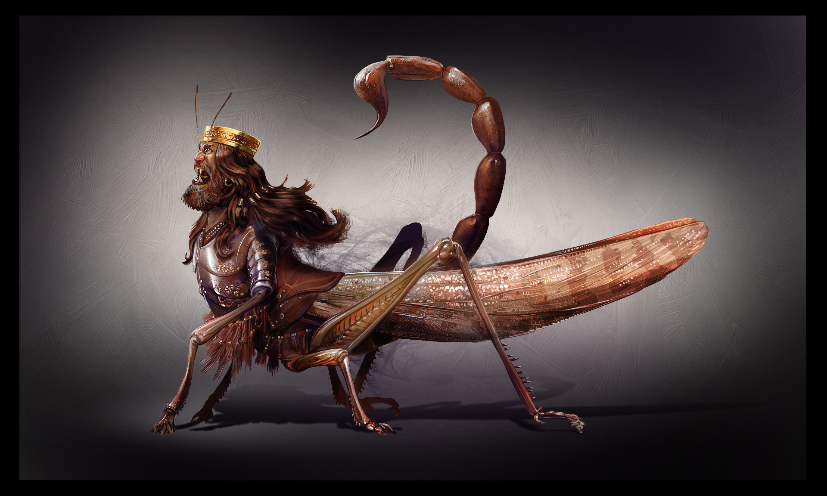

Slide 147
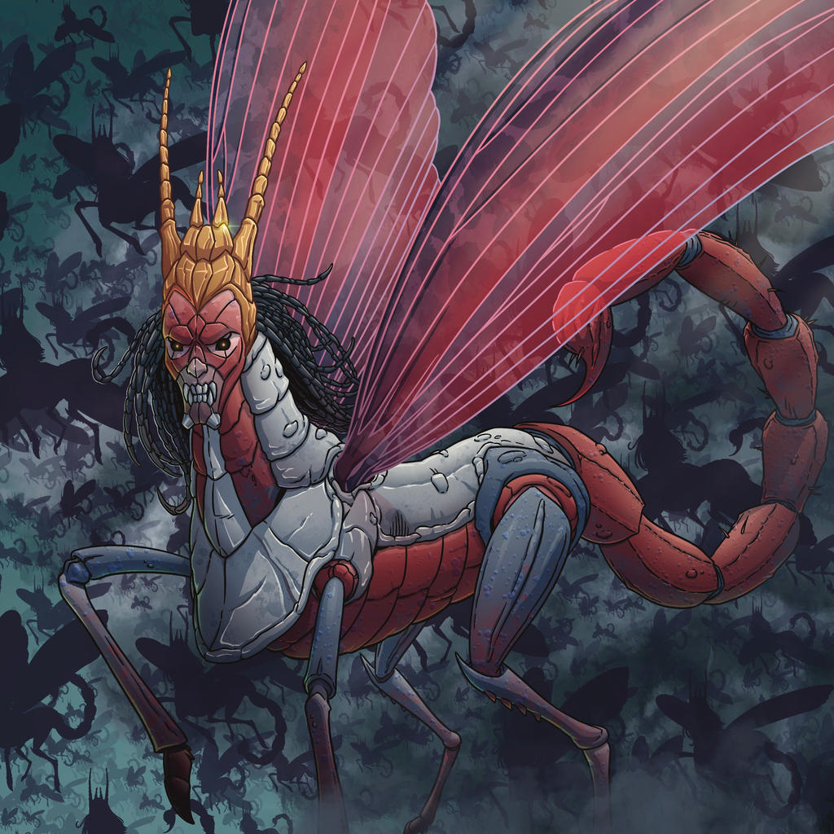

Slide 148
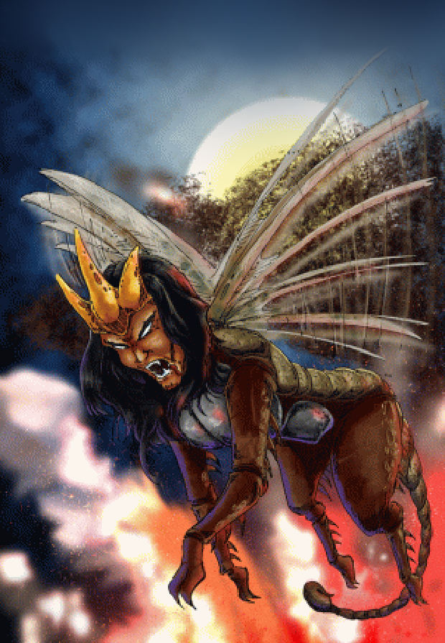

Slide 149
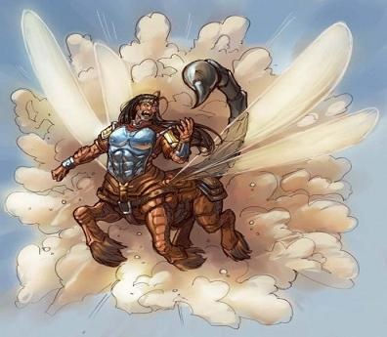

Slide 150
5th TRUMPET (Rev. 9:11)
Abaddon (Hebrew): A destroying angel
Apollyon (Greek): Destroyer
An angel does not have to be evil to destroy things
(Exodus 12: 23; 2 Samuel 24:16-17; 1 Chronicles 21:12-16; 1 Cor. 10:10)

Slide 151
5th TRUMPET (Rev. 9:11)
And they have over them a king - One by whom they are peculiarly directed and governed.
The names signify a particular being... By this he is distinguished from the dragon, whose proper name is Satan.
(Vs. 12) The first Woe has passed & still there are two more Woes to come!

Slide 152
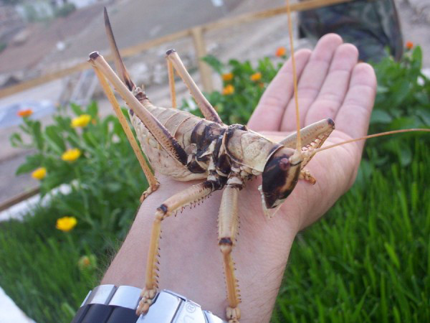

Slide 153
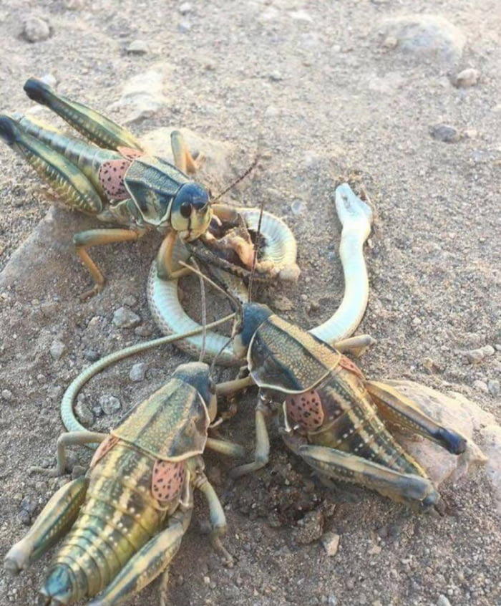

Slide 154
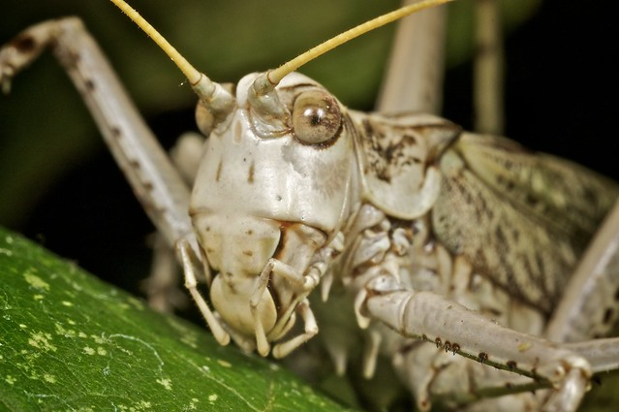

Slide 155
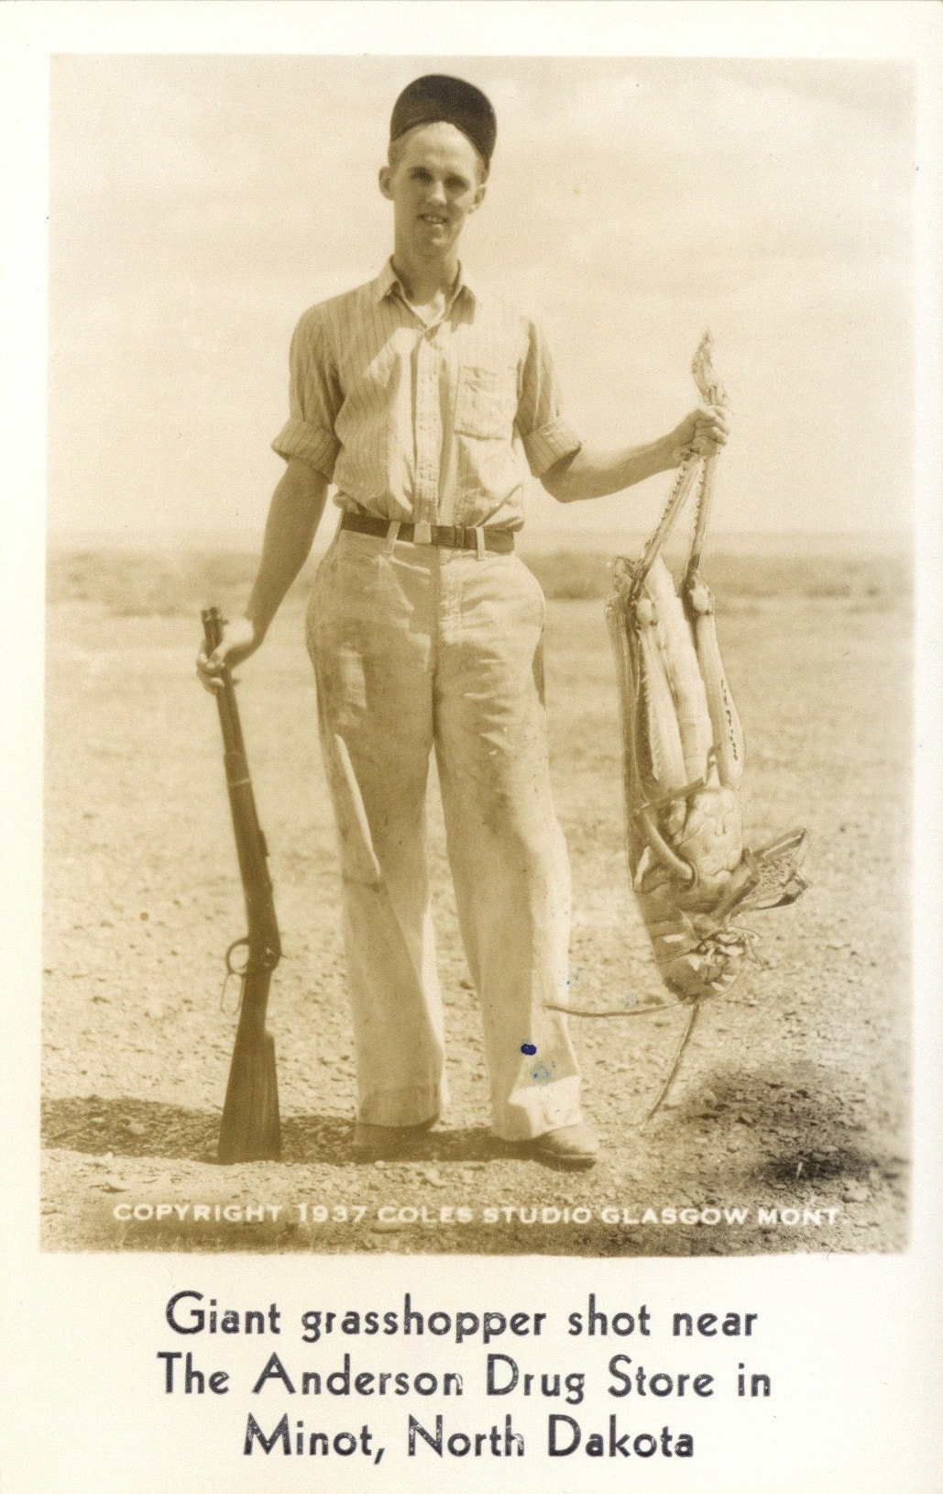

Slide 156
6th TRUMPET (Rev. 9:13-21)
“THE SECOND WOE”

Slide 157
6th TRUMPET (Rev. 9:14)
Loose... It would seem that power was given to the sixth angel to loose the 4 angels in addition to his office of blowing the trumpet. But if the 6th angel did not literally loose them; the meaning still is, that the effect of his blowing the trumpet would be the same as if angels that had been bound should be suddenly loosed and allowed to go forth over the earth.

Slide 158
6th TRUMPET (Rev. 9:14)
The general meaning here is that, in the vicinity of the river Euphrates, there were mighty powers which had been bound or held in check, which were now to be let loose upon the world…. Some power that seemed to be kept back by an invisible influence, was now suddenly let loose and allowed to accomplish the purpose of desolation mentioned in the subsequent verses.

Slide 159
6th TRUMPET (Rev. 9:15)
An hour--a day--a month--a year; that is, 1 year 4 weeks & 5 days OR 391 days
For to slay the third part of men… The meaning here is, that these angels will spread desolation over about a third part of the world. The desolation would be so widespread that it would seem to encompass a third of the world.

Slide 160
6th TRUMPET (Rev. 9:16)
The number of the armies of the horsemen was *two hundred thousand thousand… I heard the number of them.
*(200,000 x 1,000 = 200,000,000)
They were so numerous that John did not pretend to be able to estimate the number himself, for it was beyond his power of computation; but he heard it stated that there were “200 million” of them.

Slide 161
6th TRUMPET (Rev. 9:17)
“Breastplates of fire-jacinth, and brimstone”
That is, red, blue, and yellow:
RED is the colour of fire…
BLUE is the colour of jacinth…
YELLOW is the colour of brimstone (which is sulfur)

Slide 162
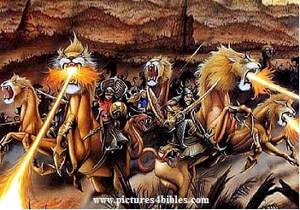
6th TRUMPET (Rev. 9:17-19)

Slide 163
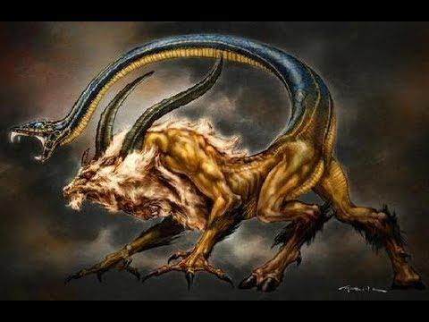
6th TRUMPET (Rev. 9:17-19)

Slide 164
6th TRUMPET (Rev. 9:18)
“By these three”:
Three things-- referring to the fire, the smoke, and the brimstone.
Those immense numbers of horsemen would sweep over the world, and a full third part of the race of men would seem to fall before them.

Slide 165
6th TRUMPET (Rev. 9:20-21)
And the rest of the people, who were not put to death by these evils, were not turned from the works of their hands, but went on giving worship to evil spirits, and images of gold, silver, brass, stone and wood; which have no power of seeing or hearing or walking. They didn't repent of their murders, nor of their sorceries, nor of their sexual immorality, nor of their thefts.

Slide 166
7th TRUMPET (Rev. 11:15-19)
“THE THIRD WOE”

Slide 167
7th TRUMPET: 3rd WOE!
Other views exist on what the 3rd Woe is, as there are also many views on how to read Revelation, some views will have a distinct take on what events encompass the 3rd woe and when it actually ends.
However, when one examines the passage of Revelation 11:15-19 one cannot avoid the following events that are mentioned. Whether some events are woeful or not, is debatable:

Slide 168
7th TRUMPET: 3rd WOE!
(Vs. 15-17) The coming Kingdom of Jesus Christ when He will rule supreme
(Vs. 18) The coming Judgments of God when He will pour out his wrath upon the unbelievers and give His rewards to the believers
(Vs. 19) The manifestations of God’s glory

Slide 169
7th TRUMPET: 3rd WOE!
The 7th trumpet which includes the 3rd Woe, seems to extend to and through the Millennial Kingdom & the end of the world. The 7th trumpet emphasizes Christ’s return. The 7th trumpet introduces and includes the seven bowl judgments of the wrath of God.
Based on the passage, this 3rd woe spans to & probably includes the great white throne judgment.

Slide 170
7th TRUMPET: 3rd WOE!
WOE! Is an exclamation of grief; therefore it is fitting to highlight the events or activities which might cause grief:
The reign or rulership of Jesus may cause grief to the nations that are opposed to Christ’s governance over them.
“And the nations were angry …” (Vs. 18)

Slide 171
7th TRUMPET: 3rd WOE!
“thy wrath is come…” (Vs. 18)
This phrase alone encompasses the magnitude of the 3rd woe and can involve a variety of events which signify the pouring out of God’s wrath in the form of:
- Judgment of Babylon & other nations
(Rev. 14:8-11, 18-19; 16:19; 18:3; 19:15)
- The bowl judgments (Rev. 15:1; 16:1)
- Annihilation of the Anti-Christ, false prophet & the remnant (Rev. 19:11, 19-21)

Slide 172
7th TRUMPET: 3rd WOE!
“…and the time of the dead that they should be judged” (Vs. 18)
The dead more than likely refers to the unbelieving dead. Those departed souls that were not saved when they were alive are normally called “the dead.” Hence this could be in reference to the Great White Throne Judgment when all the unbelieving dead will be judged.
(Rev. 20:12-13)

Slide 173
7th TRUMPET (Rev. 11:18)
“And that thou should give reward unto thy servants…”
In the final winding up of human affairs God will bestow the long-promised reward on those who have been his faithful servants…the righteous. The righteous will be duly rewarded for their works.
This is also a Judgment, but a judgment of the saints. Could it be the Judgment Seat?

Slide 174
7th TRUMPET (Rev. 11:18)
And should destroy them which destroy the earth:
All who have spread desolation over the earth and persecuted the righteous; and all who have done injustice and wrong to others will be destroyed.
All the authors and aggressors of bloody wars will be destroyed.

Slide 176
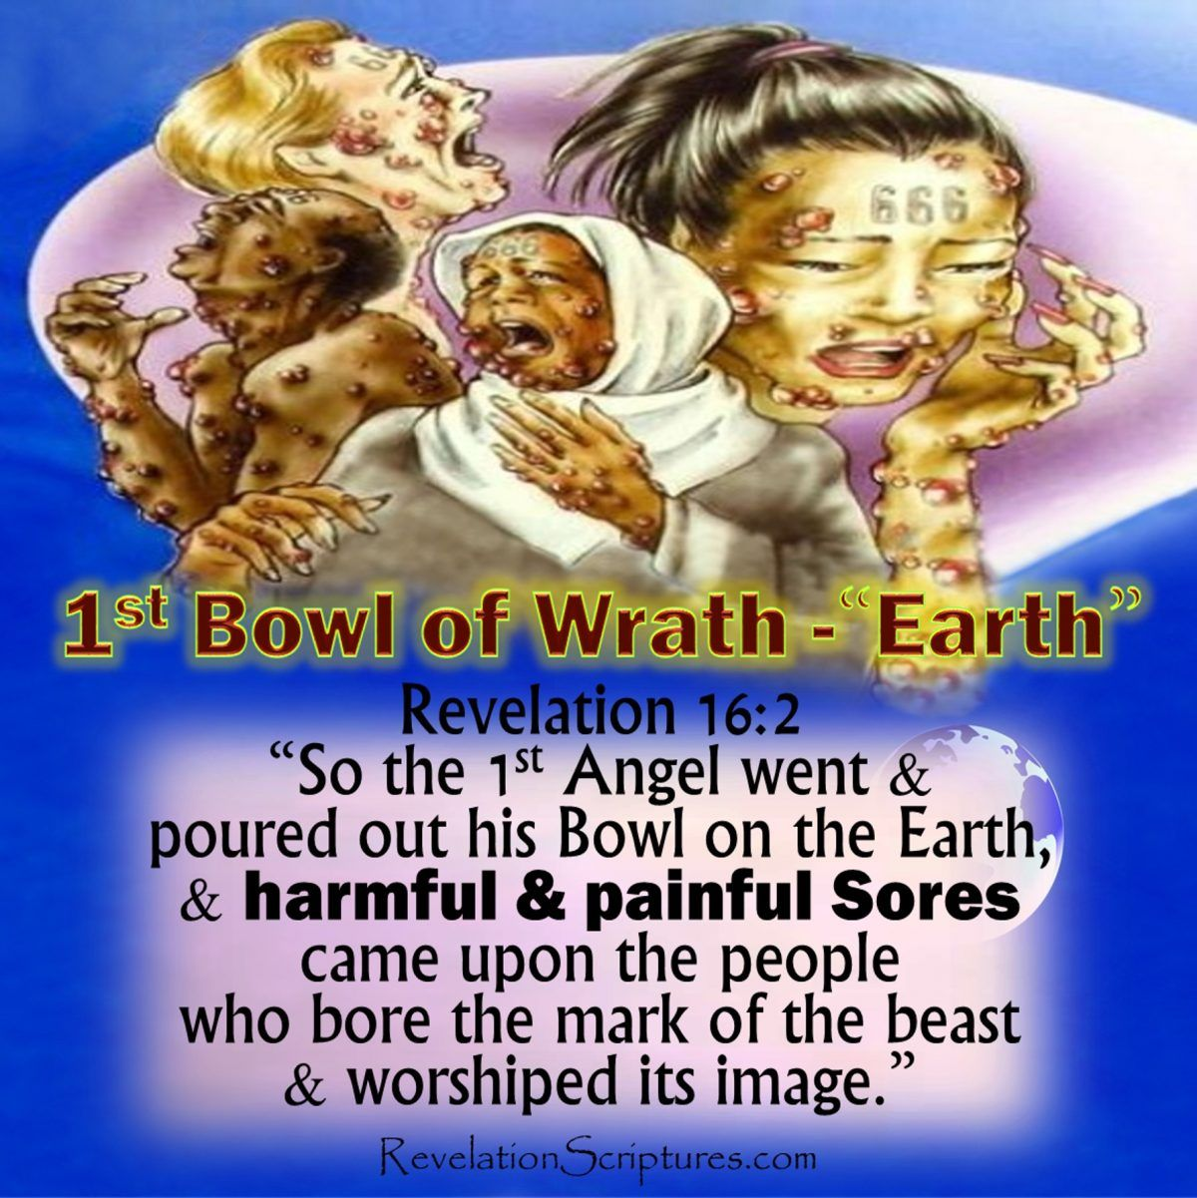
Revelation 16:2 – 1st BOWL

Slide 177
Revelation 16:3 – 2ND BOWL

Slide 178
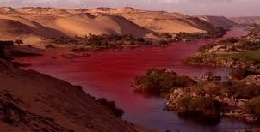
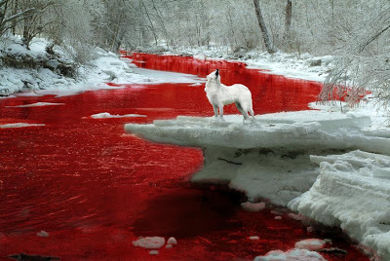
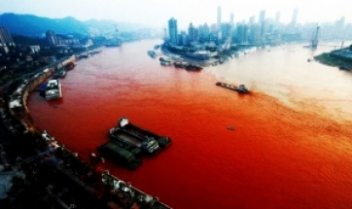
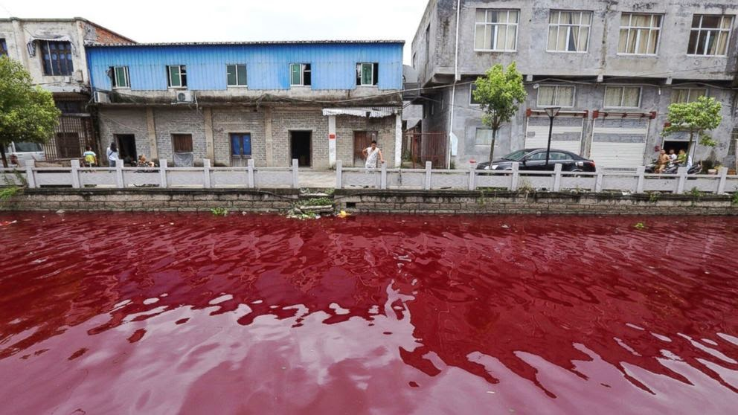
Revelation 16:4-7 – 3RD BOWL
BLOOD ON THE FRESH WATERS

Slide 179
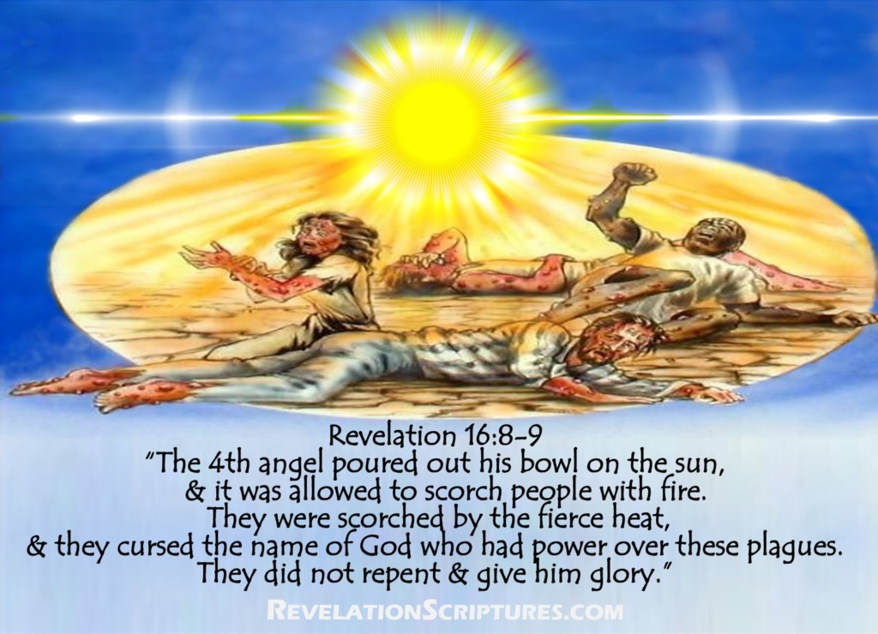
Revelation 16:8-9 – 4TH BOWL

Slide 180
Revelation 16:8 4TH BOWL
…and power was given unto HIM to scorch men with fire
The language used here is personification. The “sun” was personified or depicted as a being; as if increased power was given to its rays. The notion of intense or consuming heat is implied in the phrase; and the reference here is to represent the calamity that the sun would increase its heat.

Slide 181
Revelation 16:10-11 – 5TH BOWL

Slide 182
Revelation 16:10-11 5TH BOWL
The phrase “the seat of the beast” means the seat or throne which the representative of that power occupied. It was the center of the beast’s power, authority and influence; the central point or place of the Antichrist’s dominion.

Slide 183
Revelation 16:10-11 5TH BOWL
The previous bowl judgments had been preparatory to the 5th bowl. This was now a direct blow aimed at the headquarters of the Anti-Christ, which was still not yet the final overthrow, for that is reserved for the pouring out of the last bowl. All that is represented here is a heavy judgment which was merely preliminary to that final overthrow.

Slide 184
Revelation 16:10-11 5TH BOWL
“…and his kingdom was full of darkness”
There was confusion--disorder--distress; for darkness is often the symbol of calamity. This bowl did not destroy, but certainly distressed the Antichrist. It filled his kingdom with the darkness of misery and trouble. As an evidence of this distress, it is said here that they gnawed their tongues for pain.

Slide 185
Revelation 16:10-11 5TH BOWL
“… they gnawed their tongues for pain”
This is a most significant expression of anguish. The word rendered gnawed does not occur elsewhere in the New Testament, nor is the expression elsewhere used in the Bible; but its meaning is plain--it indicates deep sorrow & horror. Their pain was likely due to the previous plagues, but it was compounded by the darkness.

Slide 186
Revelation 16:10-11 5TH BOWL
Verse 11 shows that each new plague was accompanied with the continuance of the preceding plagues. In other words; there was an accumulation, not a mere succession of plagues.
The verse also indicates that these unbelievers recognized the source and reason for their pain, but would not repent and turn to God almighty!

Slide 187
THE END IS NEAR
A LOOK AT END TIMES

Slide 188
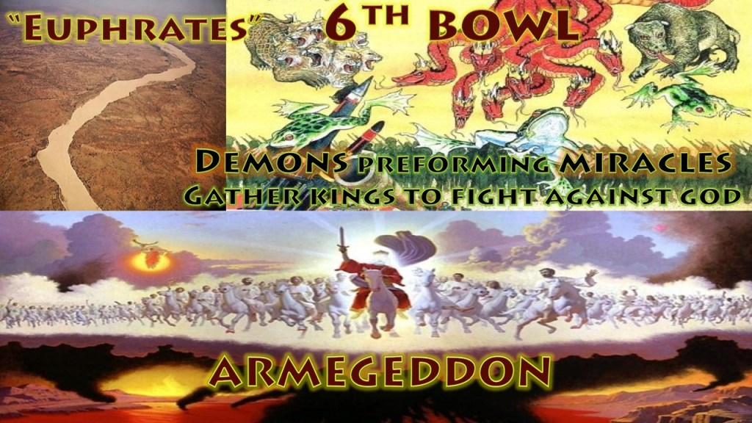
Revelation 16:12-16 – 6TH BOWL

Slide 189
Revelation 16:12 – 6TH BOWL
The 6th judgment will dry up the Euphrates River which was previously turned to blood. The Euphrates River actually forms the eastern border of Palestine and is represented as a barrier to prevent the passage of "the kings of the East" on their way to the West. Therefore, this actual drying up of the river will be done by God to facilitate the crossing of the armies of the kings of the east as they march to the final war of Armageddon.

Slide 190
Revelation 16:12 – 6TH BOWL
The persons here referred to as "kings of the East" were ready to make a movement towards the West, over the Euphrates, and would do this if this obstruction were not in their way. Who these "kings of the East" are is not said. The natural interpretation is that they are the kings that preside over the countries of the eastern hemisphere. Why there was a proposed movement to the West is not said; but it might have been for conquest.

Slide 191
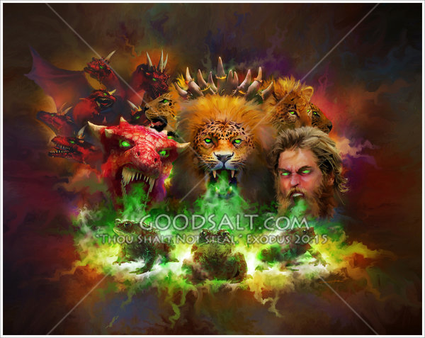
Revelation 16:13 – 6TH BOWL

Slide 192
Revelation 16:13 – 6TH BOWL
The "three unclean spirits like frogs…"
The term "unclean spirit" is used in the NT gospels to refer to demons. Why are they characterized as frogs?
1. This is another reference to the Egyptian plagues
2. Frogs are a symbol of evil
3. Frogs represent vile & unclean things

Slide 193
Revelation 16:13 – 6TH BOWL
There is an alliance of three powers described as the dragon, the beast, and the false prophet. From their mouths came three unclean spirits, like frogs, who go forth to the kings of the earth, rally their forces under the banners of the three allied powers, and march them to the battle of the great day of the Almighty.

Slide 194
Revelation 16:13 – 6TH BOWL
Their nature ➔ spirits
Their quality ➔ unclean
Their number ➔ three
Their likeness ➔ frogs
They are the spirits of demons, and perform marvels; they go to kings all over the world, to assemble them for the battle on the Great Day of Almighty God.

Slide 195
Revelation 16:14 – 6TH BOWL
“For they are the spirits of devils.”
The Greek is "demons." They are demonic influences & will show forth false miracles by which to deceive men. They will marshal their forces for the last conflict. The drying up of the Euphrates will prepare the way for this battle.
Which go forth unto the kings of the earth. Which will particularly affect and influence kings and rulers.

Slide 196
Revelation 16:14 – 6TH BOWL
…And of the whole world. It might be represented as affecting the whole world.
…to gather them. To unite and combine them that it might be represented as an assembling of the hosts for battle.
That great day of God when he will inflict full vengeance on his foes. The final conflict for the kingship of the world.

Slide 197
Revelation 16:15 – 6TH BOWL
Here is a sudden but timely warning to put everyone on their guard, when this sudden and generally unexpected tribulation should take place. This is designed evidently to admonish saints to watch, or to be in readiness for his coming --since, whenever it would occur, it would be at a time when they were not expecting him.

Slide 198
Revelation 16:15 – 6TH BOWL
The essential idea here, is the duty of vigilance. Saints are to awaken to duty and to danger; they are not to be found sleeping on their post; they are to be ready for death & ready for the coming of the Son of man.
“…so that he will not walk about naked and men will not see his shame” It refers not to the loss of salvation, but to believers who will be ashamed of their activities and unholy lifestyle at Jesus' Second Coming.

Slide 199
Revelation 16:16 – 6TH BOWL
“And he gathered them together”
Who gathered them?
Rev. 19:19 identifies the beast (the ANTICHRIST) as the one leading the army for the battle of Armageddon. Hence it could very well be the ANTICHRIST that gathered the army and then lead the army into the battle of Armageddon.

Slide 201
Revelation 16:16 – ARMAGEDDON
Armageddon--" Mountain of Megiddo"-- Megiddo was in a mountainous region, but the battles were fought in an adjacent valley. Megiddo was distinguished for being the place of decisive conflict and hence it became an emblem of a decisive battle-field; apparently it will be the place of a major battle in the future end time events.

Slide 202
Revelation 16:16 – ARMAGEDDON
The Hebrew word Megiddo seems to mean a place of troops. Megiddo comes from a root word, gadad: "cut off," and means slaughter. Armageddon signifies the city or the mountain of Megiddo; to which the valley of Megiddo was adjoined. Hence Armageddon is a symbolic name for a place of great slaughter.

Slide 203
Revelation 16:16 – ARMAGEDDON
Armageddon is the prophesied location of a gathering of armies for a battle during the end times. It will be a decisive battle between the forces of evil and the forces of good. Armageddon is the final war between the forces of God & the forces of Satan. What we are to expect as the fulfillment of this battle is that there will be a rallying of the armies of Satan which will stand in opposition to the army of God.

Slide 204
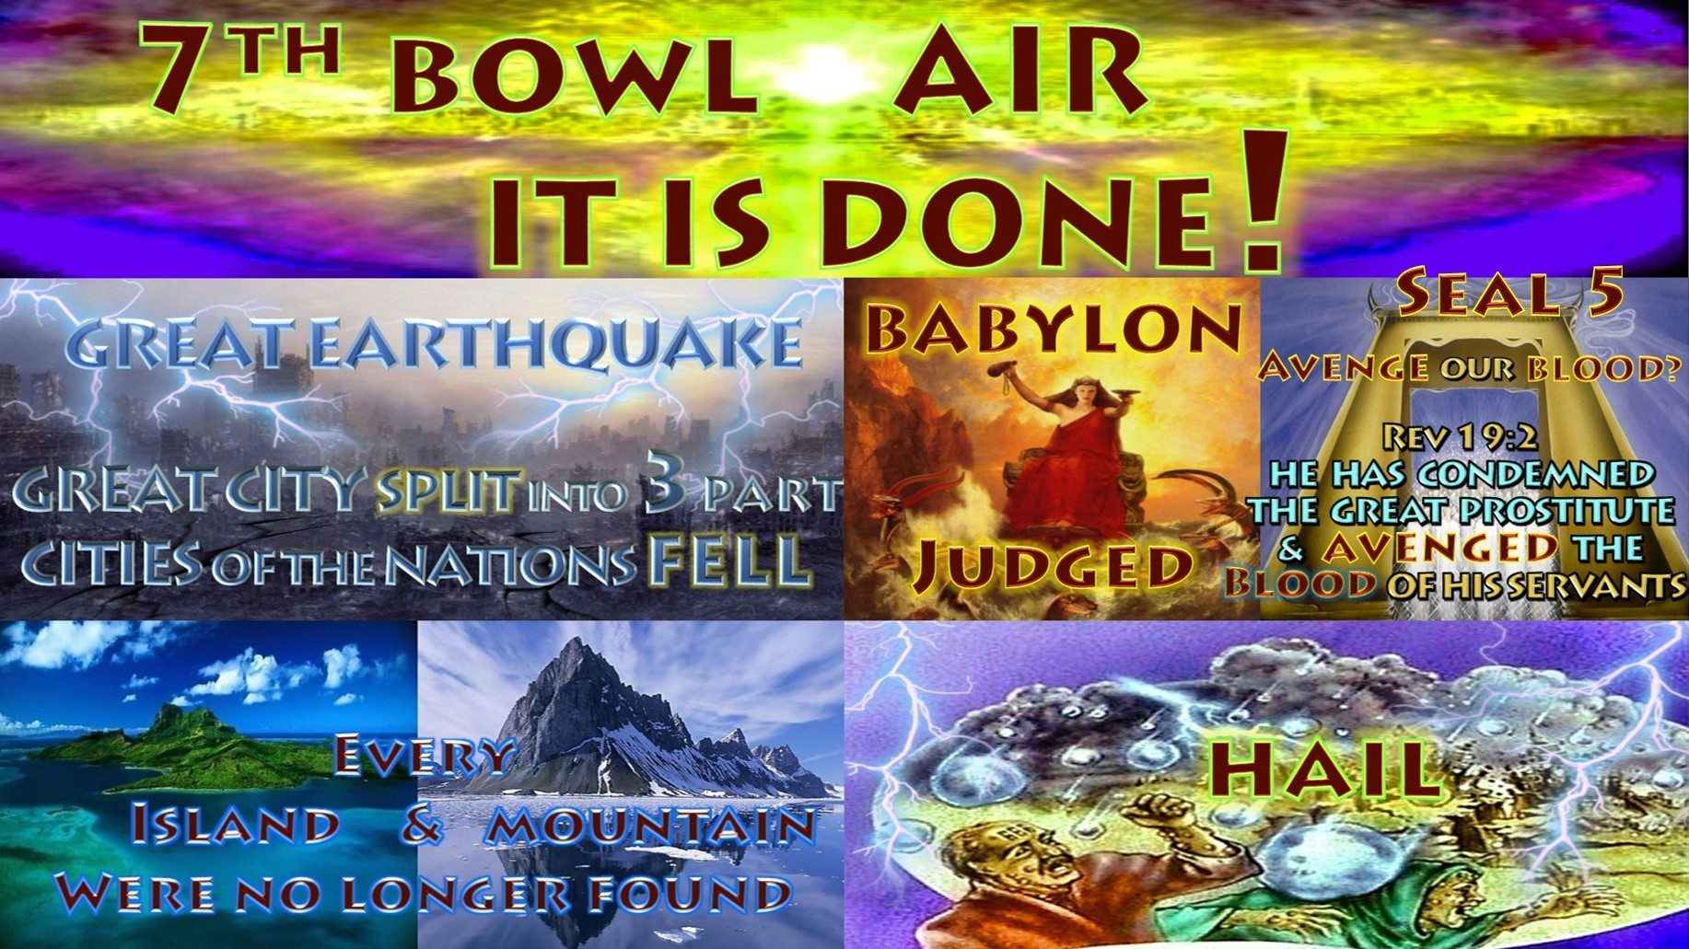
Revelation 16:17-21 – 7TH BOWL

Slide 205
Revelation 16:17 – 7TH BOWL
And there came a great voice out of the temple of heaven. The voice of God… From the throne (Rev. 4:2; 21:6) This shows that it was the voice of God, and not the voice of an angel… Saying, It is done. The series of judgments is about to be completed; the dominion of the beast is about to come to an end for ever. The meaning here is, that that destruction was so certain, that it might be spoken of as now accomplished.

Slide 206
Revelation 16:18 – 7TH BOWL
And there were voices, and thunders, and lightnings… Accompanying the voice that was heard from the throne. These accompaniments seem to be elements that are associated with the presence of God especially around His throne; as this is the 4th time these elements are being mentioned in the book. (Rev. 4:5; 8:5; 11:19)

Slide 207
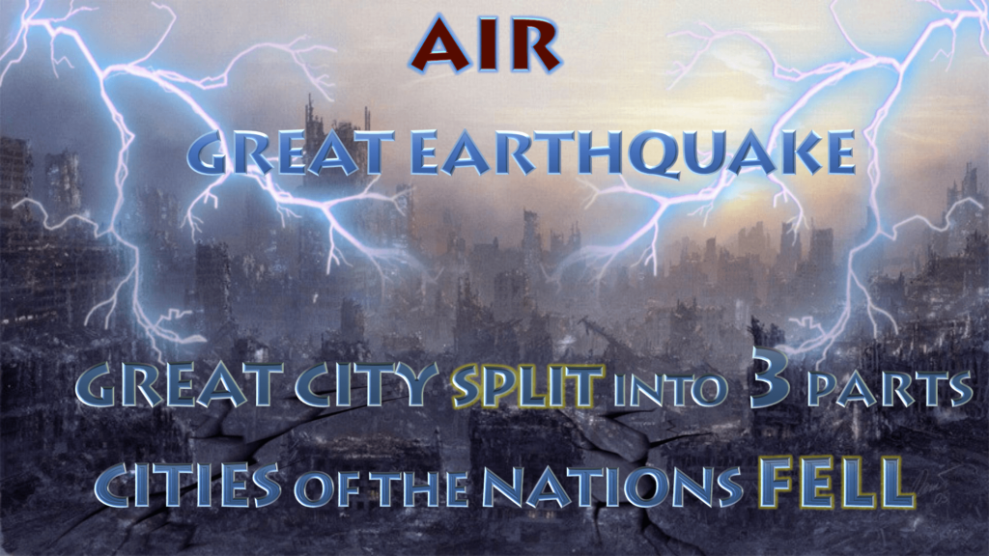
Revelation 16:18 – 7TH BOWL

Slide 208
Revelation 16:18 – 7TH BOWL
A great earthquake
A mighty shaking and rupturing such as was never seen before. This earthquake was described as great: “MEGAS” meaning high, large, loud, massive or expansive… also mighty meaning vast in magnitude. The earth will experience extensive damage from this “mother of all earthquakes.” Society will be upheaved to its very foundations and shaken to its very core.

Slide 209
Revelation 16:19 – 7TH BOWL
The great city: Some say Jerusalem, others say Rome… Most say its the city of Babylon or the mighty power that represented Babylon… a spiritual Babylon. (The same verse mentions “great Babylon”---“great city” )
The division into three parts could be in reference to its destruction. Here it can be implied that the whole city was broken into three portions because of the great earthquake.

Slide 210
Revelation 16:19 – 7TH BOWL
And the cities of the nations fell...
Those cities in alliance with the great city, or under the control of that central power, also fell. As the capital fell, the dependent cities fell also. The cities of the nations that were in league with that great city, will share the same fate. These cities represent the centers of the power and influence of Satan, the beast, false prophet, and all their anti-Christian associates.

Slide 211
Revelation 16:19 – 7TH BOWL
and great Babylon came in remembrance before God...
That is, for purposes of punishment. It had been permitted to carry on its purposes, and to practice its abominations, unchecked. Now the time had come when all that it had done was to be remembered, and the long-suspended judgment was to fall upon it.
To give unto her the cup of the wine: That is; to punish or to destroy Babylon

Slide 212
Revelation 16:20 – 7TH BOWL
Every island and mountain was "moved out of its place" in Rev 6:14; but here “every island fled away, and the mountains were not found”
Perhaps the meaning is that the border lines & mountainous terrains between states and nations shall pass away and the earth shall be flattened like one big plate.

Slide 213
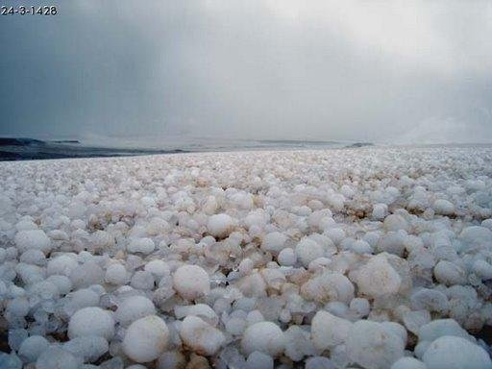
Revelation 16:21 – 7TH BOWL
GREAT HAIL STORM

Slide 214
Revelation 16:21 – 7TH BOWL
The weight of the stones (55-100 pounds) represents the awful severity of the judgments. No suffering; however great or long, will bring these wicked sinners to repentance or lead them to submit to God and obey him. Instead they will blaspheme against God.
However, they will all eventually perish.

Slide 215
The Antichrist (The Beast)
The Mark of the Beast

Slide 216
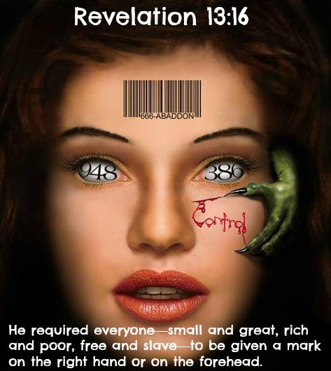

Slide 217
THE MARK OF THE BEAST
And he makes all persons low and high, rich and poor, free persons and slaves, to have a MARK put upon their right hand or upon their foreheads (Rev. 13:16)
MARK (charagma): A scratch or etching, a stamp (as a badge of servitude). Something that is graven or marked for ownership.

Slide 218
As the saints were sealed by God in Revelation 7:3, so will the evil one mimic God's action by marking his own. The Greek word implies an animal brand or an impression made by a stamp like a seal or logo on a government document.
This branding or marking could also be applied by tattooing.

Slide 219
THE MARK OF THE BEAST
And he makes ALL PERSONS low and high, rich and poor, free persons and slaves, to have a mark put upon their right hand or upon their foreheads (Rev. 13:16)
ALL PERSONS: This is a clear indication that whosever chooses to worship the antichrist will be marked. There will be no exemptions. All antichrist followers will be marked!

Slide 220
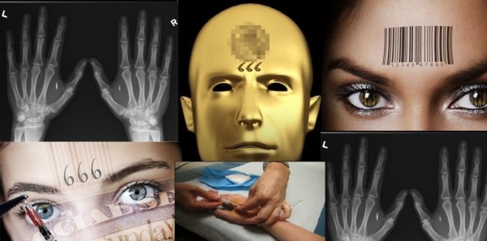

Slide 221
THE MARK OF THE BEAST
And he makes all persons low and high, rich and poor, free persons and slaves, to have a mark put upon their right hand or upon their foreheads (Rev. 13:16)
right hand or foreheads : This means that the mark will be on either one of two places: the right hand OR the forehead (Rev. 14:9, 20:4). The mark will most likely be visible so that the antichrist followers can be easily identified.

Slide 222
The mark of the beast relates to the buying and selling of food, conducting business and possibly employment. The antichrist will claim jurisdiction over the traffic & trade of the world and make it tributary to his own purposes. This is represented by saying that no one might "buy or sell" (Rev.13:17)…except by his permission. It is clear that where this power exists, there will be absolute control over the wealth of the world.

Slide 223
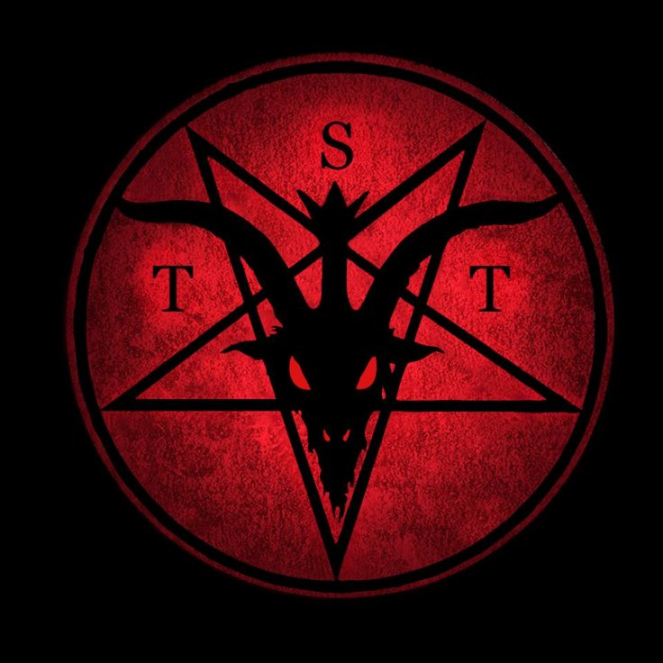
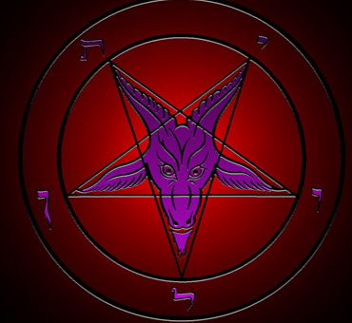
Revelation 13:17
They had to have THE MARK
Which could be some type of
LOGO or SYMBOL
Which represents
The antichrist

Slide 224
Revelation 13:17
…Or THE NAME
The antichrist will have a name
Which equates to 666

Slide 225
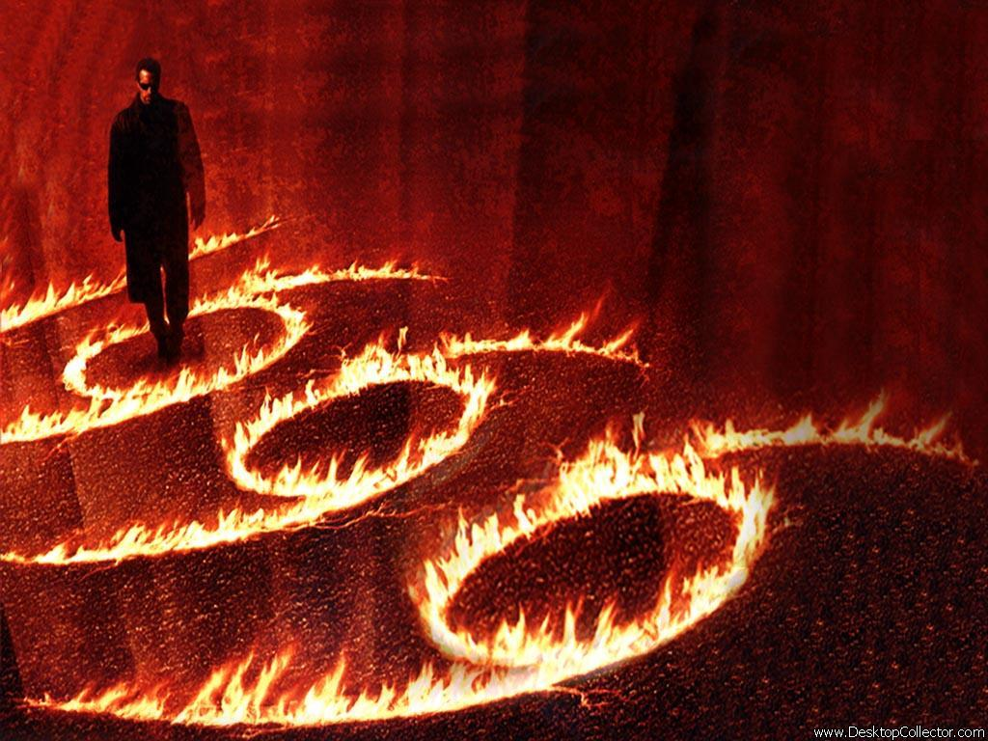
Revelation 13:18
THE NUMBER OF A MAN

Slide 226
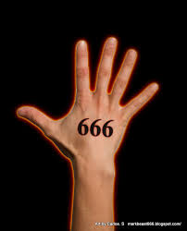
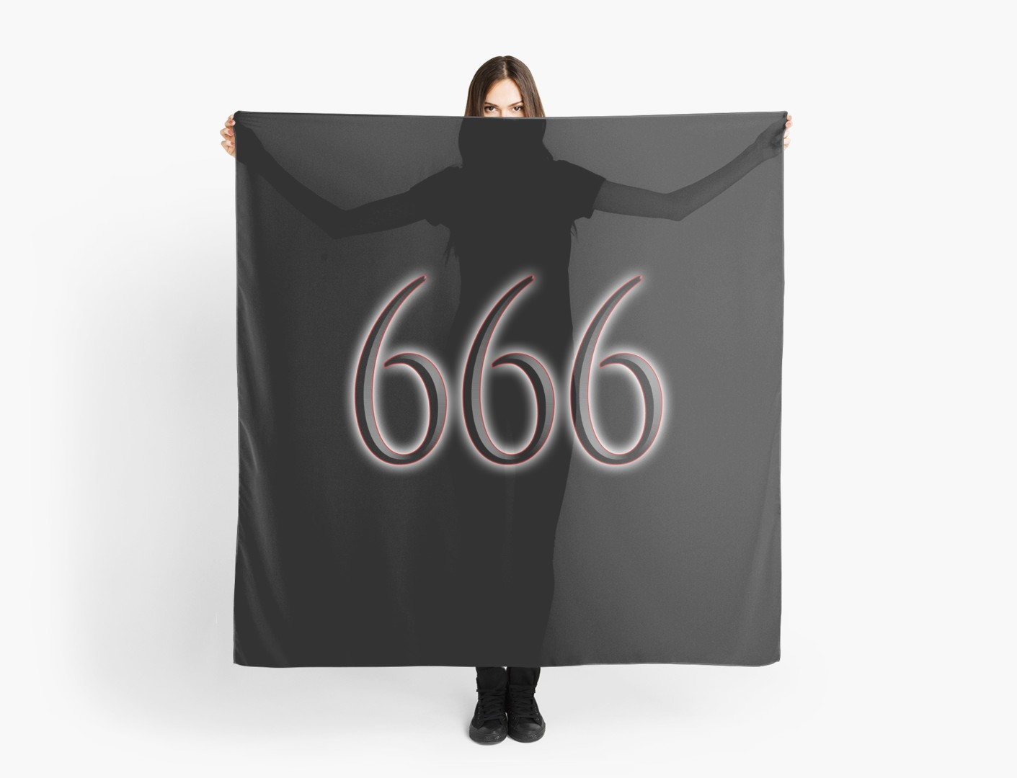
Revelation 13:17
…Or THE NUMBER 666

Slide 227
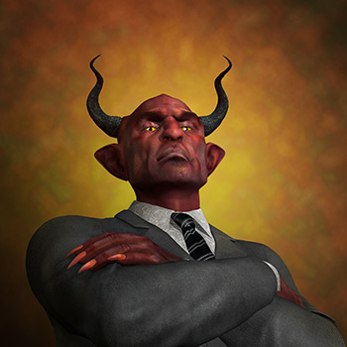
THE CHARACTER
AND
NATURE OF
THE ANTICHRIST

Slide 228
The Antichrist: Character & nature
HE IS A MAN
Rev. 13:18 Here is wisdom. Let him that hath understanding count the number of the beast: for it is the number of a man; and his number is Six hundred threescore and six.
2 Thess. 2:3 Let no man deceive you by any means: for that day shall not come, except there come a falling away first, and that man of sin be revealed, the son of perdition
He is not a ‘spirit being’ or a demon, this is going to be a man. This also tells us his gender… he will be male not female.

Slide 229
The Antichrist: Character & nature
HE WILL BE THE MAN OF SIN
2 Thess. 2:3 Let no man deceive you by any means: for that day shall not come, except there come a falling away first, and that man of sin be revealed, the son of perdition*
There will be no limits to the conceit and evil intentions of this dictator’s perverted character. He is called the son of *death and destruction. He will be the lawless one, meaning; a morally bad person who rejects the righteousness of God's laws. Disobedience, immorality, rebellion, violence and utter selfishness will be manifestations of this man of sin.

Slide 230
The Antichrist: Character & nature
HE WILL CLAIM TO BE GOD & DEMAND WORSHIP
2 Thess. 2:4 …Who opposeth and exalteth himself above all that is called God, or that is worshipped; so that he as God sitteth in the temple of God, shewing himself that he is God.
He will be the self-declared god of this world. After he has been honoured as world messiah for 3½ years he will proceed to the most extreme form of rebellion against God by declaring himself to be God and by demanding the worship of all people (Rev. 13:8, 12).

Slide 231
The Antichrist: Character & nature
HE WILL BE A BLASPHEMER
Dan. 7:25 And he shall speak great words against the most High, and shall wear out the saints of the most High, and think to change times and laws: and they shall be given into his hand until a time and times and the dividing of time.
Dan. 11:36 And the king shall do according to his will; and he shall exalt himself, and magnify himself above every god, and shall speak marvellous things against the God of gods, and shall prosper till the indignation be accomplished: for that that is determined shall be done.
Rev. 13:6 And he opened his mouth in blasphemy against God, to blaspheme his name, and his tabernacle, and them that dwell in heaven.

Slide 232
The Antichrist: Character & nature
HE WILL DISPLAY MIRACULOUS POWERS
Rev. 13:2 And the beast which I saw was like unto a leopard, and his feet were as the feet of a bear, and his mouth as the mouth of a lion: and the dragon gave him his power (Dunamis) and his seat, and great authority
2 Thess. 2:8-9 And then shall that Wicked [one] be revealed… Even him, whose coming is after the working of Satan with all power and signs and lying wonders
He will be a notorious occult practitioner who will make use of the great powers given to him by Satan

Slide 233
The Antichrist: Character & nature
HE WILL BE THE GREAT DECEIVER
2 Thess. 2:9-10 Even him, whose coming is after the working of Satan with all power and signs and lying wonders And with all deceivableness of unrighteousness in them that perish; because they received not the love of the truth, that they might be saved.
He will be without integrity. Through political fraud he will gain a position of leadership, and by the use of clever diplomacy (political lies) he will become world leader (Dan. 9:27). He will be the big briber. Double standards, bribery and corruption will be the order of the day in his wicked regime.

Slide 234
The Antichrist: Character & nature
HE WILL CONTROL THE WORLD’S ECONOMY
Rev. 13:16-17 And he causeth all, both small and great, rich and poor, free and bond, to receive a mark in their right hand, or in their foreheads: And that no man might buy or sell, save he that had the mark, or the name of the beast, or the number of his name.
Whoever rules the world’s goods, rules the unsaved world. When people start getting hungry, they will do almost anything to keep from starving. Even submit to an ungodly ruler. He causes everyone to receive a mark so that they can’t even buy food or any goods at all unless they have his mark upon them.

Slide 235
The Antichrist: Character & nature
HE WILL NOT HAVE A DESIRE FOR WOMEN
Dan. 11:37 Neither shall he regard the God of his fathers, nor the desire of women, nor regard any god: for he shall magnify himself above all.
Desire here means: delight, goodly, pleasant, precious… meaning; the antichrist will not delight in women, he will not be pleased or pleasured by women and he will not see women as precious.
THIS COULD MEAN THAT THE ANTICHRIST MIGHT BE A HOMOSEXUAL!

Slide 236
The Antichrist: Character & nature
HE WILL RULE THE EARTH FOR A TIME
Rev. 13:5 & 7 And there was given unto him a mouth speaking great things and blasphemies; and power was given unto him to continue three & a half years… And it was given unto him to make war with the saints, and to overcome them: and power was given him over all kindreds, and tongues, and nations.
Dan. 7:25 And he shall speak great words against the most High, and shall wear out the saints of the most High, and think to change times and laws: and they shall be given into his hand for three & a half years

Slide 237
The Antichrist: Character & nature
HE WILL BEHEAD THE SAINTS
Rev. 20:4 And I saw thrones, and they sat upon them, and judgment was given unto them: and I saw the souls of them that were beheaded for the witness of Jesus, and for the word of God, and which had not worshipped the beast, neither his image, neither had received his mark upon their foreheads, or in their hands; and they lived and reigned with Christ a thousand years.
The Antichrist will set up a system to behead those who profess allegiance to Christ.

Slide 238
The Antichrist: Character & nature
HE WILL DESECRATE GOD’S TEMPLE
Daniel 9:27And he shall confirm the covenant with many for one week: and in the midst of the week he shall cause the sacrifice and the oblation to cease, and for the overspreading of abominations he shall make it desolate, even until the consummation, and that determined shall be poured upon the desolate.

Slide 239
The Antichrist: Character & nature
HE WILL BE VERY WEALTHY
Daniel 11:43 & 45 But he shall have power over the treasures of gold and of silver, and over all the precious things of Egypt: and the Libyans and the Ethiopians shall be at his steps. And he shall plant the tabernacles of his palace between the seas in the glorious holy mountain; yet he shall come to his end, and none shall help him.

Slide 240
The Antichrist: Character & nature
HE WILL MAKE WAR AGAINST CHRIST
Rev. 19:19 And I saw the beast, and the kings of the earth, and their armies, gathered together to make war against him that sat on the horse [CHRIST], and against his army.

Slide 241
The Antichrist: Character & nature
HE WILL BE A PSYCHOPATH
He will seem exceedingly friendly and charming when he deceives people; to the extent that some will believe that there is nothing evil about him. But when the dark side of his character is manifested, he will commit the most unimaginable cruelties. During the first half of the tribulation period the charming side will be dominant. In the second 3½ years, the dark and vicious side will be openly seen; and because of his lack of moral principles, the antichrist will be completely unpredictable to many persons.

Slide 242
The Antichrist & his deadly wound
And I saw one of his heads as it were wounded to death; and his deadly wound was healed: and all the world wondered after the beast. (Rev. 13:3)
And he exercises all the power of the first beast before him, and causes the earth and them which dwell therein to worship the first beast, whose deadly wound was healed. (Rev. 13:12)
And deceives them that dwell on the earth by the means of those miracles which he had power to do in the sight of the beast; saying to them that dwell on the earth, that they should make an image to the beast, which had the wound by a sword, and did live. (Rev. 13:14)

Slide 243
The Antichrist & his deadly wound
The phrase "wounded to death" could mean that the antichrist received a mortal wound that would have been fatal if he had not been healed. A blow was struck that would have naturally killed the Antichrist, but there was something that prevented the fatal result. John does not say by whom the wound was inflicted, nor does he describe the nature of the wound.

Slide 244
The Antichrist & his deadly wound
It is unlikely that the antichrist will actually be dead & then resurrected, but he may give the appearance of having been resurrected. Satan has supernatural abilities, but he is not powerful enough to resurrect people from the dead. Only God can create life; the devil cannot. The devil has great power to deceive people; he is a master magician. With his vast knowledge of humanity and the universe, he is able to perform counterfeit miracles.

Slide 245
The Antichrist & his deadly wound
The Antichrist’s deadly wound scenario could be likened to that of the apostle Paul. The citizens of Lystra stoned Paul to death (or so they thought) and they assumed that Paul was dead, until he miraculously got up and walked back into the city (Acts 14:19-20). So it is possible that the Antichrist will be assumed dead by many and then he will be miraculously healed from his life threatening injury.

Slide 246
The Antichrist & his deadly wound
Satan will likely engage in a miracle in healing the wounded (but not dead) antichrist, or engage in some kind of masterful deception, or perhaps a combination of both. In any event, the antichrist will appear to be resurrected from the dead. If Satan pulls off some kind of counterfeit resurrection, he will deceive people’s minds so that they accept this as an indication of the antichrist’s power and deity and subsequently worship him.

Slide 247
The Antichrist & his deadly wound
Notice that John says that "one of the heads" --that is, one of the seven heads--was wounded. This deadly wound was given to him on his head by the sword possibly war (Rev. 13:14). Which could also mean one of the confederates or one of the dynasties was dealt a heavy blow. Or it could be specifically referring to the Antichrist; who will suffer major damage or harm to his physical body or figuratively to his government. It could even be both the antichrist & a sector of his kingdom being struck.

Slide 248
The Antichrist & his deadly wound
Whoever or whatever it is that will be struck down…The symbolism implies that a mortal wound was inflicted on the power represented by the antichrist; and when he was about to perish, his power or his life was miraculously restored.

Slide 249
The Antichrist & his deadly wound
As a result of this miraculous recovery; many persons will wonder at the antichrist.
The word “wondered” that is used, means properly, to be astonished; to be amazed… then to wonder at… then to admire and to follow.
The world "worshipped" the beast; and the general idea is that the beast received such a universal reverence or that he inspired such universal awe, that people chose to follow him.

Slide 251
The 2nd Beast: THE FALSE PROPHET
And I beheld another beast coming up out of the earth; and he had two horns like a lamb, and he spoke like a dragon.
(Revelation 13:11)

Slide 252
The 2nd Beast: THE FALSE PROPHET
The 2nd beast rises from the earth and is thereby distinguished from the 1st beast who came from the sea; also note the usage of the phrase “another beast.”
The appearance of the 2nd beast is also different from the 1st beast. The 2nd beast has only 2 horns while the 1st beast has 10 horns. The 2 horns suggest that the 2nd beast will have some strength & authority but not much reign & rule as the 1st beast which had 10 horns.

Slide 253
The 2nd Beast: THE FALSE PROPHET
Two horns like a lamb . . . spoke like a dragon.
The lamb may allude to an appearance of meekness or innocence… which may indicate the character of the 2nd beast as an imitation of the lamb of God (Jesus). This beast is no meek & weak person; as he speaks like a dragon. Thereby alluding to his association and representation of Satan. His approach will be subtle & sneaky to woo people and then strike like a snake.

Slide 254
The 2nd Beast: THE FALSE PROPHET
The aim of the 2nd beast, otherwise called the false prophet (Rev. 16:13; 19:20; 20:10) is to promote the worship of the 1st beast, the antichrist. At no time in his tenure, will the false prophet promote himself; his interests are always concerned with the antichrist. The verse declares that his power is as great as the antichrist but he uses it to promote & push the agenda of the antichrist.

Slide 255
The 2nd Beast: THE FALSE PROPHET
And he (false prophet) exercises all the power of the first beast (antichrist) before him, and causes the earth and them which dwell therein to worship the first beast, whose deadly wound was healed.
(Revelation 13:12)

Slide 256
The 2nd Beast: THE FALSE PROPHET
Note that it is the false prophet who will be the main influencer to sway the people to worship the antichrist.
The false prophet will promote the antichrist everywhere he is allowed. He is going to make a big spectacle, which gets the attention of many persons and then point them to the antichrist.

Slide 257
And he does great wonders, so that he makes fire come down from heaven on the earth in the sight of men (Rev. 13:13)

Slide 258
The 2nd Beast: THE FALSE PROPHET
And he does great wonders…
“wonders”… This word is commonly employed to denote miracles, signs or tokens.
The false prophet will cause fire from the sky to come down to the earth.
The phrase "in the sight of men" implies that this would be done publicly.

Slide 259
The 2nd Beast: THE FALSE PROPHET
And deceives them that dwell on the earth by the means of those miracles which he had power to do in the sight of the beast; saying to them that dwell on the earth, that they should make an image to the beast, which had the wound by a sword, and did live.
(Revelation 13:14)

Slide 260
The 2nd Beast: THE FALSE PROPHET
The false prophet’s power of leading astray the inhabitants of the earth, is due to the miracles which he has been permitted to work. The false prophet will convince the inhabitants of the earth to erect a statue in recognition of the antichrist.

Slide 261
And he had power to give life unto the image of the beast, that the image of the beast should both speak, and cause that as many as would not worship the image of the beast should be killed. (Rev. 13:15)

Slide 262
The 2nd Beast: THE FALSE PROPHET
The Greek word for “life” used in verse 15 is actually “pneuma” which means breath, wind or spirit. Therefore this could be a supernatural miracle performed by the false prophet thru the power of Satan that actually gives life to the image. Or it could be a technologically advanced operation performed by the false prophet to give the appearance of real life and speech to the image.

Slide 263
The 2nd Beast: THE FALSE PROPHET
And he causes all, both small and great, rich and poor, free and bond, to receive a mark in their right hand, or in their foreheads (Rev. 13:16)
Note well: That it is the false prophet who will be the main influencer (causer) to enforce the implementation of the mark of the beast; thereby still promoting & pushing the agenda of the antichrist.

Slide 264
The doom of the antichrist & false prophet
Rev. 19:20 And the beast was taken, and with him the false prophet that wrought miracles before him, with which he deceived them that had received the mark of the beast, and them that worshipped his image. * These both were cast alive into a lake of fire burning with brimstone.
The antichrist & false prophet will be the first persons to be cast into the lake of fire.
Their destiny is the lake of fire

Slide 266
THE ANTICHRIST & FALSE PROPHET WILL BE CONDEMNED TO A PLACE OF NO RETURN

Slide 267
FUTURE RESURRECTIONS

Slide 268
Resurrection of dead Church saints
CHIEF PASSAGES
1 Thessalonians 4:13-18
1 Corinthians 15:40-57

Slide 269
Resurrection of dead Church saints
This RESURRECTION occurs at the rapture & ONLY involves the DEAD IN CHRIST
The living saints at the rapture will NOT be resurrected, they will just be changed
These believers who have died will be reunited with their transformed earthly bodies
The dead in Christ will be raised to new life and will receive new bodies or glorified bodies

Slide 270
Resurrection of dead Church saints
In this resurrection; Jesus will be returning with the spirits of the saints because their bodies had separated from them at death, but their spirits went to heaven to be with the Lord
What will rise? Their physical bodies
How will their bodies rise? The spirits that Jesus bring with him will give their bodies life again
From where will they rise? The Graves *
* The grave represents land or water; or anywhere their bodies are buried in the world

Slide 271
Resurrection of tribulation saints
CHIEF PASSAGE
Revelation 20:1-6

Slide 272
Resurrection of tribulation saints
This will be the resurrection of the tribulation saints who died during the great tribulation period
This resurrection will occur at the beginning of the millennial reign of Jesus Christ
It is called the first resurrection in distinction from the second & last (general resurrection) when all the dead will be literally raised up from their graves, and assembled for the white throne judgment

Slide 273
Resurrection of tribulation saints
Surely this is a literal resurrection, and it is clear that the blessed dead will rise before the wicked dead
The saints who suffered on the earth will rise again to reign over the earth. During the time of their living there, they shall in that time enjoy a more holy, happy, peaceful and flourishing condition in contrast to the life they lived before

Slide 274
Resurrection of Old Testament saints
The resurrection of the O.T. saints is probably the most obscure of all the resurrections, as it is slightly difficult to determine the time period in which their resurrection happens
There are different viewpoints as to when the O.T. saints are resurrected, but one thing is certain, and that is… the O.T. saints will indeed be resurrected
Another obscurity is that the O.T. saints are not specifically identified as other groups… (Eg. Church, tribulation saints & unbelievers)

Slide 275
Resurrection of Old Testament saints
Some O.T. saints might have been resurrected in the ‘many’ that was mentioned in Matthew 27:52-53
Some say the rest of O.T. saints might have already been resurrected according to these Scriptures:
Ephesians 4:8-10
John 5:25
Matthew 8:11

Slide 276
Resurrection of Old Testament saints
Others believe that the O.T. saints have not yet been raised & might be resurrected after the great tribulation just before the millennial kingdom according to these Scriptures:
Job 19:25-27
Ezekiel 37:1-14
Daniel 12:1-3, 13
Revelation 20:4(a)

Slide 277
Resurrection of the unbelieving dead

Slide 278
Resurrection of the unbelieving dead
This resurrection occurs after the millennium. In this resurrection, unbelievers are raised to face the Great White Throne Judgment and experience the second death
(Revelation 20:11-15)

Slide 279
Resurrection of the unbelieving dead
Vs. 12: “The dead, small & great”
Dead: refers to the physically dead as well as spiritually dead (Unregenerate)
Unbelievers from every rank, degree, race, class & status since time began, were brought before God.

Slide 280
Resurrection of the unbelieving dead
Vs. 12: “THE BOOKS”
There were two Sets of books:
The “books” of works!
The “book” of life!

Slide 281
Resurrection of the unbelieving dead
Vs. 12: “The books of works”
Which are the books of reckoning; the testimony of their conscience, actions & their works.
The books contain the records of human deeds by which they will be judged. Each person will get what they deserve.

Slide 282
Resurrection of the unbelieving dead
Vs. 13: “The sea, death & hell gave up the dead”
The sea and *death have the bodies of all human beings; Hell (Hades) has their spirits/souls.
* Death is here personified, and represented as a keeper of dead bodies; probably no more than earth or the grave is meant.

Slide 283
Resurrection of the unbelieving dead
Vs. 13: “The sea, death & hell gave up the dead”
Their bodies and souls/spirits will be reunited that they may be judged according to their works. Hell therefore gives up the spirits/souls and the sea and death (earth) give up the bodies.

Slide 284
Resurrection of the unbelieving dead
Vs. 14: “Death & hell cast into…”
Death was now abolished, and the place for separate spirits (hell) was no longer needful. All dead bodies and separated souls were rejoined, consequently the existence of death & hell was no longer necessary. (1 Cor. 15:26, 55)

Slide 285
Resurrection of the unbelieving dead
Vs. 14: “The second death”
The first death consisted in the separation of the soul from the body for a season; the second death is the separation of body and soul from God for ever. The first death is that from which there may be a resurrection; the second death is that from which there can be no recovery.

Slide 286
Resurrection of the unbelieving dead
Vs. 14: “The second death”
By the first death the body is destroyed during time; by the second death, both body and soul are destroyed through eternity.

Slide 287
Resurrection of the unbelieving dead
Vs. 15: “Not found… lake of fire”
The book of life will determine who goes into the lake of fire not the books of works.
Their names are not in the book because they reject God’s salvation & by the same token God will reject them.

Slide 288
END TIME BATTLES

Slide 290
The BATTLE OF ARMAGEDDON
According to Revelation chapters 19 & 2o, the chronology of the battle of Armageddon falls between the 2nd coming of Christ and the millennial reign of Christ
Hence, the return of Jesus Christ is a prelude to the Armageddon. Jesus knows that He will return to do battle before He reigns in His millennial kingdom; so He will come prepared for war
(READ - Revelation 19:11-21)

Slide 291
The BATTLE OF ARMAGEDDON
In Rev. 19:7-10 Jesus Christ is seen as the bridegroom; but in the verses to follow (11-16) Jesus is now further revealed as an all-conquering warrior. This describes Jesus' coming as the Jews expected Him the first time… as a powerful military general.
Note that the entire context from (Vs. 11-18) is replete with confidence that Jesus will be the victor in the battle of Armageddon.

Slide 293
The BATTLE OF ARMAGEDDON
Saying to all the fowls that fly in the midst of heaven… That is, to all the birds of prey--all that feed on flesh--such as hover over a battle field.
Come and gather yourselves together…
All this imagery is taken from the idea that there would be a great slaughter, and that the bodies of the dead would be left unburied to the birds of prey.

Slide 294
The BATTLE OF ARMAGEDDON
Unto the supper of the great God.
As if the great God were about to give the birds a feast from the carcasses of those slain. It is called “God’s supper” because He gives it; and the image is merely that there would be a great slaughter of his foes.
The imagery is taken from Ezekiel 39:17-20, where God invites the birds & wild beasts to come to the table which He has provided.

Slide 295
The BATTLE OF ARMAGEDDON
“That you may feast on the flesh of kings and the flesh of generals and the flesh of mighty men, on the flesh of horses and their riders, and on the flesh of all mankind, whether they are free men or slaves, great men or small.” (Vs. 18)

Slide 296
The BATTLE OF ARMAGEDDON
And the kings of the earth, and their armies, gathered together.. There is allusion here to the same assembling of hostile forces which is described in Rev. 16:13-14 & Rev. 17:12-14, for the great decisive battle that is to determine the destiny of the world--whether the Messiah or Antichrist shall reign. There can be no doubt that the writer in these passages designed to refer to the same event, which is...
“THE BATTLE OF ARMAGEDDON”

Slide 297
The BATTLE OF ARMAGEDDON
In the battle of Armageddon; the enemies of Jesus will be all bark and no bite. This battle is renown and has often been touted with a lot of hype; but from all indications, the battle of Armageddon will be:
A very brief battle
A one-sided battle
A decisive battle

Slide 298
The BATTLE OF ARMAGEDDON
And the beast was taken, and with him the false prophet ….These both were cast alive into a lake of fire burning with brimstone
The head of the so-called mighty army was removed, thereby dismantling the army by dismembering the head from the body. This strategic & effective move, leaves the army vulnerable & exposed for complete defeat and total annihilation.

Slide 299
The BATTLE OF ARMAGEDDON
Which sword proceeded out of his mouth.
The rest of the army was cut down by a word. They fell before Christ as He spoke, as if they were slain by a sword. Perhaps this indicates that the effect that is to be produced when these great powers shall be destroyed is that they will be subdued & slain by the very word of Jesus Christ the most High God.

Slide 300
THE BATTLE OF GOG & MAGOG

Slide 301
THE BATTLE OF GOG & MAGOG
The battle of Gog & Magog will occur after the Millennial reign of Christ. It will be the final battle on earth as no more battles are mentioned after this. In fact it would seem as if this battle will wipe out the last of humanity, particularly the unbelievers. Because after the annihilation of this innumerable army of Satan followers, the next main event is the Great White Throne Judgement of the unbelieving dead.
(READ-Revelation 20:7-10)

Slide 302
THE BATTLE OF GOG & MAGOG
“And when the thousand years are expired, Satan shall be loosed out of his prison”
Satan is loosed at the end of the thousand years and goes out and deceives the nations; and the peace that existed will now be disturbed and a most dreadful war is on the horizon. Satan will be permitted again to tempt people & stir them up to unite in opposing Christ, and he will attempt to exterminate the saints.
(Rev. 20:7)

Slide 303
THE BATTLE OF GOG & MAGOG
The earth shall have its golden age during the millennial kingdom, but it will not last forever. Satan will be loosed for a little season and wickedness will revive; the great adversary will somewhat regain his influence over the human race. The devil will be loosed only "for a little season" (Rev. 20:3). It will only be for a short period, but Satan will use the little time he has to deceive the nations and assemble an army.
(Rev. 20:8)

Slide 304
THE BATTLE OF GOG & MAGOG
…Which are in the four quarters of the earth…
It is implied here that the deception would not be confined to one spot or portion of the world, but would extend afar. This also implies that the earth would not be entirely converted to Christianity (not everyone will be saved) and it proves that the character of many* human hearts will not be changed during the millennial kingdom.
* “…the number of whom is as the sand of the sea.”
(Rev. 20:8)

Slide 305
THE BATTLE OF GOG & MAGOG
GOG & MAGOG: The name GOG occurs as the name of a prince in Ezek. 38:2-3,16; 39:1,11. "He is an invader of the land of Israel, the chief prince of Meshech and Tubal," (Ezek. 38:2).
MAGOG is also mentioned in Ezek. 38:2 as "the land of Magog;" and in Ezek. 39:6, "I will send a fire on Magog." As the terms are used in the Old Testament, the representation would seem to be that GOG was the prince or leader of a people called MAGOG.
(Rev. 20:8)

Slide 306
THE BATTLE OF GOG & MAGOG
All that is to be understood is that John means to say that at the time referred to… there will be formidable enemies who might be compared with the dreaded leader Gog & his dwellers in the land of Magog… who will invade the Holy land and wage war against Christ and his saints. It is simply mirroring the dreaded leader Satan and his army who will wage war on Christ and His saints.
(Rev. 20:8)

Slide 307
THE BATTLE OF GOG & MAGOG
And the army went up over the face of the earth, and surrounded the camp of the saints, and the well loved city….
Satan & his army will travel across the length of the earth and surround the camp of the saints and the city of Jerusalem. The assembling of the army will take a while and then the journey to Jerusalem will also take a while. Therefore it is reasonable to deduce that this battle will not commence immediately, nor even a day after the millennial reign. (Rev. 20:9)

Slide 308
THE BATTLE OF GOG & MAGOG
“fire came down out of heaven and destroyed them”
(Rev. 20:9)

Slide 309
THE BATTLE OF GOG & MAGOG
Like the battle of Armageddon; the enemies in the battle of Gog & Magog will be all bark and no bite. The results show that the battle of Gog & Magog will be:
A very brief battle
A one-sided battle
A decisive battle

Slide 310
THE BATTLE OF GOG & MAGOG
The battle of Gog & Magog will be the final battle for Satan and it would seem as if God destroys the army first and leaves Satan for last. This is the army that Satan will lead, but he will be fighting a losing battle. The devil will be defeated at the battle of Gog & Magog.

Slide 311
(Rev. 20:10)

Slide 312
“AND THERE WAS WAR IN HEAVEN” (Rev. 12:7)

Slide 313
THE BATTLE OF THE ANGELS
The setting of this battle is said to be heaven. It will be a conflict between the powers of good and evil…the armies of light and darkness. War in heaven is a seeming contradiction, but yet it is true that an epic battle will take place in heaven one day, between the good angels & the bad angels.
(READ: Revelation 12:7-12)

Slide 314
THE BATTLE OF THE ANGELS
There are only two angels named in the Bible (Michael & Gabriel). Michael is called a “chief prince” (Dan. 10:13,21) and a “great prince” of the nation of Israel (Dan. 12:1).
He is called an “archangel” in Jude 1:9.
Michael is presented as the archangel having other angels under his command.
(Rev. 12:7)

Slide 315
THE BATTLE OF THE ANGELS
“Michael and his angels ... & the dragon and his angels fought”
The nature & details of this battle are not stated; it is beyond mortal vision. The weapons that were used and in what way the battle was engaged, are points on which we have no knowledge. However, we could make some assertions regarding this war, based on the little we see in Scripture.
(Rev. 12:7)

Slide 316
THE BATTLE OF THE ANGELS
“War” [POLEMOS]: To bustle; warfare (a single encounter or a series); a battle, a fight.
“Fought” [POLEMEO]: To be engaged in warfare; to battle; to fight; make war
The definitions imply that there was a battle which involved some kind of physical struggle (Hand combat, weapon combat, powers combat or ALL)
(Rev. 12:7)

Slide 317
THE BATTLE OF THE ANGELS
The BATTLE OF THE ANGELS will be:
A two-sided battle (both sides will fight)
A spiritual battle (No human beings)
A territorial battle (Access to heaven denied)
A non-fatal battle (No fatalities mentioned)
(Probably) A longer battle than the others
A decisive battle (Victory for the good angels – Rev. 12:8a)

Slide 318
THE BATTLE OF THE ANGELS
“…there was no longer a place found for them in heaven"
This implies that Satan and his followers have had access to heaven for some time; & frequently accuses the believer. (Rev. 12:10b)
►(Job 1-2; Zechariah 3:1-2;1 Kings 22:19-23) They were cast out so that they were never seen any more in heaven.
(Rev. 12:8b)
Notes:
Rev. 12:10 “BEFORE” God: “In the face of” or “in the presence of”… (SEE Luke 10:17-18 & John 12:31)

Slide 319
THE BATTLE OF THE ANGELS
“And the great dragon was cast out...he was cast out into the earth" (Rev. 12:9)
The term “cast out” is used several times in this context and in other portions. It literally means to “throw down aggressively;” which means that Satan was literally kicked out of heaven.
The earth became the realm of Satan's activities
…And his angels were cast out with him
…they share the same lot as their leader.

Slide 320
THE BATTLE OF THE ANGELS
After Michael and his angels' victory over the dragon and his angels, a celebration follows, regarding the devil's downfall. The saints in heaven rejoice in this song of confidence and triumph. This song of victory is because of the final triumph of the gospel over the powers of evil. Now is the mighty power of God manifested in casting down and subduing the great enemy of the saints.
(Rev. 12:10)

Slide 321
THE BATTLE OF THE ANGELS
“Now is come… the kingdom of our God”
The reign of God was now to be established among men; and Christ would come to rule.
The dispensation of the kingdom begins with the return of Christ to the earth to rule for 1,000 years. Christ is the anointed one of the Father; that is, anointed to rule the kingdom as the Messiah.

Slide 322
THE BATTLE OF THE ANGELS
“…Because he knows that he has but a short time” (Rev. 12:12)
Satan knows that his time is limited in which he will be permitted to wage war with the saints on the earth. The end of days was at hand… This period extends from Satan being cast out of heaven to him being cast into the abyss & then finally cast into the lake of fire.

Slide 323
THE BATTLE OF SATAN & THE JEWS
After Satan loses the battle of the angels, he will be filled with such fury that he will turn all of his burning hatred in an even more aggressive manner toward the Jewish people. The devil will make war with the remnant of Israel.
(READ: Revelation 12:13-17)

Slide 324
THE BATTLE OF SATAN & THE JEWS
Satan will be confined to earth and he will therefore use that opportunity to persecute Israel (the woman). He will unleash his wrath on the Jewish nation because he was unable to conquer Jesus, he lost the battle with the angels and he will no longer be able to access heaven.
(Rev. 12:13)

Slide 325
THE BATTLE OF SATAN & THE JEWS
The eagle’s wings are symbolic of God's protection and provision to Israel (Exodus 19:4 & Deuteronomy 32:11-12)
The imagery here is that the woman is represented as prepared for a rapid flight; so prepared as to be able to outrun her pursuer, and to reach a place of safety
(Rev. 12:14)

Slide 326
THE BATTLE OF SATAN & THE JEWS
God will take care of his chosen nation, Israel, by preserving them from the fatal attacks of Satan. God will provide for Israel’s safety and protection in the time of trouble. The place she flies to for safety, namely the wilderness, is called her place because it is prepared or appointed by God for her safety.
(Rev. 12:14)

Slide 327
THE BATTLE OF SATAN & THE JEWS
Israel will be kept alive. It is not mentioned by whom this would be done, but it is evident that God would ensure it. During this period in which Israel would be under God’s witness protection program; the nation will not become extinct.
“…a time, and times, and half a time…”
The same as three and half years ➔ forty-two months ➔ 1260 days…. Which is the last part of the tribulation.

Slide 328
THE BATTLE OF SATAN & THE JEWS
“And the serpent cast out of his mouth water as a flood after the woman…” (Rev. 12:15)
A literal interpretation would mean that Satan will attack the Jews with a flood in an attempt to drown them or to flush them out of their wilderness refuge
A figurative interpretation could mean that the flood represents great multitudes of nations/peoples/armies OR a flood of persecutions of various kinds

Slide 329
THE BATTLE OF SATAN & THE JEWS
“And the earth helped the woman, and the earth opened her mouth, and swallowed up the flood …” (Rev. 12:16)
A literal interpretation would mean that God will cause the earth to open up (possibly an earthquake) to swallow the water & once again deliver his people
A figurative interpretation could mean that God will consume the opposition or shield Israel from the persecution

Slide 330
THE BATTLE OF SATAN & THE JEWS
Satan was angry that he lost another battle so he continued the warfare by seeking to destroy the remnant of Israel’s seed.
The remnant of her seed: These were the rest of Israel’s offspring. They were children of God who trusted Christ as Savior. Most likely they were tribulation converts of Israel who were excluded from the place of refuge.
(Rev. 12:17)

Slide 331
THE BATTLE OF SATAN & THE JEWS
The remnant of her seed:
This is probably when Satan will assign the antichrist to unleash intense persecution on the remnant of Israel; and from scriptural indications Satan & the antichrist will prevail over that remnant to the point of killing most of them. But their God who allowed it will avenge the saints in the future battles. (Rev. 13:7; 20:4; Daniel 7:21-22)

Slide 332
THE ANTICHRIST’S WAR WITH THE 2 WITNESSES
During the great tribulation period, God will send two agents, bearing divine witness, which will preach the gospel to people. These agents will be filled and sustained by the Holy Spirit.
The antichrist will wage war on these 2 witnesses after they have fulfilled their purpose.
(READ: Revelation 11:3-13)

Slide 333
THE ANTICHRIST’S WAR WITH THE 2 WITNESSES
And I will authorize My two witnesses to prophesy for 1,260 days (42 months or 3 ½ years) clothed in sackcloth.
I will grant to my two witnesses the right, or the power, of prophesying, during the specified time of three & a half years .
(Rev. 11:3)

Slide 334
THE ANTICHRIST’S WAR WITH THE 2 WITNESSES
And when they have come to the end of their witness, the beast which comes up out of the bottomless pit will make war on them and overcome them and put them to death.
The beast will fight against the witnesses and will kill them.
(Rev. 11:7)

Slide 335
THE ANTICHRIST’S WAR WITH THE 2 WITNESSES
“…ascends out of the bottomless pit…” This properly means that the beast’s origin is the underworld; or that it will have characteristics which will show that it was from beneath. The meaning is that the beast was not of divine or holy origin, but came from the world of darkness.
In Rev. 11:7 the beast "ascends out of the bottomless pit" but in Rev. 13:1 the beast "rises up out of the sea;“ and if this is the same antichrist then it simply indicates that the antichrist will rise from different places to fulfill different purposes.

Slide 336
THE ANTICHRIST’S WAR WITH THE 2 WITNESSES
“The beast…shall make war against them”
The antichrist will endeavour to exterminate the 2 witnesses by force. It would be in the form of "war;" that is, there might be an effort to destroy them by using weapons. Whatever is used, the antichrist will only overpower the 2 witnesses because God allows it by taking their powers away.
(Rev. 11:7)

Slide 337
THE ANTICHRIST’S WAR WITH THE 2 WITNESSES
The great city. The last part of the verse shows that this was JERUSALEM… “…where our Lord was crucified” (Rev. 11:8)
Sodom and Egypt. Two names which are typical of great wickedness. Jerusalem is here being compared to Sodom & Egypt, due to their wickedness.

Slide 338
THE ANTICHRIST’S WAR WITH THE 2 WITNESSES
And the people and tribes and languages and nations will be looking on their dead bodies three and a half days, and will not let their dead bodies be buried. (Rev. 11:9)
And those who are on the earth will have pleasure and delight over them; and they will send offerings one to another because these two prophets gave great trouble to them. (Rev. 11:10)

Slide 339
THE ANTICHRIST’S WAR WITH THE 2 WITNESSES
But at the end of the three and a half days, the breath of life from God entered into them, and they rose to their feet; and all who saw them were terrified. (Rev. 11:11)
Then they heard a loud voice calling to them out of Heaven, and bidding them come up; and they went up to Heaven in the cloud, and their enemies saw them go. (Rev. 11:12)

Slide 340
THE ANTICHRIST’S WAR WITH THE 2 WITNESSES
And just at that time (when the 2 witnesses had ascended)… there was a great earthquake, and a tenth part of the city was overthrown.
7,000 people were killed in the earthquake, and the rest were terrified and gave glory to the God of Heaven.
(Rev. 11:13)

Slide 341
THE ANTICHRIST’S WAR WITH THE 2 WITNESSES
“And there were slain in the earthquake 7,000 men”…
A tenth part (7,000) of the inhabitants of the city were killed by the earthquake; therefore there were about 70,000 inhabitants in all.
And the rest - The remaining 63,000 persons worshipped God.
(Rev. 11:13)

Slide 342
The beast & the nations’ war against Christ
(READ: Rev. 17:8-14)
Rev. 17: 14 could very well be referring to the same “Battle of Armageddon” in Rev. chapter 19
The beast that rises from the sea & the beast that rises from the bottomless pit, could very well be the same “antichrist”

Slide 343
Similarities of the beast from the sea & bottomless pit
BOTH HAVE 7 HEADS & 10 HORNS
Rev. 13:1 ¶ And I stood upon the sand of the sea, and saw a beast rise up out of the sea, having seven heads and ten horns, and upon his horns ten crowns, and upon his heads the name of blasphemy.
Rev. 17:3 So he carried me away in the spirit into the wilderness: and I saw a woman sit upon a scarlet coloured beast, full of names of blasphemy, having seven heads and ten horns.
Rev. 17:8 The beast that thou sawest was, and is not; and shall ascend out of the bottomless pit

Slide 344
Similarities of the beast from the sea & bottomless pit
BOTH ARE BLASPHEMOUS
Rev. 13:1 ¶ And I stood upon the sand of the sea, and saw a beast rise up out of the sea, having seven heads and ten horns, and upon his horns ten crowns, and upon his heads the name of blasphemy.
Rev 13:5 And there was given unto him a mouth speaking great things and blasphemies; and power was given unto him to continue forty and two months.
Rev. 17:3 So he carried me away in the spirit into the wilderness: and I saw a woman sit upon a scarlet coloured beast, full of names of blasphemy, having seven heads and ten horns.

Slide 345
THE SAME WAR AS ARMAGEDDON
BOTH LEAD THE KINGS OF THE EARTH TO THE SAME WAR
Rev 16:14 For they are the spirits of devils, working miracles, which go forth unto the kings of the earth and of the whole world, to gather them to the battle of that great day of God Almighty.. 16 And he gathered them together into a place called in the Hebrew tongue Armageddon.
Rev 17:12 And the ten horns which thou sawest are ten kings, which have received no kingdom as yet; but receive power as kings one hour with the beast. 13 These have one mind, and shall give their power and strength unto the beast.

Slide 346
THE SAME WAR AS ARMAGEDDON
BOTH LEAD THE KINGS OF THE EARTH TO THE SAME WAR
Rev. 17:14 ¶ These shall make war with the Lamb, and the Lamb shall overcome them: for he is Lord of lords, and King of kings: and they that are with him are called, and chosen, and faithful.
Rev. 19:19 And I saw the beast, and the kings of the earth, and their armies, gathered together to make war against him that sat on the horse, and against his army. 20 And the beast was taken, and with him the false prophet that wrought miracles before him, with which he deceived them that had received the mark of the beast,

Slide 347
Revelation 17:8
This account of the beast in verse 8 has a triple description of him.
“The beast that thou sawest was, and is not”… and in the close of the verse the same phrase adds, “and yet is”
Therefore you have 3 dimensions or 3 time capsules of the beast ---
“ the beast that was, and is not…and yet is.”

Slide 348
Revelation 17:8
There are three things affirmed here:
Firstly, that “it was” – implies that the beast had an existence before.
Secondly, that “it is not” – implies that at some point the beast became extinct.
Thirdly, that “it yet is” - implies that the beast would be revived that it might be said that it still exists.

Slide 349
Revelation 17:8
The "beast" here referred to is the same that was described in chapter 13:1-3… which is the Antichrist.
And shall ascend out of the bottomless pit…
The meaning here is that the Antichrist would seem to come up from the underworld. It would appear at one time to be extinct, but would revive again.

Slide 350
Revelation 17:8
The time when the beast "is not" could be referring to the time when it received “the deadly wound.” Note that it is after the beast’s wound is healed, that he rises from the sea (Rev. 13:1); denoting a change of place. The antichristian power will return worse than ever with satanic powers from hell. His kingdom will rise again with diabolical strength and fury.

Slide 351
Revelation 17:8
…And go into perdition...
The beast’s end will be destruction. The antichristian kingdom will not be permanent, but will be overthrown and destroyed. The word perdition here is properly rendered destruction, but nothing is indicated of the nature of the destruction that would come upon it.

Slide 352
Revelation 17:8
…they that dwell on the earth shall wander…
The ungodly shall admire and worship the pomp and pride of evil. It will be so contrary to the regular course of events and so remarkable; that it will excite the attention and surprise of the unbelievers. But those whose names are written in the book of life will have their affection fixed on their Lord, and will not be deceived.

Slide 353
Revelation 17:9
“Here is the mind which has wisdom”
In other words: This calls for a mind that has wisdom… The angel said to John: What I am about to tell you requires wisdom and understanding… And then the angels tells John that: The seven heads are seven mountains on which the woman sits.

Slide 354
Revelation 17:9
This typifies all seats of evil power and political influence. In this sense, the number (seven) of the mountains symbolizes universal power.

Slide 355
Revelation 17:10
“And they are seven kings: five of them have fallen, and the one is still reigning. The seventh has not yet come, but when he comes he must continue for a short time.”

Slide 356
Revelation 17:10
7 kings would lead us to suppose that there were administrations or forms of dominion, or dynasties which will exist at that time. The antichrist would be the chief leader of a confederation of world leaders.

Slide 357
Revelation 17:10
“… five are fallen…”
This obviously refers to empires or kingdoms that once ruled but no longer reign. But the uncertainty continues as to who they are exactly. Could it be former Roman emperors or simply powerful nations that have come through history like Egypt, Assyria, Babylon, Persia & Greece? The “one that is” could be alluding to Rome as it was the dominant empire in John’s time.

Slide 358
Revelation 17:10
“… and the other is not yet come; and when he cometh, he must continue a short space”
The sixth one is to be succeeded by another (which is the 7th) in the same line, or occupying the same dominion. When that form of dominion is set up; his dominion will be of short duration. Whichever empire this is… its reign will be short-lived.

Slide 359
Revelation 17:11
The eighth in the succession of kingdoms would be the antichristian kingdom. The antichrist springs out of the seven and is a part of the other seven empires. The eighth is not merely one of the 7 restored, but a new power or person proceeding out of the seven, and at the same time embodying all the features of the previous seven. The eighth is the embodiment of all seven.

Slide 360
Revelation 17:11
It was "of the seven;" that is, he belongs to them… a continuation of the same power which they exercised before him. He had the characteristics and strength of all seven. It was a prolonging of the same power. The beast had the same central seat and the same central headquarters . It extended over the same territory and it embraced sooner or later the same nations.

Slide 361
Revelation 17:11
It will “go into perdition”… Now mentioned twice (Vs 8)
The doom of the antichrist and his kingdom will be sure and sudden. He will not escape destruction. One day the enemy will be crushed. This dominion would not be extended to a ninth, tenth or eleventh reign but would finally expire under the eighth.

Slide 362
Revelation 17:12
Rev. 17:12 refers to end-time world leaders, but without specificity; hence there is difficulty in identifying these leaders. We know that they represent or denote ten kings; that is, 10 kingdoms or powers… “Which have received no kingdom as yet”… But they were not in existence nor reigning when John wrote. It seems that these ten kings or kingdoms are to be contemporaries with the antichrist in his last or eighth dominion.

Slide 363
Revelation 17:12
“…one hour...”
It cannot be supposed that this is to be taken literally. The meaning is that this would be brief and temporary. It denotes a short period of time… one time only… a definite season or time of short duration. A similar expression is used to describe the tribulation period in Rev. 3:10 when it was called the “hour of temptation.”

Slide 364
Revelation 17:13
These have one mind... They are united in the promotion of the same objective.
And shall give their power and strength unto the beast. They all will give their warlike power and royal authority to the beast. They shall lend their influence to the support of the antichrist and become the upholders of that kingdom. They will become the beast’s dependent allies.

Slide 365
Revelation 17:14
These will make war against the Lamb, and the Lamb will overcome them, because he is the Lord of lords and King of kings; and those who are with him are named, marked out and true.
They will fight with the Lamb, but the Lamb will conquer them, for he is Lord of lords and King of kings; so, too, will those with him who have received the Call and are chosen and faithful.

Slide 366
Revelation 17:15
Here the angel proceeds and goes on farther in the explanation of the vision. The waters represent a multitude of people. They would be composed of different nations and would be of different languages. These are symbolical of the many nations and races which will support the Babylonian system.

Slide 367
Revelation 17:16
It seems to refer to internal strife among the forces of evil. This infighting was a strategy of God (as indicated by the next verse). At one stage evil was united and then evil becomes divided. This indicates some great change in their feelings and policy. At one stage they were in league with the Babylon system and then in an instant they became enemies of the state. The 10 kingdoms will turn against the city & the system.

Slide 368
Revelation 17:16
…And shall make her desolate and naked
They shall strip her (that powerful city & system) of all her power and all her attractiveness.
And shall eat her flesh …Shall destroy her
And burn her with fire …Another image of destruction.

Slide 369
Revelation 17:17
For God hath put in their hearts to fulfil his will In regard to the destruction of this mighty power… The kings would be employed as God’s agents to bring about His designs. Kings and princes are under the control of God and whatever may be their own designs, they are in fact employed to accomplish God’s purposes and are instruments in His hands. They acted harmoniously in their support of the powerful city, and so they will be united in its final destruction.

Slide 370
THE END

